Slide 1



CHANNABASAVESHWARA INSTITUTE OF TECHNOLOGY
(NAAC Accredited & ISO 9001:2015 Certified Institution) (Affiliated to Visvesvaraya Technological University, Belagavi) (Recognized by A.I.C.T.E. New Delhi)
DEPARTMENT OF COMPUTER SCIENCE & ENGINEERING
TEMPERATURE AND HUMUDITY USING MACHINE LEARNING
GUIDED BY:
Mrs. Vidya H A _{M.Tech}
Associate Professor
Dept of CSE,
CIT, Gubbi
PRESENTED BY:
Manoj Kumar D (1CG17CS053)
Nandan Kumar T N (1CG17CS060)
Kiran M (1CG17CS044)
Darshan H N (1CG17CS020)

Slide 2
CONTENTS
Introduction
Problem Statement
Existing System & Disadvantages
Proposed System & Advantages
Scope and Objective
Dataflow Diagram
Libraries Used
Implementation
Outcome of the Project
Conclusion

Slide 3
INTRODUCTION
Weather forecasting system takes parameters such as temperature, humidity, and wind and will forecast weather based on previous record therefore this prediction will prove reliable. This system can be used in Air Traffic, Marine, Agriculture, Forestry, Military, and Navy etc.
Forecasting the temperature and humidity on a particular day and date is the main aim of this project. In the project we forecast humidity and temperature for Europe.
Our project is aimed to provide real time Temperature and Humidity forecast service at finest granularity level with recommendations.
Our project is aimed to provide real time weather forecast service at finest granularity level with recommendations.

Slide 4
PROBLEM STATEMENT
The benefits of identifying important features of mechanical learning, complex data sets, play an important role in forecasting of weather.
Since the best results can be achieved with engineering learning algorithms, we should use these techniques to aware people from natural disasters.
This is because learning engineering algorithms can provide more accurate results. Apart from this, the results are achieved at a short time and people get enough time to do preparations or to escape from that place.

Slide 5
EXISTING SYSTEM
Preparation of All India weather bulletins that includes forecast & warning with graphics along with text up to 3 days for 36 sub-divisions and outlook for subsequent 4 days.
It has been issued four times in a day and disseminated to various users like Door Darshan, All India Radio, Press Information Bureau, National Disaster Management Authority, National Disaster Management, Ministry of Home affairs, Ministry of Agriculture etc.
DISADVANTAGE
If we make a single extremely bad prediction, squaring may amplify the error and can skew the metric to overestimate the model's badness.
That is an especially problematic behavior when we have noisy data even a perfect model may have a high MSE in that case, making it difficult to judge how well the model is doing.

Slide 6
PROPOSED SYSTEM
Our model collects historical weather data that includes a variety of important factors that influence weather change, such as temperature, both maximum and minimum temperatures, atmospheric moisture or humidity for every minute in a year.
In our proposed model, the collected dataset is divided into sections that are useful to the machine learning model. After that, the dataset goes through data pre-processing and training and testing phases.
ADVANTAGES
This is useful if we have unanticipated values to consider. We should pay attention to whether the value is very high or very low.

Slide 7
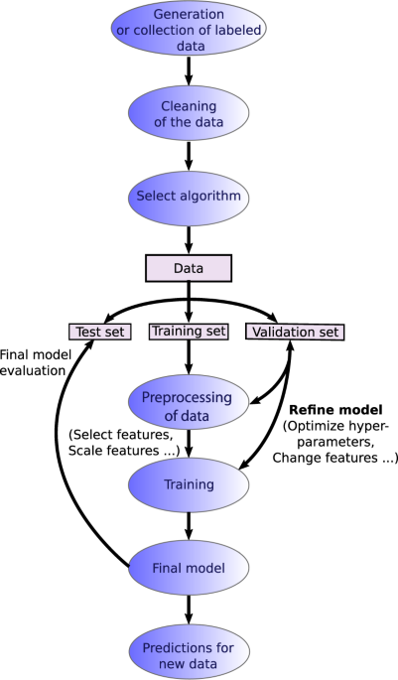
PROPOSED SYSTEM FLOWCHART

Slide 8
SCOPE
We discovered that feature scaling is an essential aspect of ML models during this project. The basic concept is to make sure that all of the functionality are on the same scale.
In the coming years, we should strive to reduce variance as much as possible, as this will aid in better prediction, resulting in a successful ML model.
Since outliers are bad for ML models, they should be avoided or omitted before determining the best match.
Weather is a non-linear system, according to this. Furthermore, unlike most forecasters, I based all of the predictions on data from a single location rather than several locations.

Slide 9
OBJECTIVES
Accurate temperature and Humidity prediction helps to safeguard life and property, playing an important role in planning activities for the government, industry, and the public.
The primary aim of this project is to review the different machine learning strategies for temperature forecasting.
This survey shows that Machine Learning techniques can help to accurately predict temperatures based on a set of input features.

Slide 10
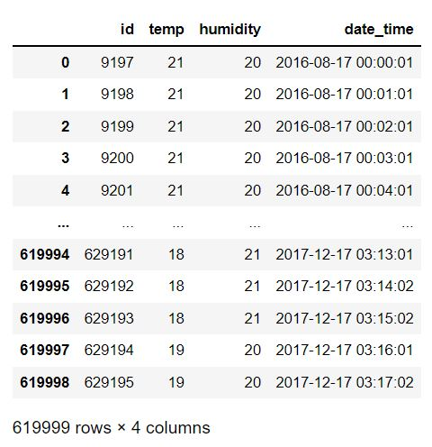
DATASET

Slide 11
LIBRARIES USED
NumPy (for Numerical Analysis)
Pandas (for handling data files)
Matplotlib (for visualizations inline & figure settings)
Seaborn (for better relational visualizations)
Scikit Learn (for model building & data pre-processing)

Slide 12
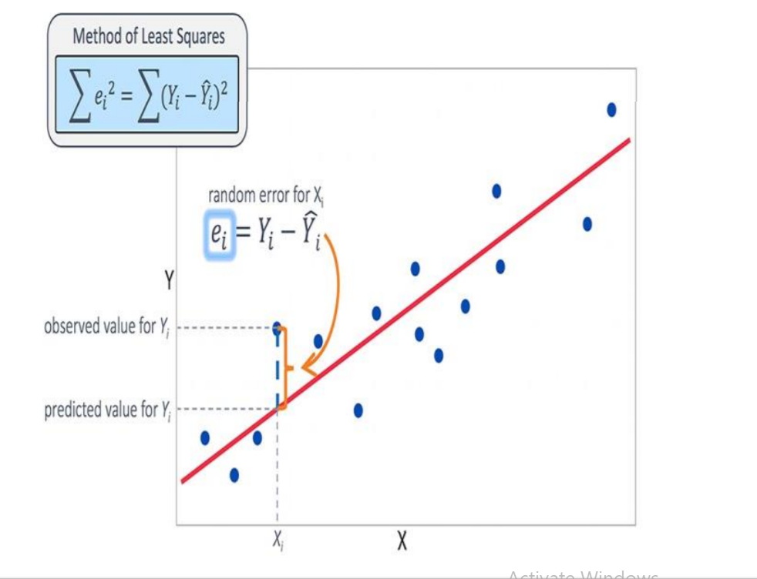
IMPLEMENTATION
Linear Regression:
Linear Regression attempt to model the relationship between two variables by fitting a linear equation to observed data. The other is considered to be dependent variable.
Linear regression is useful for finding relationship between multiple continuous variables.
y = m1.X1+m2.X2+……+b
Where,
m1, m2, m3 …. →slope
b → y intercept
X1, X2, X3 …… →independent variables
y → dependent variables.

Slide 13
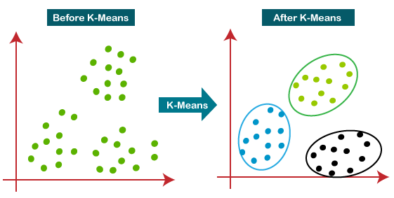
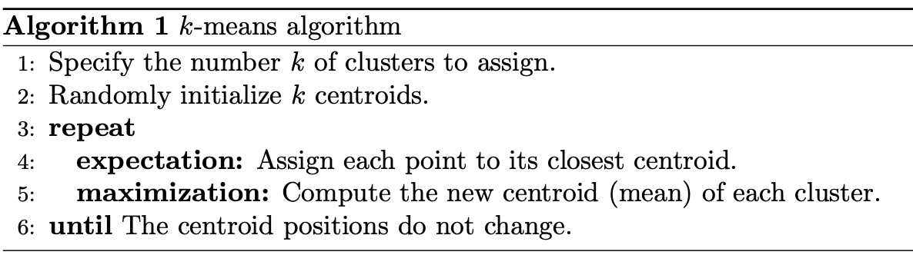
K-Means Algorithm:
k-means is one of the most straightforward unsupervised learning calculations that take
care of the notable bunching issue. The methodology pursues a basic and simple approach to
group a given informational collection through a specific number of bunches (expect k
bunches) fixed apriority. The primary thought is to characterize k focuses, one for each bunch.

Slide 14
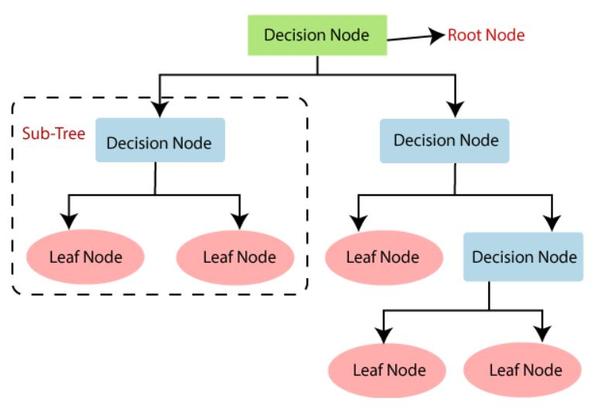
Decision Tree:
Decision Tree is a Supervised learning technique that can be used for both classification and Regression problems, but mostly it is preferred for solving Classification problems.
It is a tree-structured classifier, where internal nodes represent the features of a dataset, branches represent the decision rules and each leaf node represents the outcome.
In a Decision tree, there are two nodes, which are the Decision Node and Leaf Node. Decision nodes are used to make any decision and have multiple branches, whereas Leaf nodes are the output of those decisions and do not contain any further branches.

Slide 15
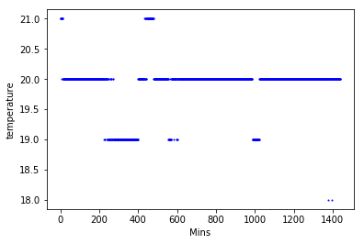
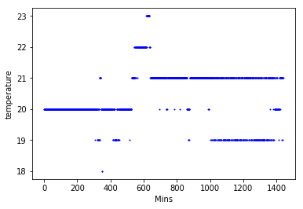
OUTCOME OF PROJECT
Temp vs time of the day graph for the first day of the dataset :
Temp vs time of the day graph for the second day of the dataset :

Slide 16
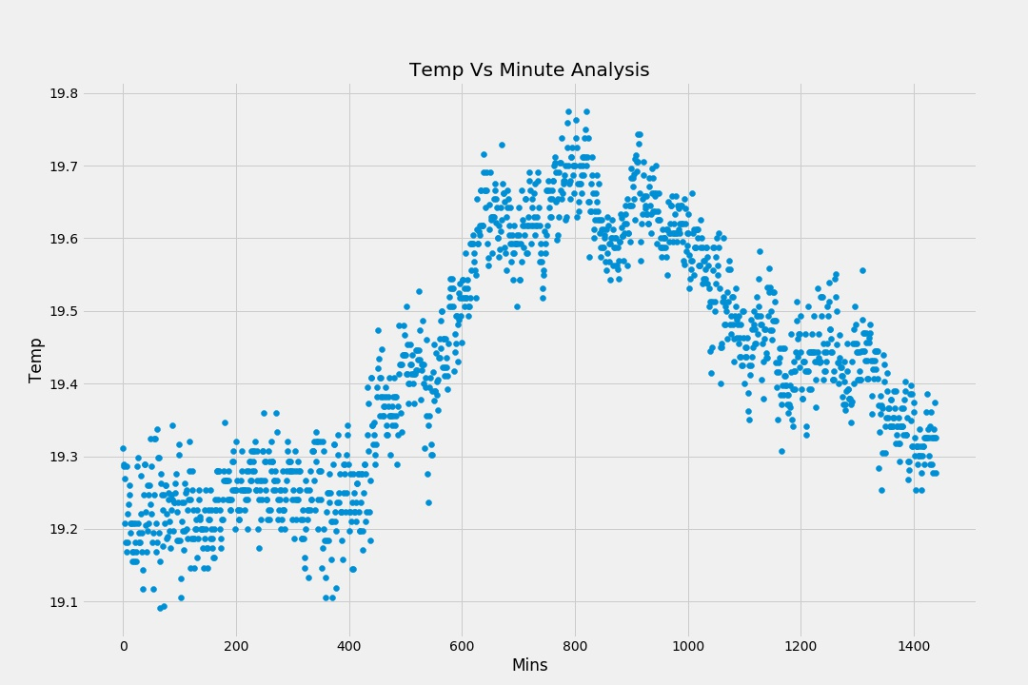
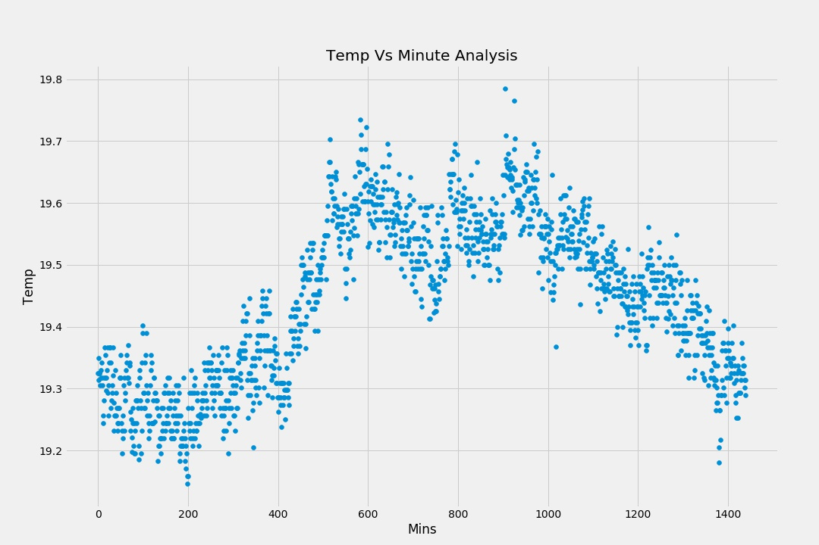
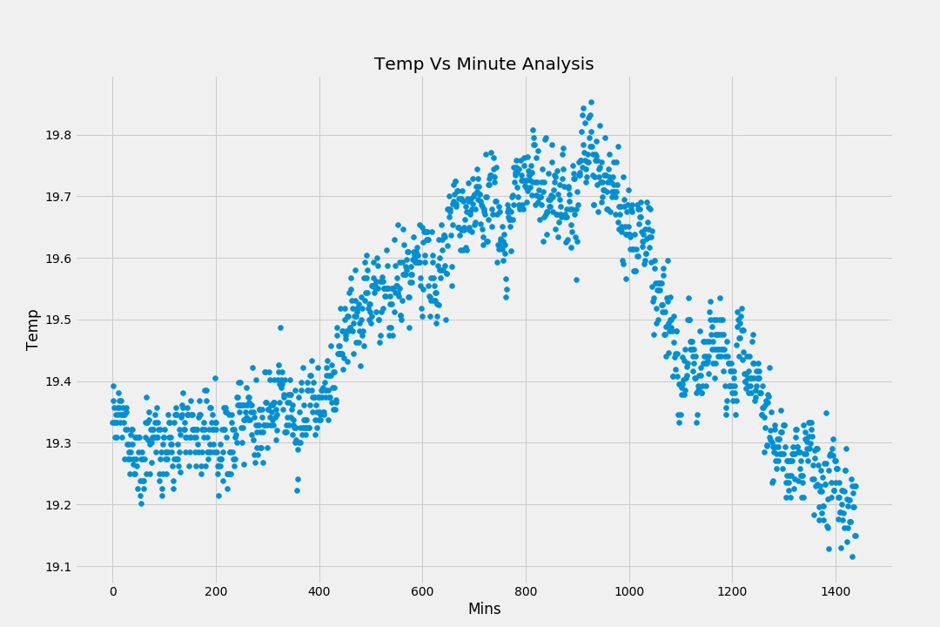
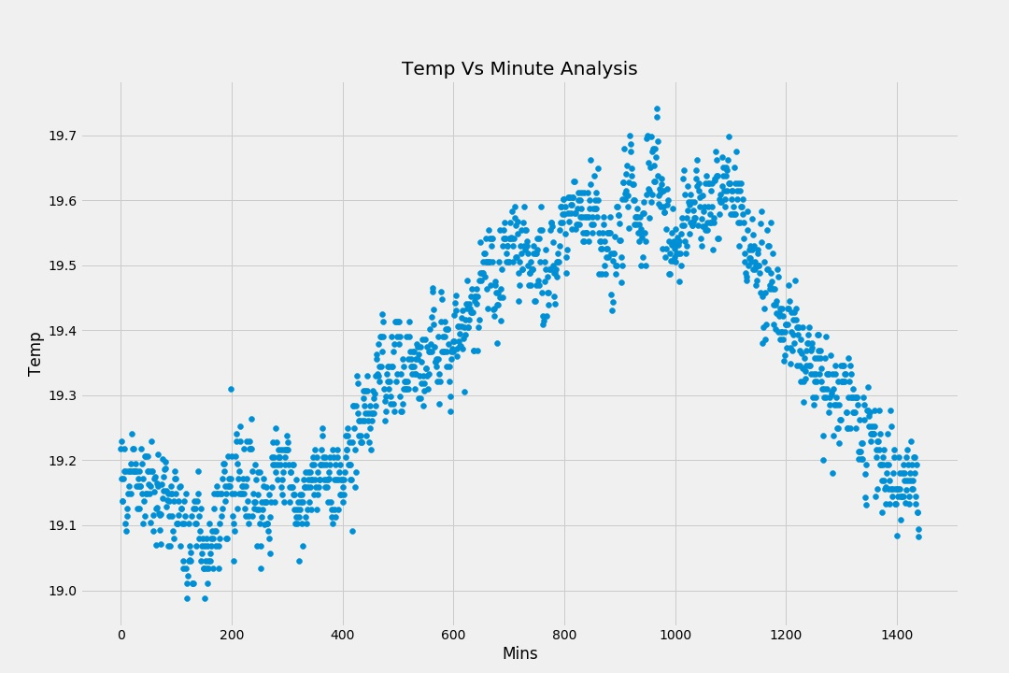
Plotting avg Temp vs time of the day for different days of the week:
Monday
Tuesday
Wednesday
Thursday

Slide 17
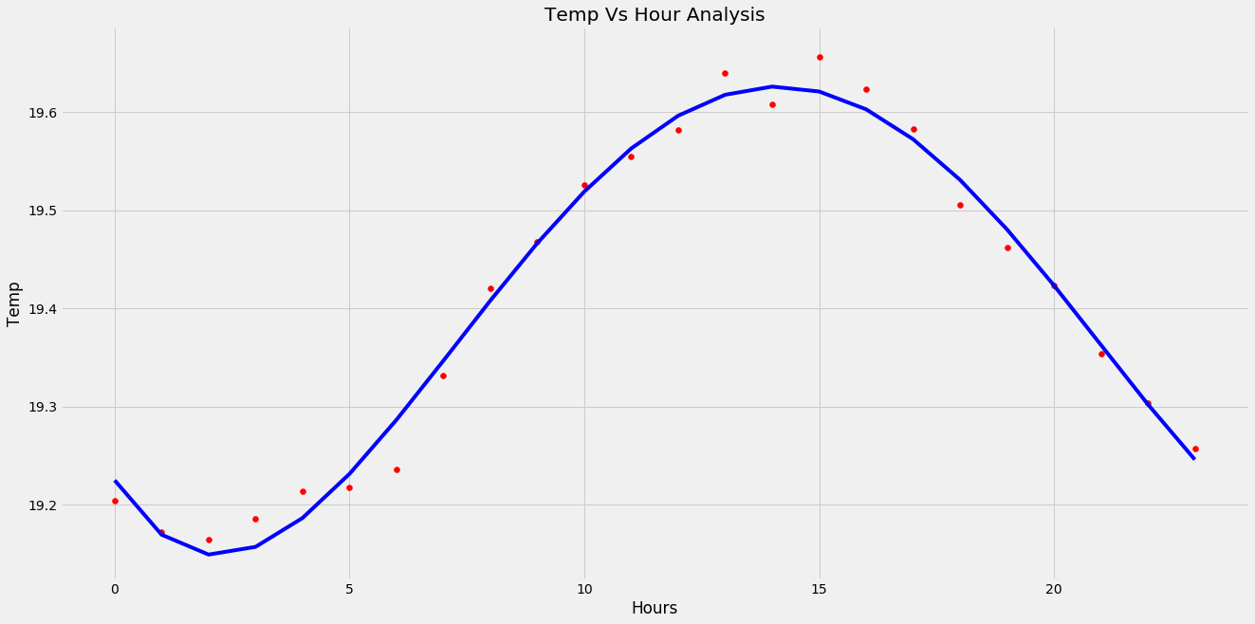
General day(hour):

Slide 18
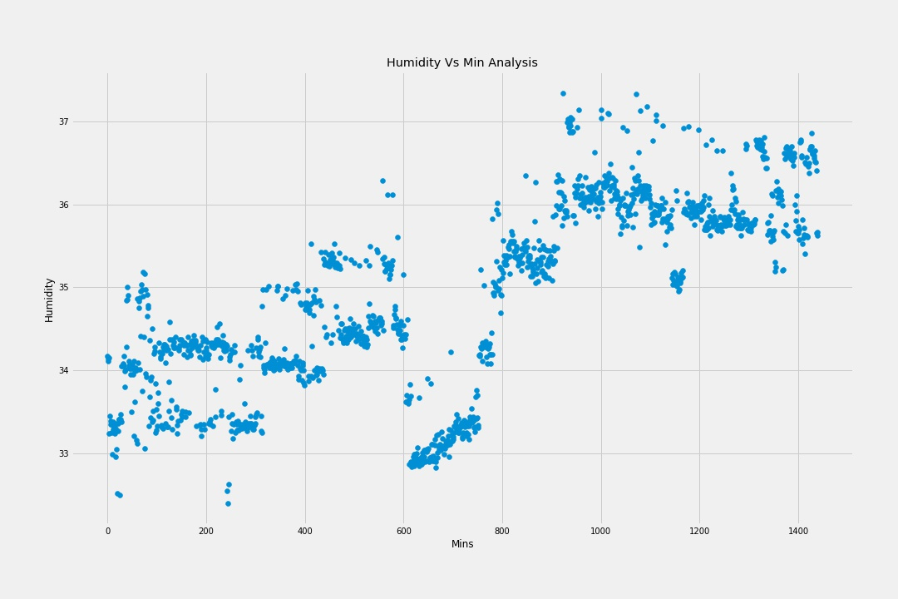
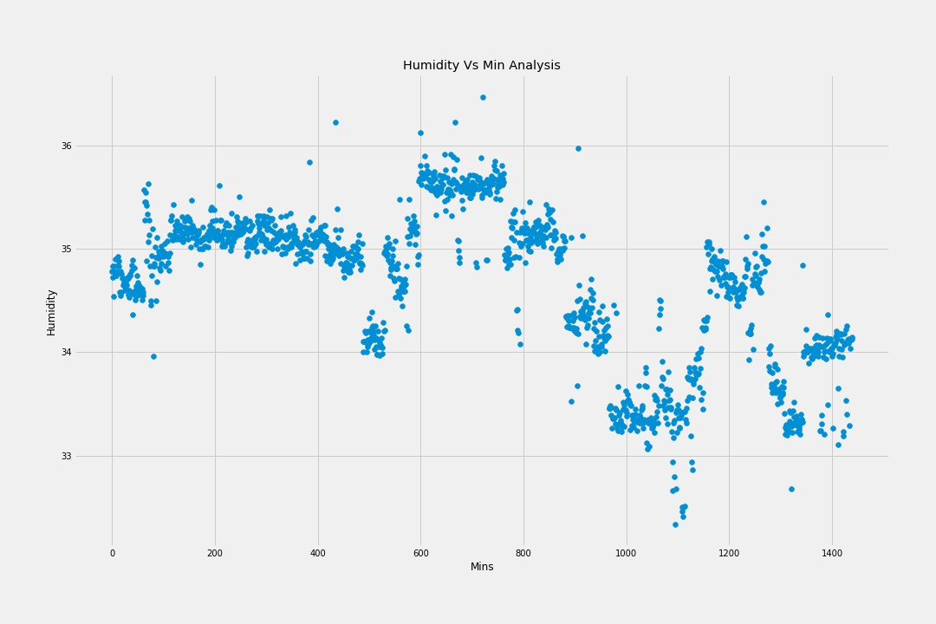
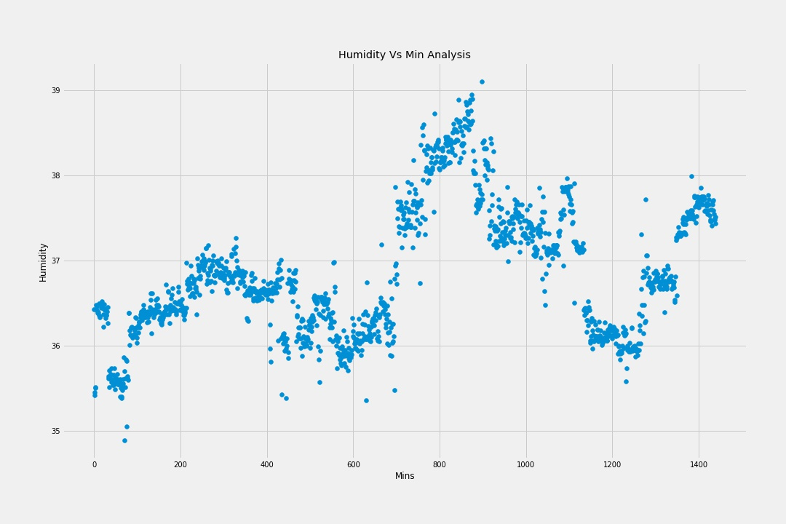
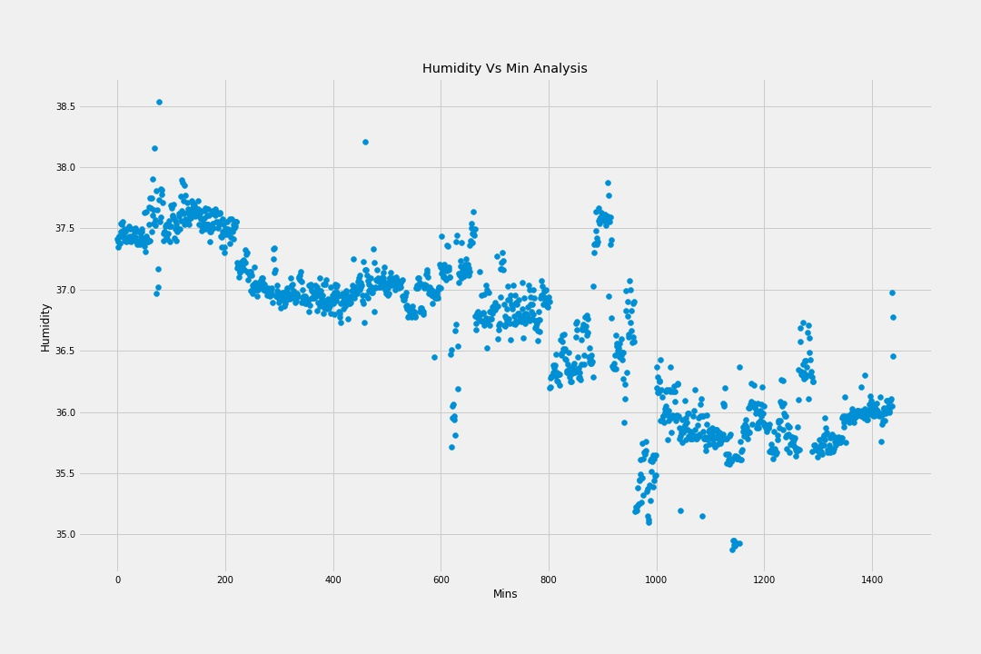
Humidity analysis:
Monday
Tuesday
Wednesday
Thursday

Slide 19
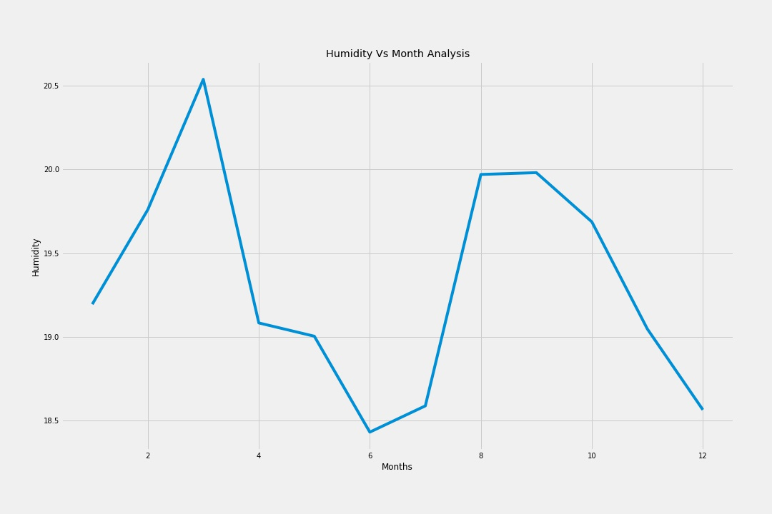
Month-wise:

Slide 20
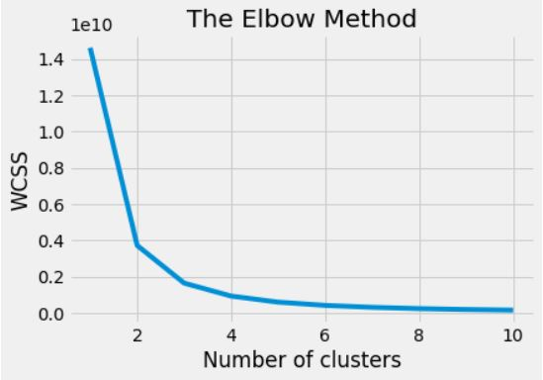
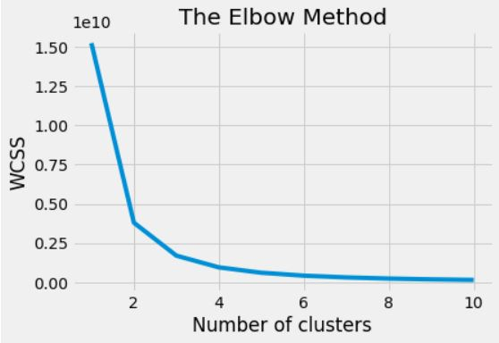
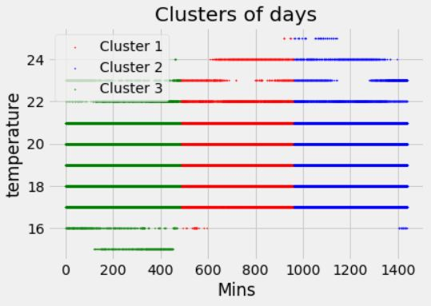
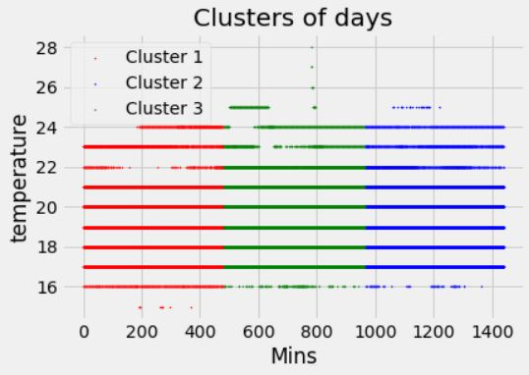
Elbow Method and Clustering :
Monday
Tuesday

Slide 21
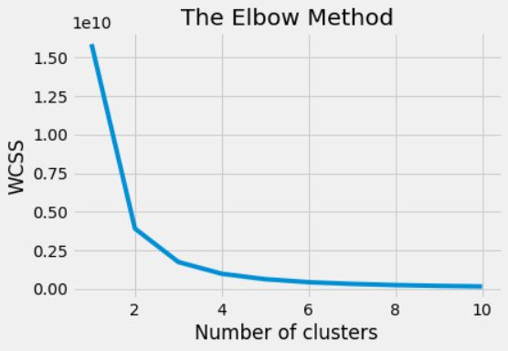
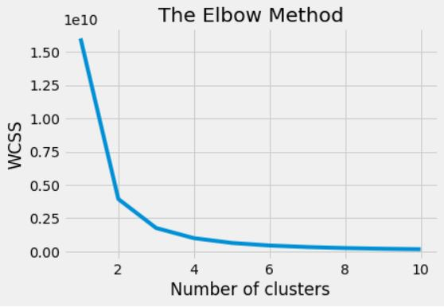
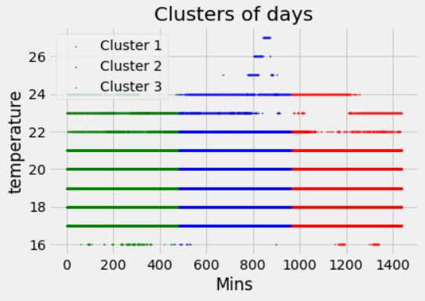
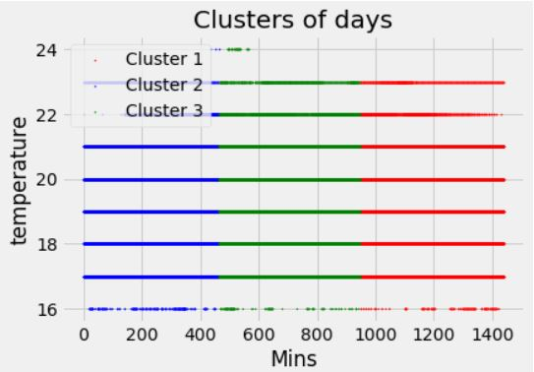
Elbow Method and Clustering:
Wednesday
Thursday

Slide 22
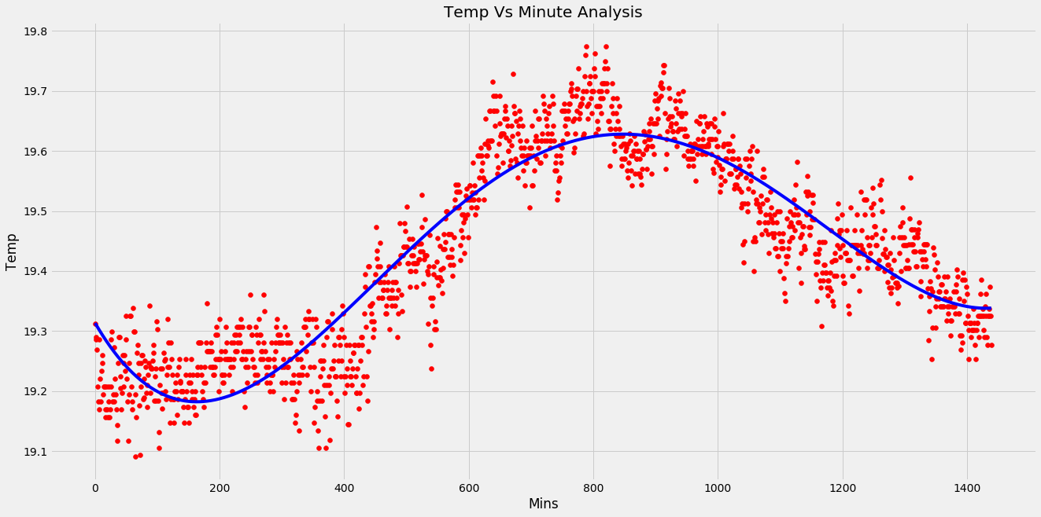
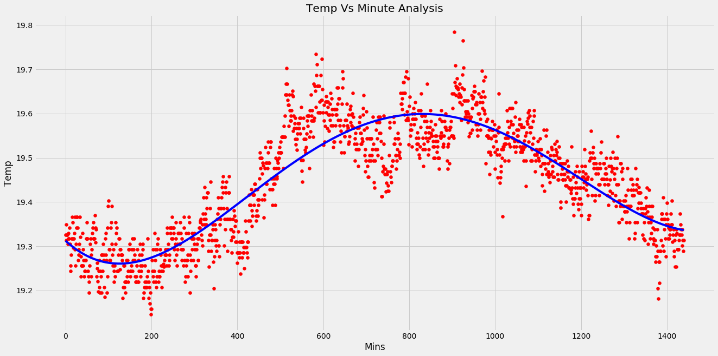
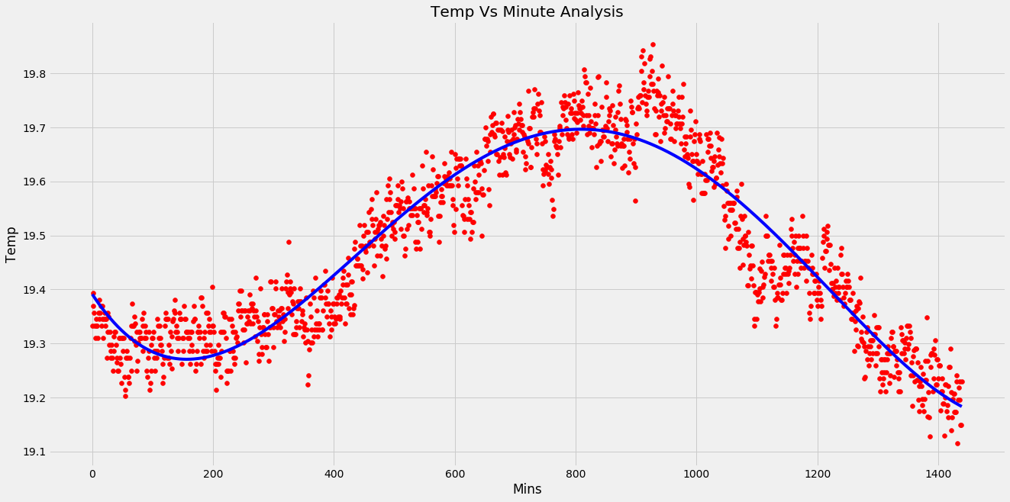
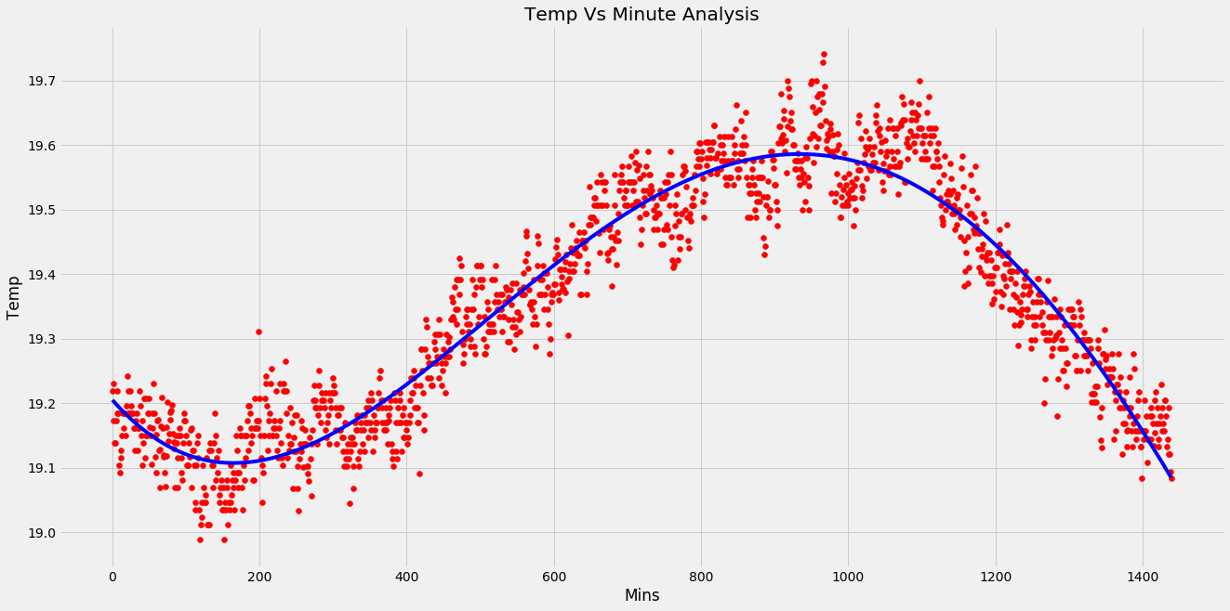
Regression:
Monday
Tuesday
Wednesday
Thursday

Slide 23
CONCLUSION
Traditionally, weather forecasting(Temperature and Humidity) has always been performed by physically simulating the atmosphere as a fluid and then the current state of the atmosphere would be sampled.
In the previous system the future state of the atmosphere is computed by solving numerical equations of thermodynamics.
Our proposed solution of using Machine learning for weather predicting is relatively robust to most atmospheric disturbances when compared to traditional methods.
Another advantage of using machine learning is that it is not dependent on the physical laws of atmospheric processes.
Decision Tree algorithm gives 88.49% accuracy for temperature prediction and 90.04% accuracy for humidity prediction.

Slide 24




THANK YOU
Nandan Kumar TN CSE, CIT
Manoj Kumar D CSE, CIT
Kiran M CSE, CIT
Darshan HN CSE, CIT

