Slide 1
MINIMUM SPANNING TREE

Slide 2
MST
A minimum spanning tree (MST) or minimum weight spanning tree is a subset of the edges of a connected, edge-weighted undirected graph that connects all the vertices together, without any cycles and with the minimum possible total edge weight.
2.That is, it is a spanning tree whose sum of edge weights is as small as possible.
3.More generally, any edge-weighted undirected graph (not necessarily connected) has a minimum spanning forest, which is a union of the minimum spanning trees for its connected components

Slide 3
Kruskal's Algorithm
1. Kruskal's algorithm is a minimum-spanning tree which finds an edge of the least possible weight that connects any two trees
2. The difference between Kruskal's and Prim's Algorithm is Prim's algorithm initializes with a node, whereas Kruskal's algorithm initiates with an edge. Prim's algorithms span from one node to another while Kruskal's algorithm select the edges

Slide 4
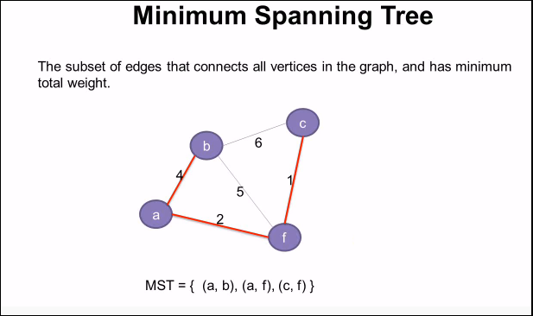

Slide 5
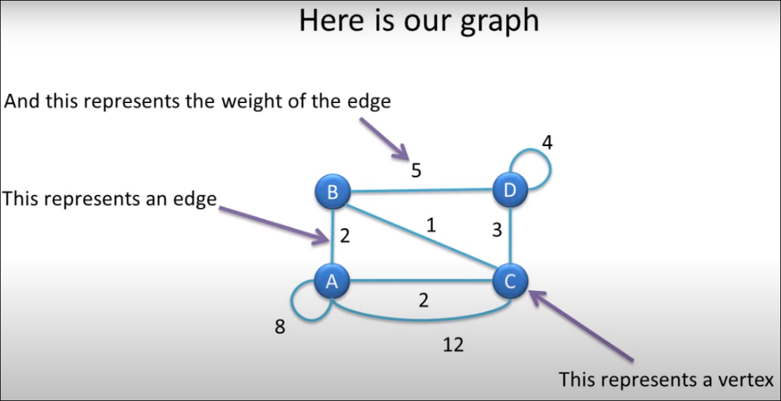
Notes:
1.Remove all loops: Note:Any edge that starts and ends at the same vertex is loop.
2.Remove all parallel vertex between two edges except the one with least weight.
Note: in this graph vertex A and Vertex C are connected with two parallel edges having weight 2 and 12, hence we are removing 12

Slide 6
How to proceed
1. Sort all the edges in non-decreasing order of their weight. 2. Pick the smallest edge. Check if it forms a cycle with the spanning tree formed so far. If cycle is not formed, include this edge. Else, discard it. 3. Repeat step#2 until there are (V-1) edges in the spanning tree..

Slide 7
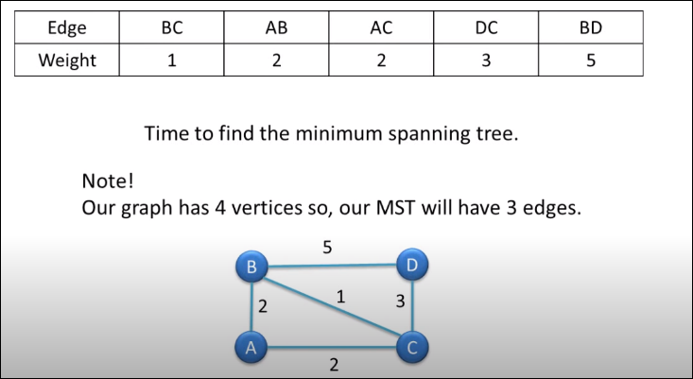
CALCULATION

Slide 8
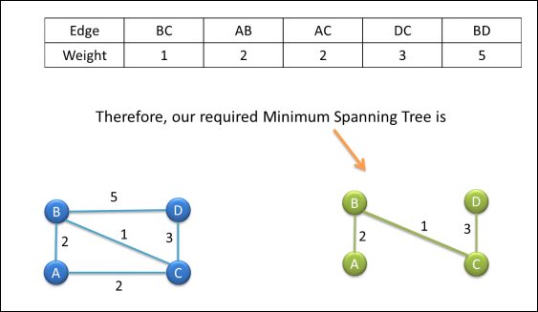
Output

Slide 9
Thank You

