Slide 1
Remotely Controlled Robotic Arm with Parallel Simulation
Group 12
SS Chandra Mouli 09005045
B sravan Kumar 09005046
B Kiran Maruthi 09005047
Sonika Malloth 09005054
D V Ramana 09005059

Slide 2
Project Description
The Robotic arm is controlled by a user from a remote place with the help of a controller.
The remote control is a mechanical arm which controls the movements of the robotic arm and its jaws.
Simultaneously, a simulation of the mechanical arm’s movement is shown in blender, in the computer.

Slide 3
Task Specification
Building and designing mechanical arm.
Mounting the mechanical arm on Spark V.
Zigbee communication between Spark V and the computer to send the potentiomenter values.
Designing the simulation.
Communicating (USB serial communication) with the robotic arm through Python scripts.
Making the mechanical smooth and intuitive.

Slide 4
Project Plan
Mechanical arm is built with the help of metal strips with potentiometers attached wherever movements are to be recorded.
Wires from the potentiometers are connected to the ADCs of Spark V .
Python scripts receive the potentiometer values sent through Zigbee.
The simulated arm was built in Blender software and the potentiomter values are sent to it .

Slide 5
Project Plan
Instructions to the Robotic arm are sent int the form of a string through USB. Using this string format the Robotic arm can be controlled from any programming language.
To make the mechanical arm intuitive we had to calibrate it.
Developing the mechanical arm was an evolving process initially untill it was completed.
Learning Blender and developing simulation was done parallely.

Slide 6
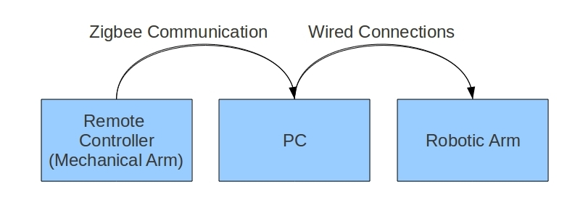
Overview

Slide 7
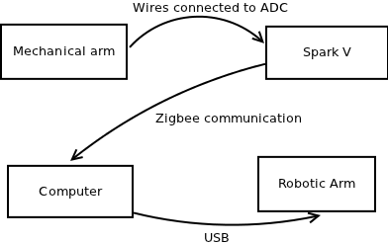
Flow Chart

Slide 8
Challenges/Tasks completed
Building and designing a flexible and an intuitive mechanical arm.
Conecting the potentiometer wires to the ADCs. We had to remove the white line sensors to get more ADCs for potentiometers.
The values given by the potentiometers are not linear. They are calibrated with precision to produce the angles to be given to the blender.
Processing: All the processing has been done with python scripts on linux platform.

Slide 9
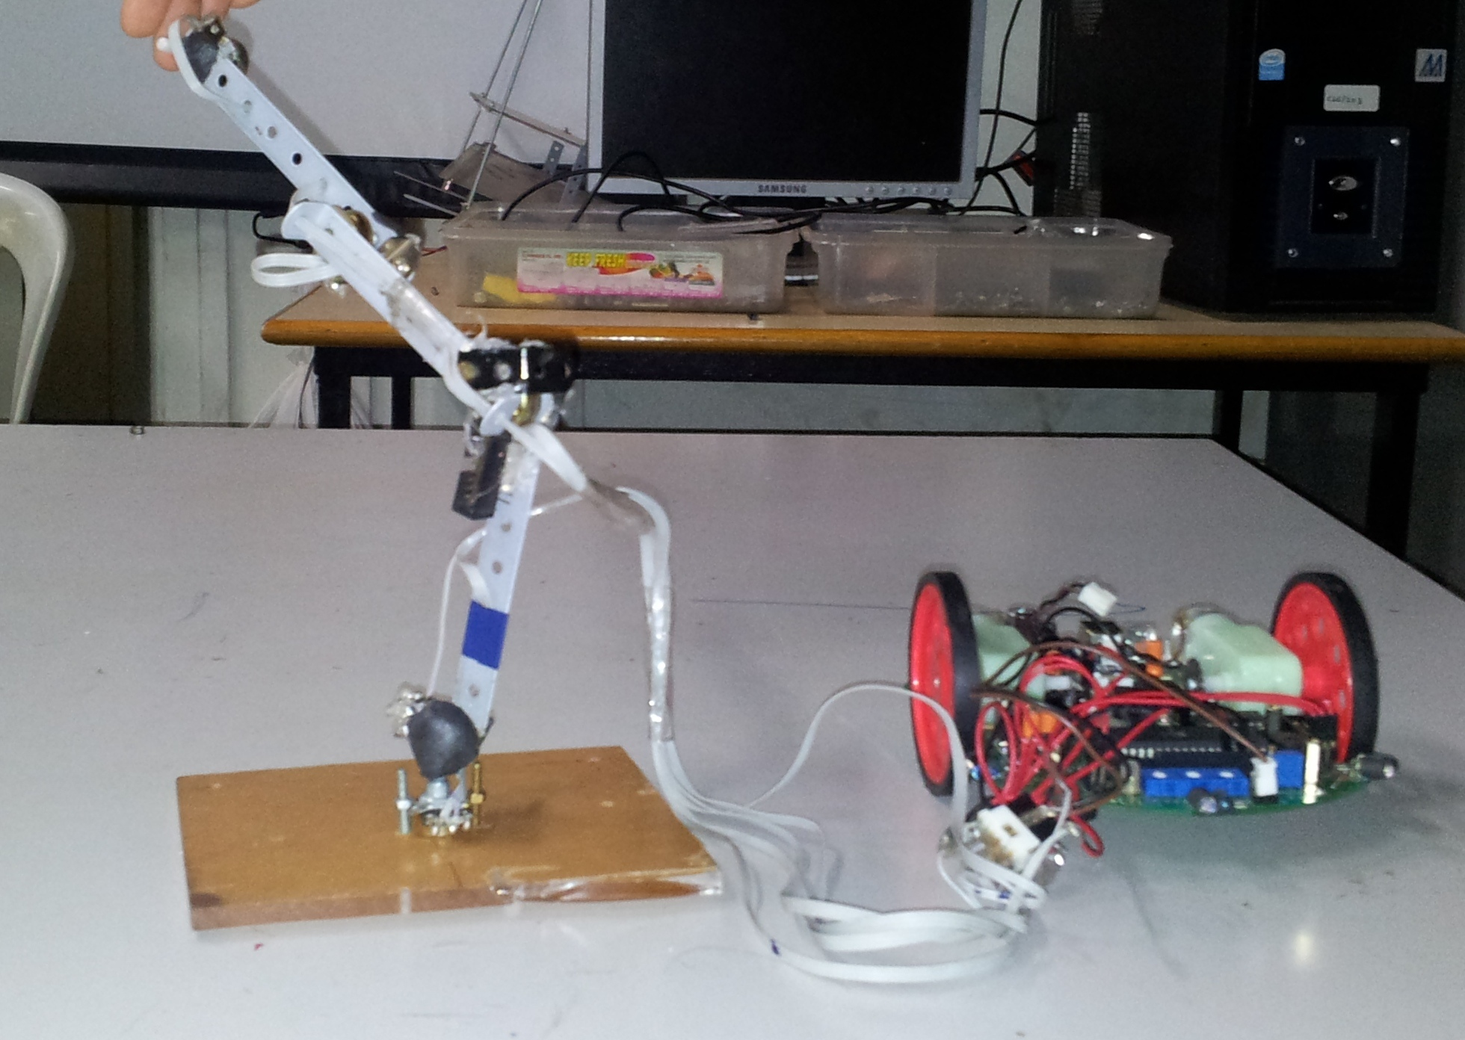
Mechanical arm

Slide 10
Challenges/Tasks completed
Simulation : Simulation of the movements of mechanical arm was implemented in blender.This is a very big addition to our project. The values from potentiometers were used for the simulation.
Learning Blender and Python scripting along with it was a major challenge.

Slide 11
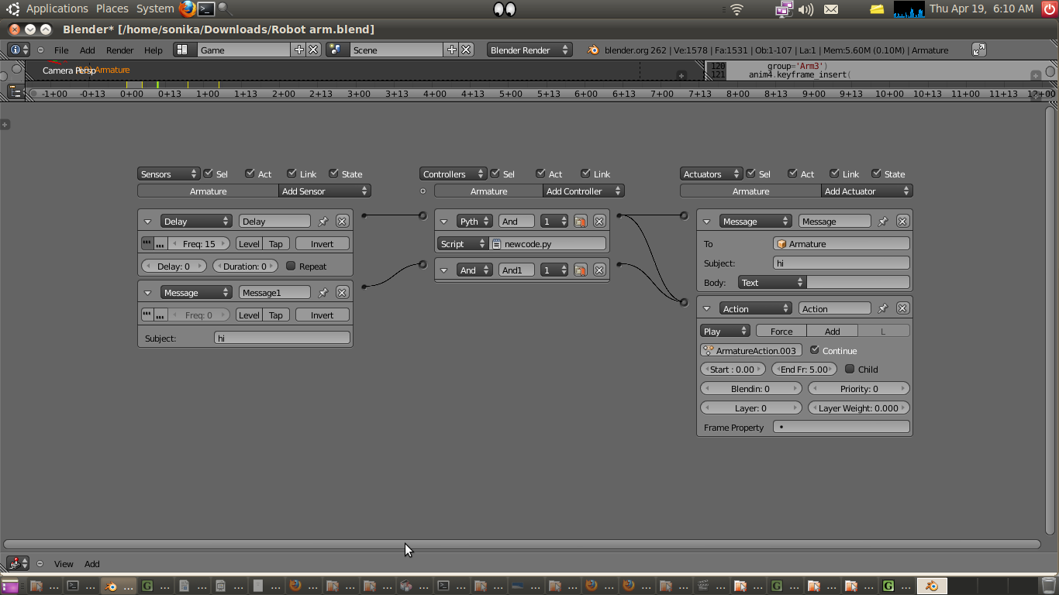
Blender Game Logic

Slide 12
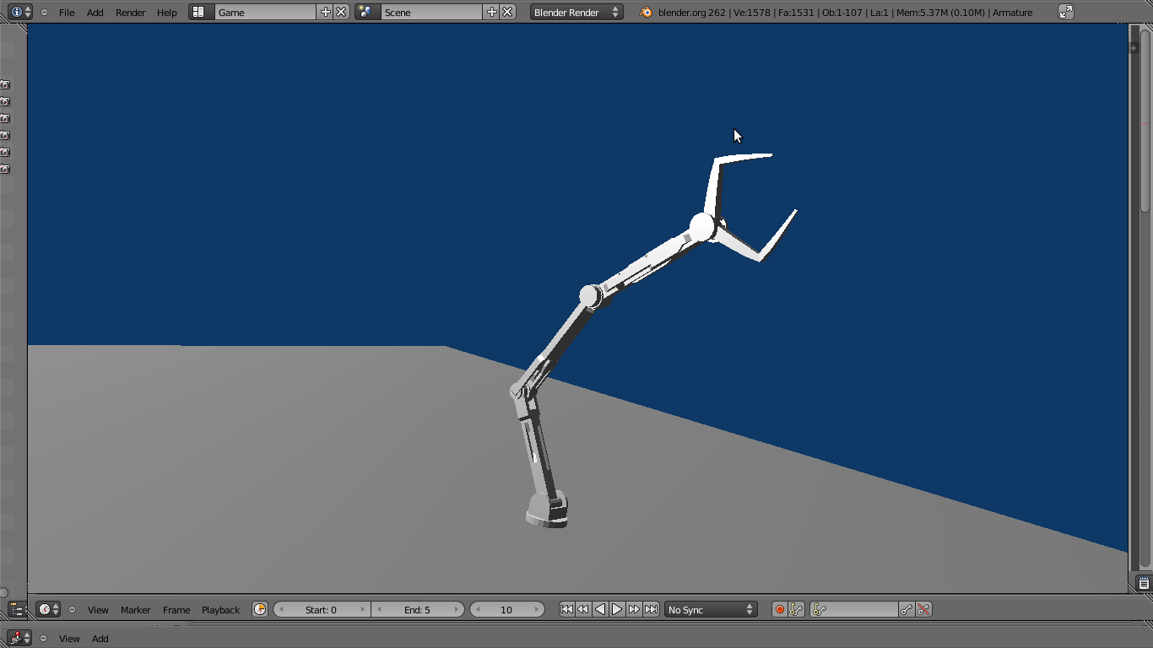
Simulation

Slide 13
Innovation
Communication with the Robotic Arm : We decoded the format of communication string tothe robotic arm. It consists of a ’#’ followed by the motor number which we want to control along with its absolute angle and speed. Four stars marks the end of the signal. This can be ported to any programming language on any operating system to control the robotic arm.
For example - #1AB**** will signal motor 1 to rotate with speed of 66 and set the angle to65(A) absolute.

Slide 14
Review,Test Plan/Cases
Test Case : Moving a piece of thermocol from one place to another :
a) Initial position:The arm makes contact with the piece of thermocol and holds it in its jaws.
b) Intermediate postition: The motion has started, and the piece is moved from the starting postion. It is currently in an intermediate position, the goal is to place it on the black piece of paper

Slide 15
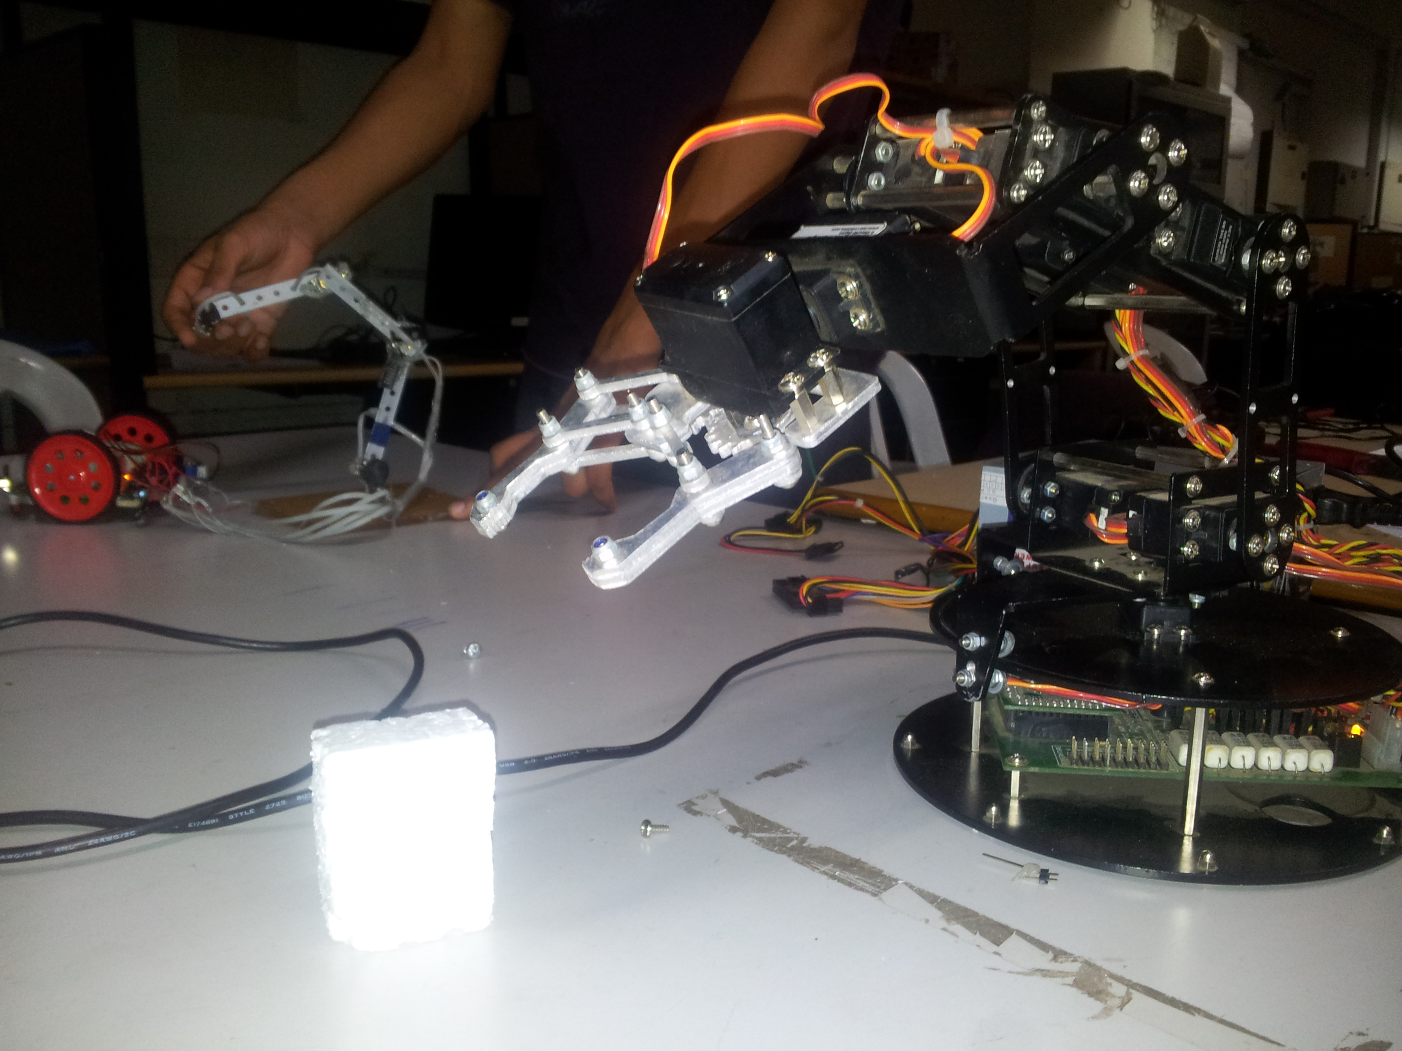
Test

Slide 16
Review,Test Plan/Cases
c) Final position: The arm is then moved above the target area and the block is gently placed over the target area. The movement of jaws is done by the rotation of the topmost potentiometer on the mechanical arm.

Slide 17
Performance Metrics
For simple tests like the previous mentioned one the arm is easy to handle.
For more complex tests like building a wall or cutting a wire the mechanical arm becomes a little difficult to handle.

Slide 18
Re-usability Features
The format of communication string to the robotic arm is a ’#’ followed by the motor number which we want to control along with its absolute angle and speed. Four stars marks the end of the string.
The code is crisp and small.
Entire code is well commented and easy to understand.

Slide 19
Future Enhancements
Wireless communication can be implemented in the robotic arm. Currently, we communicate with it through serial port. The system will be made more flexible.
The whole robotic arm can be made mobile; to increase its functionality and area of contact.A separate control for its movement can be designed.
The mechanical arm can be redesigned to fit on a human arm, so that it becomes even more easier and intuitive to control the robotic arm.

