Slide 1


Shri. Shamrao Patil (Yadravkar) Educational & Charitable Trust’s
Sharad Institute of Technology’s College of Engineering ,
Yadrav ( Ichalkaranji)
NBA Accredited Programmers. An ‘A’ Grade Institute Accredited By NAAC, An ISO 9001:2015 Accredited
Department of Electronics &Computer Engineering
Synopsis Presentation
Academic Year 2026-27
Name | Div | Roll No
Mr. Kiran Manohar Maske | A | 52
Mr. Pratik Sunil Shinde | A | 67
Mr. Shital Sanjay Patil | A | 58
Mr. Prajyot Ganapati Yejare | A | 50
Mega Project Guide:- Ms. B.K. Jagtap

Slide 2
Introduction
The increasing demand for electrical energy and the depletion of conventional energy resources have created a need for alternative renewable energy sources. Road traffic produces a large amount of noise energy, which is generally considered as environmental pollution. Instead of wasting this energy, it can be harvested and converted into useful electrical power. Noise energy harvesting uses techniques such as piezoelectric, electromagnetic, and triboelectric methods to convert sound vibrations into electricity. This approach can help in powering low-energy devices such as sensors, IoT systems, and smart road infrastructure, contributing to sustainable and eco-friendly power generation.

Slide 3
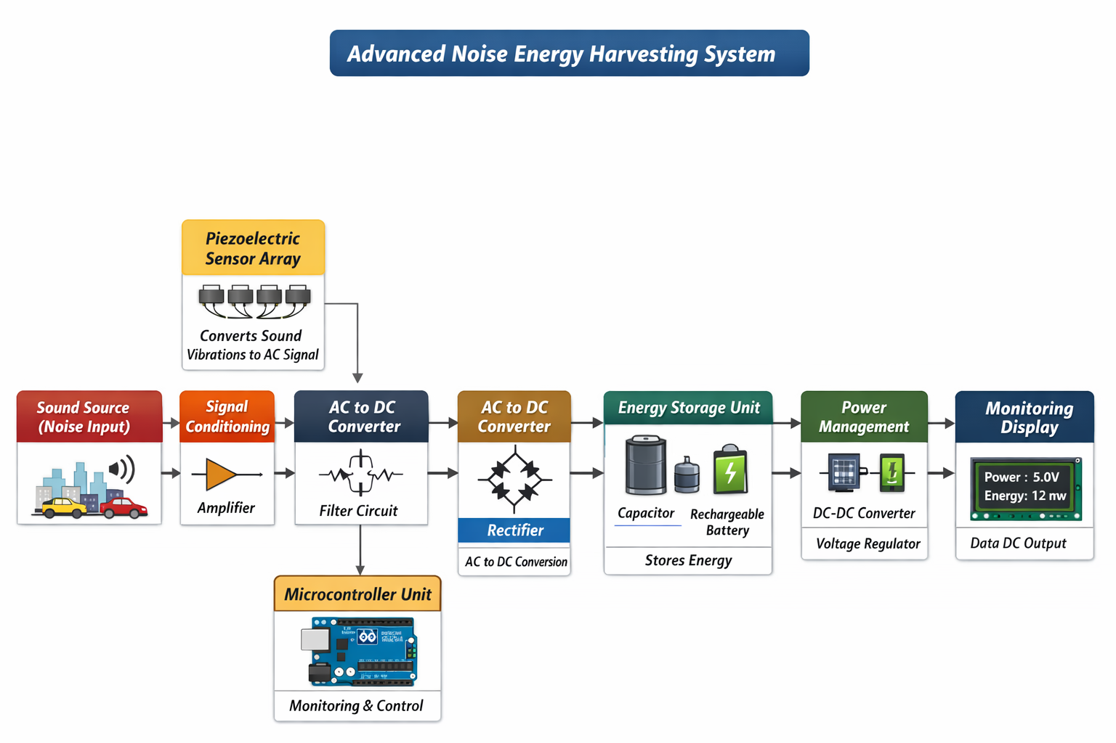
Block Diagram

Slide 4
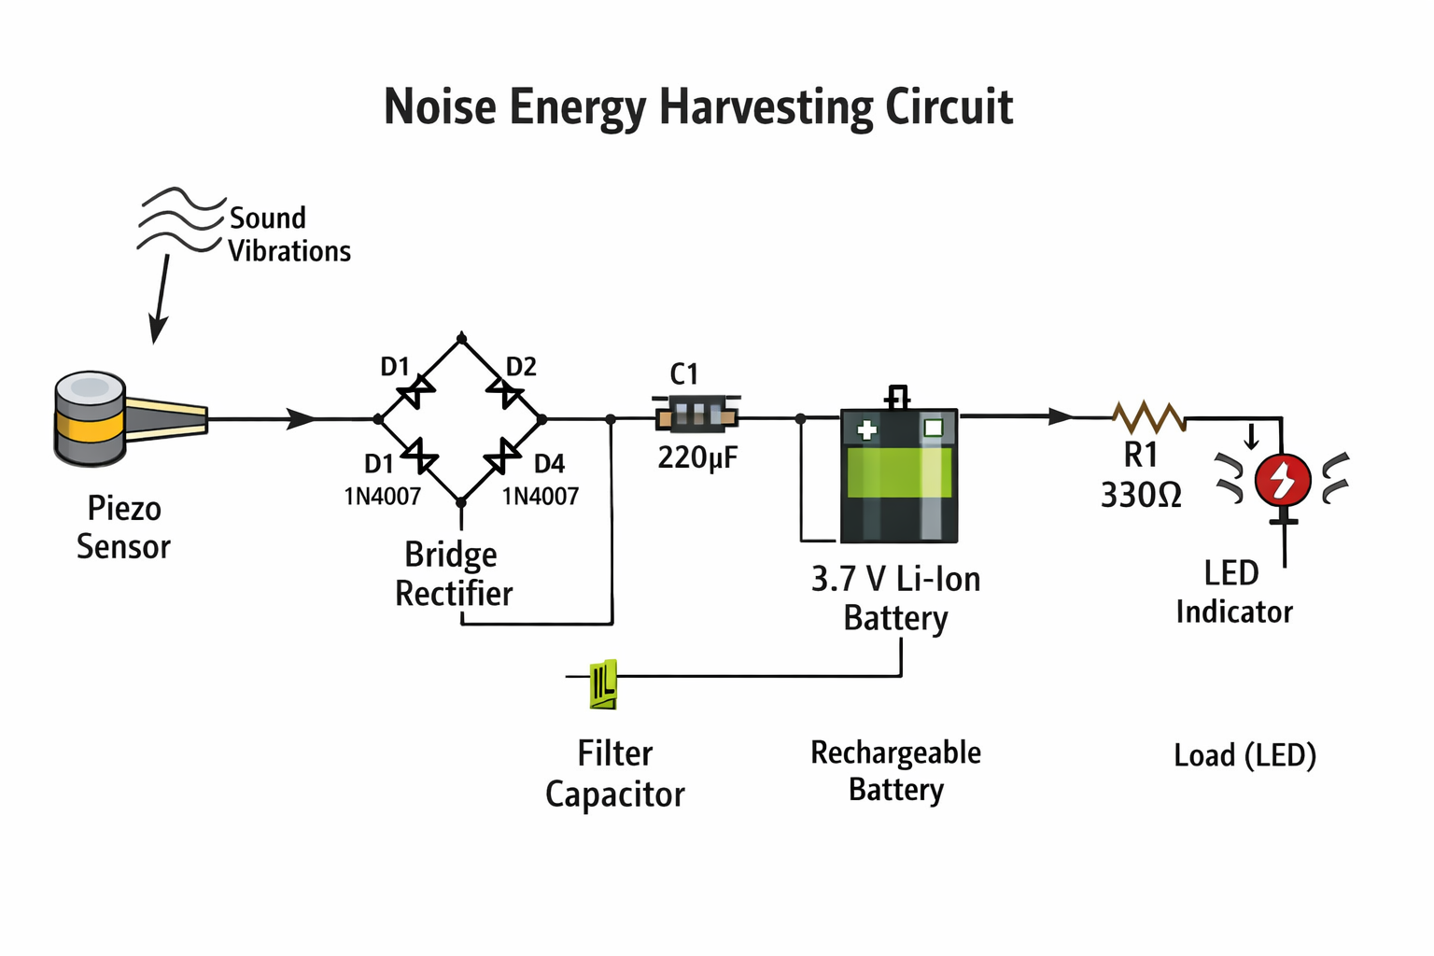
Circuit Diagram

Slide 5
Working Principle
1. Road traffic produces continuous noise in the form of sound waves.
2. These sound waves create mechanical vibrations in the surrounding air or structures.
3. The vibrations are captured by an energy harvesting device such as a piezoelectric, electromagnetic, or triboelectric sensor.
4. The mechanical vibrations are converted into electrical energy using the selected transduction mechanism.
5. The generated AC electrical signal is converted into DC using a rectifier circuit.
6. The converted energy is stored in a battery or capacitor.
7. The stored energy is used to power low-power devices such as LEDs, sensors, or IoT modules.

Slide 6
Component
Piezoelectric Sensor (Piezo Disc)
Bridge Rectifier (Schottky diodes – 1N5819)
Capacitor / Supercapacitor (for energy storage)
Rechargeable Battery (Li-ion / Li-Po 3.7 V)
Power Management / Charging Module (TP4056)
DC-DC Boost Converter (to get stable 5 V / 3.3 V)
ESP32 Microcontroller
Voltage Regulator (3.3 V for ESP32)
LED / Sensor (Load)
Resistors and Capacitors
Breadboard / PCB
Connecting Wires

Slide 7
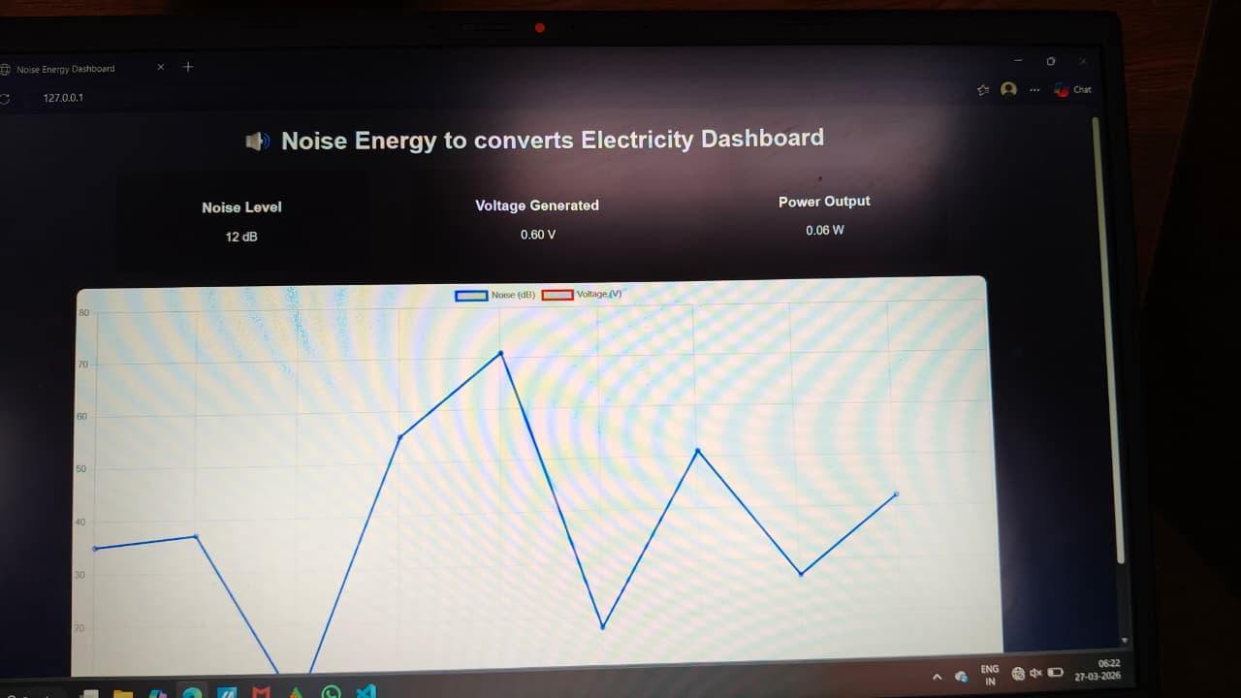
Completed Work

Slide 8
Future Scope
• Improved efficiency of sensors.
• Integration with smart grids.
• Large-scale implementation in cities.
• Hybrid energy harvesting systems.

Slide 9
Conclusion:-
Noise energy harvesting is a promising renewable technology.
It converts wasted environmental noise into useful electrical power.
It supports sustainability and aligns with SDG 7: Affordable and Clean Energy.
It is suitable for powering low-power devices such as sensors and IoT systems.

Slide 10
Thank You
We appreciate your time and attention

