Slide 1
Demand Response Modelling for Power Sector
Kiran Muloor
SRN : R18DM053
PGDM in Business Analytics,
REVA University,
Bengaluru, India
Mentor: Dr Bharatheesh Jaysimha

Slide 2
Agenda
Business Understanding
Conclusion
Data Pipeline
Approach
Business Objective
Data Preparation
Data Understanding
Evaluation
Modelling
Approach
Business Understanding
Business Objective
Data Understanding
Data Preparation
Modelling
Evaluation
Conclusion

Slide 3
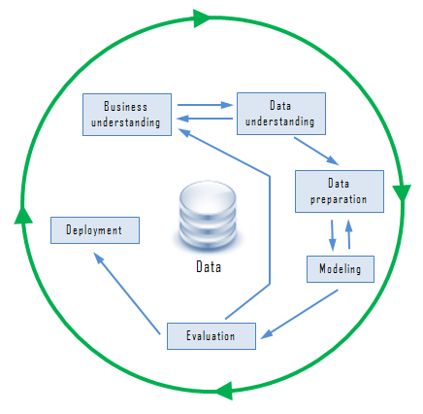
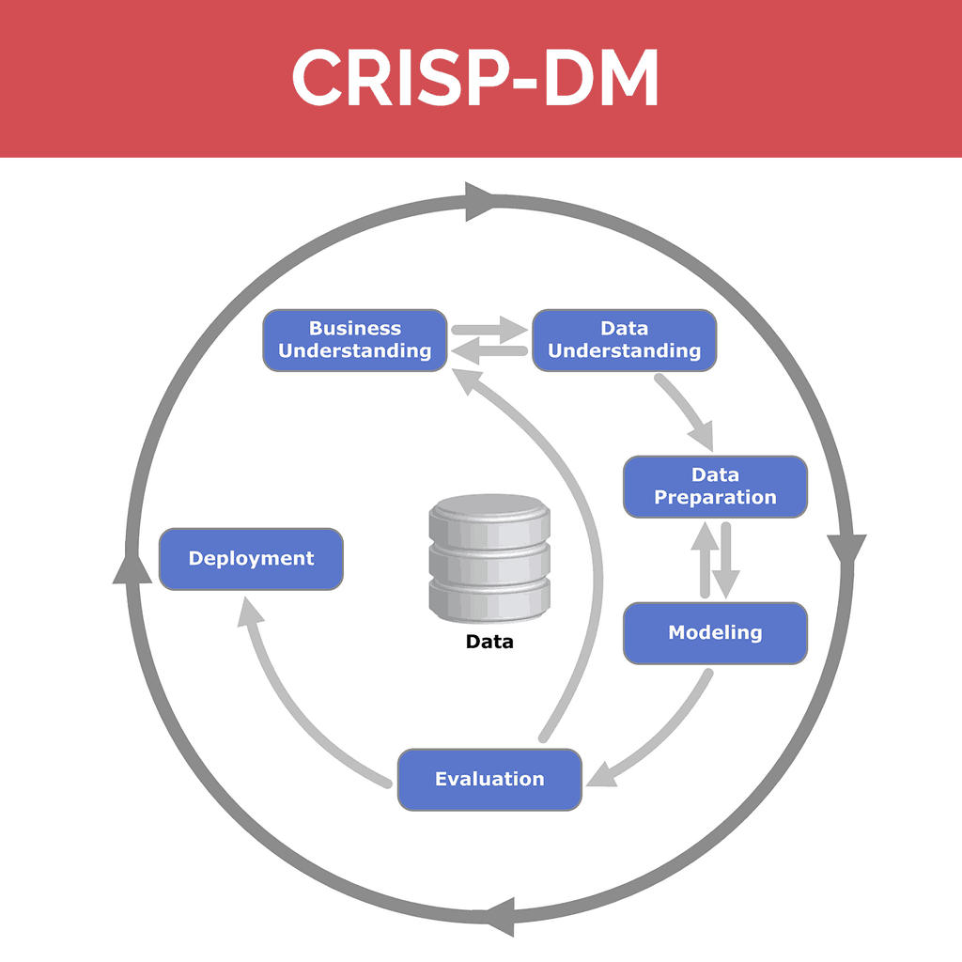
Agenda
Business Understanding
Conclusion
Data Pipeline
Approach
Business Objective
Data Preparation
Data Understanding
Evaluation
Modelling

Slide 4
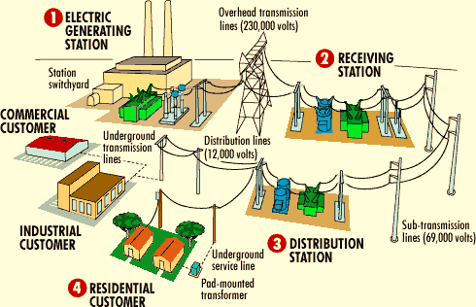

Agenda
Business Understanding
Conclusion
Data Pipeline
Approach
Business Objective
Data Preparation
Data Understanding
Evaluation
Modelling
The power sector of India is mainly governed by the Ministry of Power. India is the sixth largest in terms of power generation. There are three major pillars of power sector these are Generation, Transmission, and Distribution.
The total demand for electricity in India is expected to cross 95K MW by 2030.
http://indianpowersector.com/home/about/

Slide 5
Agenda
Business Understanding
Conclusion
Data Pipeline
Approach
Business Objective
Data Preparation
Data Understanding
Evaluation
Modelling
Electricity losses during Transmission and distribution is extremely high, it is about 28.44% (2008-2009). Revenue Losses can also be due to interruption in power outage
Current data (Jan 2019-Jun 2019) for 1.05K Customer:
Outage time - 74604.00 Minutes
Total Units lost due to outage – 3,56,70,791.12 Units
Total Revenue Lost (Avg 8.5/- per unit) -- INR 30,32,01,724.5 /-
Division
(2)
Sub-Division
(2)
Sector
(5)
Feeder
(63)
Customer
(105004)
Distribution Sectors Details:

Slide 6
Agenda
Business Understanding
Conclusion
Data Pipeline
Approach
Business Objective
Data Preparation
Data Understanding
Evaluation
Modelling
Develop a demand response model to predict the demand, minimizing revenue loss by ensure uninterrupted supply of power to consumer.
Sub-Division
Sector
Feeder
Customer
Division

Slide 7
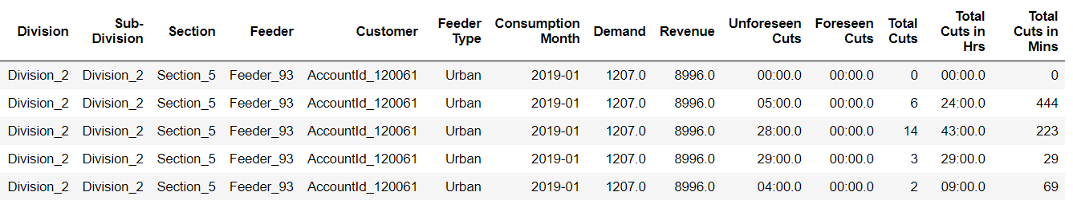
Agenda
Business Understanding
Conclusion
Data Pipeline
Approach
Business Objective
Data Preparation
Data Understanding
Evaluation
Modelling
Sample data for Demand details:
Description of the dataset
Division - Distribution Division Name
Sub-Division – Distribution Sub Division Name
Section – Distribution Section Name
Feeder – Feeder system Name
Customer – Customer Account number
Feeder Type – Type of Feeder like Urban, Rural and Industrial
Consumption Date – Electricity consumption month
Demand – Total Units consumed
Revenue – Total cost of electricity consumed
Unforeseen Cuts - Unexpected power cuts
Foreseen Cuts– Known power cuts
Total Cuts – Total Number of times power was cut per month
Total Cuts in Hrs – Total hours of power cut per month
Total Cuts in Mins – Total minutes of power cut per month

Slide 8
Agenda
Business Understanding
Conclusion
Data Pipeline
Approach
Business Objective
Data Preparation
Data Understanding
Evaluation
Modelling
Data Details:
Missing Value Imputation
1
1 Missing Feeder, imputed with using #NA
Feeder Details
2
Total 63 Feeder details for consumption
Only 24 Feeders have outage details
3
Feeder Types
There are 2 Feeder Types Urban, Industrial Type
Feature Details
4
Total 105004 Customer across 63 Feeders
6 months of data hence total data sample is 630024
5
Outage Details
Total 74604 Mins outage across 24 Feeders for 6 months
39 Feeders have not been recorded for any kind of outage

Slide 9
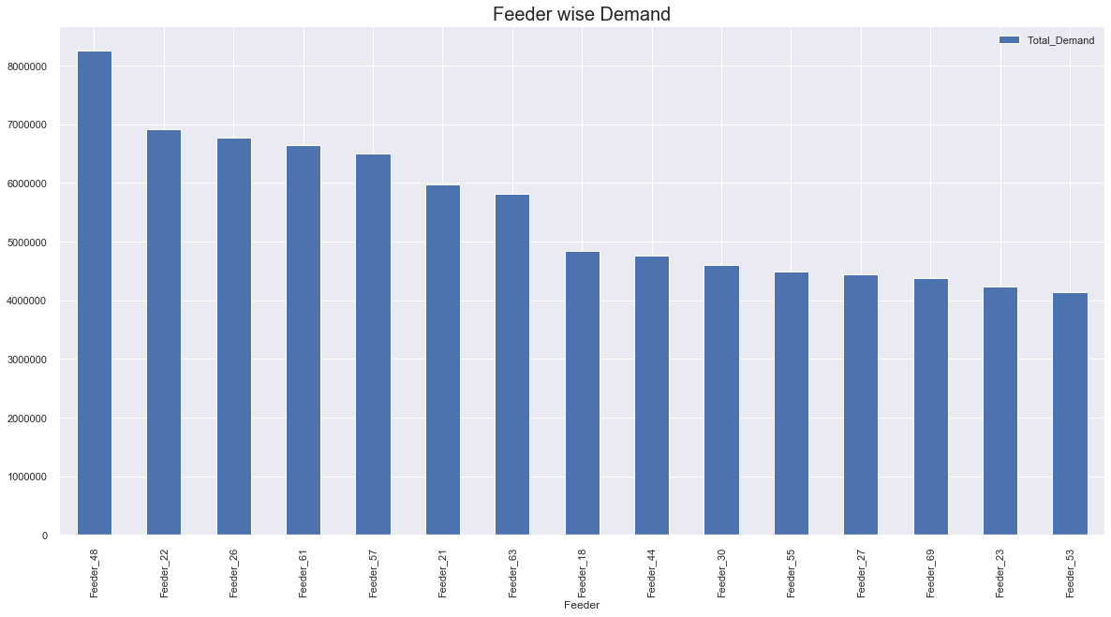
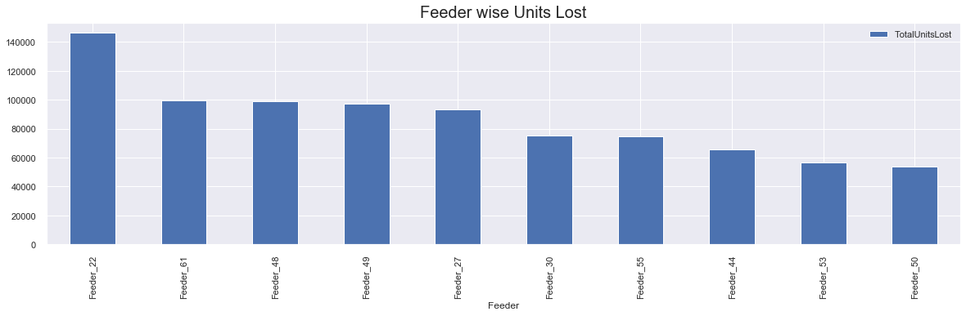
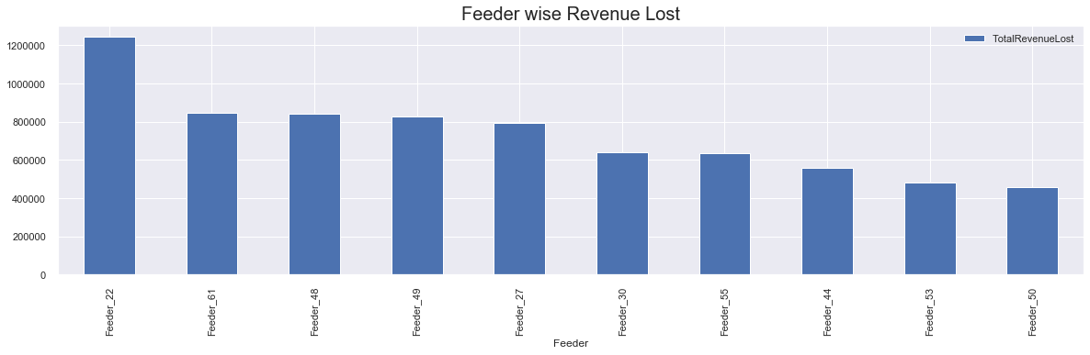
Agenda
Business Understanding
Conclusion
Data Pipeline
Approach
Business Objective
Data Preparation
Data Understanding
Evaluation
Modelling
Demand Data Details

Slide 10
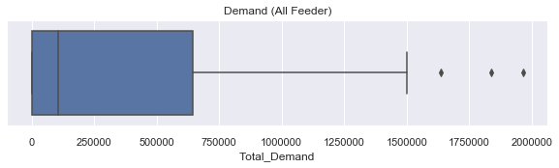
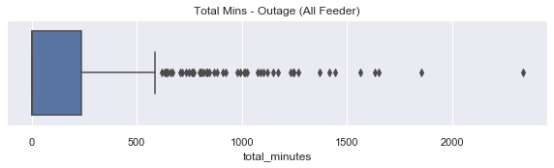
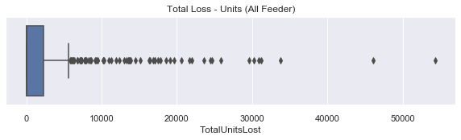
Agenda
Business Understanding
Conclusion
Data Pipeline
Approach
Business Objective
Data Preparation
Data Understanding
Evaluation
Modelling
Demand Data Details

Slide 11


Agenda
Business Understanding
Conclusion
Data Pipeline
Approach
Business Objective
Data Preparation
Data Understanding
Evaluation
Modelling
Different Modelling Techniques
Evaluation
Results
Data
Data Pre-processing
Modelling
Final Results
Feature Engineering
Creating calculated Features
Train/Test Split
Train
Test
Missing Value imputation
Data reshaping
Joining multiple data points
MSE
RMSE
MAPE

Slide 12
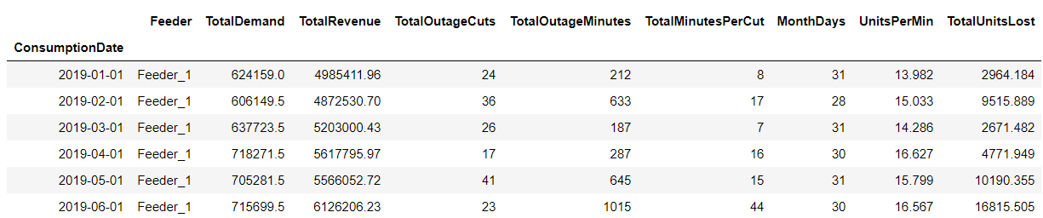
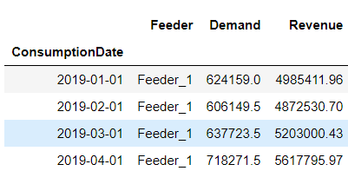
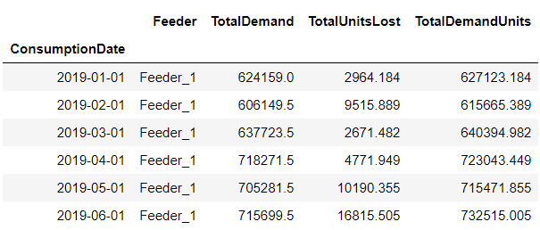
Agenda
Business Understanding
Conclusion
Data Pipeline
Approach
Business Objective
Data Preparation
Data Understanding
Evaluation
Modelling
Data Management
Data-View
Data Mart
Model Data-View

Slide 13
Agenda
Business Understanding
Conclusion
Data Pipeline
Approach
Business Objective
Data Preparation
Data Understanding
Evaluation
Modelling
Plan to find Actual Demand for each Feeder:
Consumed Units
(Current Demand)
Outage Units
(Down time units Lost)
Actual Demand
(Consumed + Outage Units)
Consumption Month | Feeder | Demand
Consumption Month | Feeder | Outage Units
Consumption Month | Feeder | Demand | Outage Units | Total Demand
x – Response | Δ x – Downtime Units | x + Δ x – Total Demand | Δx * Price = Total Revenue Loss
Downtime Unit = Sum(Outage Unit/Days in Month) /(24*60)

Slide 14
Agenda
Business Understanding
Conclusion
Data Pipeline
Approach
Business Objective
Data Preparation
Data Understanding
Evaluation
Modelling
Hold few-out Evaluation ( like Jacknife)
Multiple Simple Models
Naive Approach
Simple average
Moving average
Single Exponential smoothing
Holt’s linear trend method
Holt’s Winter seasonal method
ARIMA
Modelling is done to forecast actual Response, Outage Units and Actual Demand

Slide 15
Agenda
Business Understanding
Conclusion
Data Pipeline
Approach
Business Objective
Data Preparation
Data Understanding
Evaluation
Modelling
Demand and Response for Consumed Units:
Feeder with outage:
Feeder without any outage:

Slide 16
Agenda
Business Understanding
Conclusion
Data Pipeline
Approach
Business Objective
Data Preparation
Data Understanding
Evaluation
Modelling
Model Weightage for Demand and Response Model:
One of the Model evaluation for different Model
Calculate weight of each model

Slide 17
Agenda
Business Understanding
Conclusion
Data Pipeline
Approach
Business Objective
Data Preparation
Data Understanding
Evaluation
Modelling
Target of evaluation is MAPE < 10%

Slide 18
Agenda
Business Understanding
Conclusion
Data Pipeline
Approach
Business Objective
Data Preparation
Data Understanding
Evaluation
Modelling
Revenue loss will be reduced if the demand is met, Hence using this forecast, grid can buy adequate amount of power to reduce downtime.
This will be help for both consumer and feeder to met consumption unit.
Due to downtime we have lost around 30,32,01,724.5 /- revenue which is around 31% of total revenue generated ie (95,21,55,731.2/-)

Slide 19
Agenda
Business Understanding
Conclusion
Data Pipeline
Approach
Business Objective
Data Preparation
Data Understanding
Evaluation
Modelling
Deployment of Model
No Deployment yet, as this is Proof of Concept

Slide 20
Thank you

Slide 21
Q & A

