Slide 1
Building Recommendation Engine from Scratch
https://www.analyticsvidhya.com/blog/2018/06/comprehensive-guide-recommendation-engine-python/

Slide 2
Introduction
From Amazon to Netflix, Google to Goodreads, recommendation engines are one of the most widely used applications of machine learning techniques.
types of recommendation engine algorithms and fundamentals of creating them in Python.
mathematics behind the workings of these algorithms
create our own recommendation engine using matrix factorization.

Slide 3
1. What are recommendation engines?
A recommendation engine filters the data using different algorithms and recommends the most relevant items to users.
It first captures the past behavior of a customer and based on that, recommends products which the users might be likely to buy.
New user:
recommend the best selling products
recommend the products which would bring the maximum profit to the business.

Slide 4
2. How does a recommendation engine work?
We can recommend items to a user which are most popular among all the users
Drawback: the most popular items would be the same for each user
We can divide the users into multiple segments based on their preferences (user features) and recommend items to them based on the segment they belong to
Drawback: as the number of users increases, the number of features will also increase. So classifying the users into various segments will be a very difficult task.
Amazon (or any other big firm) does not recommend products using the above mentioned approach. They use some personalized methods which help them in recommending products more accurately.
2.1 Data collection
2.2 Data storage
2.3 Filtering the data
2.3.1 Content based filtering
2.3.2 Collaborative filtering

Slide 5
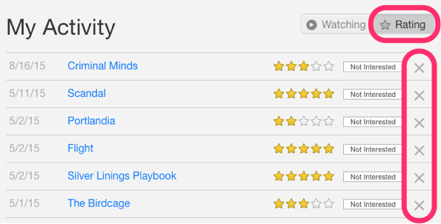
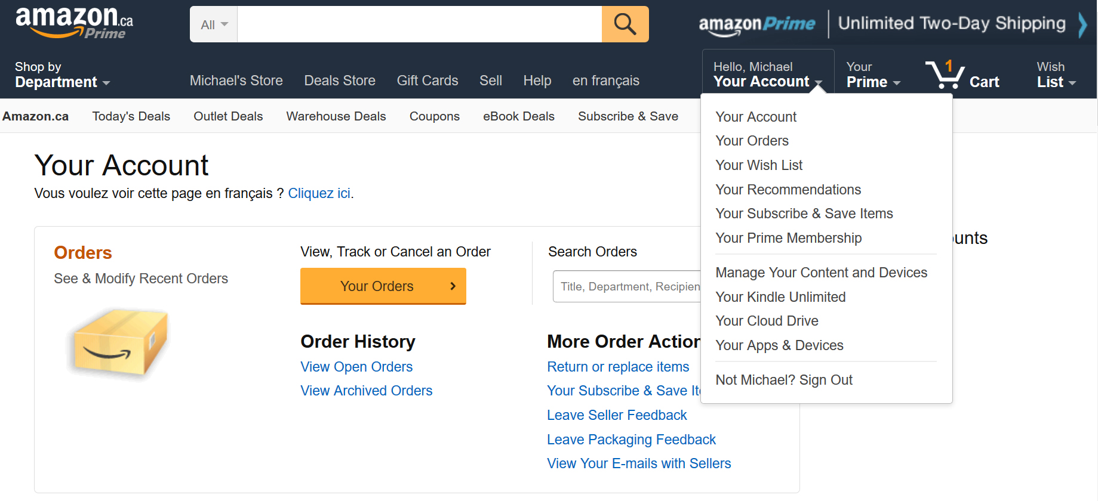
2. How does a recommendation engine work? : Data collection
This is the first and most crucial step for building a recommendation engine.
The data can be collected by two means:
Explicit data is information that is provided intentionally, i.e. input from the users such as movie ratings.
Implicit data is information that is not provided intentionally but gathered from available data streams like search history, clicks, order history, etc.

Slide 6
2. How does a recommendation engine work? : Data storage
The amount of data dictates how good the recommendations of the model can get.
For example, in a movie recommendation system, the more ratings users give to movies, the better the recommendations get for other users.
The type of data plays an important role in deciding the type of storage that has to be used.
This type of storage could include a standard SQL database, a NoSQL database or some kind of object storage.

Slide 7
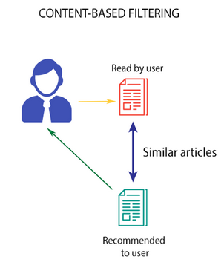


2. How does a recommendation engine work? : Data Filtering : Content based filtering
This algorithm recommends products which are similar to the ones that a user has liked in the past.
Consider the example of Netflix.
profile vector: all the information related to each user in a vector form
item vector : All the information related to movies
cosine similarity : cosine of the angle between the profile vector and item vector
ranges between -1 to 1
movies are arranged in descending order based on:
Top-n approach: where the top n movies are recommended
Rating scale approach: Where a threshold is set and all the movies above that threshold are recommended
Euclidean Distance: Similar items will lie in close proximity to each other if plotted in n-dimensional space.
Pearson’s Correlation: It tells us how much two items are correlated. Higher the correlation, more will be the similarity.
Drawback: it is limited to recommending items that are of the same type. It will never recommend products which the user has not bought or liked in the past.
Notes:
To extract the relevant information required to make the final recommendations.

Slide 8
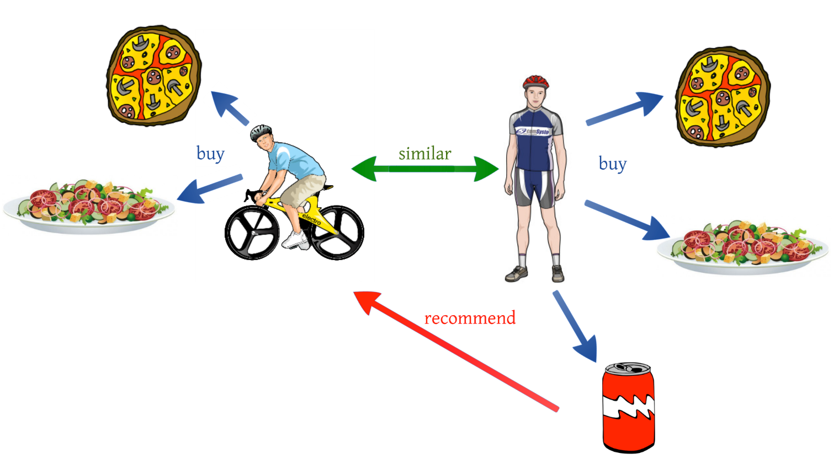

2. How does a recommendation engine work? : Data Filtering : Collaborative filtering
algorithm uses “User Behavior” for recommending items.
This is one of the most commonly used algorithms in the industry as it is not dependent on any additional information.
User-User collaborative filtering
This algorithm first finds the similarity score between users
(Pearson correlation).
picks out the most similar users
find the items rated by both the users
recommends products which these similar users have liked or bought previously.
The prediction (Pu,i ) of an item for a user u is calculated by computing the weighted sum of the user ratings given by other users to an item i.
Drawback: This algorithm is quite time consuming as it involves calculating the similarity for each user and then calculating prediction for each similarity score.
select only a few users (neighbors) instead of all to make prediction
Select a threshold similarity and choose all the users above that value
Randomly select the users
Arrange the neighbors in descending order of their similarity value and choose top-N users
Use clustering for choosing neighbors
useful when the number of users is less.
Rv,i is the rating given by a user v to a movie I
Su,v is the similarity between users

Slide 9
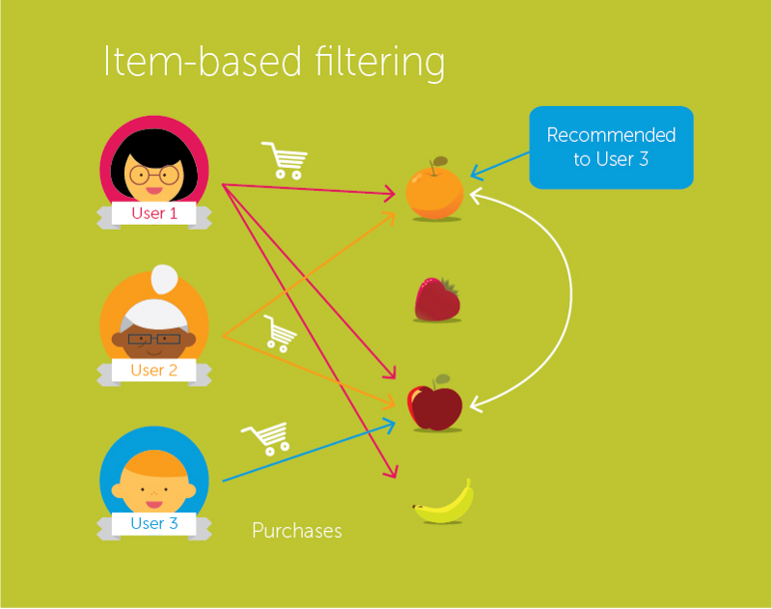
Item-Item collaborative filtering
Effective when the number of users is more than the items being recommended.
Instead of taking the weighted sum of ratings of “user-neighbors”, we take the weighted sum of ratings of “item-neighbors”
what will happen if a new user or a new item is added in the dataset?
Visitor Cold Start
a new user is introduced in the dataset.
Apply a popularity based strategy, i.e. recommend the most popular products. These can be determined by what has been popular recently overall or regionally.
Product Cold Start
a new product is launched in the market or added to the system.
We can make use of Content based filtering to solve this problem.
The system first uses the content of the new product for recommendations and then eventually the user actions on that product.

Slide 10
3. Case study in Python using the MovieLens Dataset
MovieLens dataset and build a model to recommend movies to the end users.
100,000 ratings (1-5) from 943 users on 1682 movies
Demographic information of the users (age, gender, occupation, etc.)

Slide 11
4. Building collaborative filtering model from scratch

Slide 12
5. Building a simple popularity and collaborative filtering model using Turicreate

Slide 13
6. Introduction to matrix factorization
We do not have the ratings for each movie given by each user.
We must find a way to predict all these missing ratings.
For that, we have to find a set of features which can define how a user rates the movies. These are called latent features.
We need to find a way to extract the most important latent features from the the existing features.
Matrix factorization, is one such technique which uses the lower dimension dense matrix and helps in extracting the important latent features.

Slide 14
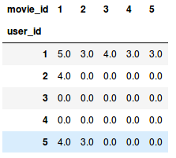
6. Introduction to matrix factorization
Consider a user-movie ratings matrix (1-5) given by different users to different movies.
user_id: the unique ID of different users
Movie_id: each movie is also assigned a unique ID.
A rating of 0.0 represents that the user has not rated that particular movie (1 is the lowest rating a user can give).
We want to predict these missing ratings.
Using matrix factorization, we can find some latent features that can determine how a user rates a movie.
We decompose the matrix into constituent parts in such a way that the product of these parts generates the original matrix.

Slide 15
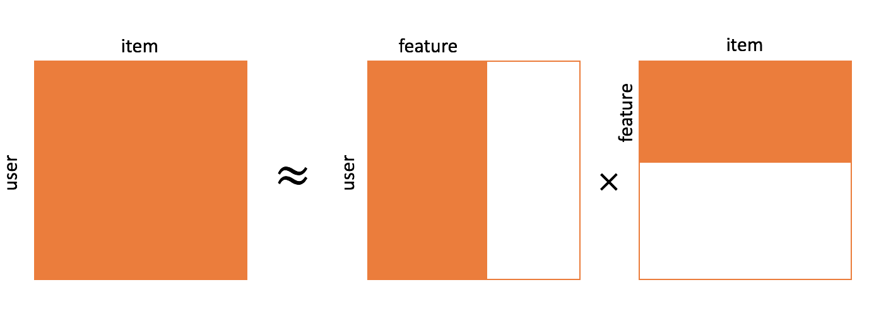

6. Introduction to matrix factorization
Let us assume that we have to find k latent features.
So we can divide our rating matrix R(MxN) into P(MxK) and Q(NxK) such that P x QT (here QT is the transpose of Q matrix) approximates the R matrix:
P is MxK user-feature affinity matrix which represents the association between users and features
Q is NxK item-feature relevance matrix which represents the association between movies and features
Σ is KxK diagonal feature weight matrix which represents the essential weights of features
Choosing the latent features through matrix factorization removes the noise from the data. How? Well, it removes the feature(s) which does not determine how a user rates a movie
rating rui for a movie qik rated by a user puk across all the latent features k, we can calculate the dot product of the 2 vectors and add them to get the ratings based on all the latent features.
R(MxN)
P(MxK)
Q(NxK)

Slide 16
add new data to our user-movie rating matrix
no change: diagonal feature weight matrix Σ,
No change: tem-feature relevance matrix Q.
user-feature affinity matrix P.
multiply with Q on both sides
updated user-feature affinity matrix.

Slide 17




we decomposed R matrix into P and Q. But how do we decide which P and Q matrix will approximate the R matrix?
We can use the gradient descent algorithm for doing this.
The objective here is to minimize the squared error between the actual rating and the one estimated using P and Q. The squared error is given by:
eui is the error
rui is the actual rating given by user u to the movie i
řui is the predicted rating by user u for the movie I
Aim was to decide the p and q value in such a way that this error is minimized.
We need to update the p and q values so as to get the optimized values of these matrices which will give the least error.
The update rule in gradient descent is defined by the gradient of the error to be minimized.
we can apply the update rule for puk and qki.
α is the learning rate which decides the size of each update.
The above updates can be repeated until the error is minimized.
The optimal P and Q matrix which can be used to predict the ratings.

Slide 18
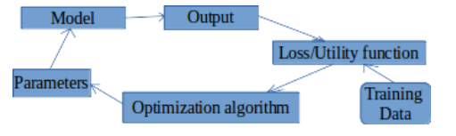
So based on each latent feature,
all the missing ratings in the R matrix will be filled using the predicted rui value.
Then puk and qki are updated using gradient descent and their optimal value is obtained

Slide 19


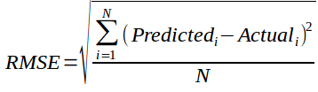
Evaluation metrics for recommendation engines
Recall: What proportion of items that a user likes were actually recommended
Here tp represents the number of items recommended to a user that he/she likes and tp+fnrepresents the total items that a user likes
Precision: Out of all the recommended items, how many did the user actually like?
Here tp represents the number of items recommended to a user that he/she likes and tp+fprepresents the total items recommended to a user
RMSE (Root Mean Squared Error): the error in the predicted ratings:
The above metrics tell us how accurate our recommendations are but they do not focus on the order of recommendations
i.e. they do not focus on which product to recommend first and what follows after that. We need some metric that also considers the order of the products recommended.

Slide 20

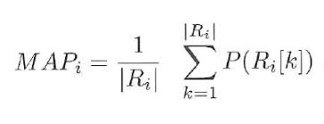
ranking metrics:
Mean Reciprocal Rank: Evaluates the list of recommendations
Suppose we have recommended 3 movies to a user, say A, B, C in the given order, but the user only liked movie C. As the rank of movie C is 3, the reciprocal rank will be 1/3
Larger the mean reciprocal rank, better the recommendations
MAP at k (Mean Average Precision at cutoff k): Precision at cutoff k is the precision calculated by considering only the subset of your recommendations from rank 1 through k
Suppose we have made three recommendations [0, 1, 1]. Here 0 means the recommendation is not correct while 1 means that the recommendation is correct. Then the precision at k will be [0, 1/2, 2/3], and the average precision will be (1/3)*(0+1/2+2/3) = 0.38
Larger the mean average precision, more correct will be the recommendations
NDCG (Normalized Discounted Cumulative Gain):
The main difference between MAP and NDCG is that MAP assumes that an item is either of interest (or not), while NDCG gives the relevance score
Let us understand it with an example: suppose out of 10 movies – A to J, we can recommend the first five movies, i.e. A, B, C, D and E while we must not recommend the other 5 movies, i.e., F, G, H, I and J. The recommendation was [A,B,C,D]. So the NDCG in this case will be 1 as the recommended products are relevant for the user
Higher the NDCG value, better the recommendations

Slide 21
Conclusion

