Slide 1

pediawise.com
Kiran Nasim (she/her) 07/24/2023

Slide 2
About the site
PediaWise is a searchable, subscription-based website that covers important health information from pregnancy through the first 3 years of life.
It includes the weekly PediaGuides, Newsletter, Hot Topics, Freebies, Top 10 Lists, News Alerts, Questions of the Week, and MORE.
https://pediawise.com/
Project done for Howard Development and Consulting

Slide 3
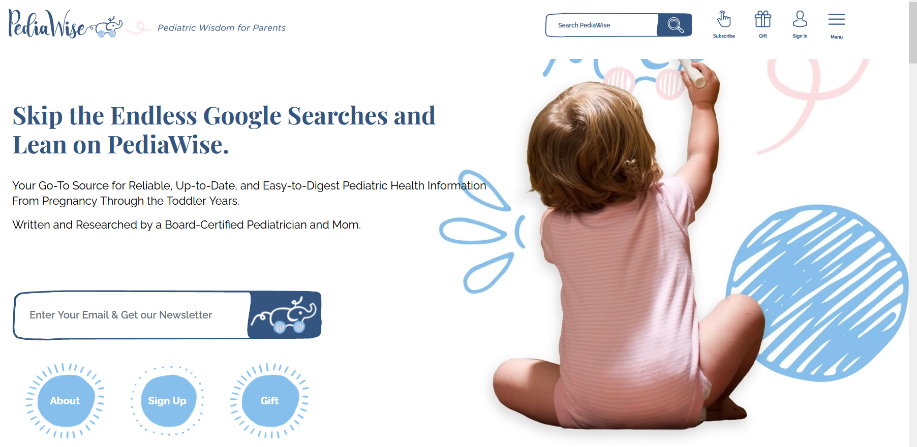
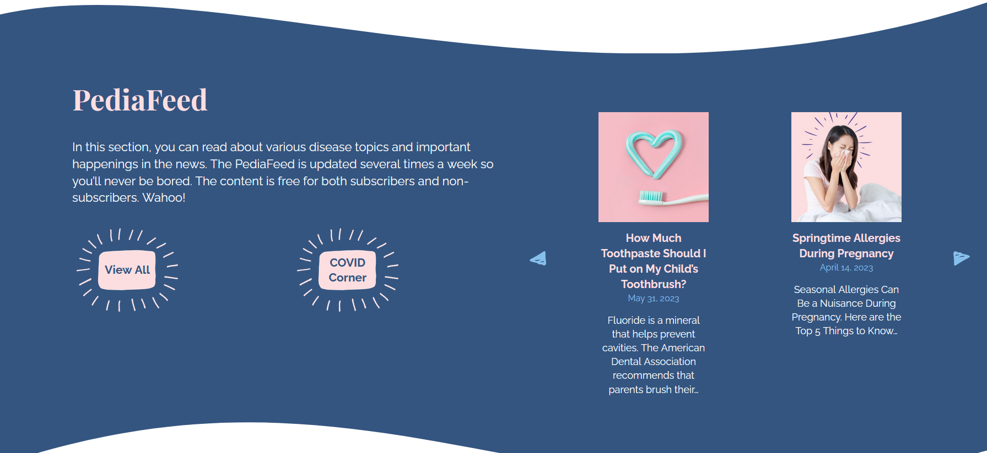
Design and wireframing
Designer created wireframes and mockups to plan the website's layout, structure, and user interface.
Responsive design for various devices.
Tricky UI elements with unconventional layouts.
Figma designs were handed over to the developer.

Slide 4
Scoping the project and timeline
Review the designs. Around 10 templates were needed. E-commerce store functionality. Membership functionality.
Homepage
Contact Page
Post archive
Post single
Category page
Topics page
Gift page
Registration template
Sign up
Scope and timeline: 3-4 weeks. 120 hrs

Slide 5
Platform and tech-stack
Content heavy site - CMS(WordPress)
HTML, CSS, SCSS, JQuery, PHP, based on understrap theme
Membership - private content
Ecommerce - stripe

Slide 6
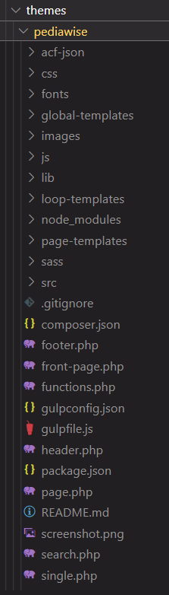
Theme Structure
Create child theme, based on parent understrap theme.
Set up theme structure such as style.css, functions.php, header.php, footer.php, assets folder etc.
Taxonomies to distinguish several post types.

Slide 7
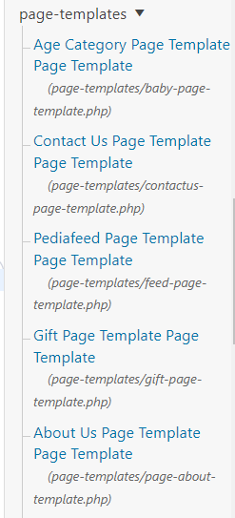
Front-end development
Start implementing the website's design by creating page templates using HTML, Scss, and Jquery.
Create page-templates
Make home page, individual php page template files using wordpress functions and hooks.
Integrate the template files with SCSS, JS files to implement styles and some jquery features
Ensure the website is responsive and optimized for different screen sizes, used bootstrap breakpoints.

Slide 8
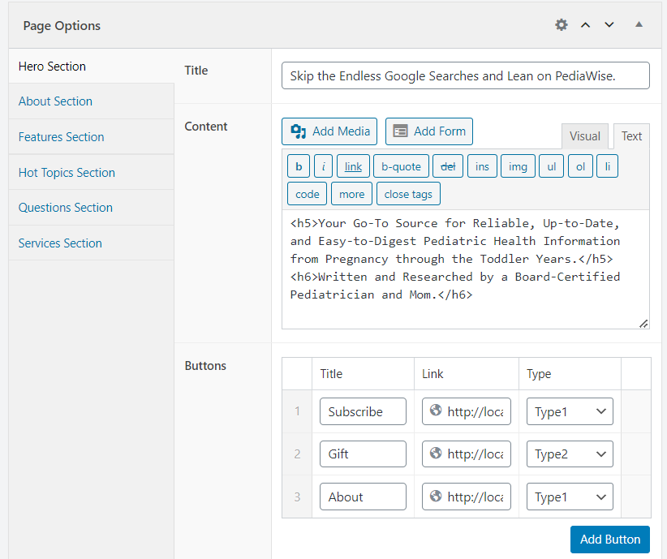

Homepage
ACF rows

Slide 9
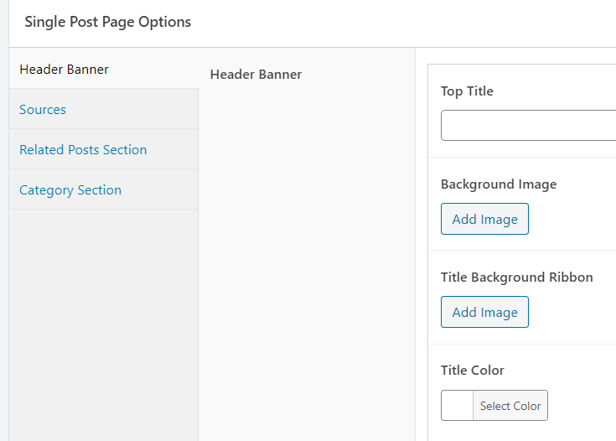
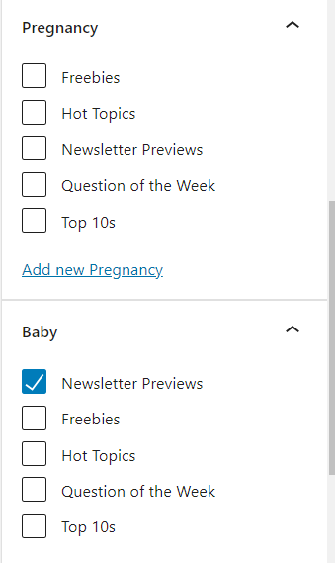
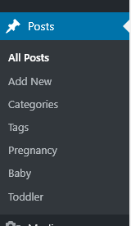
2. Posts
Gutenberg
Single Post Options

Slide 10
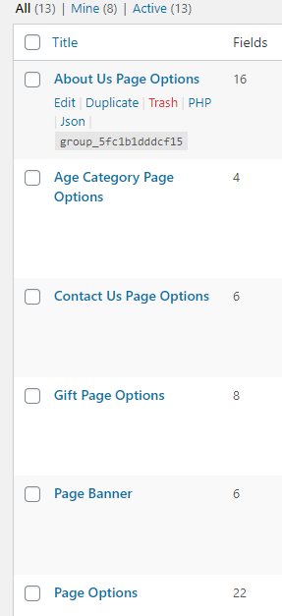
Back-end development
ACF(Advanced Custom Fields)
Custom Post Types
WP Full Stripe
Woocommerce
Integration of Features:
Implement features specific to the website's purpose such as search functionality with custom JS, PHP, wp code, contact feature by Ninja form, membership feature etc.

Slide 11
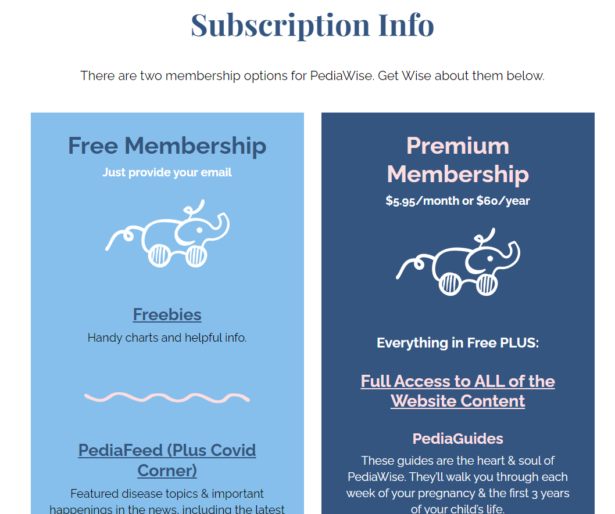
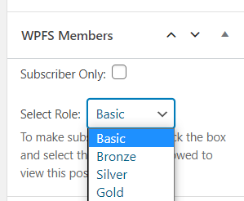
3. Membership - Private Content
WP Full Stripe Members
Woocommerce

Slide 12
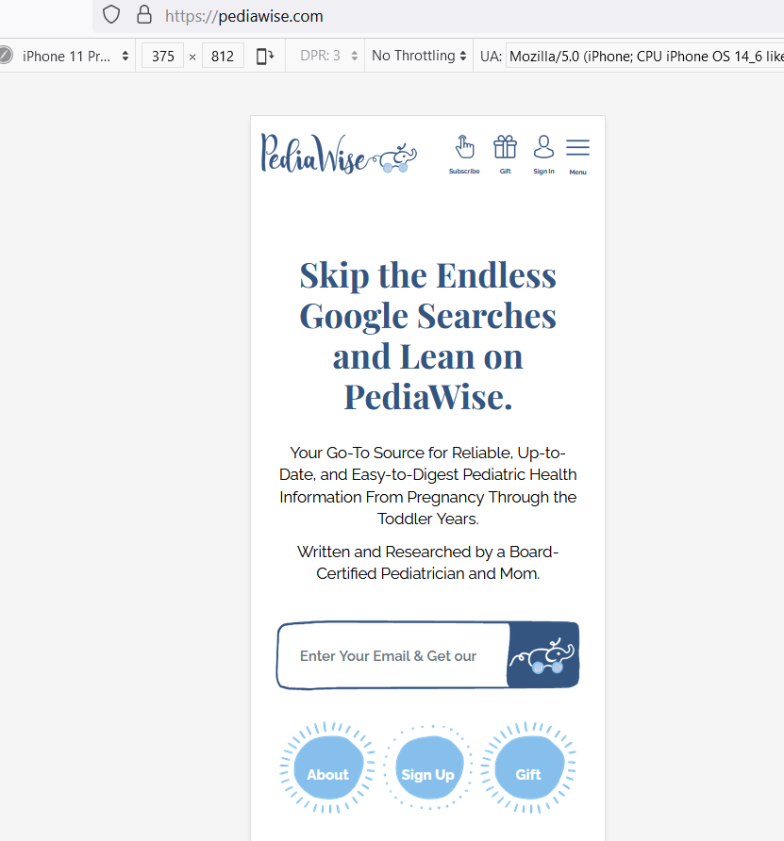
Testing and Quality Assurance
Thoroughly test the website for functionality, browser/device compatibility, and performance.
Accessibility check using Chrome Lighthouse extension
Fix any bugs or issues that arise during testing.

Slide 13




Deployment and Maintenance
Choose a hosting provider and deploy the website to make it accessible to the public.
Monitor the website's performance and client’s feedback regularly.
Perform periodic updates, security patches, and maintenance to keep the website running smoothly.

Slide 14
Possible Improvements
Using ACF flexible content rows so client can have more flexibility in using defined sections across the pages
Providing more custom options in the ACF sections for styles and layouts
Gutenberg + ACF

Slide 15
Thank You! QA

