Slide 1
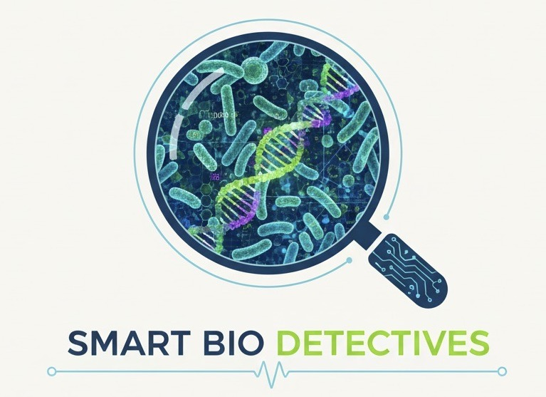

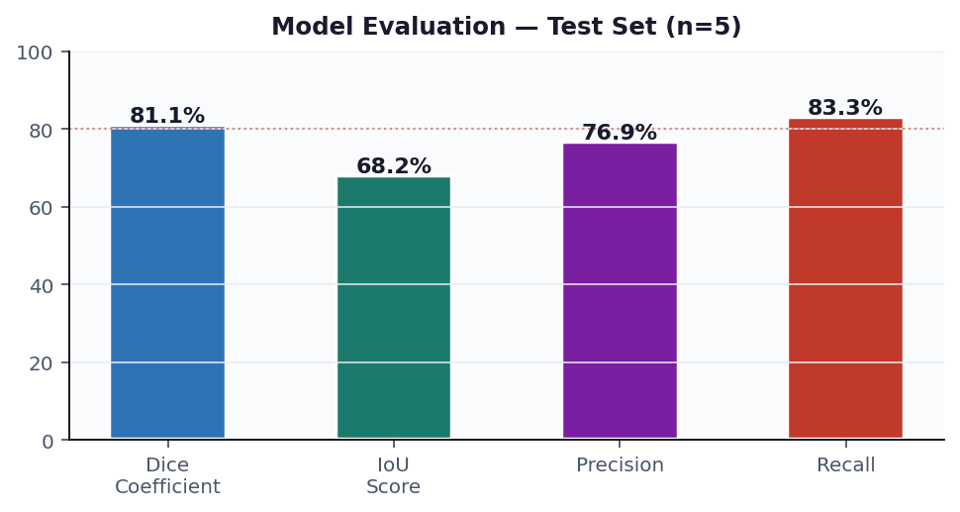
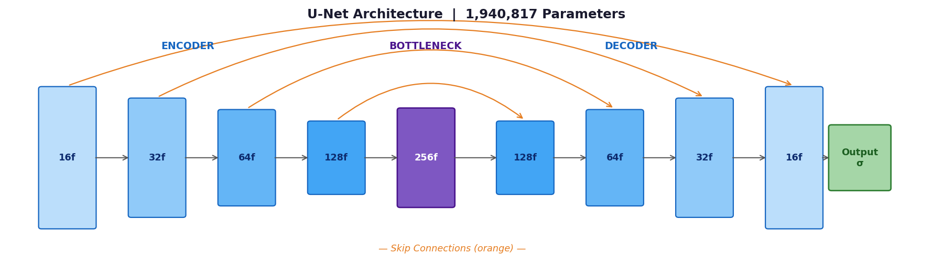
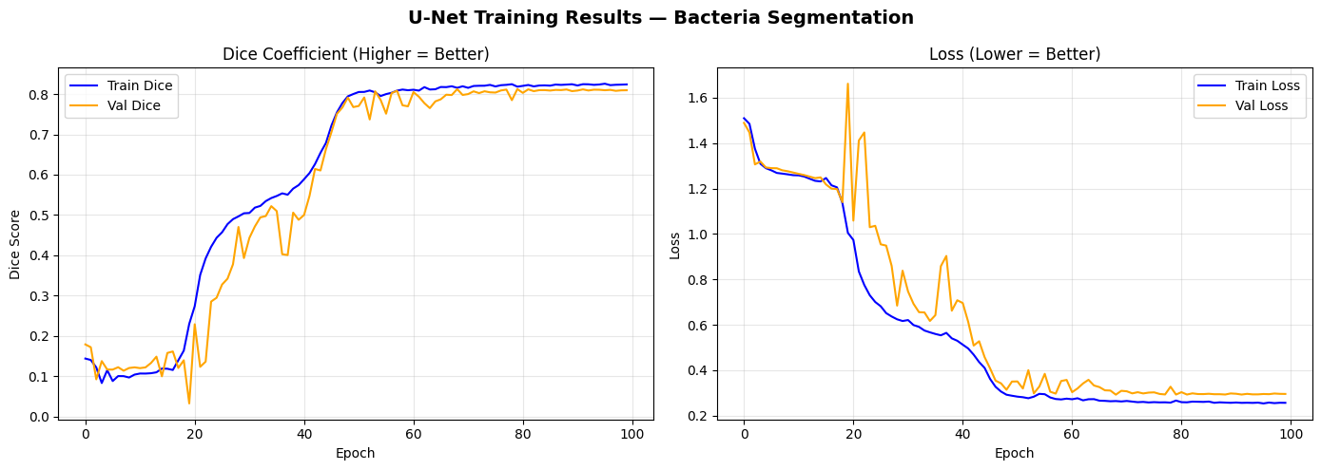
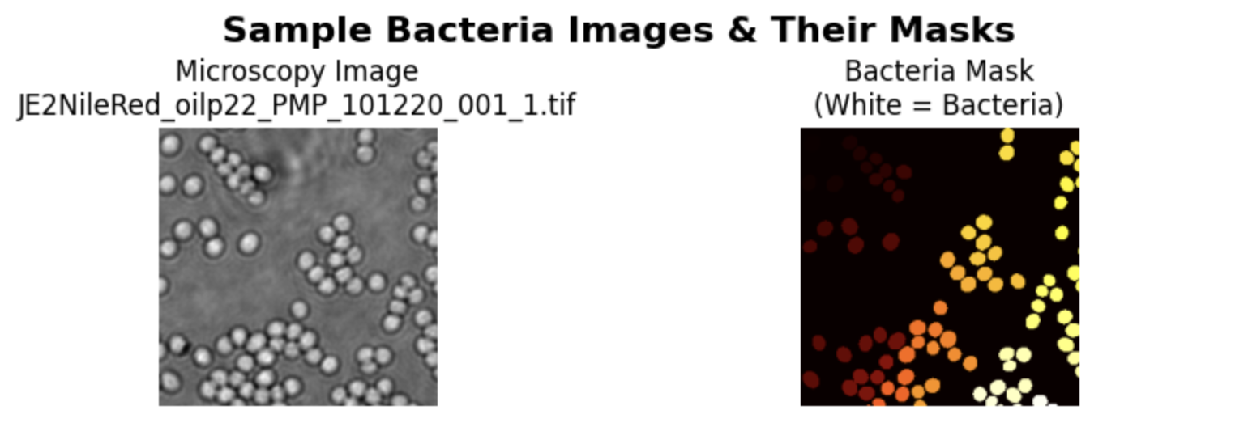
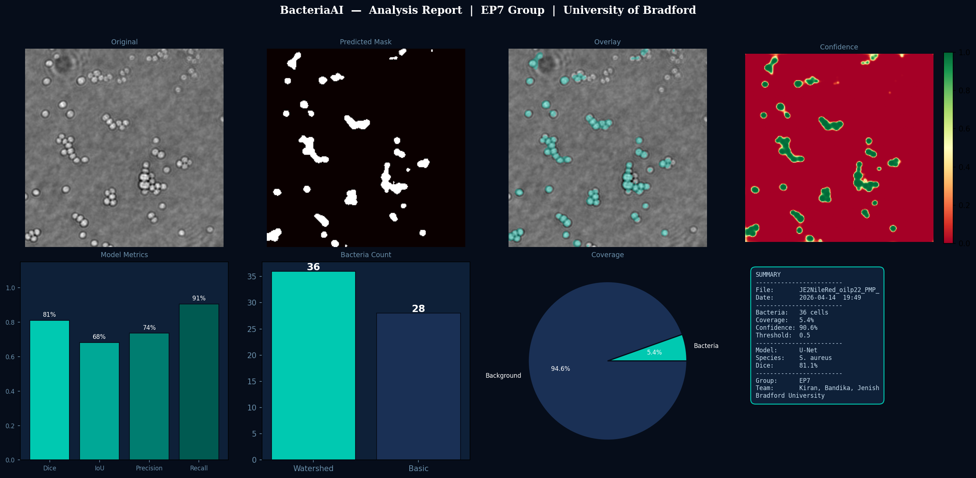
University
of Bradford
Using AI in Bacterial Diagnostics and Quantification
Faculty of
Engineering &
Informatics
EP7 Group: Kiran Nyaupane · Bandika Dhital · Jenish Dani | Supervisor: Dr Kulvinder Panesar | Client: Dr Maria Katsikogianni | COS6032-E, University of Bradford
Introduction and Problem Context
Design
Implementation
Results and Evaluation
Operate
Bacterial infections, especially those caused by Staphylococcus aureus, remain a critical global health challenge — particularly in low- and middle-income countries (LMICs). Traditional diagnostic methods such as culture-based microscopy are slow, error-prone, and require specialist expertise, contributing to delayed treatment and accelerating antimicrobial resistance (AMR).
28 Training
Patches
5 Test
Images
84 After
Augment.
67/17 Train/Val
(80/20)
The U-Net architecture was selected for proven biomedical segmentation performance and effectiveness on small datasets. It features an encoder (contracting), decoder (expanding), and skip connections that preserve spatial detail for precise mask prediction.
81.1% Dice Coefficient
68.2% IoU Score
76.9% Precision
83.3% Recall
The trained model was deployed as a live Streamlit web dashboard accessible via public URL, enabling real-time bacterial analysis during the AI Exhibition on 21 April 2026.
DeepBacs dataset — S. aureus JE2 strain, Nile Red fluorescent dye
5-point cleaning: integrity · mask match · empty · size · corrupt
Preprocessing: greyscale → 256×256 → normalise [0,1] → binarise masks {0,1}
Augmentation: horizontal + vertical flip (3× dataset expansion)
U-Net Architecture
Dashboard Features
Upload any .tif / .png / .jpg microscopy image for instant AI analysis
Adjustable detection threshold slider (0.1 – 0.9)
Three-panel view: original image | predicted mask | teal overlay
Bacteria count displayed using Watershed algorithm
Export formats: JSON results · CSV spreadsheet · Report PNG · Mask PNG
Session history: analyse and export multiple images at once
Model Performance tab: training curves and counting comparison charts
This project delivers an AI-driven automated pipeline for bacterial detection, segmentation, and quantification from fluorescence microscopy images — enabling faster and more reliable diagnostics without specialist input.
Aims & Objectives
Training Progress
Preprocess fluorescence microscopy images for deep learning model training
Develop a U-Net segmentation model for pixel-level bacteria detection
Evaluate using Dice, IoU, Precision, and Recall on unseen test images
Implement Watershed algorithm for accurate individual cell counting
Deploy an interactive Streamlit dashboard for real-time demonstration
Input
256 × 256 × 1 (single-channel greyscale)
Sample Microscopy Images
Encoder
4 blocks: 16→32→64→128 filters + MaxPool + Dropout
Final Deliverables
Bottleneck
256 filters — deepest compressed representation
Trained U-Net Model
best_model.h5 — epoch 90, val Dice 0.8235
Done
Decoder
4 blocks: Conv2DTranspose + skip connection concatenation
Colab Notebook
Full 20-cell pipeline
Done
Methods: CDIO, Conceive and Agile PM
Skip Connections
4 direct encoder→decoder links — preserve boundary detail
Streamlit Dashboard
app.py (525 lines) — live exhibition URL
Done
The project follows the CDIO framework (Conceive–Design–Implement–Operate) delivered through Agile Scrum with 5 sprints and continuous supervisor review.
Output
Conv2D(1, sigmoid) — per-pixel probability map [0,1]
Best val Dice = 0.8235 (epoch 150 / 150) | ReduceLROnPlateau at epochs 79, 93, 103
Agile PM Workbook
Backlog · Sprint Plan · Gantt · ROAM · Risks
Done
Loss
Dice Loss + Binary Cross-Entropy (combined)
Bacteria Counting Results (Streamlit dashboard)
Exhibition Poster
A0 poster — CDIO format
Done
CONCEIVE
Identified the clinical problem: slow manual bacterial microscopy in LMICs. Conducted background research and literature review (U-Net, bacterial imaging, AMR). Held client kick-off meeting with Dr Maria Katsikogianni to confirm dataset, scope, and success criteria (Dice ≥ 0.80). Defined team roles: Kiran (Model Dev), Bandika (Data Eng.), Jenish (Evaluation).
DeepBacs dataset | Brightfield image (left) | Expert-annotated binary segmentation mask (right)
Optimiser
Adam lr=1e-4 → ReduceLROnPlateau at epochs 79, 93, 103
Watershed reduces total error 64 → 14 (78% improvement over basic counting)
Design Pipeline
Callbacks
ModelCheckpoint | EarlyStopping patience=20
Success Criteria
Parameters
1,940,817 | Google Colab T4 GPU | ~15 min training
Dice Score ≥ 0.80: ✓ 0.8235 achieved
Fluorescence
Images
5-Point
Cleaning
Pre-process
256×256
Augment
28→84
U-Net
Training
Mask
Prediction
Watershed
Count
Dashboard
& Export
Accurate segmentation: ✓ 81.1% Dice
DESIGN
Designed the full data preprocessing pipeline (resize 256×256, normalise [0,1], binarise masks). Selected U-Net encoder-decoder architecture with skip connections based on literature review. Planned combined Dice+BCE loss function. Defined evaluation metrics and train/val/test split strategy. Structured Agile sprint plan with 24-item Product Backlog.
Counting accuracy improved: ✓ 78% error reduction
Training: Best model checkpoint saved at epoch 90 (val_dice=0.8235). EarlyStopping halted training at epoch 110/150.
System works in demo: ✓ Live URL deployed
Results clearly presented: ✓ Poster + Dashboard
IMPLEMENT
Ethical Implications and Future Improvements
Dataset & Research Details
References:
Applied 5-point data cleaning pipeline — zero corrupt/missing files. Augmented 28 → 84 samples (horizontal + vertical flip). Built U-Net in TensorFlow/Keras (1,940,817 parameters). Trained 150 epochs with ModelCheckpoint, EarlyStopping (patience=20), ReduceLROnPlateau. Best val Dice = 0.8235 at epoch 90. Watershed counting: 78% error reduction (64→14).
Patient safety: This is a research prototype — clinical deployment requires extensive prospective trials, regulatory approval, and independent validation before use
GDPR compliance: DeepBacs dataset contains no patient-identifiable information; all images are from a controlled laboratory setting with open-access licensing
Algorithmic bias: Model trained on a single protocol (JE2 strain, Nile Red stain) — performance may degrade with different microscopes, stains, or bacterial species
Transparency: Confidence scores displayed alongside all predictions; AI must augment clinician judgement, not replace it
EU AI Act: If deployed clinically, this would be classified as high-risk AI under medical device provisions — requiring conformity assessment and registration
Sustainability: Free Google Colab T4 GPU used for training — minimal energy footprint relative to commercial AI infrastructure
Future improvements: Multi-species detection · Edge deployment (model quantisation) · Clinical LIS integration · Real-time video microscopy analysis · Prospective clinical validation study
Species
Staphylococcus aureus (JE2 strain)
Kim, M.J., Park, J., Kang, M., Jeong, U., Jeong, D., Kang, N.-G., Hwang, S.J., Youn, S.H., Hwang, B.K., Hyun, Y. and Kim, D. (2023). Bacteria detection and species identification at the single-cell level using super-resolution fluorescence imaging and AI analysis. Biosensors and Bioelectronics, [online] 240, p.115603. doi:https://doi.org/10.1016/j.bios.2023.115603.
Lee, S., Park, J.S., Hong, J.H., Woo, H., Lee, C., Yoon, J.H., Lee, K.-B., Chung, S., Yoon, D.S. and Lee, J.H. (2025). Artificial Intelligence in Bacterial Diagnostics and Antimicrobial Susceptibility Testing: Current Advances and Future Prospects. Biosensors and Bioelectronics, p.117399. doi:https://doi.org/10.1016/j.bios.2025.117399.
Ronneberger, O., Fischer, P. and Brox, T. (2015). U-Net: Convolutional Networks for Biomedical Image Segmentation. Lecture Notes in Computer Science, 9351, pp.234–241. doi:https://doi.org/10.1007/978-3-319-24574-4_28.
World Health Organization (2017). WHO publishes list of bacteria for which new antibiotics are urgently needed. World Health Organization.
Stain
Nile Red fluorescent dye
OPERATE
Format
.tif (TIFF), 256×256 pixels, greyscale
Evaluated on 5 unseen test images: Dice 81.1%, IoU 68.2%, Precision 76.9%, Recall 83.3%. Deployed Streamlit dashboard with image upload, segmentation overlay, bacteria count, and export (JSON/CSV/PNG). Launched live exhibition URL via localtunnel. Presented full working system on 21 April 2026.
Train
28 image-mask pairs (brightfield patches)
Test
5 unseen full images with ground truth masks
Augmented
84 samples (horizontal + vertical flip, 3×)
Agile PM
Split
67 training / 17 validation (80/20, random_state=42)
5 Sprints | 111 total story points | Oct 2025 – Apr 2026
Kiran (ScrumMaster/Model) · Bandika (Data Engineering) · Jenish (Testing & Eval)
Weekly standups · Sprint reviews with Dr Panesar · Monthly client check-ins
GitHub version control · Google Drive shared storage · MoSCoW prioritised backlog
Definition of Done: code committed, cell runs without error, output verified, blog entry made
Masks
Binary: 1 = bacteria pixel, 0 = background
Acknowledgments Dr Kulvinder Panesar (Supervisor) · Dr Maria Katsikogianni (Client) · University of Bradford, Faculty of Engineering and Informatics · COS6032-E Module Team
Framework
TensorFlow 2.19 / Keras | Python 3.12
Compute
Google Colab NVIDIA T4 GPU | ~1hr 47min training
COS6032-E Industrial AI Project | University of Bradford | EP7 Group: Kiran Nyaupane · Bandika Dhital · Jenish Dani | Supervisor: Dr Kulvinder Panesar | Client: Dr Maria Katsikogianni | April 2026

