Slide 1
Salesforce Technical Exercise
Kiran Pallikila
04/13/2021

Slide 2
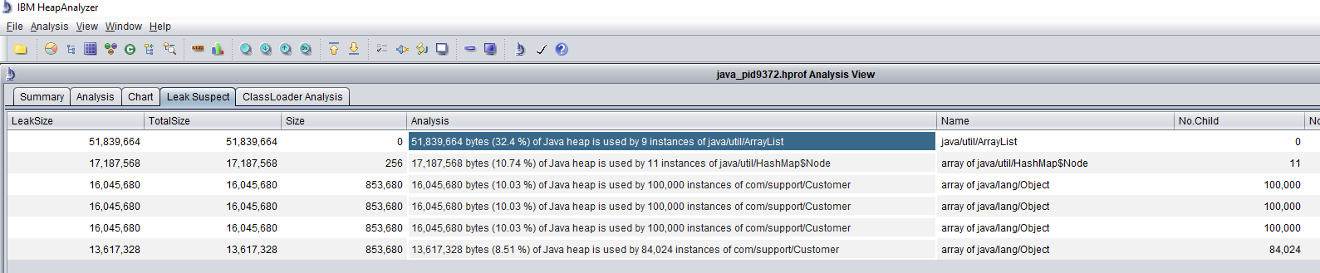
Topics:
Review root cause for OutofMemoryError.
API Demo.
Problem 1: OutofMemory
Reproduced error and analyzed heap dump.
Producing 100k customer objects per sec.

Slide 3
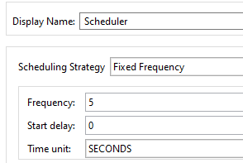
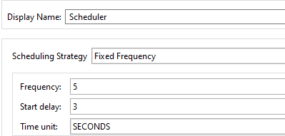
Possible solutions:
Increase Frequency on producer, add 3sec delay in consumer.
Improved customer creation time by 5x when scale up to 1M records.
Improved customer creation time by 3x when scale up to 10M records.
No of Records | Average Time for Creation (Given Code) | Average Time for Creation (Improved Code)
100K | 1 sec | 1 sec
1M | 10 sec | 2 sec
10M | 70 sec | 20 sec

Slide 4
Possible solutions:
Increase heap.
Update GC policy +UseG1GC +UseStringDeduplication.
Implement equals and hash code methods in Customer java class to eliminate duplicates.
No of Records | Allocated heap | OutofMemory | Producer scheduler Frequency | Consumer Start Delay | Consumer scheduler Frequency
100K | 150MB | No | 5 sec | 3 sec | 5 sec
1M | 300MB | No | 5 sec | 3 sec | 5 sec
10M | 2048MB | No | 30 sec | 30 sec | 30 sec

Slide 5
API Demo:
API uses file connector to list files in configured folder.
Based on the format(.txt,.pdf,.png) files get moved to respective folders.
Upon success Email notification sent to requested parties.
Components used: File (Integration style), HTTP, Email, Sockets, Choice Router(message Routing), Data weave, Logger.
Error Handling and Munit test cases.

Slide 6
Enhancements:
Use of SFTP or FTP connector.
Configure ActiveMQ/AnypointMQ for message recovery.
Implement batch processing for large data sets.
Watermark on processed records.
Implement retry mechanism for failed records.

Slide 7
Environment:
Depends on volume, allocate no of workers and adjust heap.
Shared/Dedicated load balancer to route the traffic.
Use of Git, Bamboo/Jenkins for CI/CD.
Secure API using ClientID policy and Basic AUTH/OAuth.
Performance test using JMeter/LoadUI.
Splunk/SumoLogic for server logs aggregation.
AppDynamics/Dynatrace for application monitoring.
Build dashboard for API metrics.

Slide 8
Questions?

