Slide 1
ReactiveX Demo

Slide 2
Table of Content
Problem Statement
Async Programing Options
ReactiveX
Challenges
Demo
References

Slide 3
Problem Statement
Gateway
Service 1
Motivations for Async Programming
Blocking, Sync Programing gets in trouble under load
Distributed Microservices collaborating over network
Resiliency
Parallel processing
Better Threads Utilization
Service 2
Client Call
Service 3
Service 3
Service 3

Slide 4
Async Implementation Optoins
Option | Concerns
Callbacks | Not Composable “Callback Hell” for nested cases
Future | Future.get() is blocking Complex beyond 1 level composition
CompletableFuture (Java8) ListenableFuture (Spring/Guava) | Good for single async operation, Complex beyond 1 level composition

Slide 5
ReactiveX
Library for composing async & event-based programs using observable sequences
Iterable
T next()
Boolean hasNext()
throws RuntimeException
Observable
onNext(T t)
onCompleted()
onError(Throwable e)
Blocking/Synchronous
Pull
Non-blocking/Asynchronous
push
Powerful abstraction of low-level concerns – thread safety, thread synchronization, non-blocking IO, etc

Slide 6
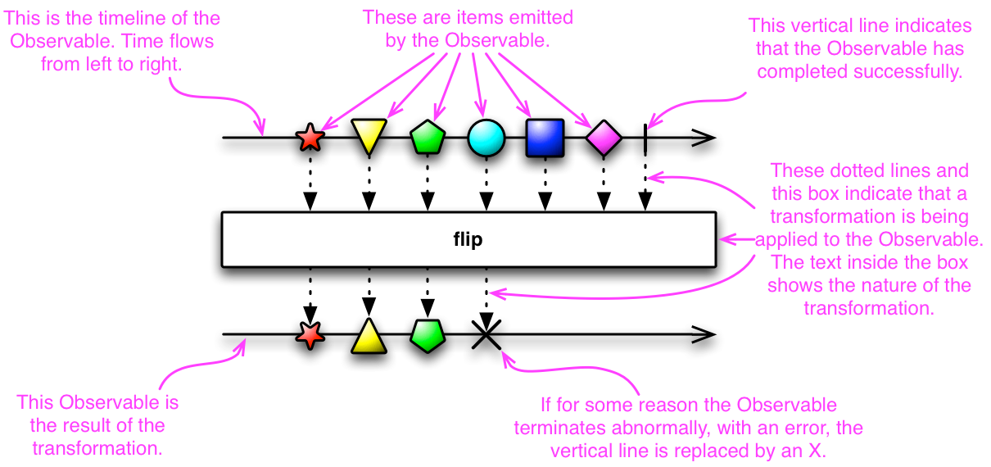
Visualization using marble Diagram

Slide 7
Demo
/dashboard/{customerId}
Dashboard
Cart
/cart/{customerId}
CatalogItem
/catalogItems?skus=[]
Account
/account/{customerId}

Slide 8
Appendix

Slide 9
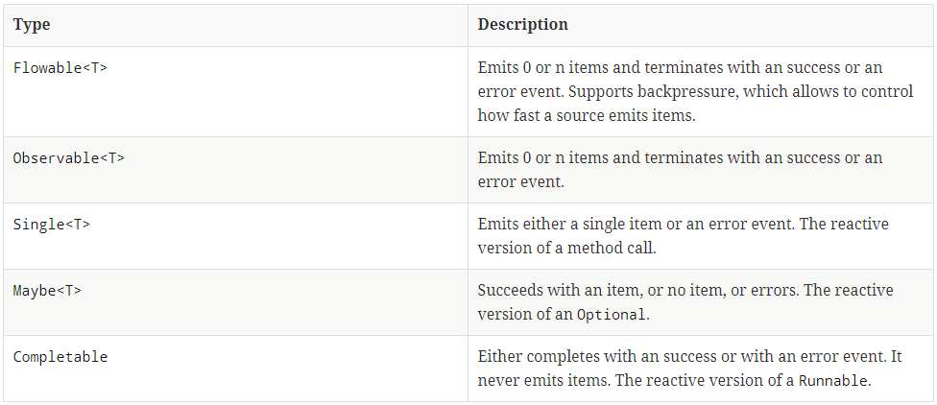
Reactive Observables

Slide 10
References
http://rxmarbles.com/ Interactive reactive marble diagrams
reactivex.io/
reactive-streams.io
Alternatives
Akka
Spring Reactor (Spring 5)

Slide 11
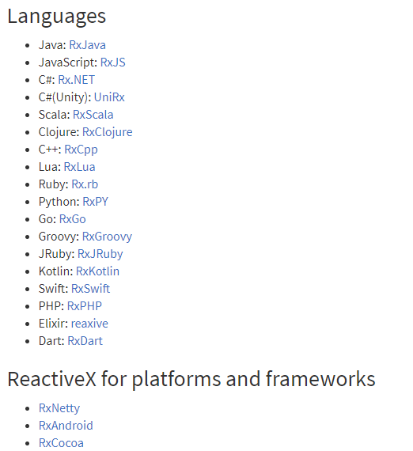
ReactiveX Programing Languages

Slide 12
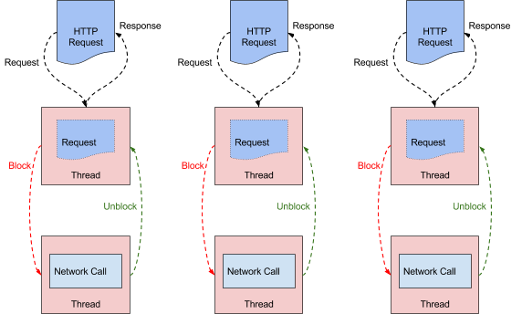
Blocking/Sync Programing model
Image Source: https://medium.com/netflix-techblog/

Slide 13
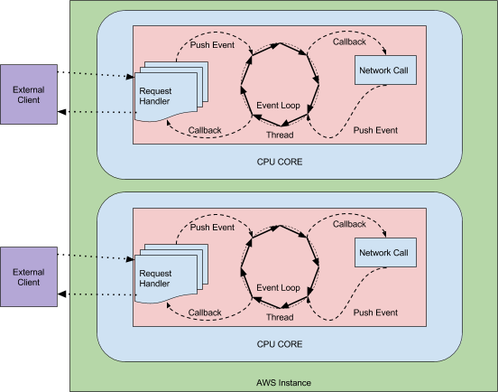
Non-Blocking/Async Programing model
Image Source: https://medium.com/netflix-techblog/

