Slide 1
Streaming Services
User Analysis Report
By: Kiran Patel
Email Id: kiranpatelpatel18@gmail.com
Contact/Whatsapp Number: 9960478884

Slide 2




Executive Summary
This analysis examines critical performance indicators across our streaming platform, revealing actionable insights that span revenue optimization, user engagement patterns, and behavioral trends. Our findings provide a foundation for strategic initiatives aimed at improving retention, personalizing content delivery, and maximizing lifetime customer value.
Revenue Distribution
Engagement Correlation
Three distinct subscription tiers generate revenue with significant ARPU variation, indicating clear value perception differences and opportunities for tier optimization.
Watch hours increase proportionally with subscription tier and recommendation effectiveness, validating our personalization algorithms.
Device & Time Patterns
Retention Metrics
Desktop and smartphone dominate platform access, with peak viewing concentrated during evening and late-night hours across demographics.
Active memberships constitute the majority of our user base, while loyalty points distribution reveals long-tail engagement opportunities.
Payment method preferences demonstrate regional variation, and language localization shows strong correlation with increased watch time, underscoring the importance of market-specific customization strategies.

Slide 3
Users by Price Tier
Key observations:
The distribution reveals subscriber concentration patterns that inform content licensing priorities
Tier migration opportunities exist within the current user base
Entry-level pricing drives volume while premium tiers contribute disproportionately to revenue
Churn risk varies significantly by tier, requiring differentiated retention strategies
The balance between tiers suggests healthy platform economics with room for premium tier expansion through feature enhancement and exclusive content offerings.

Slide 4


Movies vs Series Watched per User
Movie Consumption
Series Engagement
Single-session content preferences reveal viewer habits around standalone storytelling, casual viewing patterns, and content discovery behaviors that differ fundamentally from serialized engagement.
Episodic content drives sustained platform return behavior, creates habit formation, and generates the "binge-watching" patterns that characterize modern streaming consumption and improve retention metrics.
Movies serve as gateway content for new subscribers
Series viewers demonstrate higher lifetime value
Completion rates typically higher than series
Episode completion predicts subscription renewal
Genre diversity broader in film consumption
Serialized content creates appointment viewing
Content Mix Strategy
The balance between movies and series consumption informs content acquisition budgets and original production investments. Users who engage with both formats demonstrate the highest platform stickiness and longest subscription duration.
Understanding individual user preferences enables more effective homepage curation and recommendation algorithms that can drive engagement across both content types.

Slide 5
Recommendations vs Watch Hours
Personalization Impact on Engagement
Our recommendation engine serves as a critical driver of platform engagement, directly influencing watch hours and content discovery. This analysis quantifies the relationship between recommendation effectiveness and user consumption patterns.
The positive correlation between recommendation engagement and total watch hours validates continued investment in machine learning capabilities and content metadata enrichment. Users who actively engage with recommended content demonstrate significantly higher platform satisfaction scores and lower churn rates.
This relationship suggests that improving recommendation accuracy should remain a top technical priority, with potential returns including increased retention, higher ARPU through tier migration, and reduced customer acquisition costs through improved word-of-mouth and lower churn rates requiring replacement subscribers.

Slide 6
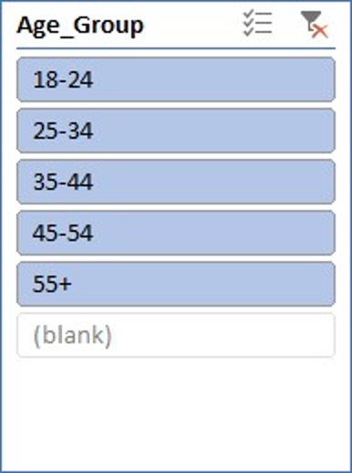
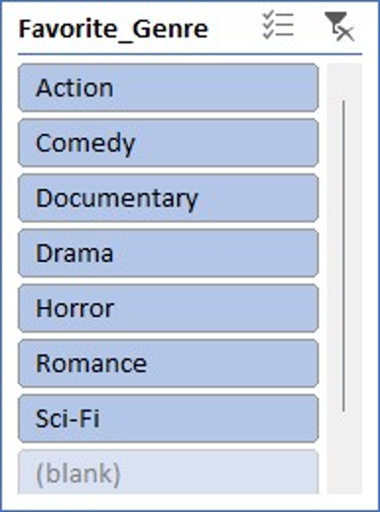



Preferred Genres by Age Group
Demographic Content Preferences
Age-based genre preferences reveal distinct consumption patterns that should inform content acquisition strategies, marketing campaigns, and user interface design. Understanding these preferences enables more effective content investment decisions and targeted promotional activities that resonate with specific demographic segments.
18-24 Age Group
25-44 Age Group
45+ Age Group
Younger viewers gravitate toward action, horror, and sci-fi content, demonstrating openness to genre experimentation and trending titles that gain social media momentum.
Core demographic shows diverse preferences spanning drama, comedy, and documentary content, with highest overall engagement and subscription conversion rates.
Older subscribers favor drama, classic films, and documentary content, with longer average watch sessions and strong loyalty to familiar genres and franchises.
Content Strategy Implications
Cross-Generational Opportunities
Licensing budgets should reflect demographic distribution and genre preferences
Identifying content with broad age appeal enables efficient marketing spend and creates opportunities for shared viewing experiences that can drive household subscription consolidation and reduce per-user acquisition costs.
Original content development can target underserved age-genre combinations
Marketing creative should be tailored to demographic viewing patterns
Homepage layouts can dynamically prioritize genres based on user age

Slide 7
Device Usage Trends
Platform Access Patterns
Device preference analysis reveals how subscribers access content, informing technical development priorities, quality of service investments, and user experience optimization efforts across platforms.
21.5%
Tablet
Highest proportion of total streaming hours
20.9%
Smartphone/Smart TV Usage
Second-largest device category by engagement
36%
Other Devices
Desktop and Laptops

Slide 8
Peak Watch Time Trends
Temporal Viewing Patterns
Understanding when users engage with content enables optimization of content releases, infrastructure capacity planning, and marketing communications timing to maximize impact and minimize technical disruption.
Morning (6am-12pm)
1
Highest engagement period, primarily mobile viewing during commutes with news and short-form content preference
2
Afternoon (12pm-6pm)
Moderate engagement with gradual increase toward evening, mixed device usage patterns
Evening (6pm-10pm)
3
Primary viewing window with peak concurrent users, highest quality streaming demands, and family viewing patterns
4
Late Night (10pm-2am)
Secondary peak among younger demographics, binge-watching behavior, individual rather than shared viewing
Strategic Applications
Content Release Timing
Infrastructure Planning
Marketing Communications
New releases should be scheduled before evening peak to maximize day-one engagement and social media discussion during high-traffic periods. Major originals benefit from weekend late-night releases targeting binge viewers.
CDN capacity and server resources must be scaled to handle evening concurrent stream peaks without quality degradation. Proactive capacity monitoring prevents buffer rate increases during high-demand windows.
Email campaigns and push notifications should be timed for afternoon delivery, positioning content recommendations just before evening viewing decisions. Social media engagement peaks align with viewing patterns.
These temporal patterns also inform customer support staffing models, with evening availability critical for addressing streaming issues when they have the greatest impact on user experience and satisfaction.

Slide 9
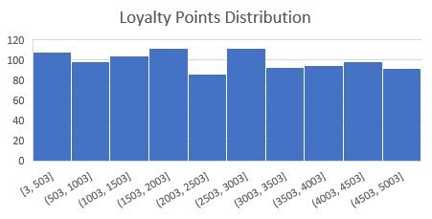
Retention & Loyalty
Key Observations:
Active users likely download more and log in frequently.
High loyalty correlates with engagement

