Slide 1
Prophylactic Treatment
Kiran prasannadas

Slide 2
Introduction
Each year, nearly 900,000 Americans die prematurely from the five leading causes of death
Heart disease, Cancer, Chronic lower respiratory diseases, Stroke, and Unintentional injuries
Together they accounted for 63% of all U.S. deaths
Courtesy: Centers for Disease Control and Prevention
https://cdc.gov

Slide 3
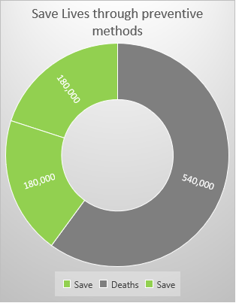
save life
20% – 40% of the 900,000 deaths due to the leading causes are preventable
Identify who is at risk!
Proper screening

Slide 4
Problem statement
Prophylactic treatment against a future bad outcome may be possible if some knowledge or intelligence is available to predict the onset.
A patient once admitted is observed across time.
We focus on to predict the onset of bad outcome after 12 hours.

Slide 5
dataset
13,178,226 observations, Each row is a time-stamped observation entry
146 variables
Target : Outcome_12hr
Location details, dates, admit source, discharge disposition, LOS, ethnicity, marital status, lab values, Charlson Comorbidity indexes

Slide 6
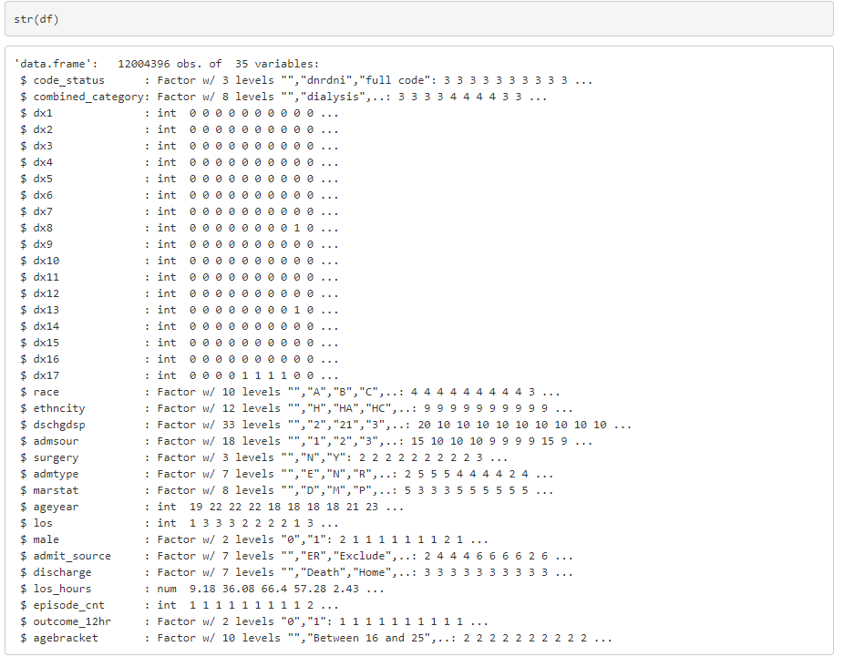
Feature & observation selection
Removed the features with majority NA values
Highly correlated features (LOS, LOS hours, marital status, age..)
Factors with high number of levels (Drug name)
Removed the observations that are marked as Exclude (Exclude==1)
Deteriorating Patient Eligible is “in”
Reduced the dataset to 12,004,396 obs. & 32 variables

Slide 7
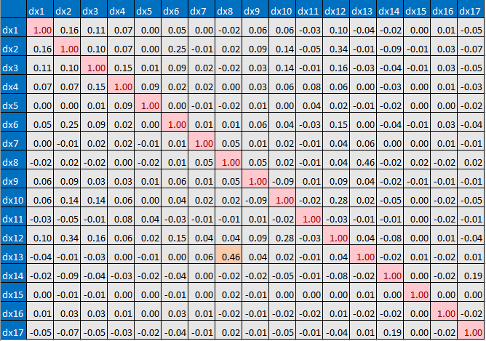
Correlation: Charlson Comorbidity indexes
dx1 | Myocardial Infarct
dx2 | Congestive Heart Failure
dx3 | Peripheral Vascular Disease
dx4 | Cerebrovascular Disease
dx5 | Dementia
dx6 | Chronic Pulmonary Disease
dx7 | Ulcer
dx8 | Mild Liver Disease
dx9 | Diabetes
dx10 | Diabetes with Organ Damage
dx11 | Hemiplegia
dx12 | Moderate/Severe Renal Disease
dx13 | Moderate/Severe Liver Disease
dx14 | Metastatic Solid Tumor
dx15 | Aids
dx16 | Rheumatologic Disease
dx17 | Other Cancer

Slide 8
Highly imbalanced target distribution

Slide 9
Synthetic minority over sampling technique – smote (DMwR)

Slide 10
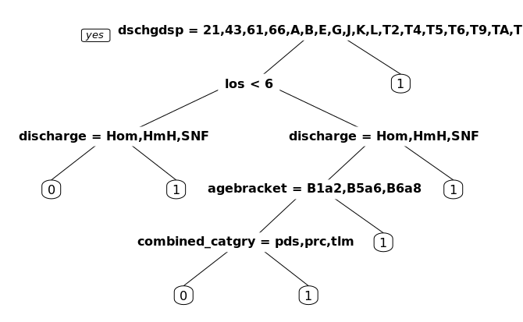
Model – decision tree
Discharge disposition, los, discharge, agebracket, combined category

Slide 11
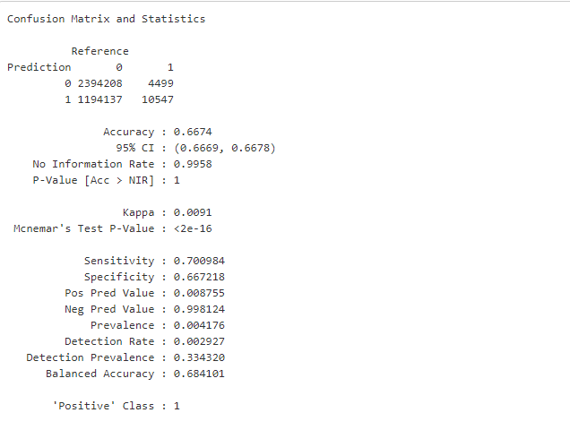
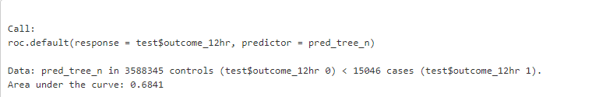
Prediction accuracy : DT
Accuracy: 66.74%
Sensitivity : 70.09%
AUC: 68.41%

Slide 12
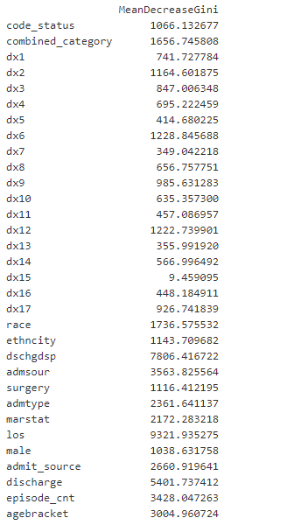
Model – random forest
Los, Dischdsp, discharge

Slide 13
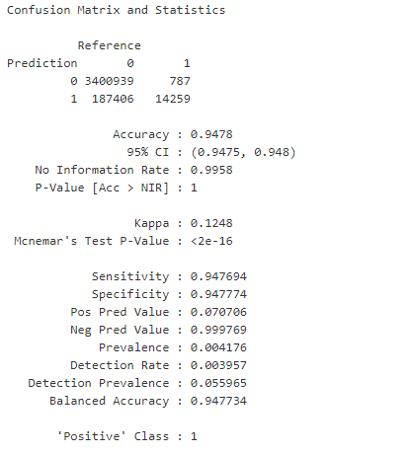
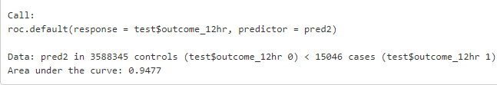
Prediction accuracy : rf
Accuracy: 94.78%
Sensitivity: 94.77%
AUC: 94.77%

Slide 14
Conclusion
Developed a model that could predict the onset of a bad outcome within 12 hours.
Random forest with 70:30 split gave good accuracy.
The model prediction of the onset of bad outcome can save lives by giving urgent attention and taking preventive measures.

