Slide 1
DevOps Cloud(AWS)
Author: Kiran P
Tools and Technologies:
Operating System: Ubuntu
Cloud: AWS | Cloud-Orchestration: Terraform
Container: Docker | Container-Orchestration: Kubernetes | Infrastructure-Automation: Ansible
Source Code Repo: GIT | CI/CD: Jenkins | Build Tool: Maven | Maven-Repo: Nexus3
Coding: HTML + CSS | Scripting: Shell Script
Prerequisites:
--> AWS Account
--> Git Account
--> Knowledge On Above Tools and Technologies.

Slide 2
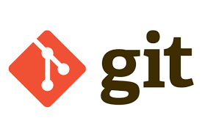
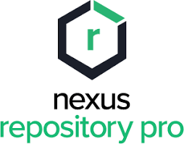

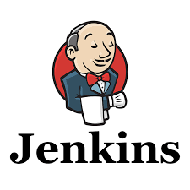
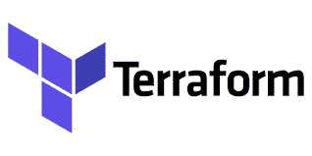
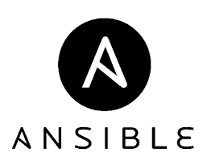
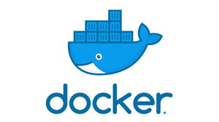
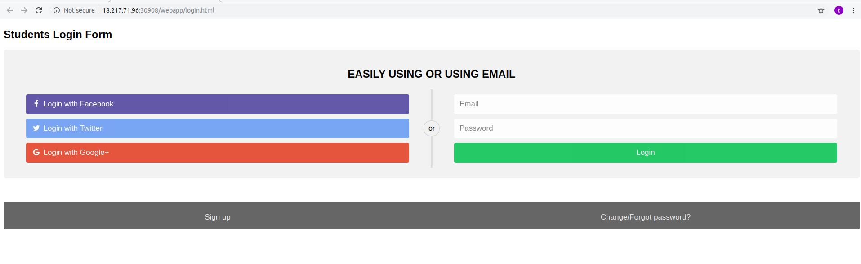
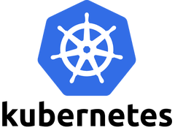
Overall Architecture:
Checkout Code
Build Maven Code
and Push artifacts
to Nexus Repo
Launch EC2
Using tf file
Install
Jenkins
Build Docker Image
and Push to
Docker Hub
Access site
Using K8S IP
And NodePort
Deploy the Image
on K8S Cluster
Pull the Image

Slide 3
AWS EC2 Instances Architecture:
Install Jenkins
Launch EC2 Instance
Using tf file and
Install Ansible
Install Tools
Using ansible
yaml files
Install Nexus3
Install Docker
Install K8S
Clone Repo: https://github.com/kiranpe/DevOpsCloud.git

Slide 4

Build and Deploy:
Deploy Artifacts
to Nexus Repo
Build Code
with Maven
Check Out
Code
Access the Site
Using K8S IP
and Node Port
Deploy Image
on K8S
Build Docker
Image and
Push to Docker Hub
Pull The
Docker Image
Repo: https://github.com/kiranpe/maven-project.git

Slide 5
Terraform:
What is Terraform?
Terraform is a tool for building, changing, and versioning infrastructure safely and efficiently. Terraform can manage existing and popular service providers as well as custom in-house solutions.
→ Configuration files describe to Terraform the components needed to run a single application or your entire datacenter. Terraform generates an execution plan describing what it will do to reach the desired state, and then executes it to build the described infrastructure. As the configuration changes, Terraform is able to determine what changed and create incremental execution plans which can be applied.
→ The infrastructure Terraform can manage includes low-level components such as compute instances, storage, and networking, as well as high-level components such as DNS entries, SaaS features, etc.
Why Terraform?
→ Terraform lets you define infrastructure in config/code and will enable you to rebuild/change and track changes to infrastructure with ease. Terraform provides a high-level description of infrastructure.
→ Terraform has a lively community and is open source, there is a massive community developing around this tool. Many people are already using it, and it’s easier to find people who know how to use it, plugins, extensions, professional support, etc. This also means Terraform is evolving at a much faster rate. They do releases very often.
→ Terraform’s speed and operations are exceptional. One cool thing about Terraform is, it’s plan command lets you see what changes you’re about to apply before you apply them.
Terraform Setup:
→ Terraform Setup is very easy and straight forward.
→ Download terraform(using linux version): https://www.terraform.io/downloads.html
→ unzip terraform_x.xx.x_linux_amd64.zip
→ sudo mv terraform /usr/local/bin/
→ terraform –version
result: Terraform v0.xx.xx

Slide 6
AWS CLI:
What is AWS cli?
AWS Command Line Interface(AWS CLI) is a unified tool using which, you can manage and monitor all your AWS services from a terminal session on your client.
In our case Terraform uses aws configuration files to interact with AWS to launch instances for that we need to set up aws cli.
Installation:
→ Before you are going to set up aws cli, you need AWS account. Please sign up for AWS account it’s just 2 RS/-.
→ Once you got the account login in to account and finish IAM set up for two factor authentication.
→ Once everything is done, go to IAM users and create new user and give programmatic access to the user and add below groups to the user.
AmazonEC2FullAccess: required for launch instance.
AmazonS3FullAccess: required for How to manage Terraform state
You can also give “AdminstrationAccess” but it’s not necessary.
→ Download csv file and keep it safe.. we need key values to configure aws cli.
→ Go to EC2 section and create key pairs with name “keyfile” and download it and keep it “/sites” folder and create security group “k8scluster” like below SS. If in case you are using diff names please update terraform files with key pair and security group names.
Note: security group creation file is available in “readmefiles” folder.

Slide 7
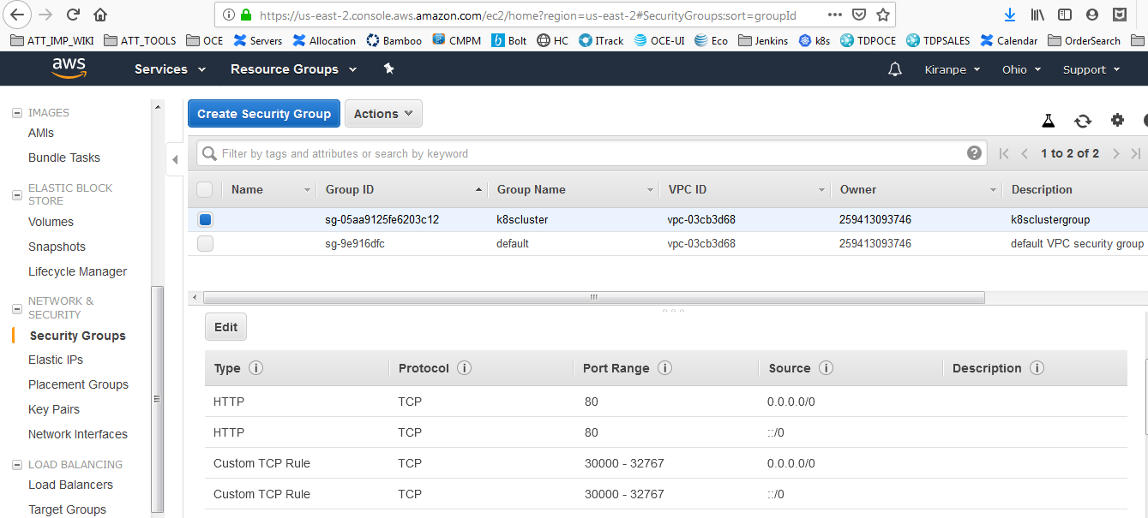

Slide 8
Installing AWS CLI Using pip:
The common way to install AWS CLI is using pip. pip is a package management system which is used to install and manage software packages written in Python.
Step 1: Install pip (on Ubuntu OS)
sudo apt install python3-pip
pip install awscli --upgrade –user
step 2: Install aws cli
sudo apt-get install awscli
Step 3: Check installation
aws --version
result: aws-cli/1.16.247 Python/3.7.3 Linux/5.0.0-31-generic botocore/1.12.237
Configure AWS CLI
Step 5: Use the below command to configure AWS CLI (Details will be in Downloaded CSV file)
aws configure
AWS Access Key ID [None]: AKI************
AWS Secret Access Key [None]: wJalr********
Default region name [None]: us-east-2
Default output format [None]:
you can see your credential here: cat ~/.aws/credentials

Slide 9
Git:
Git is a free and open source distributed version control system designed to handle everything from small to very large projects with speed and efficiency.
Git is easy to learn and has a tiny footprint with lightning fast performance. It outclasses SCM tools like Subversion, CVS, Perforce, and ClearCase with features like cheap local branching, convenient staging areas, and multiple workflows.
Installation:
In Ubuntu Git installation is very easy.
→ sudo apt-get install git
You need a git hub account. You can get one here https://github.com

Slide 10
Jenkins:
What is Jenkins?
→ Jenkins is an open source Continuous Integration server capable of orchestrating a chain of actions that help to achieve the Continuous Integration process in an automated fashion.
→ Jenkins is free and is entirely written in Java.
Installation:
Create id_rsa key in your Local Ubuntu System by using ssh-keygen
→ ssh-keygen -t rsa (No Password) (Automated)
Clone Git repo : git clone https://github.com/kiranpe/DevOpsCloud.git
Download Java jdk(jdk-xxx-linux-x64.tar.gz) and Apache maven(apache-maven-x.x.x-bin.tar.gz) tar files and keep them inside “K8S-Terraform/Jenkins-Terraform” folder.
Now Go to Jenkins-Terraform folder and run terraform commands. For more commands check in terraform-setup file).
terraform init → Download all required files including provider details
terraform plan → Shows what is going to create
terraform apply →apply what ever shows in the plan and creates instance
terraform destroy → terminate instance(use when you wants to terminate instance)

Slide 11
Once you run the terraform apply, terraform reads jenkins-terraform.tf file and create instance based on the file configuration.
jenkins-terraform.tf:
--------------------------
This file launches the t2.micro EC2 instance and install the Ansible, Java, Jenkins and Maven.
More info is available in README.md file inside Jenkins-Terraform folder.
Once Jenkins Server installation is complete, ssh to jenkins box and do the below set up.
Generate rsa key to ssh to K8S instances(Deployment purpose)
→ sudo su - jenkins (do it as jenkins user.. ) (Automated)
→ ssh-keygen -t rsa (No Password) (Automated)
AWS CLI (Required when doing k8s set up using jenkins)
→ aws configure
Docker Login (must)
→sudo docker login

Slide 12
Maven:
What is Maven?
Apache Maven is a software project management and comprehension tool. Based on the concept of a project object model (POM), Maven can manage a project's build, reporting and documentation from a central piece of information.
Installation:
Maven Installation is part of Java installation yaml file.
Files are available in “K8S-Terraform/Jenkins-Terraform” folder.
Note: Please go through online tutorials to understand Maven better.

Slide 13
Nexus3:
What is Nexus?
Nexus is a repository manager. It allows you to proxy, collect, and manage your dependencies so that you are not constantly juggling a collection of JARs. It makes it easy to distribute your software. Internally, you configure your build to publish artifacts to Nexus and they then become available to other developers. You get the benefits of having your own 'central', and there is no easier way to collaborate.
Installation:
Go to Nexus3 folder and you can see two files there.
Terraform file creates the instance on AWS Cloud and nexus yaml file pull the nexus3 docker image and runs the image and creates nexus volume under “/sites/nexus-data”.
you can find nexus admin password under this folder and logs as well.
settings.xml:
→ Create deployment user in nexus or else use your logins in settings.xml.
→ SSH to jenkins server and sudo as jenkins user
→ sudo su – jenkins
→ cd .m2
Update logins in .m2/settings.xml..

Slide 14
K8S:
What is Kubernetes?
→ Kubernetes is a portable, extensible, open-source platform for managing containerized workloads and services, that facilitates both declarative configuration and automation.
→ It has a large, rapidly growing ecosystem.
→ Kubernetes services, support, and tools are widely available.
Installation:
→ Go to “K8S-Terraform/SingleNode-K8S-Terraform/” folder and Simply run below commands.
terraform init
terraform plan
terraform apply -auto-approve
Terraform file will launch two EC2 instances and creates the master node and worker node and install the K8S in both nodes and join the worker node with master node.
You can do Multinode set up also. Files are under MultiNode-K8S-Terraform. Set up is same but it will launch two worker nodes.
More Info is available in README.md file.

Slide 15
Docker:
What is Docker?
Docker is a tool designed to make it easier to create, deploy, and run applications by using containers. Containers allow to package up an application with all of the parts it needs, such as libraries and other dependencies, and ship it all out as one package.
Installation:
Docker installation is part of K8S installation yaml file. Below are the steps for manual installation.
→ curl -fsSL https://download.docker.com/linux/ubuntu/gpg | sudo apt-key add -
→ sudo add-apt-repository "deb [arch=amd64] https://download.docker.com/linux/ubuntu $(lsb_release -cs) stable"
→ sudo apt-get update
→ sudo apt-get install -y docker-ce
→ sudo systemctl status docker
→ sudo usermod -aG docker ${USER}
→ newgrp docker --> to run commands as docker user

Slide 16
Ansible:
Ansible is an open source IT Configuration Management, Deployment & Orchestration tool. It aims to provide
large productivity gains to a wide variety of automation challenges. This tool is very simple to use yet powerful enough to automate complex multi-tier IT application environments.
→ Ansible is a helpful tool that allows you to create groups of machines, describe how these machines should be configured or what actions should be taken on them. Ansible issues all commands from a central location to perform these tasks.
→ No other client software is installed on the node machines. It uses SSH to connect to the nodes. Ansible only needs to be installed on the control machine (the machine from which you will be running commands) which can even be your laptop. It is a simple solution to a complicated problem.
Ansible Terms:
Controller Machine: The machine where Ansible is installed, responsible for running the provisioning on the servers you are managing.
Inventory: An initialization file that contains information about the servers you are managing.
Playbook: The entry point for Ansible provisioning, where the automation is defined through tasks using YAML format.
Task: A block that defines a single procedure to be executed, e.g. Install a package.
Module: A module typically abstracts a system task, like dealing with packages or creating and changing files. Ansible has a multitude of built-in modules, but you can also create custom ones.
Role: A pre-defined way for organizing playbooks and other files in order to facilitate sharing and reusing portions of a provisioning.
Play: A provisioning executed from start to finish is called a play. In simple words, execution of a playbook is called a play.
Facts: Global variables containing information about the system, like network interfaces or operating system.
Handlers: Used to trigger service status changes, like restarting or stopping a service.

Slide 17
Advantages Of Using Ansible:
Simple: Ansible uses a simple syntax written in YAML called playbooks. YAML is a human-readable data serialization language. It is extraordinarily simple. So, no special coding skills are required and even people in your IT organization, who do not know what is Ansible can likely read a playbook and understand what is happening. Ansible always executes tasks in order. It is simple to install too.
Agentless: Ansible is completely agentless. There are no agents/software or additional firewall ports that you need to install on the client systems or hosts which you want to automate. You do not have to separately set up a management infrastructure which includes managing your entire systems, network and storage.
Efficient: No extra software on your servers means more resources for your applications. Also, since Ansible modules work via JSON, Ansible is extensible with modules written in a programming language you already know.

Slide 18
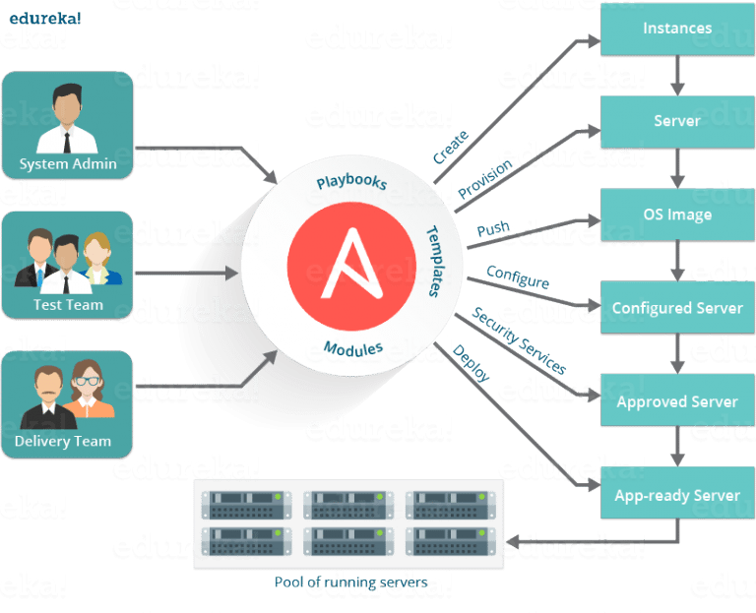
Ansible in DevOps

Slide 19
Maven Project:
Once your Infrastructure is ready, then create job in Jenkins using maven-project git repo.
Repo: https://github.com/kiranpe/maven-project.git
→ Update pom.xml distribution management with Nexus3 ip details.
→ Add maven build step with "clean deploy"
→ Add below commands to jenkins execute shell in build steps
#Checking Docker image Quality before deploying to k8s
ansible-playbook docker-image.yaml
#Deploying image on K8S
cd "$WORKSPACE"/ymlfiles/
#push rsa key to master node
ansible-playbook push_rsa_key.yaml -i hosts --private-key /sites/keyfile.pem
#Deploy image
ansible-playbook webapp.yaml -i hosts
Note: Don’t forgot to update hosts file with K8S cluster IP’s and pom.xml with Nexus3 IP.
→More Info is available in README.md file.

Slide 20
All In One File:
Created Single file to launch EC2 instances using Terraform and install all the required Tools.
Before using it better to understand the concepts first. Try manual set up first and then use ansible to automate infrastructure and then use Terraform to automate everything.
Terraform File is available in “AllInOneFile” Folder.

Slide 21
Local host Setup:
Automated local system setup using Ansible. Files are available in localhost-setup folder. While running below playbooks it will ask your login details.
Installation Terraform and Docker:
Run playbook:
-----------------------
ansible-playbook install-terraform-docker.yaml --extra-vars "ansible_sudo_pass=yourPassword ansible_python_interpreter=/usr/bin/python3"
Install Awscli:
Run Playbook:
--------------------------
ansible-playbook awscli-configure.yaml --extra-vars "ansible_sudo_pass=yourPassword ansible_python_interpreter=/usr/bin/python3"

