Slide 1
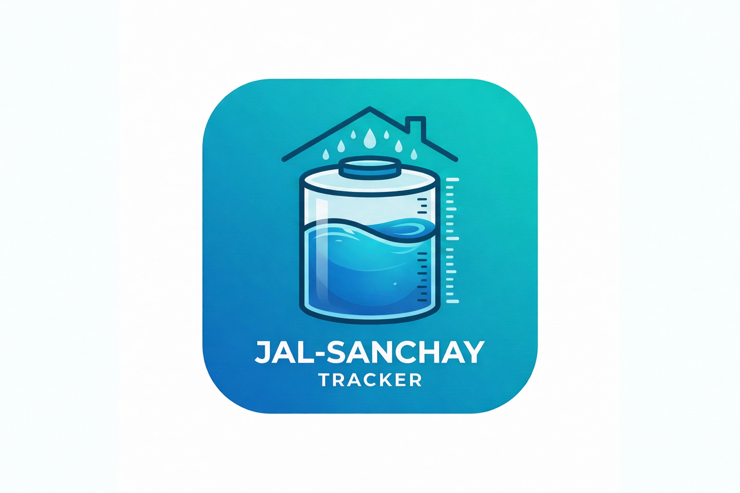
Internship Phase - 2 Presentation
(22INT)
Internship Title: Android App Development using Gen AI
Project: Jal-Sanchay Tracker
Company: MindMatrix
Name: Update Student Name
USN: Update USN
Branch: Computer Science & Engineering
Course: Android App Development using Gen AI
Internship Guide
Update Guide Name
Associate Professor
Department of CSE
MCE, Hassan

Slide 2
MindMatrix VTU
Jal-Sanchay
Rainwater Tracker
for Households
Android App Development using GenAI
Natural Resources Track
PROJECT #86
MindMatrix VTU Internship Program

Slide 3
THE PROBLEM
Why Water Saving Stays Invisible
1
2
3
No Measurement
No Historical Record
Low Awareness
Many households collect rainwater but do not know how much water is actually saved after each rainfall.
Rainfall is rarely stored in a structured way, so monthly and all-time conservation becomes hard to review.
Without a clear dashboard, tank progress, and impact score, conservation remains hard to explain or improve.
Slide 2 of 8

Slide 4
THE VISION
Core Value
Jal-Sanchay
1
Save Setup
Roof area, tank capacity, and roof material
A Household Rainwater App
for Everyday Tracking
2
Enter Rainfall
Record rainfall values with validation
Jal-Sanchay Tracker is a mobile application that helps households save setup details, record rainfall, estimate harvested water, and understand the real-life impact of conservation through a clean guided flow.
3
Track Dashboard
See saved litres, tank progress, and history
4
Measure Impact
Convert litres into household water-day meaning
Slide 3 of 8

Slide 5
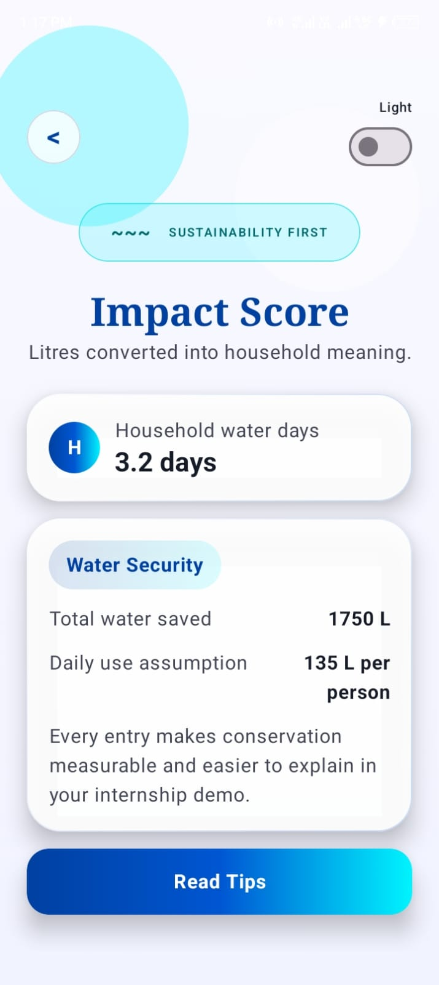
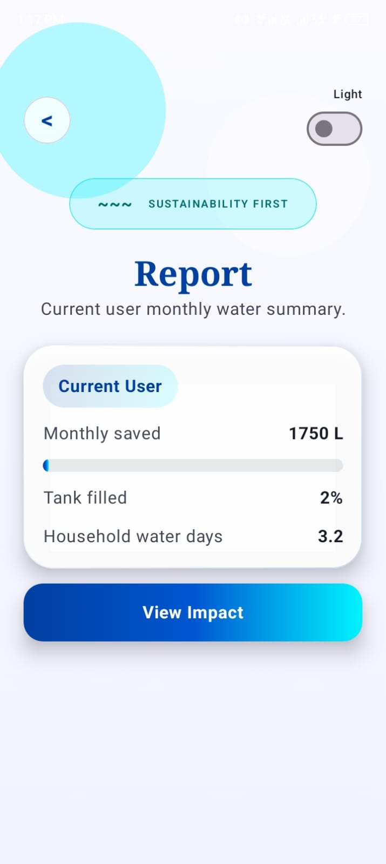
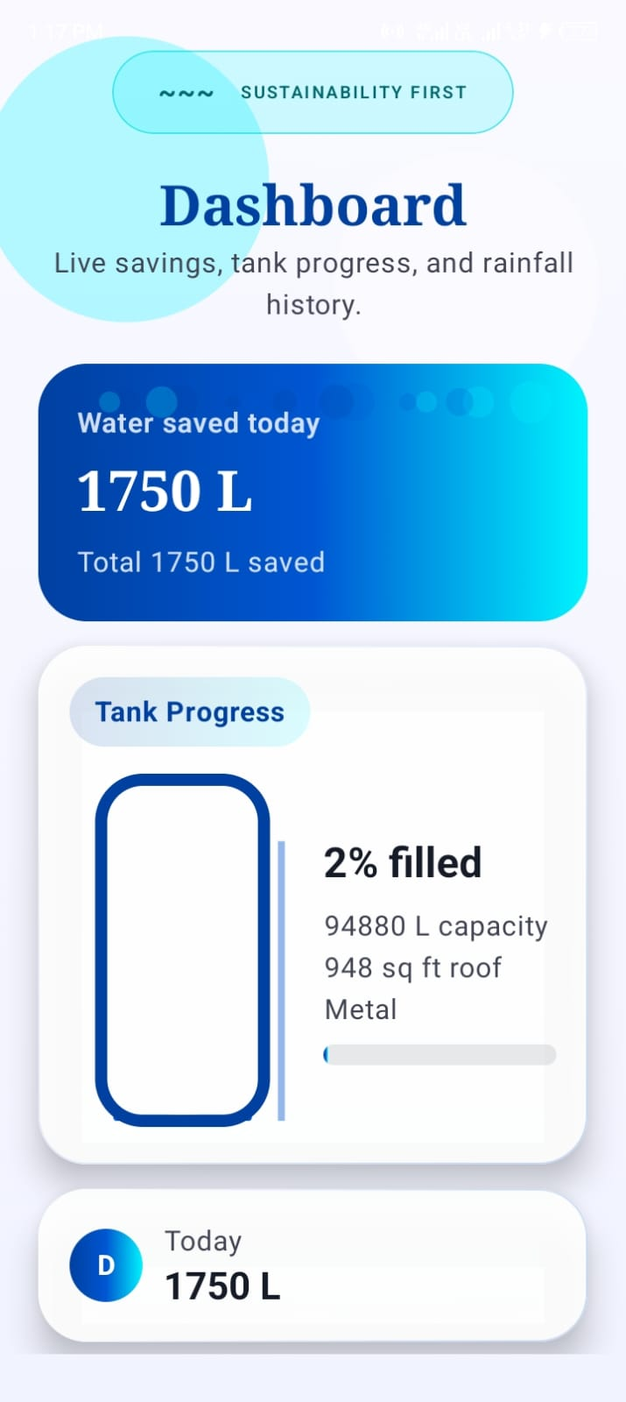
APP SCREENS
Guided User Flow - Part 1
Welcome Screen
Setup Screen
Data Entry Screen
Slide 4 of 8

Slide 6
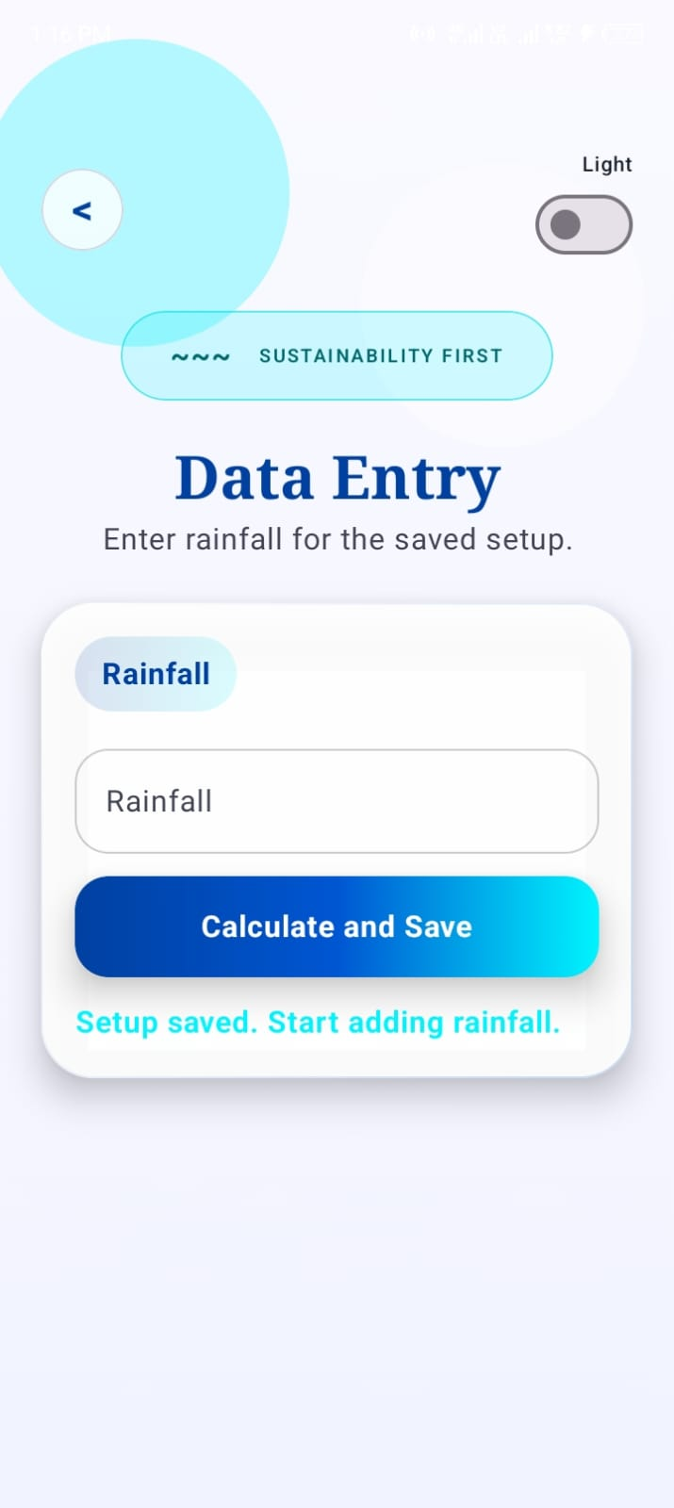
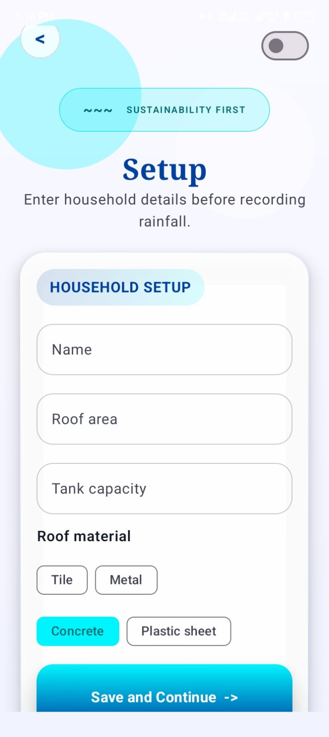
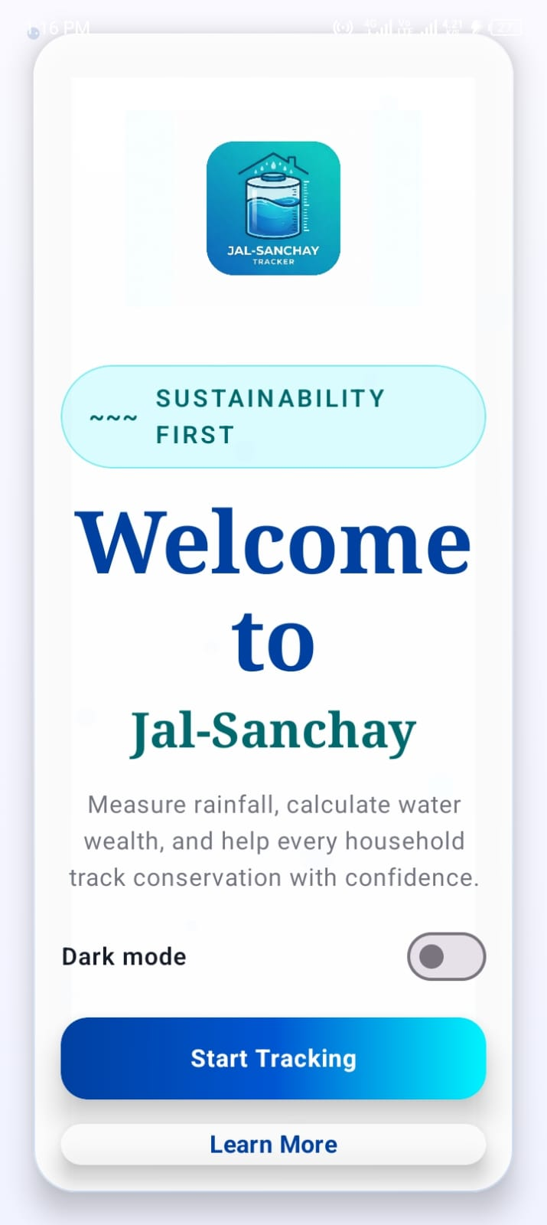
APP SCREENS
Guided User Flow - Part 2
Dashboard
Report
Impact Score
Slide 5 of 8

Slide 7
TECHNICAL IMPLEMENTATION
How We Build It
Android (Kotlin + Compose)
Room Database
-> Single-activity flow with polished Compose screens
-> Store user_infrastructure and rainfall_log tables
-> Guided navigation from Welcome to Tips
-> Save historical rainfall entries locally
-> Reusable UI cards, buttons, and tank visual
-> Support monthly report and offline persistence
Reactive State Updates
Water Calculation Logic
-> DAO queries expose Flow for live database changes
-> Rainfall, roof area, and runoff behavior estimate saved litres
-> ViewModel uses StateFlow for screen state
-> Tank percentage and household days are derived values
-> Compose recomposes dashboard and tank in real time
-> Impact screen explains the conservation result clearly
Slide 6 of 8

Slide 8
IMPACT GOALS
Why This Matters
1
2
3
4
Water Awareness
Household Tracking
Concept Clarity
Sustainability
Makes Saving Visible
Builds Better Habits
Explains Impact
Encourages Action
The app turns rainfall into visible litres, tank progress, and report data that users can understand quickly.
Historical entries and monthly summaries help families review how much rainwater harvesting is really contributing.
Impact score converts saved litres into household water days, making conservation easier to explain in demos and reports.
A clean and friendly mobile experience motivates regular entry of rainfall data and stronger long-term water awareness.
Slide 7 of 8

Slide 9
SUCCESS CRITERIA
Future Scope
What Makes Jal-Sanchay
Demo Ready
Live weather API integration
Charts for rainfall analytics
- Guided flow: Welcome -> Setup -> Data Entry -> Dashboard -> Report -> Impact -> Tips
Cloud sync and backup
- Rainfall history stored and retrieved through Room Database
Regional language support
- Dashboard updates live using Flow, StateFlow, and Compose recomposition
Smart reminders for rainfall entry
- Water tank progress and household impact shown visually
Measure every drop.
Explain every saving.
- Clean branded UI using the blue and aqua app theme
- Ready for internship presentation and database demonstration
Slide 8 of 8

