Slide 1
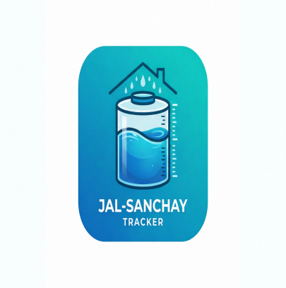
DEPARTMENT OF ISE, HASSAN
Malnad College of Engineering
(An Autonomous Institute Affiliated to VTU, Belagavi)
HASSAN, KARNATAKA 573202, INDIA
Computer Science and Engineering
MINI PROJECT
"JAL-SANCHAY TRACKER"
Update Student 1 (USN)
Update Student 2 (USN)
Update Student 3 (USN)
Update Student 4 (USN)
Under the guidance of
Project Guide
( Update Name )
Department of Computer Science and Engineering

Slide 2
Contents:
Abstract
Aim
Introduction
Problem Statement
Objectives
Features
Literature Survey
Database Design
Software Requirements
Hardware Requirements
Screens
Conclusion
References

Slide 3
Abstract:
Jal-Sanchay Tracker is an Android application developed to help households measure the effectiveness of rainwater harvesting using a simple guided flow. The app is built with Kotlin and Jetpack Compose for the user interface, Room Database for local storage, Hilt for dependency injection, and MVVM for clean architecture. Users first complete a household setup, then enter rainfall values in millimeters. Based on the roof area, tank capacity, and roof material, the app estimates harvested water and presents the result through a live dashboard, tank progress visual, report, impact view, and water-saving tips. The application stores historical rainfall entries locally and updates the dashboard in real time using Room Flow, StateFlow, and Compose recomposition.

Slide 4
Aim:
To design and implement a user-friendly Android application that helps households record rainfall, estimate harvested water, track storage progress, and understand the practical impact of rainwater conservation.
Guided Android flow
Modern Compose UI
Rainfall data validation
Water saving calculation
Room database history
Dashboard and impact tracking

Slide 5
INTRODUCTION:
Jal-Sanchay Tracker is a sustainability-focused Android application created to make rainwater harvesting measurable and understandable for everyday users. The app provides a guided journey from setup to rainfall entry, dashboard monitoring, reporting, impact calculation, and practical tips. It is developed using Kotlin, Jetpack Compose, Room Database, Hilt, Coroutines, and MVVM architecture. By storing setup and rainfall data locally and reacting to changes in real time, the app helps users see how much water has been saved, how full their storage tank is, and how many household water days that saving represents. This improves awareness, encourages conservation habits, and makes rainwater harvesting more actionable.

Slide 6
Problem Statement:
Many households have rainwater harvesting systems but no simple way to measure whether they are actually effective. Without a clear record of rainfall, roof catchment, and stored water, conservation stays conceptual instead of practical. Manual tracking is inconsistent, calculations are often skipped, and users rarely understand how rainfall translates into daily household impact. In addition, most users need a clean and easy interface rather than a technical system. A mobile application is therefore required to store historical rainfall data, estimate water savings automatically, and present the result through clear visuals such as tank progress, reports, and impact views.

Slide 7
Simple Setup Allow the user to save household details like roof area and tank capacity. Rainfall Entry Record rainfall values with validation and local storage. Live Dashboard Show water saved, recent entries, and animated tank progress. Monthly Report Summarize total and monthly harvested water clearly. Impact Score Convert litres into understandable household water days. User Guidance Provide practical tips for better rainwater harvesting.
OBJECTIVES:

Slide 8
FEATURES:
The application is designed to reduce manual effort and provide meaningful household water insights through a guided Android experience. Major features include:
Welcome Screen
Branded entry screen for a guided user experience.
Household Setup
Stores name, roof area, tank capacity, and roof material.
Rainfall Calculation
Converts rainfall into estimated saved water.
Room Database
Stores historical entries locally on the device.
Live Dashboard
Updates tank progress and summaries in real time.
Report and Impact
Shows monthly totals and household water-day impact.
Tips Section
Encourages better conservation practices.

Slide 9
Literature Survey:
No | Title (Short) | Author(s) | Year | Key Focus | Conclusion
1 | Urban Rainwater Harvesting | A. Campisano et al. | 2017 | Domestic rainwater reuse systems | Monitoring and storage design improve household water efficiency
2 | Rainwater Quality and Use | M. S. Islam et al. | 2010 | Usability of rooftop-harvested rainwater | Proper collection and storage make rainwater a valuable local resource
3 | Smart Water Monitoring | R. K. Kodali et al. | 2018 | IoT-based water level and usage tracking | Real-time tracking increases awareness and better decision-making
4 | Sustainable Urban Water Systems | M. Sharma, P. Kansal | 2013 | Rainwater harvesting in Indian cities | Local harvesting supports sustainability and reduces dependency on municipal supply
5 | Decision Support for Harvesting | J. Liaw, Y. Tsai | 2004 | Storage sizing and rainfall data use | Historical rainfall analysis is essential for effective harvesting systems
6 | Household Conservation Behaviour | S. Willis et al. | 2011 | How feedback changes water use | Visible usage feedback encourages long-term conservation habits

Slide 10
Database Design:
user_infrastructure
Name / user id
Roof area
Tank capacity
Roof material
rainfall_log
Rainfall (mm)
Saved litres
Timestamp
Historical entries
monthly_report_cache
Monthly totals
Cached reporting values
app_settings
Theme / settings
App-level preferences
Room Database is used for local persistence in the application. The user_infrastructure table stores household setup details, while rainfall_log stores each rainfall entry as a historical record. Monthly summaries are supported through monthly_report_cache, and internal preferences can be stored in app_settings. DAO queries expose Flow-based streams so the dashboard updates automatically when new rainfall data is inserted.

Slide 11
System Requirements:
Software Requirements
1. Programming Language:
Kotlin
2. UI Toolkit:
Jetpack Compose, Material 3
3. Database:
Room Database (SQLite)
4. Architecture / Libraries:
Hilt, Coroutines, StateFlow, MVVM
5. Development Tools:
Android Studio, Gradle, Android SDK

Slide 12
System Requirements: Hardware Requirements
Developer System:
Processor: Intel i3 / i5 / Ryzen equivalent or above
RAM: Minimum 8 GB recommended
Storage: At least 2 GB free for Android Studio, SDK, and project files
Android Test Device:
Android version: 7.0 (API 24) or above
RAM: 3 GB or higher recommended
Storage: Minimum 200 MB free for app install and local database
Display: Standard phone screen for testing responsive Compose UI

Slide 13
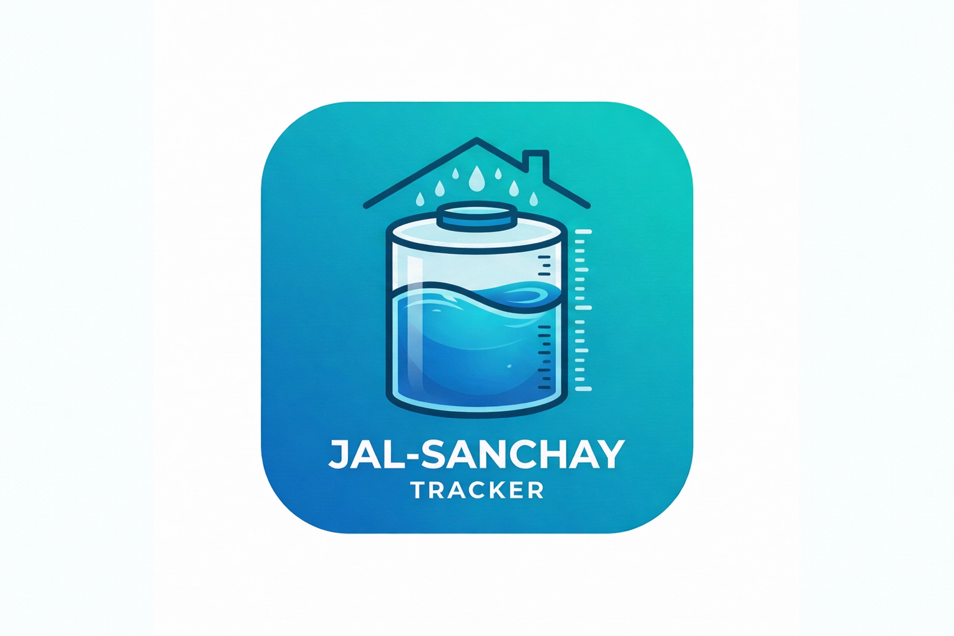
Welcome Page
Setup Page
Dashboard / Report
Impact / Tips

Slide 14
CONCLUSION:
Jal-Sanchay Tracker successfully demonstrates how an Android application can turn rainwater harvesting into a measurable and user-friendly household activity. By combining setup data, rainfall entry, local Room storage, and a reactive Jetpack Compose dashboard, the system gives users clear feedback about litres saved, tank progress, and household impact. The project also highlights good Android development practices through MVVM architecture, Hilt dependency injection, validation logic, and real-time state updates using Flow and StateFlow. Overall, the application promotes sustainability awareness while serving as a strong internship-level implementation of Kotlin Android development.

Slide 15
REFERENCES:
1. Android Developers Documentation - Jetpack Compose
2. Android Developers Documentation - Room Persistence Library
3. Android Developers Documentation - Hilt and dependency injection
4. Research articles on rainwater harvesting and household water conservation
5. Project requirement brief for Jal-Sanchay Tracker

