Slide 1

DEPARTMENT OF ISE, HASSAN
Malnad College of Engineering
(An Autonomous Institute Affiliated to VTU, Belagavi)
HASSAN, KARNATAKA 573202, INDIA
Computer Science and Engineering
MINI PROJECT (22CS604)
“EVENT MANAGEMENT SYSTEM”
Gagan H N (4MC22CS045)
H N Tanisha Jain (4MC22CS055)
Himanth K R (4MC22CS064)
Kiran P S (4MC22CS082)
Under the guidance of
Dr. Ramesh B
( Professor )
Department of Computer Science and Engineering

Slide 2
Contents:
Abstract
Aim
Introduction
Problem Statement
Objectives
Features
ER Diagram
Hardware and Software Requirements
Conclusion
References

Slide 3
Abstract:
The Event Management System is a comprehensive web-based application designed to simplify and automate the registration and management of college events. By integrating HTML, CSS, and JavaScript for the frontend with Google Apps Script and Google Spreadsheets as the backend.
One of the primary challenges in managing college events is ensuring a smooth registration process while maintaining accurate records. This system addresses that challenge by incorporating an OTP (One-Time Password) verification feature for secure login.
Once logged in, participants are greeted with a clean and intuitive registration form. The system's autofill functionality is one of its standout features. By simply entering their name, students can have their USN (University Serial Number) and branch automatically fetched from the backend.

Slide 4
Aim:
To design and implement an efficient, user-friendly system that allows students for easy registration and organizers to efficiently handle large amount of participant data
Automated Registration Process
Secure Authentication
Autofill Functionality
Duplicate Entry Prevention
Event opportunity and limt enforcement
Admin panel management

Slide 5
INTRODUCTION:
The Event Management System is a web-based application designed to streamline the registration and management of college events. Developed using HTML, CSS, and JavaScript for the frontend and integrated with Google Apps Script and Google Spreadsheets for the backend, it ensures a seamless experience for both participants and event organizers.
The system features a secure login with OTP verification for authorized access.
Upon entering their name, participants benefit from an autofill functionality that retrieves their USN and branch from the database, reducing manual errors. It also includes real-time validation to prevent duplicate entries and ensures adherence to event and opportunity limits.
Event managers can access an intuitive admin panel to filter and view participant lists by event and branch. This efficient, user-friendly solution enhances transparency, reduces administrative workload, and ensures fair participation.

Slide 6
Problem Statement:
Managing college events using traditional methods like paper forms or spreadsheets is inefficient and prone to errors. Participants often face delays during registration, while organizers struggle to maintain accurate records. Without a streamlined system, verifying participant details, preventing duplicate entries, and ensuring compliance with event limits become challenging.
Additionally, a lack of secure authentication poses risks of unauthorized access and data manipulation. Event managers often rely on manual processes to track registrations, making it difficult to monitor participation across different events and branches. This results in confusion, mismanagement, and increased administrative workload.
The absence of a centralized platform also limits the ability to access and analyze participant data in real-time, making event coordination inefficient. To address these challenges, an automated system is required to ensure accurate data management, secure access, and effective event monitoring.

Slide 7
Simple Registration User-friendly online form for quick and error-free event registration.
OTP Authentication Secure login using OTP to restrict access to authorized users only.
Autofill Details Auto-fetch USN and branch from Google Sheets by entering participant name.
No Duplicates Real-time checks to block duplicate registrations for the same event.
Limit Enforcement Restricts the number of events per participant to ensure fair chances.
Admin Dashboard Admins can view, filter, and manage data by event and branch easily.
OBJECTIVES:

Slide 8
FEATURES:
This system will significantly minimize human efforts, and offer real-time data access to organizers.
It also supports features like:
OTP Login Secure login with OTP to block unauthorized access.
Autofill Details Auto-fetch USN and branch by entering the participant’s name.
Easy Event Registration Simple form with event dropdown for quick selection.
No Duplicate Entries Real-time checks to stop multiple entries for the same event.
Limit on Participation Restricts how many events a student can join to keep it fair.
Admin Panel Admins can filter and manage registrations by event and branch.
Google Sheets Backend All data saved in Google Sheets with live updates and easy access.

Slide 9
Literature Survey:
No | Title (Short) | Author(s) | Year | Key Focus | Conclusion
1 | Online Ticketing Adoption (Indonesia) | Indrawati et al | 2015 | Adoption factors for web-based ticketing | Improving service quality boosts online usage
2 | Reservation-Only Commuting | Ryo Takagi | 2017 | Flexible, reservation-based rail system | Dynamic seat reassignment reduces congestion
3 | Real-Time Ticketing (India) | Chatterjee et al. | 2018 | Dynamic seat allocation and live charting | Increases flexibility and efficiency for users
4 | Unified Booking App (Romania) | Scarişoreanu | 2019 | App for rail and road ticket booking | Centralized access simplifies ticketing
5 | Auction Tatkal Scheme (India) | Mukhopadhyay et al. | 2016 | Emergency ticket bidding system | Prioritizes urgency, optimizes ticket allocation
6 | Smart Metro App (Bangladesh) | Alam, Siddique | 2022 | QR-based ticketing, destination alerts | Enhances commuter experience via automation

Slide 10
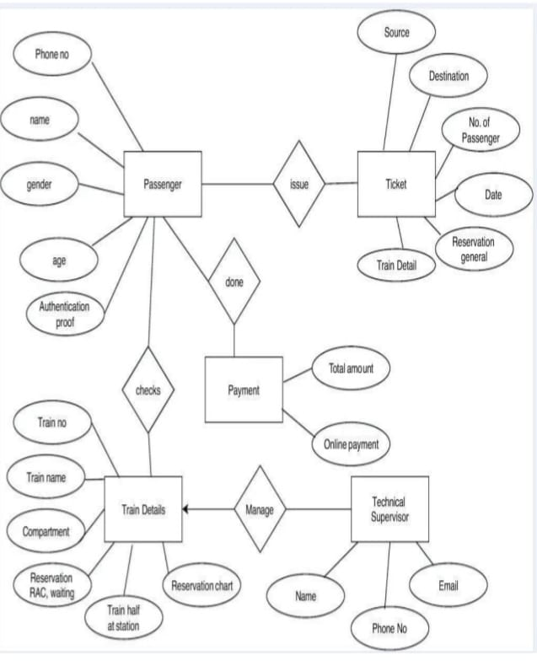
ER Diagram:
The diagram shows how different entities interact in the railway reservation system. It defines the relationships between Passenger, Ticket, Payment, Train Details, and Technical Supervisor.
• Entities: Such as Passenger, Ticket, Payment, admin, Train Details, and Technical Supervisor
• Support Tables: Like Passenger Table, Ticket Table, for content and communication.

Slide 11
System Requirements:
Software Requirements
1.Frontend Technologies:
HTML, CSS, JavaScript
2.Backend Technologies:
Google spreadsheets
3.Development Tools:
Code Editor: Google appscript
4.Server & Deployment:
Google Drive
\

Slide 12
System Requirements: Hardware Requirements
Server Requirements:
Processor: Intel i5/i7(or Ryzen5/7) or equivalent
RAM: Minimum 4GB (Recommended 16GB for scalability)
Storage: Minimum 250GB SSD (Recommended 500GB SSD)
Network: High-speed internet connection for online access
Client-Side Requirements (User Devices):
Processor: Intel i3(or Ryzen3) or above
RAM: 4GB or higher
Storage: Minimum 100GB HDD/SSD
Display: 1366x768 resolution or higher

Slide 13
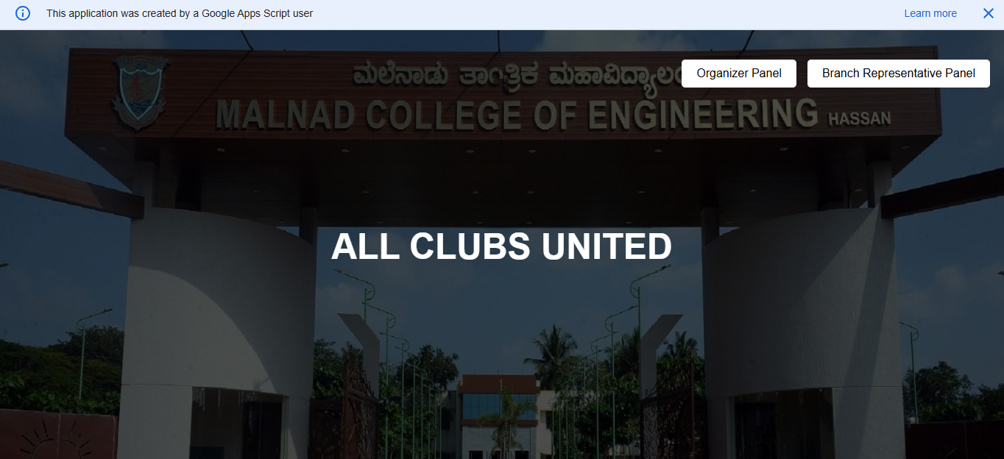
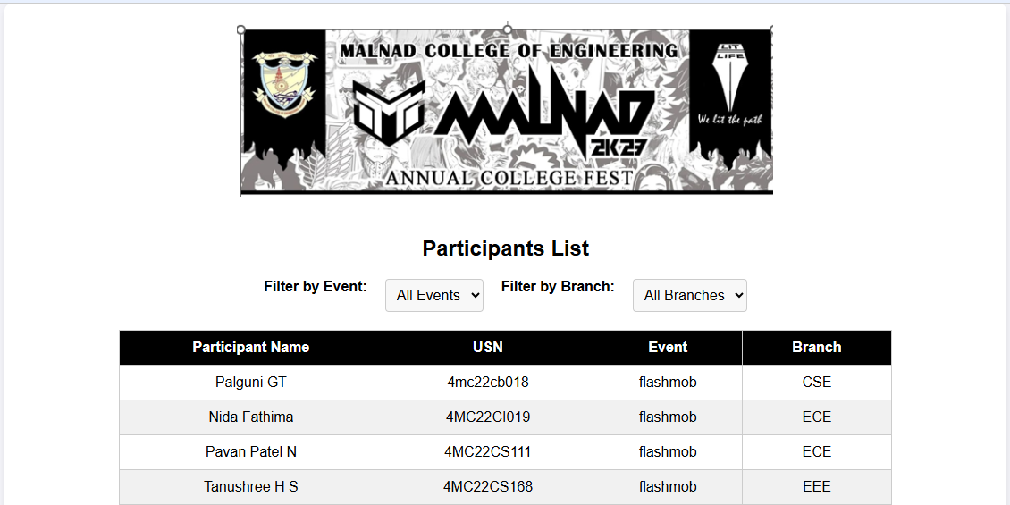


Home Page
Organizer Page
Participant Login Page
Organizer login Page

Slide 14
CONCLUSION:
The Event Management System successfully addresses the core challenges associated with organizing and managing college events by offering a secure, automated, and user-friendly platform. Through OTP-based authentication, intelligent autofill, real-time validation, and round-wise participant filtering, the system ensures accurate data entry, prevents duplicate registrations, and promotes fair participation. The integration of Google Apps Script with Google Spreadsheets provides a cost-effective and scalable backend, eliminating the need for complex infrastructure.
Event organizers benefit from a powerful admin panel that enables seamless monitoring and decision-making, while Branch Representatives can quickly and accurately register participants. Overall, the system enhances transparency, reduces administrative workload, and improves the overall event coordination experience, making it an ideal solution for academic institutions seeking a modern approach to event management.

Slide 15


