Slide 1











Ideal Filters
One of the reasons why we design a filter is to remove disturbances
SIGNAL
Filter
NOISE
We discriminate between signal and noise in terms of the frequency spectrum

Slide 2


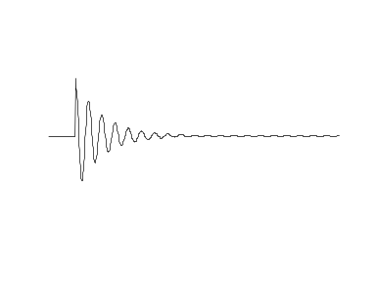
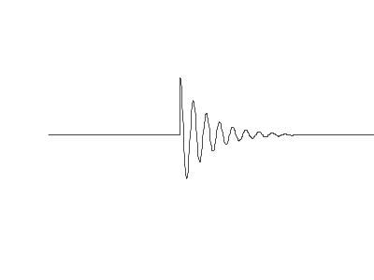

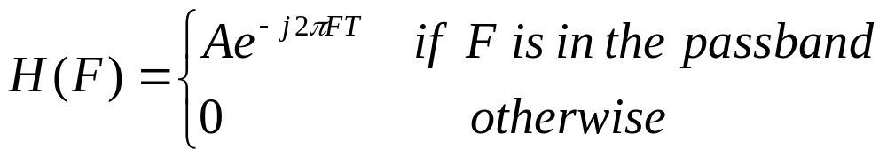


Conditions for Non-Distortion
Problem: ideally we do not want the filter to distort the signal we want to recover.
Same shape as s(t), just scaled and delayed.
IDEAL
FILTER
Consequence on the Frequency Response:
constant
linear

Slide 3





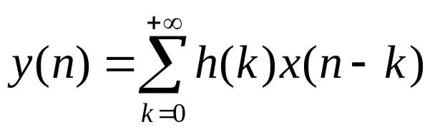
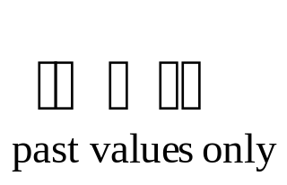
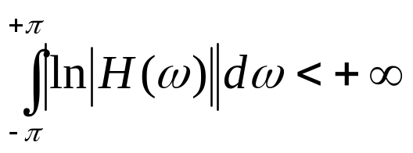




For real time implementation we also want the filter to be causal, ie.
since
FACT (Bad News!): by the Paley-Wiener Theorem, if h(n) is causal and with finite energy,
ie cannot be zero on an interval, therefore it cannot be ideal.

Slide 4



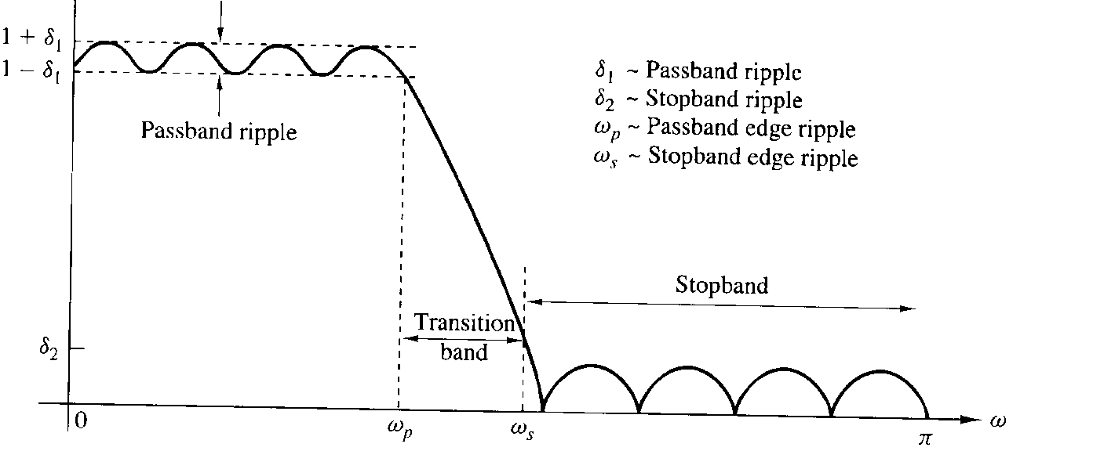
Characteristics of Non Ideal Digital Filters
IDEAL
Positive freq. only
NON IDEAL

Slide 5
Two Classes of Digital Filters:
a) Finite Impulse Response (FIR), non recursive, of the form
With N being the order of the filter.
Advantages: always stable, the phase can be made exactly linear, we can approximate any filter we want;
Disadvantages: we need a lot of coefficients (N large) for good performance;
b) Infinite Impulse Response (IIR), recursive, of the form
Advantages: very selective with a few coefficients;
Disadvantages: non necessarily stable, non linear phase.

Slide 6



Finite Impulse Response (FIR) Filters
Definition: a filter whose impulse response has finite duration.

Slide 7


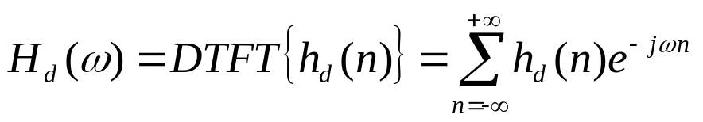
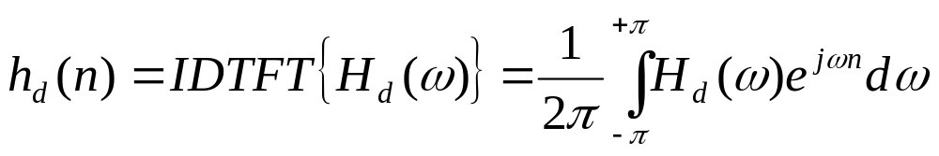
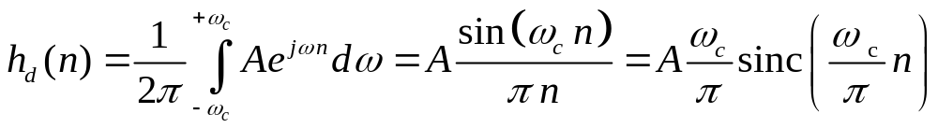


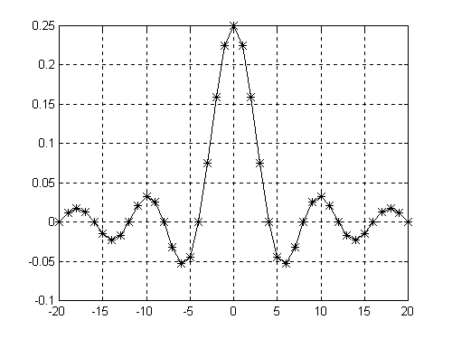

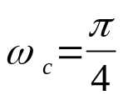






Problem: Given a desired Frequency Response of the filter, determine the impulse response .
Recall: we relate the Frequency Response and the Impulse Response by the DTFT:
Example: Ideal Low Pass Filter
DTFT

Slide 8



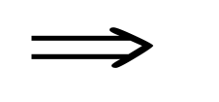

Notice two facts:
the filter is not causal, i.e. the impulse response h(n) is non zero for n<0;
the impulse response has infinite duration.
This is not just a coincidence. In general the following can be shown:
If a filter is causal then
the frequency response cannot be zero on an interval;
magnitude and phase are not independent, i.e. they cannot be specified arbitrarily
As a consequence: an ideal filter cannot be causal.

Slide 9

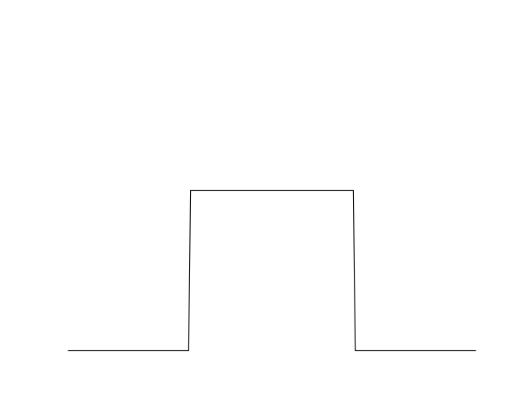
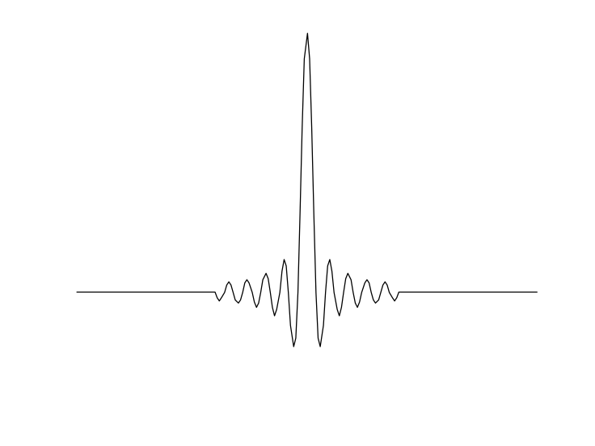


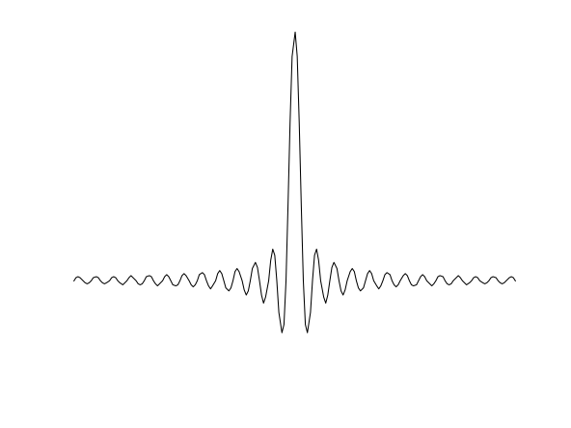



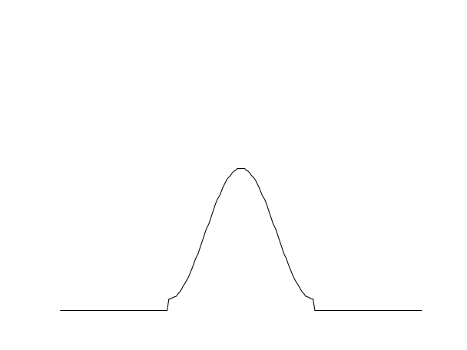

Problem: we want to determine a causal Finite Impulse Response (FIR) approximation of the ideal filter.
rectangular window
We do this by
a) Windowing
hamming window
infinite impulse response
(ideal)
finite impulse response

Slide 10


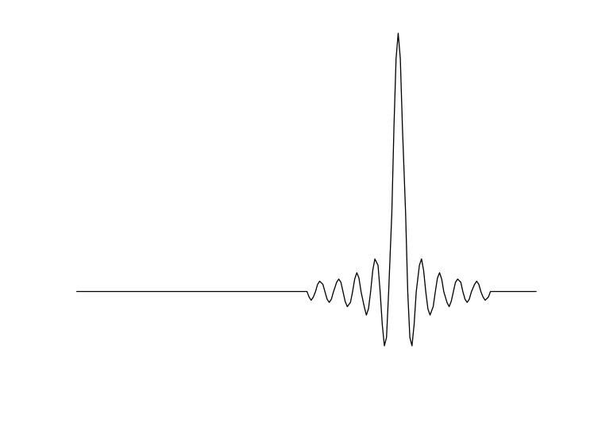
b) Shifting in time, to make it causal:

Slide 11
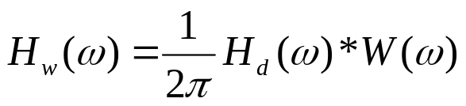



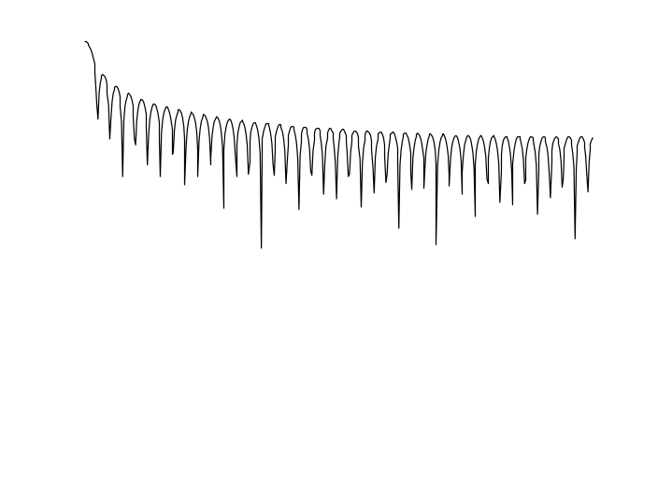
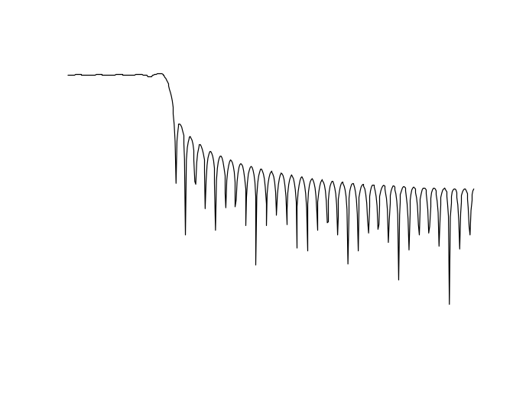





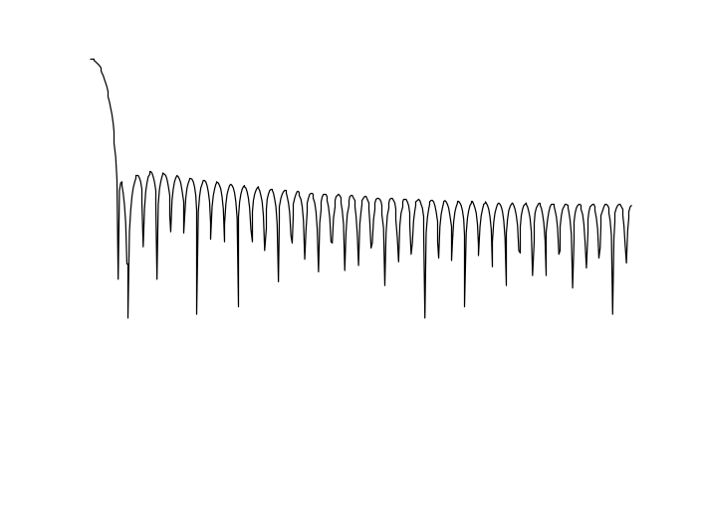
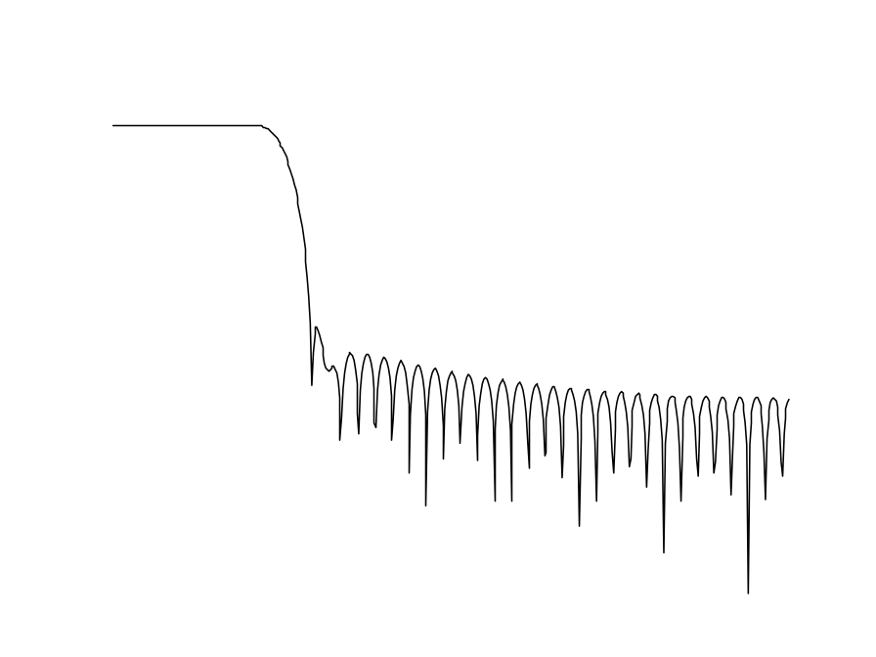
Effects of windowing and shifting on the frequency response of the filter:
a) Windowing: since then
rectangular window
hamming window

Slide 12









For different windows we have different values of the transition region and the attenuation in the stopband:
Rectangular -13dB
Bartlett -27dB
Hanning -32dB
Hamming -43dB
Blackman -58dB
attenuation
with
transition region

Slide 13
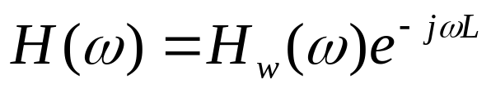

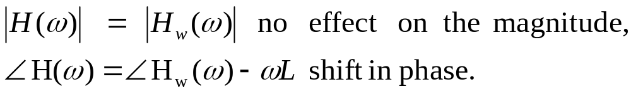


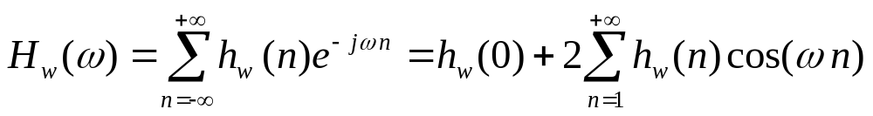
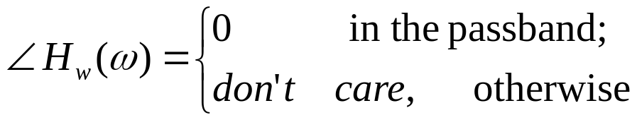
Effect of windowing and shifting on the frequency response:
b) shifting: since then
Therefore
See what is
For a Low Pass Filter we can verify the symmetry Then
real for all . Then

Slide 14
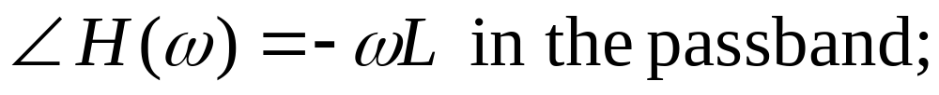




The phase of FIR low pass filter:
Which shows that it is a Linear Phase Filter.
don’t care

Slide 15










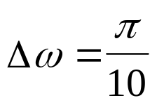
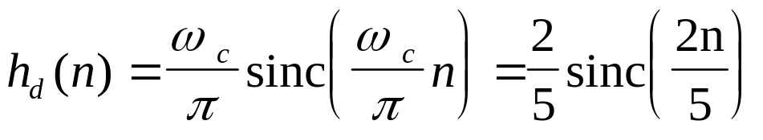
Example of Design of an FIR filter using Windows:
Specs: Pass Band 0 - 4 kHz
Stop Band > 5kHz with attenuation of at least 40dB
Sampling Frequency 20kHz
Step 1: translate specifications into digital frequency
Pass Band
Stop Band
Step 2: from pass band, determine ideal filter impulse response

Slide 16
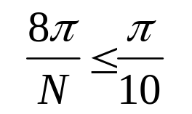
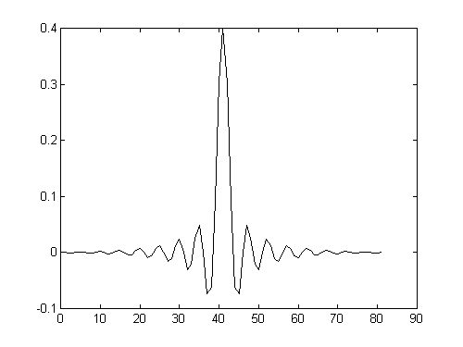
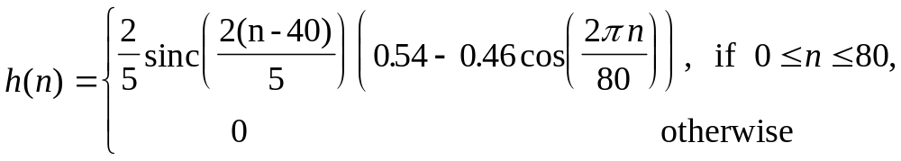
Step 3: from desired attenuation choose the window. In this case we can choose the hamming window;
Step 4: from the transition region choose the length N of the impulse response. Choose an odd number N such that:
So choose N=81 which yields the shift L=40.
Finally the impulse response of the filter

Slide 17
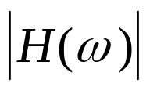
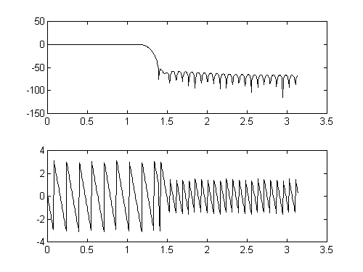



The Frequency Response of the Filter:

Slide 18


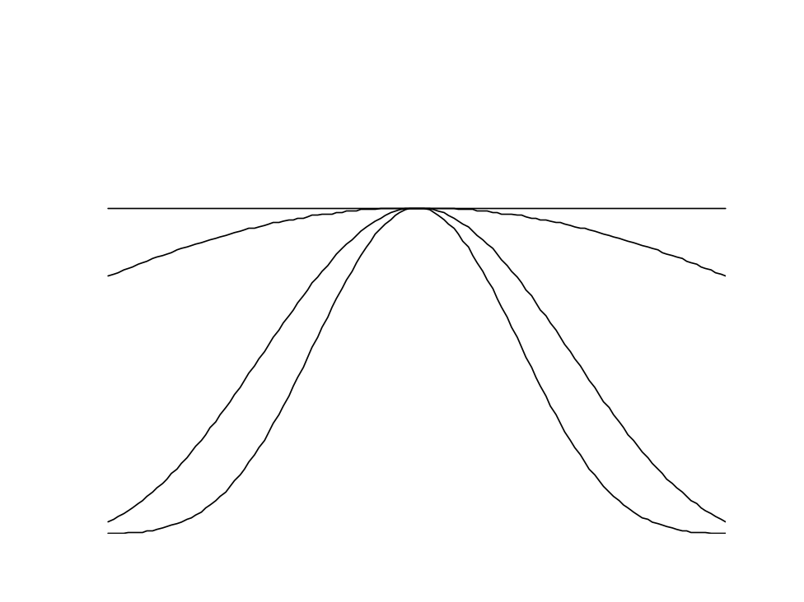






A Parametrized Window: the Kaiser Window
The Kaiser window has two parameters:
Window Length
To control attenuation in the Stop Band

Slide 19

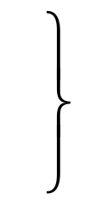
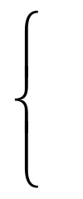


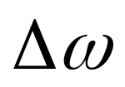

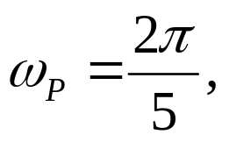
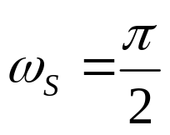
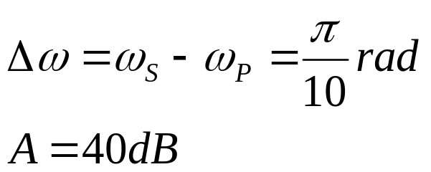
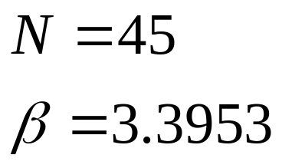
There are some empirical formulas:
Attenuation in dB
Transition Region in rad
Example:
Sampling Freq. 20 kHz
Pass Band 4 kHz
Stop Band 5kHz, with 40dB Attenuation

Slide 20
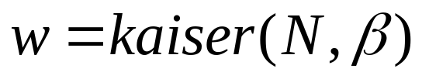
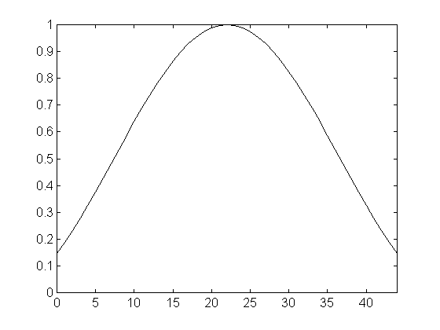


Then we determine the Kaiser window

Slide 21
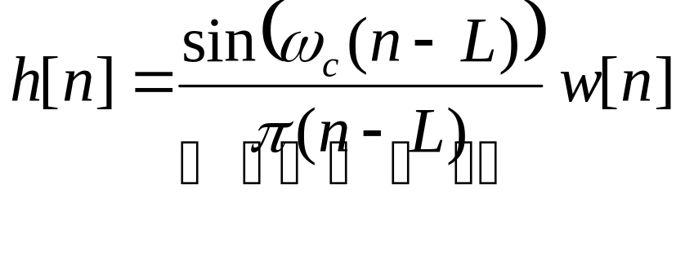
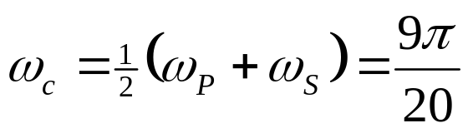

Then the impulse response of the FIR filter becomes
ideal impulse response
with

Slide 22

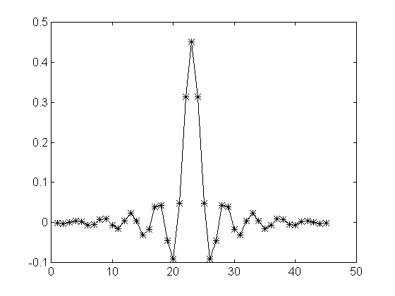

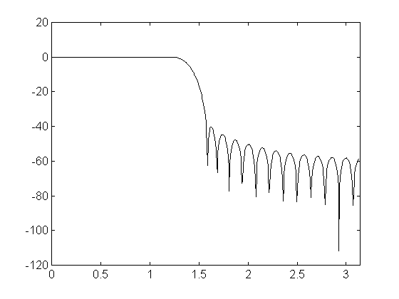


Impulse Response
Frequency Response

Slide 23
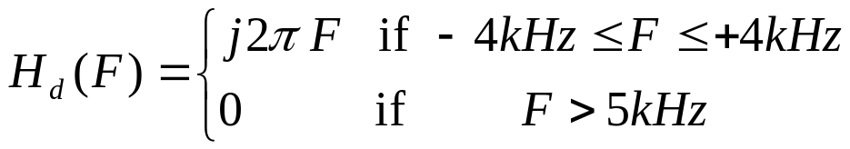


Example: design a digital filter which approximates a differentiator.
Specifications:
Desired Frequency Response:
Sampling Frequency
Attenuation in the stopband at least 50dB.
Solution.
Step 1. Convert to digital frequency

Slide 24



Step 2: determine ideal impulse response
From integration tables or integrating by parts we obtain
Therefore

Slide 25





Step 3. From the given attenuation we use the Blackman window. This window has a transition region region of . From the given transition region we solve for the complexity N as follows
which yields . Choose it odd as, for example, N=121, ie. L=60.
Step 4. Finally the result

Slide 26




Frequency Response
Impulse response h(n)

