Slide 1
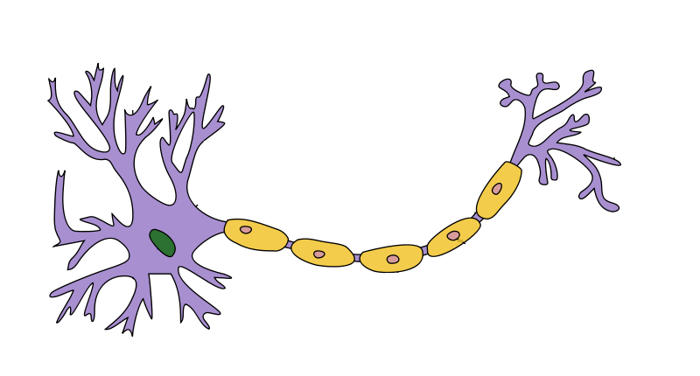
Biological Inspiration for Artificial Neuron without Activation Function
Inputs
Output
x₀=1
y
x₁
+
++
...
x_{n}
dendrite
axon
+
+
+
++
++
++

Slide 2
Biological Neuron
dendrite
axon
nucleus
+
+
+
++
++
++

Slide 3
Artificial Neuron
Inputs
Output
x₁
*w₁
+
y
*w₂
x₂
+
+
+
++
++
++

Slide 4
Biological Inspiration for Artificial Neuron
Inputs
Activation
Output
x₀=1
y
z
x₁
+
++
...
x_{n}
dendrite
axon
+
+
+
++
++
++

