Slide 1
Tech103 Capstone
Bhuvanesh Gopalarathnam/Kiran Ramanna

Slide 2
SmartStock Advisor
Real-Time, Explainable Stock Recommendations Powered by AI

Slide 3
PROBLEM STATEMENT
Problem Statement:
Investors need quick, reliable stock recommendations with clear explanations.
Audience/Impact:
Retail investors and advisors—get faster, clearer, and more trustworthy insights.
Use Case / Solution
Accept a stock symbol as input and perform comprehensive research using LLMs to generate a Buy, Sell, or Neutral recommendation.
  Develop a user interface to capture the stock symbol.
  Utilize Retrieval-Augmented Generation (RAG) and semantic search (e.g., Traversaal AI) to gather up-to-date stock details, pricing, and market trends from the web.
  Display the actionable Buy, Sell, or Neutral recommendation along with its rationale directly on the user interface.
Notes:
May require more than one slide

Slide 4
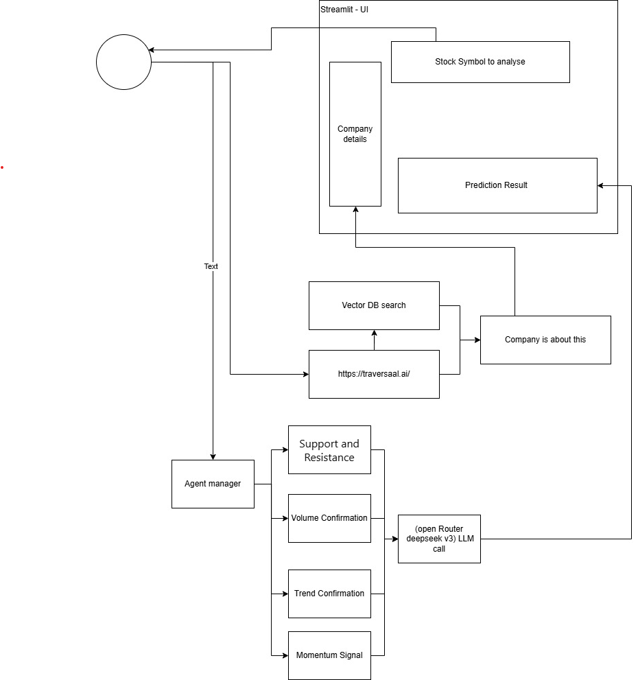
ARCHITECTURE
User Interface: Gradio-based UI for stock symbol input and result display.
Semantic Search: Uses Traversaal AI to retrieve real-time stock and company information.
Agent Manager: Coordinates four specialized agents for support/resistance, volume, trend, and momentum analysis.
LLM Integration: Leverages DeepSeek v3 LLM via OpenRouter to synthesize insights and generate clear Buy/Sell/Neutral signals.
Transparent Output: Presents detailed company data and AI recommendations directly to the user.
Notes:
May require more than one slide

Slide 5
Future Enhancements:
Implement advanced security, bias mitigation, and hallucination reduction strategies to ensure responsible AI outputs.
Introduce robust guardrails—such as hardcoded filters, output classifiers, and transparent reasoning chains—to further improve reliability and compliance.
Why this Architecture Stands Out:
End-to-End Automation: The platform transforms a simple stock symbol input into a research-backed, transparent trading recommendation—instantly.
State-of-the-Art AI: Combines retrieval-augmented generation, semantic search, and multi-agent LLM reasoning for unmatched depth and clarity.
User Trust: Every signal comes with a clear, human-readable explanation and traceable data sources, empowering confident decision-making.
Notes:
May require more than one slide

Slide 6
✅ Problem Statement (5%)
✅ Knowledge Retrieval (20%)
  Implements search functionality (src/search.py)
  Uses sentence-transformers for embeddings
  Has a search engine implementation (src/search_engines/)
  Uses Qdrant for vector storage (from requirements.txt)
✅ LLM Integration (20%)
  Implements LLM functionality (src/llm.py)
  Uses openrouter API (from requirements.txt)
  Has prompt engineering capabilities
✅ Deployment (15%)
  Implements a Gradio interface (src/gradio_app.py)
  Includes a sample interface (gradio-sample.png)
✅ Documentation & ReadMe (10%)
  Has a basic README.md
  Includes installation instructions (requirements.txt)
  Shows sample interface
✅ Agent/Workflow (Optional, +10% Bonus)The project implements multiple specialized agents:
  Volume Confirmation Agent, Support/Resistance Agent, Trend Confirmation Agent, Momentum Signal Agent
✅ Demo Video (10%)No evidence of a demo video in the repository
Future Enhancements and improved performance:
💡 Responsible AI (10%)
💡 Creativity and Ambition (10%)
💡Performance improvements
Notes:
May require more than one slide

Slide 7
Any questions?
Email to
  bhuv666@gmail.com
  kiranramanna112@gmail.com
Thank you!

