Slide 1
Cryptocurrency Market Analysis & Insights
Kiran Ranganalli

Slide 2
Objectives
Identify top-performing cryptocurrencies and their market share.
Analyze price changes, market volatility, and trends over time.
Compare market capitalization vs. total supply valuation.
Evaluate the dominance of leading cryptocurrencies in the industry.
Provide insights that help investors and analysts make data-driven decisions.

Slide 3
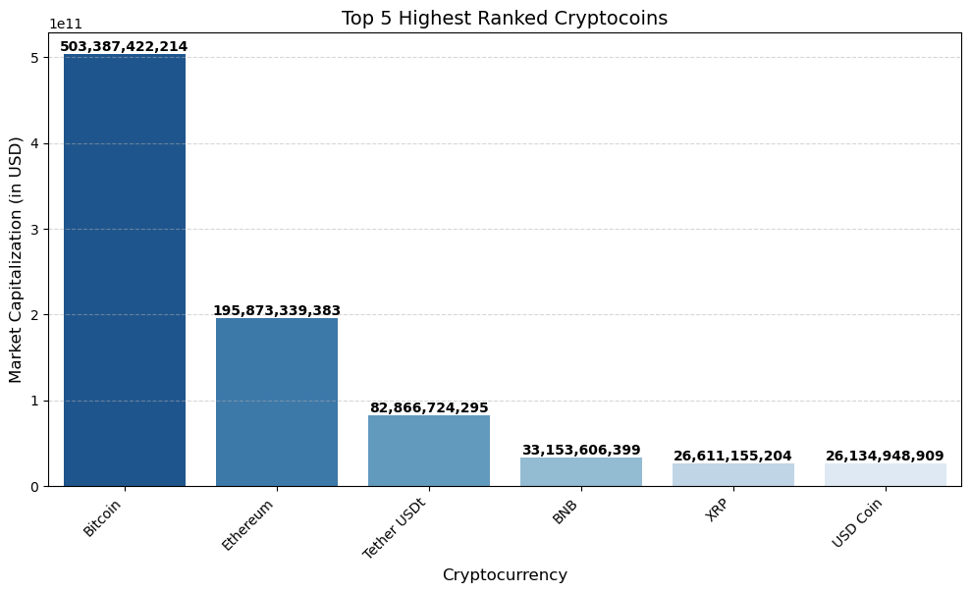
Top 5 Highest Ranked Crypto coins
Ranking is based on CoinMarketCap’s ranking system.
Bitcoin (BTC) & Ethereum (ETH) consistently dominate the market.
The top 5 cryptos collectively hold a major portion of the total market capitalization.
The graph (Right side) visualizes the market capitalization of the top 5 ranked cryptocurrencies.

Slide 4
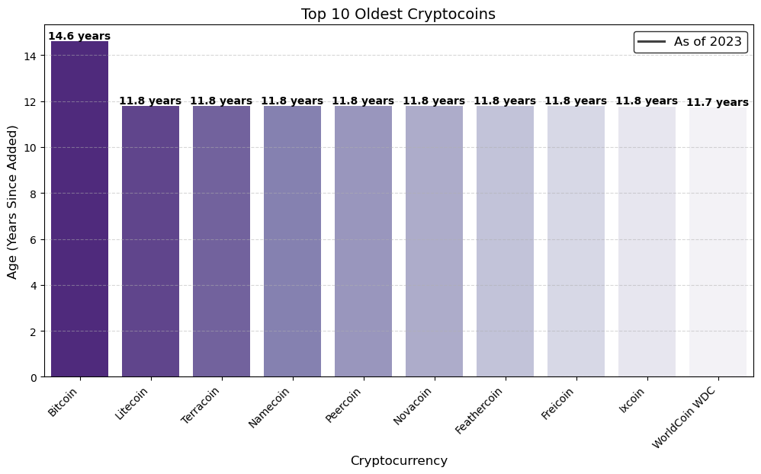
Top 10 Oldest Cryptocurrencies (As of 2023)
The chart displays the Top 10 oldest cryptocurrencies based on their listing date on CoinMarketCap.
Bitcoin is the oldest cryptocurrency, with an age of 14.6 years since its listing.
Several early cryptocurrencies, including Litecoin, Namecoin, and Peercoin, have been in the market for over 11.8 years.
The dominance of these cryptocurrencies in early adoption highlights their influence on the blockchain industry.
The data is calculated based on the date added to CoinMarketCap and converted into years for clarity.

Slide 5
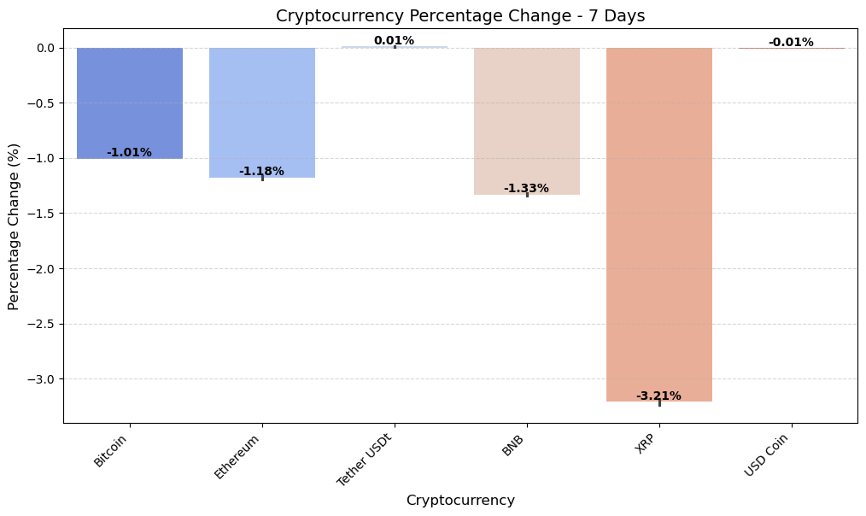
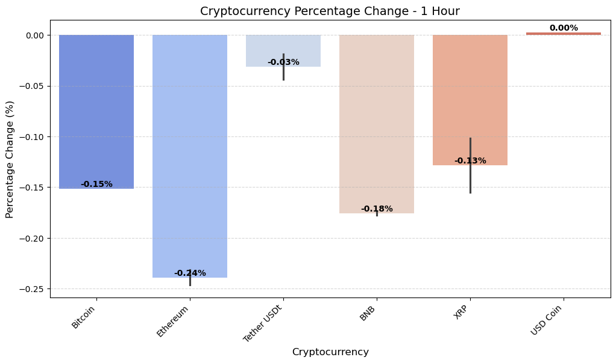
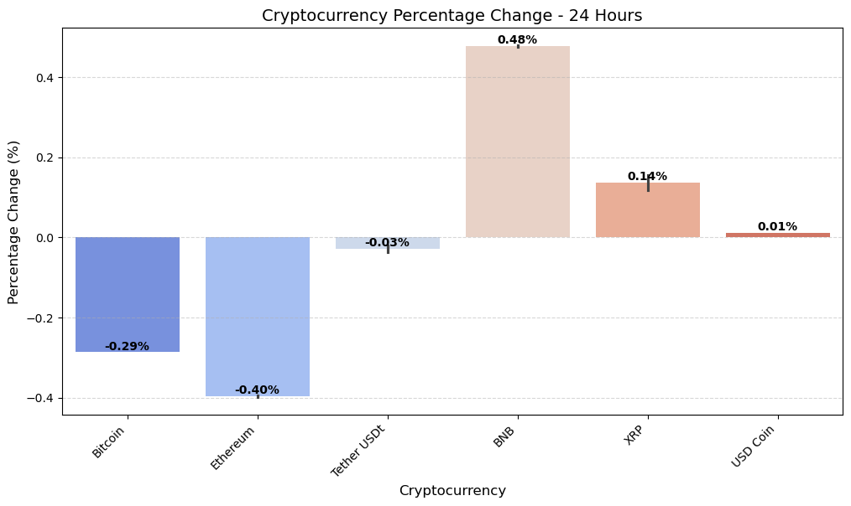
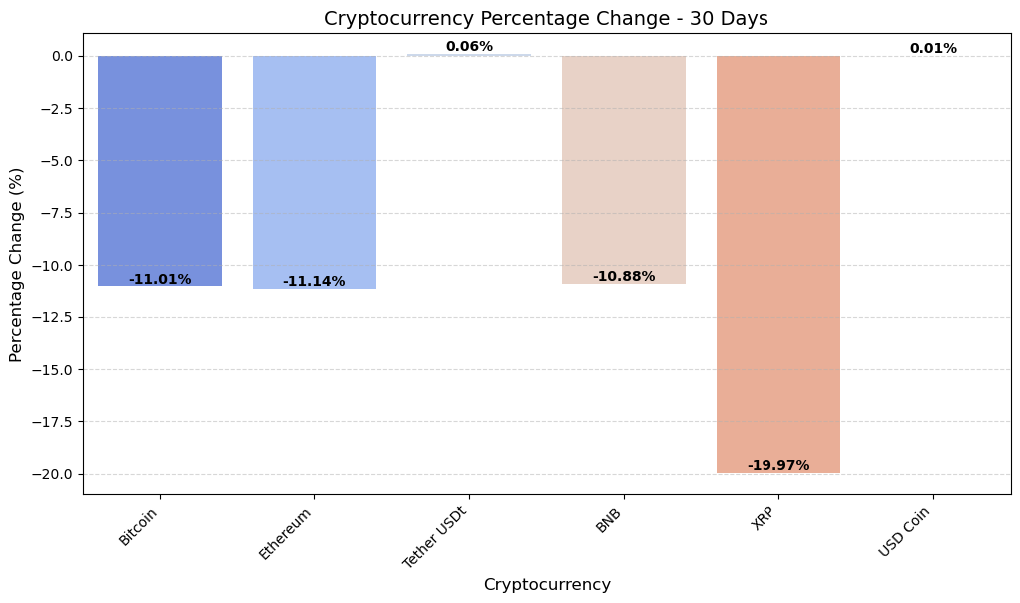
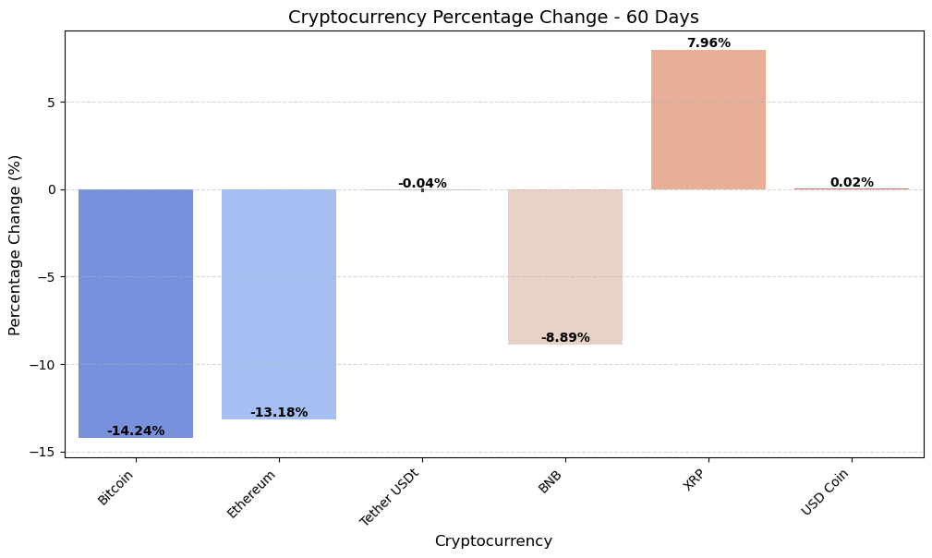
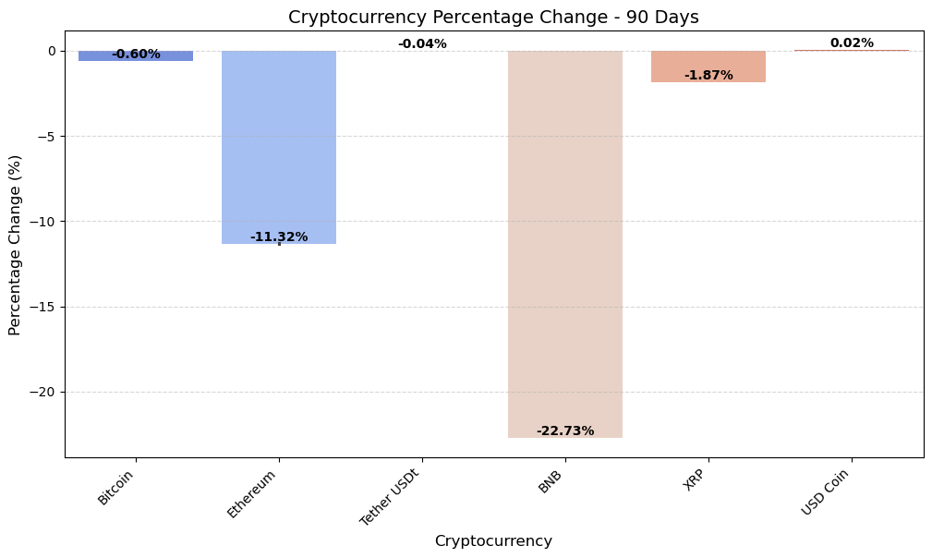
A comparative analysis of short-term and long-term price fluctuations

Slide 6
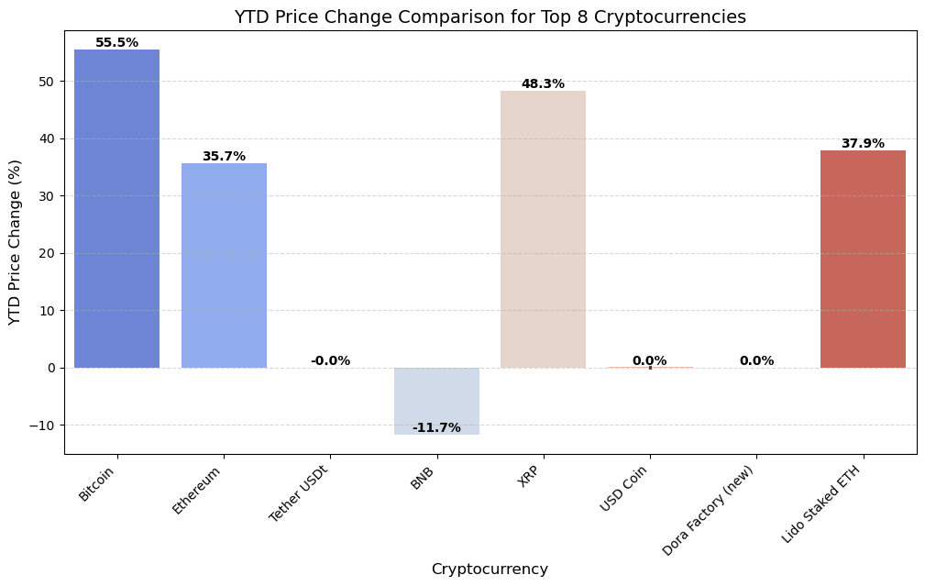
YTD Price Change Comparison for Top 8 Cryptocurrencies
The chart showcases the Year-To-Date (YTD) price change percentage of the Top 8 cryptocurrencies based on market capitalization.
Positive values indicate growth since the start of the year, while negative values show declines in price.
Bitcoin and Ethereum demonstrate steady performance, while other altcoins experience higher volatility.
The data highlights market trends, investor sentiment, and asset performance over the year.

Slide 7
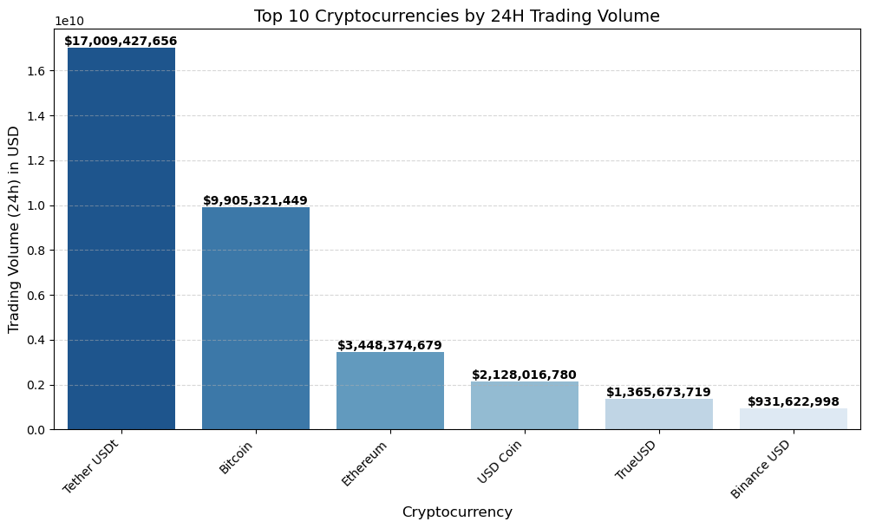
Top 10 Cryptocurrencies by 24H Trading Volume
The chart highlights the most actively traded cryptocurrencies in the last 24 hours.
Higher trading volume indicates strong liquidity and investor interest, making these coins easier to buy/sell.
Bitcoin and Ethereum often dominate, while some altcoins show high activity due to market trends.
Low trading volume suggests lower market activity and potential liquidity risks.
Business Takeaway:
Tracking trading volume trends helps investors understand market demand, liquidity, and price stability.

Slide 8
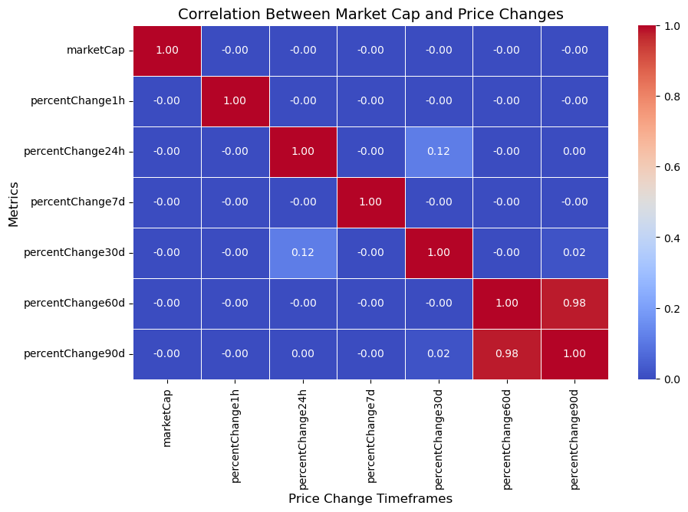
Correlation Between Market Cap and Price Changes
The heatmap shows the relationship between market capitalization and price changes across different timeframes.
The near-zero correlation between market cap and price fluctuations suggests that larger cryptocurrencies do not necessarily have more stable price movements.
Strong correlation among long-term price changes (60d & 90d) indicates that long-term trends are more predictable than short-term movements.
These insights help traders understand how market cap influences volatility and risk assessment.
Business Takeaway:
Market cap alone does not define stability—long-term trends play a stronger role in predicting price movements

Slide 9
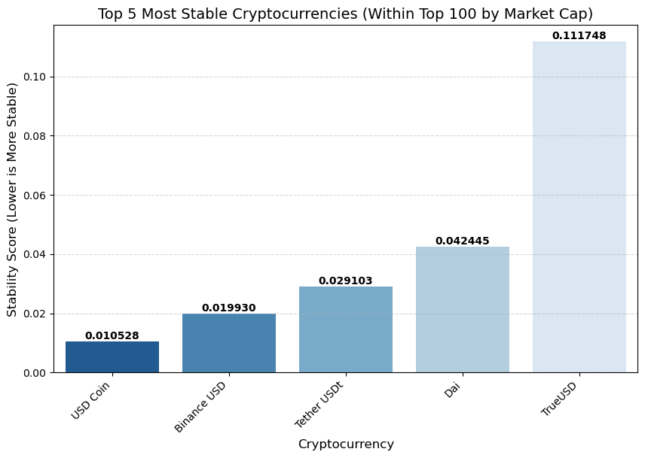
Top 5 Most Stable Cryptocurrencies (Among Top 100 by Market Cap)(Lower Is m0re stable)
This chart displays the Top 5 most stable cryptocurrencies based on their price fluctuations over multiple timeframes (1H, 24H, 7D, 30D, 60D, 90D, YTD).
Stablecoins like USD Coin, Binance USD, and Tether USDt show the lowest volatility, confirming their role in minimizing price fluctuations.
Dai and TrueUSD have slightly higher but still relatively low volatility compared to non-stable assets.
Stability is measured using the mean absolute deviation of percentage changes across different time periods.
Business Takeaway:
Investors seeking low-risk crypto assets often prefer stablecoins due to their minimal price fluctuations, making them ideal for hedging against market volatility.

Slide 10
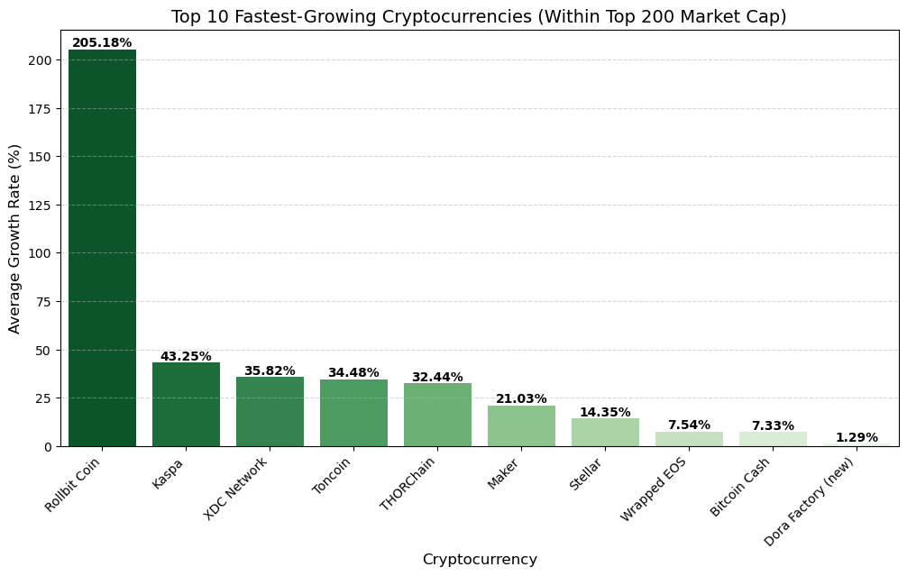
Top 10 Fastest-Growing Cryptocurrencies (Within Top 200 Market Cap)
This chart highlights the Top 10 cryptocurrencies with the highest average growth rates over 7, 30, 60, and 90 days.
Rollbit Coin leads with an exceptional 205.18% growth, significantly higher than the rest, indicating strong momentum but requiring further analysis for sustainability.
Kaspa, XDC Network, and Toncoin also exhibit notable growth, suggesting increasing adoption or investor interest.
A mix of both established and emerging cryptocurrencies appears in the rankings, showing market diversification.
Due diligence is crucial—investors should verify fundamentals, liquidity, and project credibility before considering investments based solely on growth trends.
Business Takeaway:
High growth rates can indicate strong momentum, but understanding market trends, investor demand, and project fundamentals is essential before making investment decisions.

Slide 11
SUMMARY
Objective: Analyzed the cryptocurrency market using market cap, volume, price stability, growth trends, and dominance.
Key Findings:
Identified top cryptocurrencies based on market cap and trading volume.
Measured price stability to find less volatile investment options.
Ranked fastest-growing cryptos based on year-to-date performance.
Explored market dominance to understand which coins lead the industry.
Insights: Helps investors identify stable vs. high-growth assets, track market trends, and make data-driven decisions.

Slide 12
THANK YOU
Kiran Ranganalli
Kiranranganalli@gmail.com
https://ranganallikiran199.wixsite.com/my-site-1
https://github.com/kiranranganalli

