Slide 1
E-Commerce Customer Analysis: Insights and Strategies
Business presentation
Kiran Ranganalli

Slide 2
Agenda
Introduction
Objectives
Methodology
Clustering Analysis
Key Findings
Trends and Insights
Recommendations
Conclusions and Future work

Slide 3

Objective: To analyze e-commerce data and provide actionable business insights.
Key Focus Areas:
Customer purchasing decisions.
Revenue-generating segments.
Churn prediction and customer retention.
Project Overview

Slide 4
Project Objectives
Identify factors influencing customer purchasing decisions to understand drivers of sales and engagement.
Segment customers to determine high-revenue and high-value groups for targeted marketing.
Analyze purchasing patterns over time, across product categories, and (if applicable) by region to align inventory and promotional strategies.
Predict customer churn to identify at-risk customers and implement effective retention plans.
Examine products with the highest return rates to enhance product quality and improve customer satisfaction.
Investigate gender-specific churn trends to develop tailored engagement strategies and reduce attrition.

Slide 5
Business Questions
What factors influence customer purchasing decisions?
Which customer segments generate the highest revenue?
How do purchasing patterns vary by time, product category, or region?
Can we predict customer churn or identify high-value customers?
What items have the most returns?
What Gender has the most churn?

Slide 6
Methodology
Explore the Data:
Checked for:
Missing values, duplicates, and inconsistencies.
Data types: numerical, categorical, and datetime columns.
Clean the Data:
Handled missing values with imputation (median/mode) or removal.
Removed duplicate records to ensure data integrity.
Converted datetime fields and extracted features like day, week, and month.
Feature Engineering:
Extracted features such as Recency (days since last purchase) and other customer-level metrics.
Grouped customers into segments based on clustering results (e.g., high-value, frequent returners).
Handle Outliers:
Identified outliers using statistical methods like IQR.
Managed extreme values by capping or transformation to improve data quality.

Slide 7
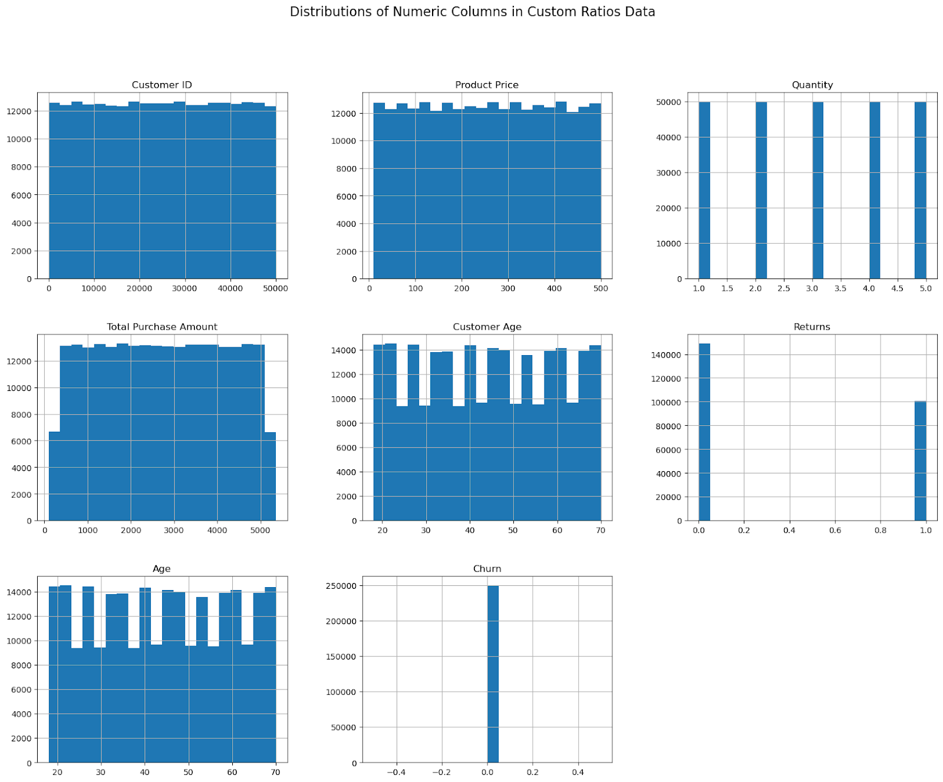
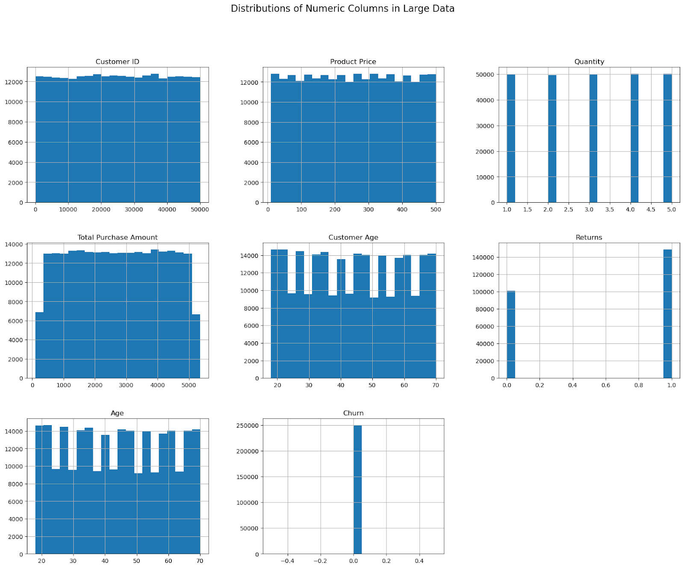
Univariate Analysis

Slide 8
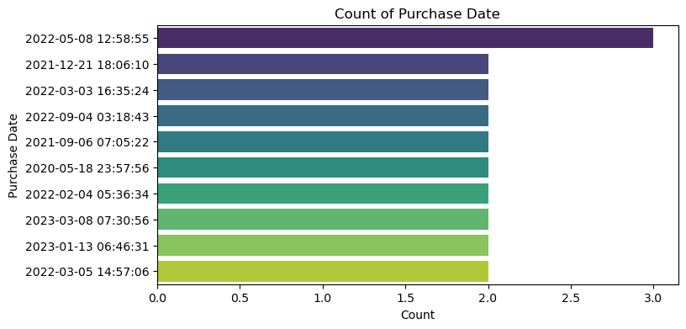
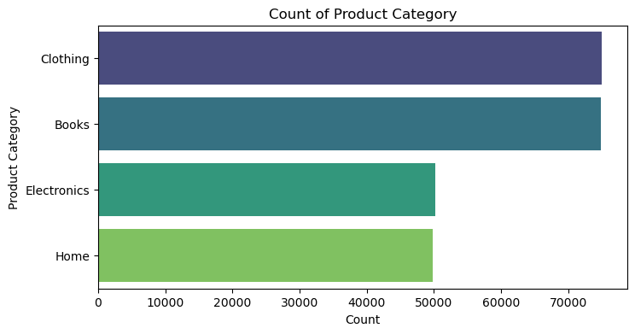
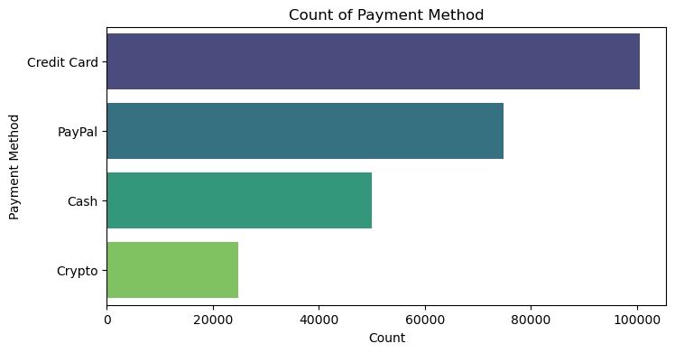
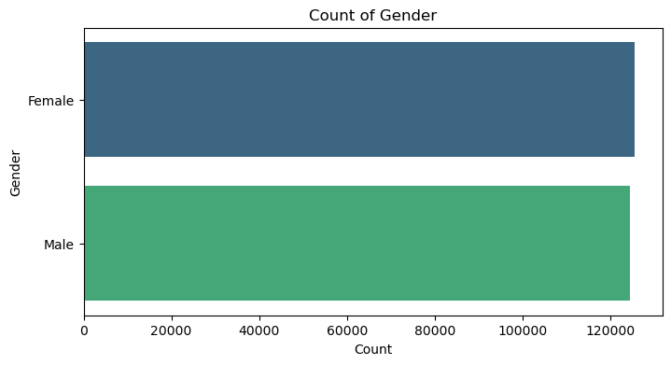
Bivariate Analysis

Slide 9


Key Findings
Analysis For k=3 Clusters:
Cluster 0:
Average Total Purchase Amount: 2533.85
High return rate (Returns = 1).
Younger customers with an average Age of 30.82.
Cluster 1:
Average Total Purchase Amount: 2920.62 (highest among clusters).
High return rate (Returns = 1).
Older customers with an average Age of 57.22.
Cluster 2:
Average Total Purchase Amount: 2725.15.
No returns (Returns = 0).
Middle-aged customers with an average Age of 43.95.
For k=4 Clusters:
Cluster 0:
Average Total Purchase Amount: 2536.18
High return rate (Returns = 1).
Younger customers with an average Age of 30.81.
Cluster 1:
Average Total Purchase Amount: 2918.13
High return rate (Returns = 1).
Older customers with an average Age of 57.22.
Cluster 2:
Average Total Purchase Amount: 1480.27 (lowest among clusters).
No returns (Returns = 0).
Middle-aged customers with an average Age of 42.56.
Cluster 3:
Average Total Purchase Amount: 3972.94 (highest among clusters).
No returns (Returns = 0).
Middle-aged customers with an average Age of 45.34.

Slide 10
Random Forest Results and Insights
1. Classification Report:
Class 0 (No Churn):
Precision: 0.80 | Recall: 0.83 | F1-Score: 0.81.
Class 1 (Churn):
Precision: 0.20 | Recall: 0.17 | F1-Score: 0.19.
Overall Metrics:
Accuracy: 0.70 | ROC-AUC: 0.5003.
2. Confusion Matrix:
True Positives (Churn Correct): 2,599.
False Positives (Wrongly Predicted Churn): 10,469.
True Negatives (No Churn Correct): 49,583.
False Negatives (Missed Churn): 12,349.
3. Feature Importance:
Most Important: Total Purchase Amount (0.898).
Age, Quantity, and Returns had minor contributions.
Insights:
Struggles with Class Imbalance (favors No Churn).
Total Purchase Amount is the key predictor.
Poor ROC-AUC (~0.5): Model is barely better than random guessing.

Slide 11
XGBoost Results Results and Insights
1. Classification Report:
Class 0 (No Churn):
Precision: 0.80 | Recall: 1.00 | F1-Score: 0.89.
Class 1 (Churn):
Precision: 0.00 | Recall: 0.00 | F1-Score: 0.00.
Accuracy: 0.80 (misleading due to class imbalance).
2. Confusion Matrix:
True Negatives: 60,052.
False Positives: 0.
False Negatives: 14,948 (all churn missed).
True Positives: 0.
3. ROC-AUC:
Score: 0.5134 (slightly above random guessing).
Indicates poor ability to separate churned vs. non-churned customers.
Insights:
Class Imbalance
causes the model to completely miss churned customers.
ROC-AUC (~0.51): Barely better than random guessing.
Ineffective for churn prediction without addressing imbalance.

Slide 12
Improving Model Performance and Insights
Address Class Imbalance:
Use SMOTE to oversample the minority class.
Apply class weights to emphasize churn in training.
Feature Engineering:
Add features like recency, frequency, and engagement metrics.
Remove low-impact features (e.g., returns, total purchase amount).
Model Optimization:
Tune XGBoost parameters (e.g., learning rate, max depth).
Experiment with advanced models like LightGBM or CatBoost.
Insights:
Churn Class Challenges:
Recall for churn is low (0.03) despite SMOTE.
High false negatives indicate weak differentiation for churned customers.
Feature Importance:
Frequency: Most significant predictor of churn.
Age and Recency: Moderate impact.
Performance Metrics:
Accuracy: 80% (dominated by Class 0 predictions).
ROC-AUC: 0.5542, slightly better than random guessing.

Slide 13
Business Questions
1. What factors influence customer purchasing decisions?
Analysis: The most significant factor influencing purchasing decisions is Frequency (number of purchases), followed by Age and Recency (days since the last purchase).
Insights: High-value customers are frequent buyers with higher engagement rates and no returns.
Recommendations: Target customers with personalized offers and campaigns based on purchase frequency and recent activity.
2. Which customer segments generate the highest revenue?
Analysis: Using K-Means clustering, high-revenue customers were identified in Cluster 3 (k=4), representing the highest spenders with no returns.
Insights: Customers in this segment are ideal for premium loyalty programs and personalized retention strategies.
Recommendations: Develop exclusive loyalty perks and targeted marketing to sustain engagement with high-value customers.
3. How do purchasing patterns vary by time, product category, or region?
Analysis: Seasonal trends show a sales peak from January to July, with a decline from August onward. Product categories like Books and Clothing generate the highest revenue but also have the highest returns.
Insights: Sales align with seasonal demand; high-return categories may benefit from improved descriptions and size guides.
Recommendations: Align inventory with seasonal trends and implement strategies to reduce returns for key categories.

Slide 14
Business Questions
4. Can we predict customer churn or identify high-value customers?
Analysis: Churn prediction models (Random Forest, XGBoost) struggled with class imbalance, achieving a best ROC-AUC score of 0.5542. High-value customers were identified through clustering (Cluster 3 in k=4).
Insights: The model accurately predicts non-churned customers but struggles with churned ones due to class imbalance.
Recommendations: Address class imbalance with SMOTE or class weighting. Add features like frequency and recency to improve predictive accuracy.
5. What items have the most returns?
Analysis: Books (30,229 returns) and Clothing (30,122 returns) are the most returned categories. Returns are primarily due to quality issues, incorrect orders, or mismatched sizes.
Insights: These categories drive significant returns, impacting overall profitability.
Recommendations: Implement detailed product descriptions, size guides, and quality checks to reduce returns.
6. What gender has the most churn?
Analysis: Male customers exhibit a slightly higher churn rate (20.28%) compared to females (19.62%).
Insights: Although the difference is small, it is statistically significant given the dataset's size.
Recommendations: Conduct targeted surveys for male customers to identify dissatisfaction and offer personalized engagement or loyalty strategies.

Slide 15
Conclusion and Key Insights
Factors Influencing Customer Purchasing Decisions:
Frequency is the most significant driver, followed by Age and Recency.
High-value customers (Cluster 3 in k=4) spend the most with no returns, making them ideal for retention and loyalty programs.
Customer Segmentation and Revenue:
Cluster 3: High spenders with no returns, suitable for premium marketing.
Clusters 0 & 1: High-return customers, requiring strategies to reduce dissatisfaction.
Books and Clothing: Most popular and high-revenue categories, but highest returns.
Purchasing Patterns:
Seasonality: Sales peak from January to July, declining from August onward.
Product Categories:
Books and Clothing: Highest revenue and returns.
Electronics and Home: Moderate revenue with lower returns.
Churn Analysis:
Challenges: Models (Random Forest, XGBoost) struggled with class imbalance.
Gender Churn: Males (20.28%) churn slightly more than females (19.62%).
Returns:
Books and Clothing dominate returns due to quality issues or mismatched expectations.

Slide 16
Future Work
Improved Feature Engineering:
Add metrics like time between purchases, lifetime value trends, and marketing engagement.
Advanced Predictive Modeling:
Test LightGBM, CatBoost, and class weighting for churn prediction.
Include support interactions and sentiment analysis as features.
Focus on High-Value Segments:
Develop loyalty programs for Cluster 3 (high spenders with no returns).
Use predictive models to identify similar high-value customers.
Reduce Returns:
Improve product descriptions, quality, and size guides for Books and Clothing
Analyze return reasons for targeted improvements.
Geographic and Time-Series Analysis:
Use regional data for location-specific strategies.
Perform time-series analysis to predict sales trends and align inventory.

Slide 17
Thank you
Kiran Ranganalli

