Slide 1
AUGMENTED REALITY IN EDUCATION E -SPOTTER
PROFESSOR
Yugyung Lee, ph.D
TEACHING ASSISTANT
Nageswara Rao Nandigam
TEAM 9
Venkata Akhila Krishna Atluri
Kiran Boinapally
Venkatesh Ponduri
Sushmanth Makkena

Slide 2
OVERALL GOAL
The main goal of our project is to provide the details(price of the book, edition, author of the book, title of the book etc.) of any book when we scan its ISBN (International standard book number ).
Platform: Android
Backend: Java, MySql
Apis: AWS book review api, OCR library and apis.
Data passing: JSON.
Editor: Eclipse

Slide 3
IMPLEMENTATIONS:
1. Scan the book & author page
2. API to Upload to OCR conversion server to convert image to text
3. Receive text from api and parse the data
4. Call amazon apis from parsed data
5. Page to display amazon api data

Slide 4
PROGRESS
Developed Android application which has login and registration page.
On valid Email address and password application will direct user to main activity. We also have a check whether user already exists or not.
Main activity is the home page (under progress) where we are going to add virtual camera.

Slide 5
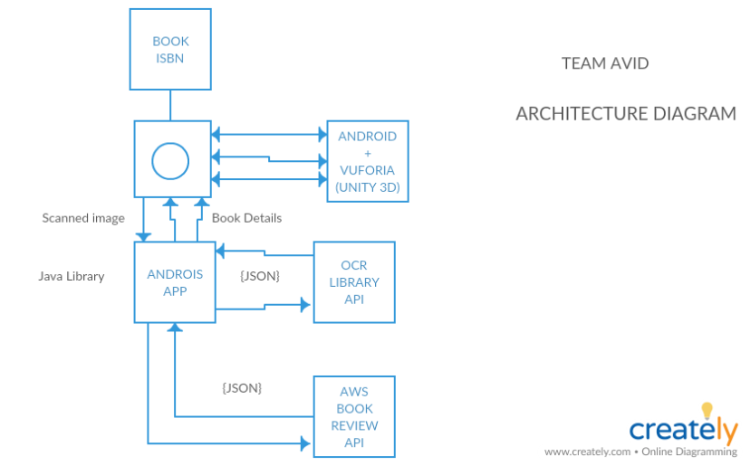

Slide 6
Thank You

