Slide 1
AUGMENTED REALITY IN EDUCATION E -SPOTTER
PROFESSOR
Yugyung Lee, ph.D
TEACHING ASSISTANT
Nageswara Rao Nandigam
TEAM 9
Venkata Akhila Krishna Atluri
Kiran Boinapally
Venkatesh Ponduri
Sushmanth Makkena

Slide 2
OVERALL GOAL
The main goal of our project is to provide the details(price of the book, edition, author of the book, title of the book etc.) of any book when we scan its ISBN (International standard book number ).
Platform: Android
Backend: Java, MySql
Apis: AWS book review api, OCR library and apis.
Data passing: JSON.
Editor: Eclipse

Slide 3
IMPLEMENTATIONS:
1. Scan the book & author page
2. API to Upload to OCR conversion server to convert image to text
3. Receive text from api and parse the data
4. Call amazon apis from parsed data
5. Page to display amazon api data

Slide 4
PROGRESS
Vuforia model setup is done and argumented reality is implemented using the front camera which is nothing but converting few images on the cover page in the 3D view.
The different details regarding the book such as review, name, rating are displayed in 3D view.

Slide 5
TASK TO BE COMPLETED
Argument reality part is done and addition of reviews dynamically is that what we integrate in the project.

Slide 6
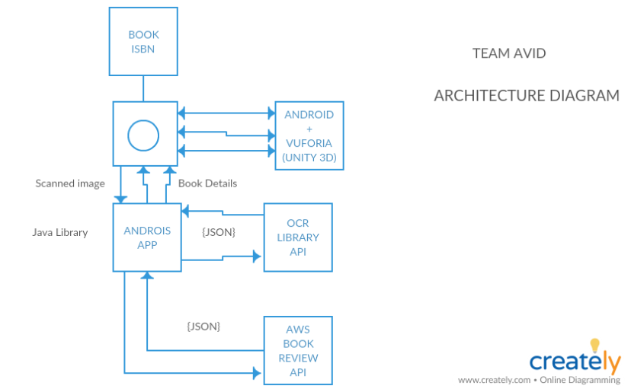

Slide 7
Thank You

