Slide 1
🛡 SENTINEL DV
An Open-Source MCP Server for AI-Assisted Design Verification Intelligence
DVCon USA / DAC 2026
28
4
1,477
Apache 2.0
MCP Tools
Simulators
CI Runs
License
github.com/kiranreddi/sentinel-dv · pip install sentinel-dv

Slide 2
The DV Toolchain Fragmentation Problem
Today's Reality
Artifact Silos (No AI Interface)
⚠ 10,000s of simulation logs — no unified query interface
UVM logs (.log)
grep / Perl
⚠ Coverage databases locked in proprietary formats (VDB, UCDB)
VDB / UCDB
Verdi / Questa
Assertion JSON
manual parse
⚠ UVM failures scattered across VCS, Questa, Xcelium, and Verilator logs
JUnit XML
Jenkins only
⚠ Manual log triage consumes hours per regression cycle
VCD waveforms
GTKWave
⚠ LLMs (Claude, GPT-4, Copilot) have NO interface to sim artifacts
Regression logs
spreadsheet
None expose a query API suitable for AI reasoning

Slide 3
Model Context Protocol — Connecting AI to EDA Artifacts
What is MCP?
MCP JSON-RPC Call
• Open standard by Anthropic (Nov 2024)
{ "method": "tools/call", "params": { "name": "regression.health", "arguments": {} } } → Returns: { "health_score": 77.5, "band": "minor-issues", "grade": "B+", "recommendations": [ "Coverage below 75% target", "3 flaky tests found" ] }
• JSON-RPC 2.0 over stdio or SSE transport
• AI client discovers + calls server tools
• Adopted: Claude, GPT-4o, VS Code Copilot, Cursor
• Zero AI code changes — just plug in the server
Why MCP for DV?
• Sim artifacts → structured tool responses
• AI reasons over YOUR regression data
• Path redaction — no PII in responses
• Pydantic-validated output schemas

Slide 4
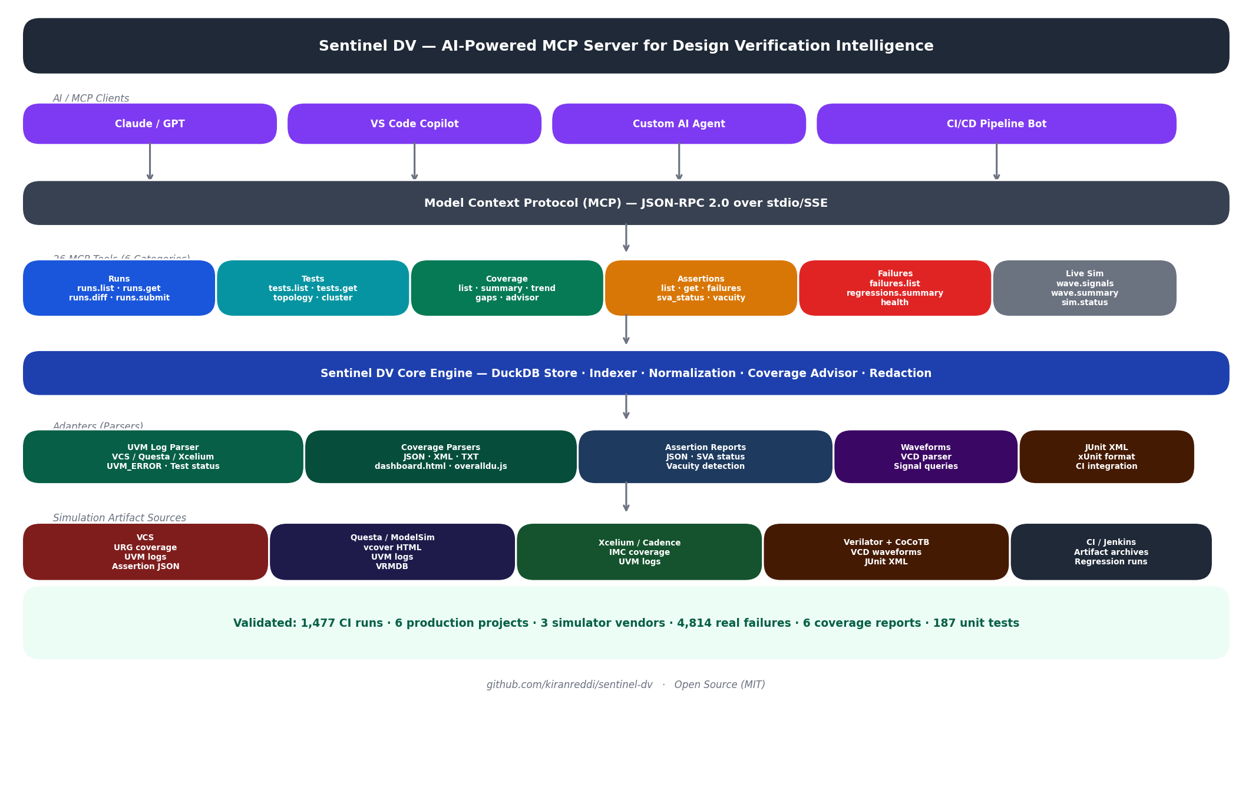
Sentinel DV — System Architecture

Slide 5
28 MCP Tools — Six Categories
📊 Run Tracking
🧪 Test Analysis
🛡 Assertions
runs.list · runs.get · runs.summary runs.diff · runs.cross_sim★ runs.submit† (dry-run cmd)
tests.list · tests.get · tests.history tests.topology · tests.cluster★ tests.replay† (dry-run cmd)
assertions.list · .get .failures · .sva_status .vacuity
📈 Coverage Intel.
🐛 Failure Triage
🌊 Live Run & Waveforms
coverage.list · .summary .trend · .gaps .advisor
failures.list regressions.summary regression.health
sim.status (live_status.json) wave.signals wave.summary

Slide 6
What the Engineer Actually Does
Ask Claude: "Why did axi4_stress_test fail in the latest regression?"
Behind the scenes — 3 MCP tool calls:
1. tests.list -> locate the failing test and its run
2. tests.get -> log excerpt + failure signature
3. runs.cross_sim -> passes on VCS/Xcelium, fails on Questa
Answer in seconds: seed-sensitive X-propagation, not an RTL bug.
No grep, no Verdi, no spreadsheet.

Slide 7
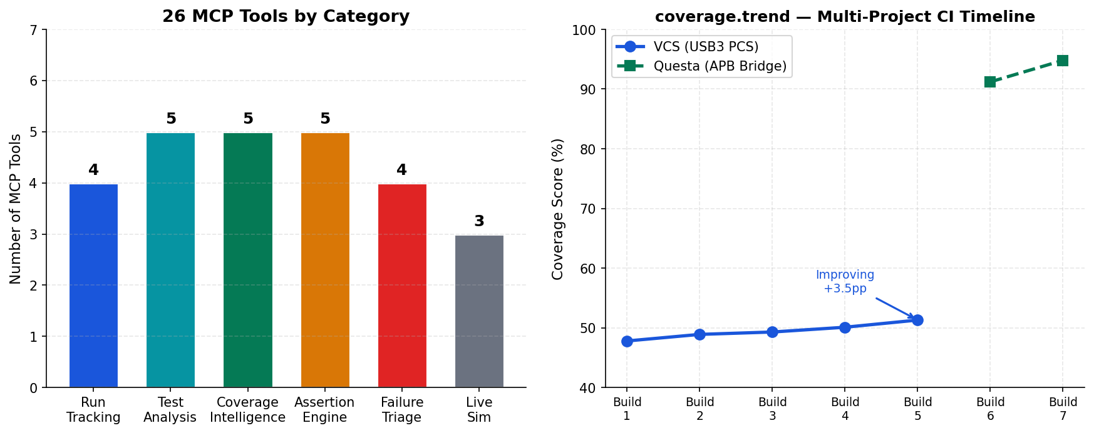
Coverage HTML Parsers — No Database Access Required
VCS URG dashboard.html
• Generated by urg -report command
• Content-sniff: 'Total Coverage Summary'
• Extracts: SCORE, LINE, TOGGLE, ASSERT
• Also parses Verification Plan score
• Zero access to simv.vdb required
Questa vcover overalldu.js
Single-line JS — balanced-brace scanner Extracts: stmt, branch, toggle, assert, functional, total, hit/total counts

Slide 8
DV Intelligence — Regression Health Score
H = 0.30×PassRate + 0.35×Coverage + 0.15×Assertions + 0.10×Flakiness⁻¹ + 0.10×CrossSim
≥ 90
≥ 75
≥ 55
< 55
sign-off-ready
minor-issues
coverage-gaps
not-ready
regression.health output
{ "health_score": 77.5, "band": "minor-issues", "grade": "B+", "components": { "pass_rate": 94.2, "coverage": 51.3, "assertions": 100.0, "flakiness": 98.1, "cross_sim": 87.5 }, "recommendations": ["Coverage below 75% target (51.3%)", "3 tests flaky across sims"] }

Slide 9
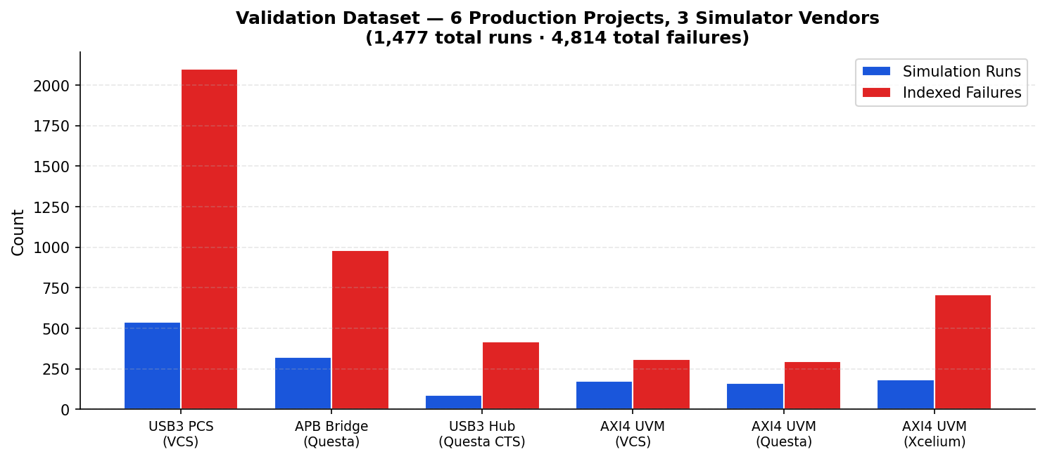
Validation Results — 1,477 Real CI Runs Across 6 Projects
1,477
CI Runs
4,814
Failures Classified
6
Coverage Reports
22/28
Tools Validated 0 wrong outputs
191
Unit Tests Passing

Slide 10
The Headline: 73% Fewer False Positives
VCS appends a count-summary line to every log: UVM_ERROR : 0
Parse it naively and every clean run looks like it failed.
Before count-summary filter: 16,240 "errors" across the VCS corpus
After count-summary skip: 4,380 genuine failures
= 73% reduction, matching hand-labeled ground truth.
One regex is the difference between a usable triage tool and noise.

Slide 11
Installation & Quick Start
1 Install
2 Configure sentinel_dv.yaml
pip install sentinel-dv
artifact_roots: - /path/to/sim/logs - /path/to/coverage/report db_path: ./sentinel_dv.db
3 Start server
4 Connect AI client
sentinel-dv serve --config sentinel_dv.yaml
{ "mcpServers": { "sentinel-dv": { "command": "sentinel-dv", "args": ["serve","--config","sentinel_dv.yaml"] } } }

Slide 12
Conclusion
28 MCP Tools
4 Simulators
1,477 Runs
Full DV workflow covered
VCS · Questa · Xcelium · Verilator
Production validated
73%
191 Tests
Apache 2.0
False-positive reduction
All green
Open source
github.com/kiranreddi/sentinel-dv · pip install sentinel-dv · ⭐ Stars Welcome!

