Slide 1
CONTAINERS
Containers are a form of lightweight virtualization that allow one to package an application and its dependencies together in a portable, isolated environment. Unlike traditional virtual machines (VMs), which include a full operating system. containers share the host system's kernel and only package the application and its dependencies. This makes containers much more lightweight and efficient compared to VMs.
Necessity of containers
When we run multiple main processes/services like tomcat(application- service), mongoDB(data-base), nginx(web-service) in one computer/server it leads to same file-structure in the OS for all these services, so when any changes made to configuration files it affects all the services which affects all the processes as all the processes consume same thing. Here we need something called as isolation
We can also achieve isolation by using different computers/servers for each processes which leads to more investment, so this problem can be solved by containers
Containers make each every services as a miniature operating system in the main OS which allows each and every service to have its own root directory

Slide 2
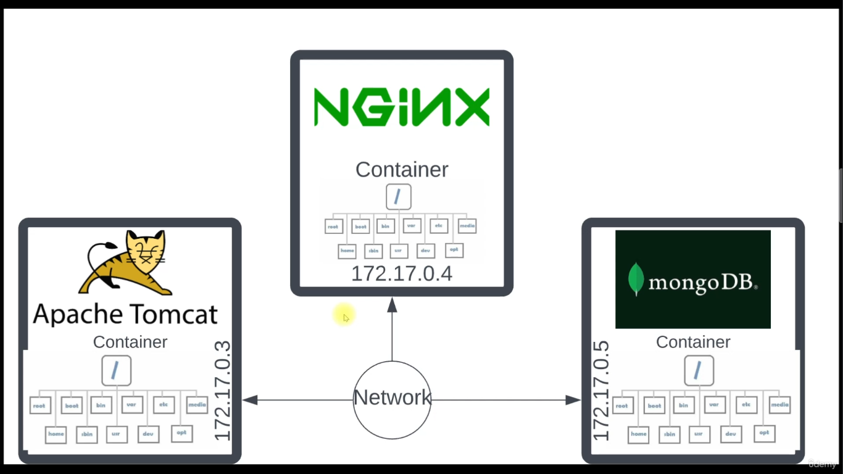

Slide 3
All the services can be connected together and this lets us to have virtualized network in the computer, each services will be provided with its own ip address
Since these isolated services will be in light weight we can archive them , these archive are called as images/container images (the purpose of creating images is that we can ship them to anywhere, the same container which we are running in our desktop can be archived and can run in production server)

Slide 4
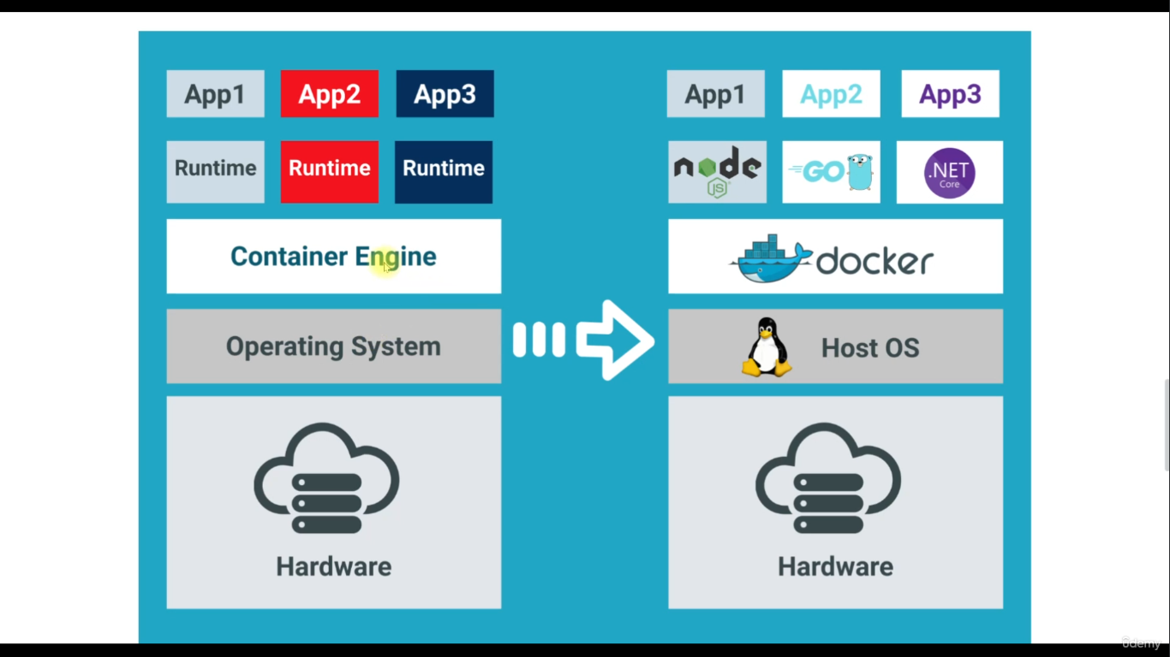

Slide 5
Refer the following overview about docker
Docker overview
Docker images and Docker containers are two fundamental concepts in Docker, but they serve different purposes:
Docker Image:
An image is a lightweight, standalone, executable package that includes everything needed to run a piece of software, including the code, runtime, libraries, environment variables, and configuration files.
It's essentially a snapshot of a filesystem and configuration needed to run a specific application.
Images are often built using a Dockerfile, which is a text document that contains all the commands a user could call on the command line to assemble an image.
Docker Container:
A container is a runtime instance of a Docker image. It's a runnable instance of an image.
Containers run applications in an isolated environment, utilizing the image's filesystem but with their own read-write layer on top of it.
They encapsulate the application and its dependencies, ensuring consistency across different environments, such as development, testing, and production.

Slide 6
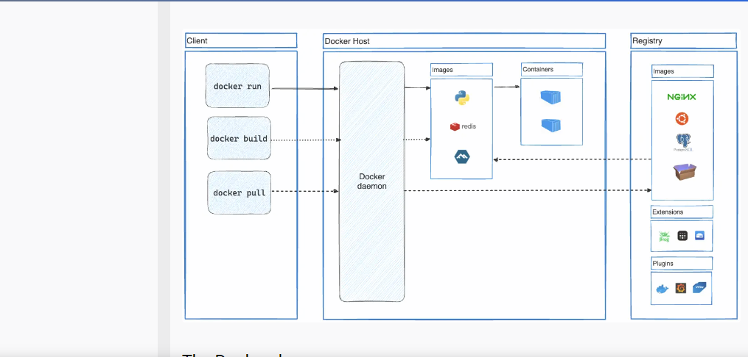

Slide 7
When you download and install Docker, it typically includes several components, including:
Docker Engine: The Docker Engine is the core runtime environment for Docker. It includes the Docker daemon (dockerd), which is a background process that manages Docker objects such as images, containers, networks, and volumes.
Docker Client: The Docker Client (docker) is a command-line tool that allows users to interact with the Docker Engine. You use the Docker Client to run commands to build, manage, and run Docker containers and images.
Docker Registry: Docker relies on registries to store and distribute Docker images. Docker Hub is the default public registry for Docker images, but you can also set up your own private registry using Docker Registry or other solutions like Amazon ECR (Elastic Container Registry) or Google Container Registry.

Slide 8
To check the docker images
Syntax: docker images
To list all the containers
Syntax: docker ps –a
To list running containers
Syntax: docker ps

Slide 9
Docker Build:
syntax: docker build -t imagename DockerfilePath
docker build is used to build a Docker image from a Dockerfile.
A Dockerfile is a text file that contains instructions for how to assemble a Docker image. It typically includes commands to specify the base image, copy files into the image, set environment variables, and define how the container should run.
When you run docker build, Docker reads the instructions from the Dockerfile and executes them to create a new Docker image.
This process results in a static snapshot of an application and its dependencies, encapsulated within the image. The image can then be distributed and used to run containers.

Slide 10
Docker Run:
docker run is used to create and run a container from a Docker image.
Once you have a Docker image built (either locally or pulled from a registry), you use docker run to instantiate a container based on that image.
When you run docker run, Docker creates a container instance from the specified image, and it starts the container based on the settings and configurations defined in the image.
This process instantiates a runnable instance of the application or service defined by the image, based on the environment and parameters provided at runtime.
In summary, docker build is used to create a Docker image, while docker run is used to create and start a container based on a Docker image. The build process precedes the run process, as you typically build an image first and then run containers based on that image.
If the docker image is not available locally, Docker run pulls the image from the repository and creates a container

Slide 11
Monolithic architecture Monolithic architecture refers to a traditional software architecture approach where all components of an application are tightly coupled and interconnected into a single unit. In simpler terms, it means that the entire application, including its user interface, business logic, and data access layers, is built and deployed as a single system
Single Deployment Unit: The entire application is packaged and deployed as a single unit. This means that when updates or changes are made to any part of the application, the entire application needs to be redeployed.
Tight Coupling: Components within the application are highly interdependent and tightly coupled. Changes made to one component may require changes to other components, making it difficult to modify or replace individual parts without affecting the entire system.
Scalability Challenges: Monolithic architectures can pose challenges in scaling the application. Since the entire application is scaled as a single unit, it may be difficult to scale specific components independently based on demand.
Development and Deployment Complexity: With all components tightly integrated, development and deployment processes can become complex, especially as the size of the application grows. Coordination among development teams may also become challenging.
Reliability and Performance: Monolithic architectures can offer good reliability and performance since all components are running within the same process, communicating via method calls or function invocations rather than over a network.

Slide 12
While monolithic architecture has been widely used and is still in use for many applications, it does have limitations, especially in terms of scalability and agility. As a result, many organizations are transitioning towards more modular and scalable architectures such as microservices or serverless architectures
Microservices architecture
Microservices is a system design architecture where a large application is broken down into smaller and independent services, each service has its own function and operates as a standalone entity, and these services communicate to each other through well-defined API (application program interface) or message queues
Using microservices architecture enables us to work on individual services without affecting the entire application making it easier to deploy updates and scale services independently
APIs play a crucial role in modern software development by enabling interoperability between different systems and facilitating the integration of third-party services and libraries.
Microservices architecture has gained popularity in recent years, especially in organizations with large, complex applications that require flexibility, scalability, and agility. However, adopting microservices requires careful planning and consideration of factors such as team structure, communication patterns, and deployment pipelines.

Slide 13
Decomposition: The application is decomposed into multiple smaller services, each responsible for a specific business function or capability. For example, services might handle user authentication, order processing, payment processing, etc.
Loose Coupling: Microservices are designed to be loosely coupled, meaning they are independent of each other and communicate through well-defined APIs (Application Programming Interfaces). This allows each service to be developed, deployed, and scaled independently without affecting other services.
Independently Deployable: Each microservice can be deployed independently, allowing for faster and more frequent updates. This enables teams to release new features or bug fixes without having to redeploy the entire application.
Technology Diversity: Microservices architecture allows for flexibility in technology choices. Each service can be developed using the most appropriate programming language, framework, or database for its specific requirements.
Scalability: Since services are deployed independently, it's easier to scale individual services based on demand. This enables better resource utilization and cost optimization compared to monolithic architectures, where the entire application needs to be scaled as a single unit.

Slide 14
Monolithic, microservices architecture and dockers
In a monolithic architecture, you typically package the entire application into a single Docker image, and then you can run multiple containers from that single image. Each container represents an instance of the entire application. So, while you may have multiple containers running, they all use the same Docker image.
In a microservices architecture, you break down your application into smaller, independent services, each serving a specific function or piece of functionality. Each of these services is packaged into its own Docker image. When you deploy your microservices-based application, you create and run multiple containers, each based on a different Docker image corresponding to a specific service. So, in this case, you have multiple containers, each using a different Docker image.
To summarize:
Monolithic architecture: Multiple containers from a single Docker image, each representing an instance of the entire application.
Microservices architecture: Multiple containers from multiple Docker images, each representing a specific microservice within the application.

