Slide 1
JSON
JSON, which stands for JavaScript Object Notation, is a lightweight data interchange format that is easy for humans to read and write and easy for machines to parse and generate. It's widely used in web development for transmitting data between a server and a web application.
Here's a detailed breakdown of JSON:
Format: JSON is a text format, which means it consists of readable text and is not binary like some other data interchange formats. This makes it easy to transmit over the network and store in files.
Data Structure: JSON represents data in a key-value pair format. Each key is a string enclosed in double quotes, followed by a colon, and then the corresponding value. Multiple key-value pairs are separated by commas. The entire data structure is wrapped in curly braces {}.
Data Types: JSON supports several data types for values:
String: A sequence of characters enclosed in double quotes.
Number: An integer or floating-point number.
Boolean: Either true or false.

Slide 2
Array: An ordered collection of values enclosed in square brackets []. Values can be of any JSON data type, including arrays themselves.
Object: A collection of key-value pairs enclosed in curly braces {}. Keys are strings, and values can be any JSON data type, including arrays or nested objects.
Null: Represents an empty value and is denoted by null.
Benefits:
Human Readable: JSON is easy for humans to read and write, which makes it convenient for debugging and troubleshooting.
Lightweight: JSON has a simple syntax, which makes it lightweight and efficient for transmitting data over the network.
Language Agnostic: JSON is not tied to any specific programming language or platform, making it widely interoperable.
Support: JSON is supported by most modern programming languages, making it easy to work with in a variety of environments.

Slide 3
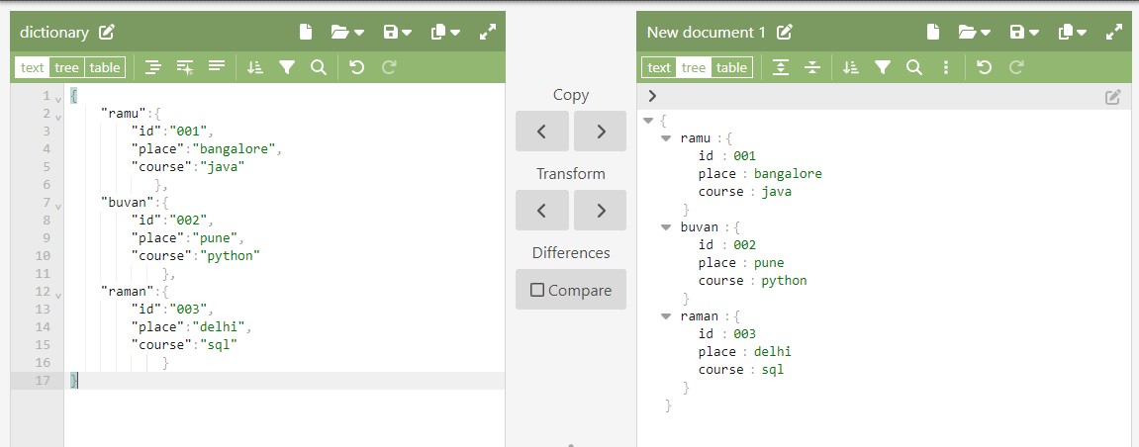
Check out the data structure in pg.no. 1 to know the basic rules to write json
Following image is the example json, left-side is input right-side is json output. Indentation is very important while writing the data structure

Slide 4
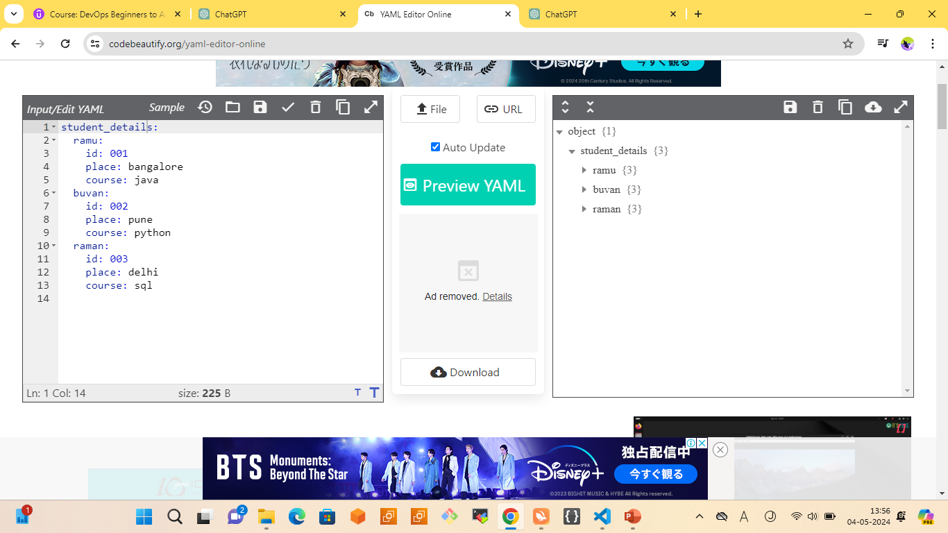
YAML
YAML, which stands for "YAML Ain't Markup Language" (a playful recursive acronym), is a human-readable data serialization format. It's often used for configuration files and data exchange between programs. YAML is commonly used in scenarios where data needs to be represented in a structured and readable manner, such as configuration files for software applications, data interchange between programming languages, and more.

Slide 5
Writing YAML involves adhering to certain rules to ensure that the data is structured correctly and interpretable by YAML parsers. Here are some key rules to follow when writing YAML:
Indentation: YAML uses indentation to represent structure. Use spaces (not tabs) for indentation, and be consistent with the number of spaces used. Typically, two or four spaces per level of indentation are common choices.
Whitespace: YAML is sensitive to whitespace. Make sure to use spaces appropriately around colons (:) to separate keys and values, and between elements within sequences.
Key-value pairs: Use a colon (:) to separate keys from values in mappings (associative arrays). Keys should be followed by a space before the corresponding value.
Sequences: Use a hyphen (-) followed by a space to denote elements in a sequence (array or list). Each item in the sequence should be preceded by a hyphen and a space.
Comments: Use the # character to indicate comments. Comments can be placed on a new line or at the end of a line, and they are ignored by YAML parsers.

Slide 6
Quoting strings: While not always necessary, strings can be enclosed in single quotes (') or double quotes (") if they contain special characters or leading/trailing spaces. This ensures that the string is interpreted correctly.
Booleans and null: YAML supports boolean values (true and false) and null values (null, Null, NULL, ~). These values are case-insensitive.
Multiline strings: For multiline strings, you can use the | character followed by a newline for a literal block scalar or > character for a folded block scalar. This preserves line breaks and indentation within the string.
Aliases and anchors: YAML allows for referencing the same node multiple times using aliases (&) and anchors (*). This can be useful for avoiding redundancy in complex structures.
Document start and end: YAML documents can contain multiple separate data structures. Use three dashes (---) to indicate the start of a new document, and three dots (...) to indicate the end.

