Slide 1
Stroke Prediction
Kiran Venkata Sai Ramakrishna Ganugula
11607355
kganu05

Slide 2
Models We use to Predict
Gradient Boosting Machine (Decision Tree)
K-Nearest Neighbors Algorithm (KNN)
Logistic Regression (LASSO, Ridge, Elastic Net)
Artificial Neural Network (ANN)

Slide 3
Data Set
This dataset contains 12 variables and 5000 observations, 6 are numeric and categorical
Id
Gender
Age
Hypertension
Heart disease
Ever married
Work type
Residence type
Avg glucose level
Bmi
Smoking status
Stroke

Slide 4
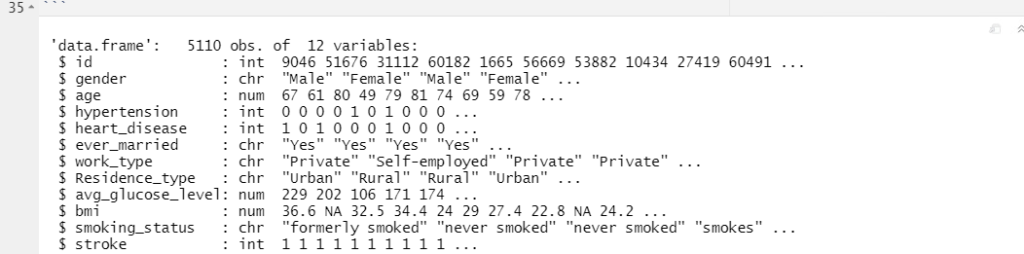
Data Set

Slide 5
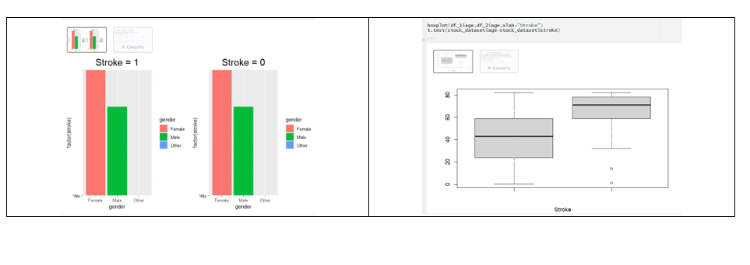
Data Exploration

Slide 6
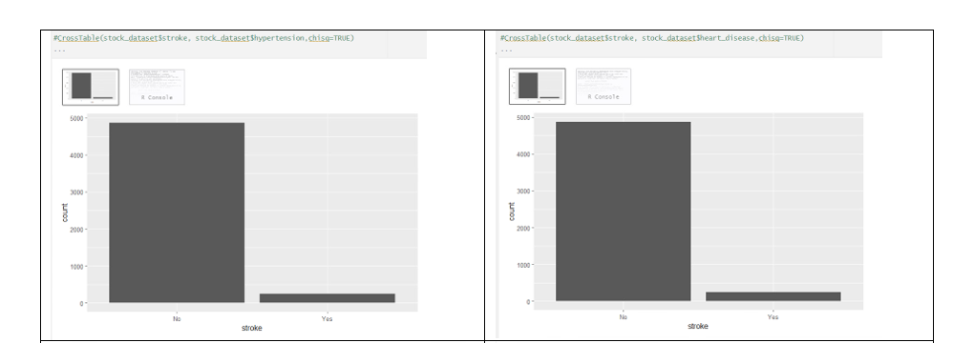
Data Exploration

Slide 7
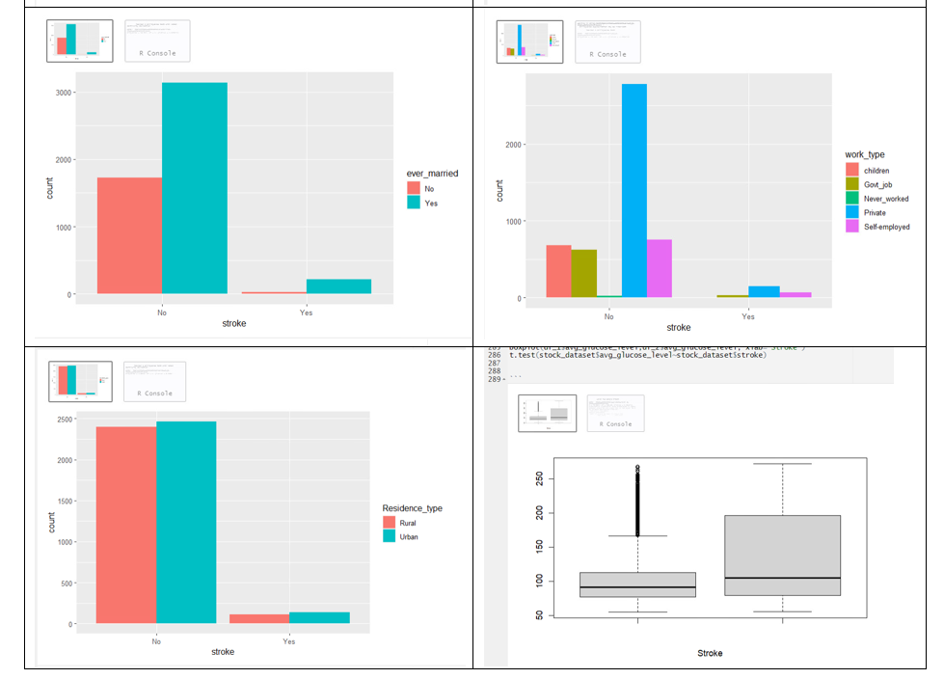
Data Exploration

Slide 8
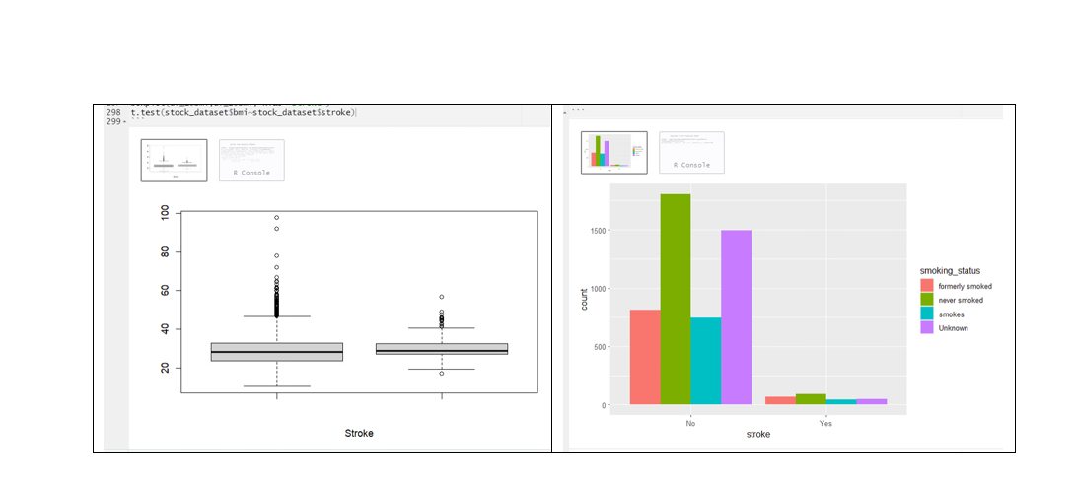
Data Exploration

Slide 9
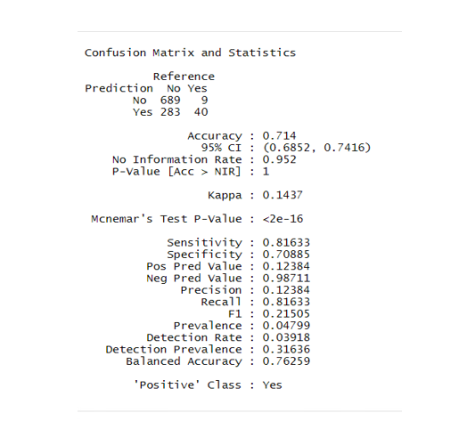
Gradient Boosting Machine (Decision Tree)

Slide 10
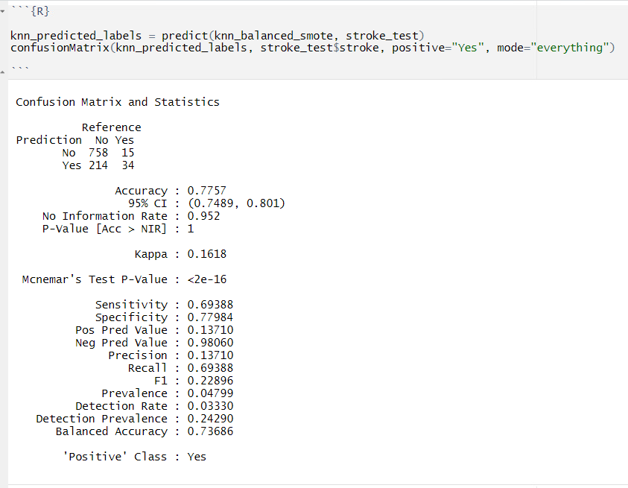
K-Nearest Neighbor Machine (KNN)

Slide 11
Logistic Regression
In this logistic regression, we have 3 types of models to predict.
LASSO
Ridge
Elastic Net

Slide 12
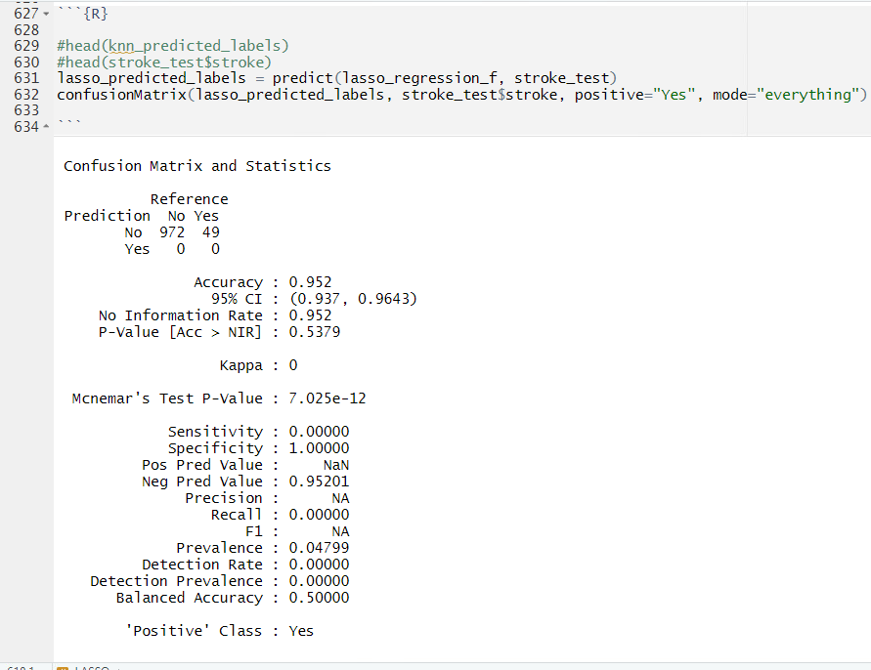
LAASO

Slide 13
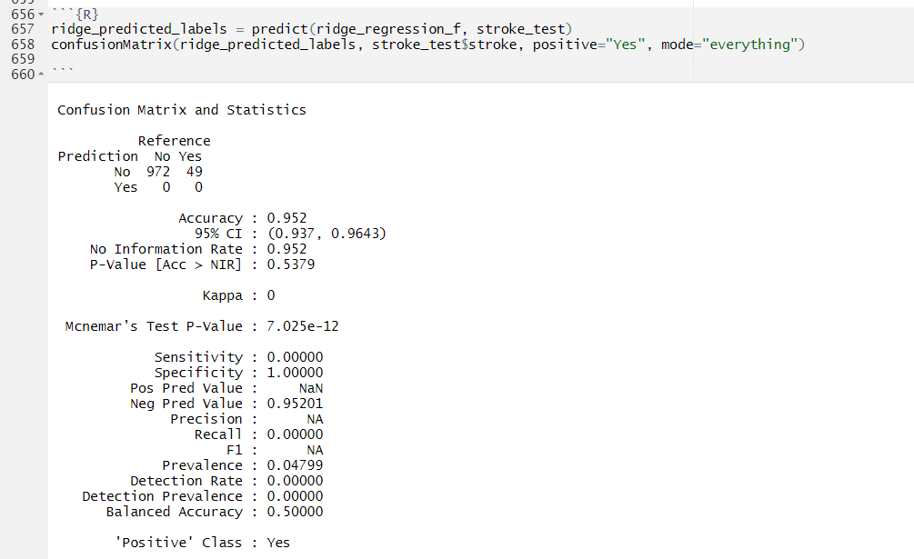
Ridge

Slide 14
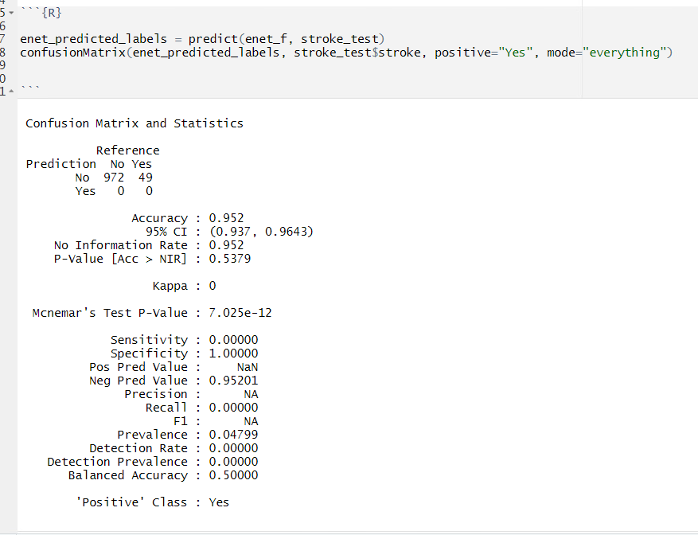
Elastic Net

Slide 15
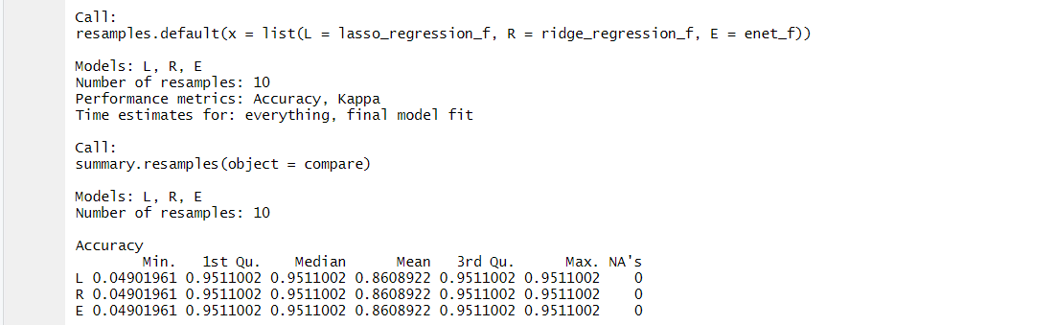
Compare of LAASO,Ridge and Elastic Net

Slide 16
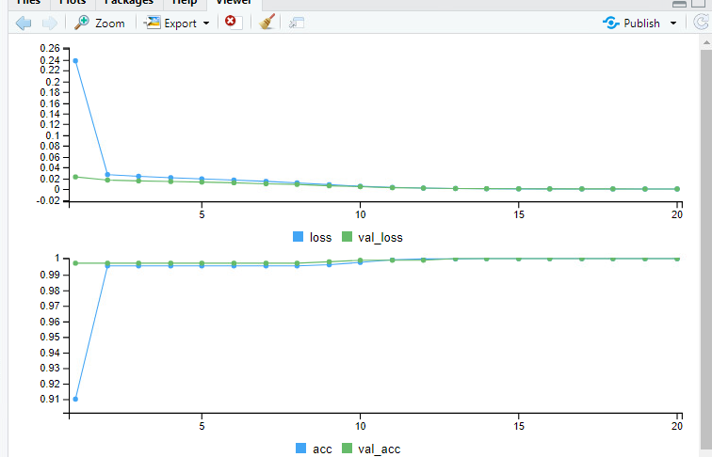
ANN Without Class Weights

Slide 17
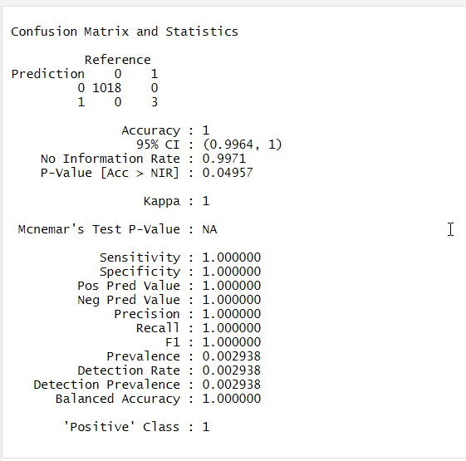
ANN Without Class Weights

Slide 18
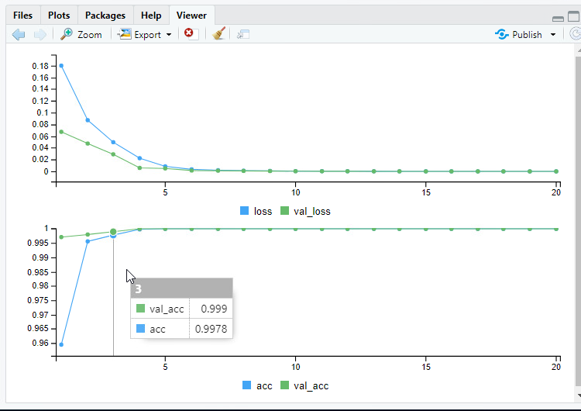
ANN With Class Weights

Slide 19
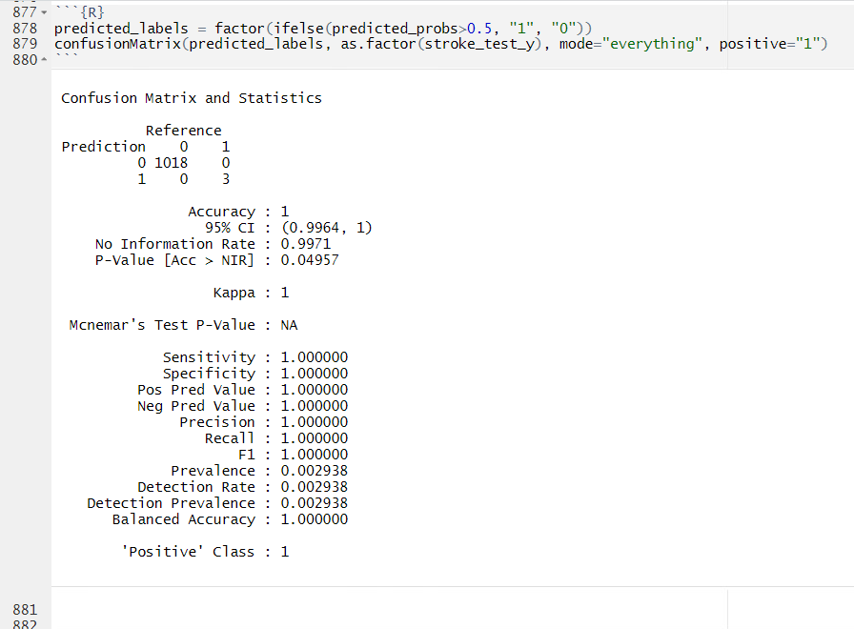
ANN With Class Weight

Slide 20
Compare All Models
In this top 2 most AUC is both the “ANN” and “ANN with class weights” the value of Most AUC is ANN with class weights. (0.9991). we got the least AUC in the Decision Tree which is 0.714. because of the imbalance we got most of the accurate values.
Comparing All the models
While comparing all the models i got the most accuracy "ANN With Class Weights" which is 0.9971
the accuracy of GBM Decision tree is 0.714
The Accuracy of KNN is 0.7757
The Accuracy of LASSO is 0.952
The Accuracy of Ridge is 0.932
The Accuracy of Elastic Net is 0.923
The Accracy of ANN is 0.996

Slide 21
Thank You

