Slide 1


SMART INDIA HACKATHON 2026
◦ PROBLEM STATEMENT ID - 26126
◦ PROBLEM STATEMENT TITLE - VISION BASED AUTONOMOUS NAVIGATION FOR UNMANNED GROUND VEHICLE FOR OUTDOOR ENVIRONMENT
◦ THEME - Smart Automation
◦ PS Category - Software
◦ Team ID - 137858
◦ TEAM NAME - HACKTIDE
Notes:
Title slide. Backup problem statement for Team HACKTIDE (PS 26126, BEL).

Slide 2












HACKTIDE
DRISHTI-Nav
See • Assess • Adapt — camera-only navigation that knows how much to trust its own eyes
One closed loop: perceive terrain, score risk and uncertainty, localise without GPS, replan on change, reach B safely.
END-TO-END AUTONOMY LOOP
1
2
3
4
5
6
Perceive
Assess
Localise
Map
Plan
Move
Lightweight segmentation labels grass, dirt, gravel, mud, rock, tree, ditch.
Energy score flags unknown pixels; a learned regressor rates frame confidence.
Visual odometry / SLAM + wheel odometry; tracking health monitored.
Dynamic risk map 0–100 per cell: terrain, geometry, obstacle, unknown, staleness.
Global A* on risk cost fires on events; local arc planner at 10 Hz.
Governor sets speed and margins from confidence; controller drives the UGV.
EXISTING APPROACH VS DRISHTI-NAV
INNOVATION & UNIQUENESS
SAFETY BY DESIGN
Existing Approach
DRISHTI-Nav
Multi-layer dynamic risk map
Fail-safe autonomy
Binary free / blocked map
Continuous risk field (0–100)
Terrain + geometry + obstacle + unknown fused per cell, updated every frame.
Every uncertainty has a response
Unknown-aware perception
Shortest path at full speed
Safer route, not just shorter
Energy-score OOD + 'novel' class: unfamiliar objects get risk, not a free pass.
Unseen cells carry risk, never 'free'
'Not detected' treated as safe
→
Unknown → uncertain → avoid
Perception-confidence governor
Hard stop on lethal cell ahead
Learned frame-quality score drives speed, safety margin and risk weight.
Low confidence → slow + wide margin
Blind to lighting changes
Confidence-aware speed & margin
Event-driven replanning
SLAM lost → hold, re-acquire
Full replan every frame
Event-driven replanning
Global A* only when the path corridor changes; local arcs at 10 Hz.
Evidence accumulates, no phantom stops
No measure of self-trust
Localisation health → recovery
Lighting-adaptive behaviour
Works with RGB-D / stereo, no GPS
Shadows / low light → lower confidence → conservative navigation.
2
Notes:
Idea slide: the loop, the contrast with the standard camera->YOLO->SLAM->A* chain, the five innovations and the safety posture.

Slide 3




HACKTIDE
FLOW AND ARCHITECTURE
confidence C (from 2) + localisation health H (from 3)
1
UGV & sensors
2
Perception with uncertainty
4
Risk map + events
5
Behaviour governor
Gazebo Harmonic outdoor world
RGB-D camera 640×480, 90° FOV
Wheel odometry — no GPS
Scenario runner: spawn obstacle, change sun
SegFormer-B0 / Fast-SCNN, 8 classes, ONNX
Energy score → per-pixel UNKNOWN
Frame confidence C (learned regressor)
CLAHE pre-processing when dark
Depth → points → 0.25 m cells; per cell: class belief, obstacle log-odds, height, unknown, confidence, last seen
risk = max(terrain, geometry, obstacle, unknown), pulled toward 'uncertain' when C is low; unseen = 35
Events: E1 new lethal cell on path · E2 corridor risk rise · E3 band change · E4 blocked > 2 s → replan
C, H → band NORMAL / CAUTIOUS / CONSERVATIVE / RECOVER
band → v_max, margin, risk weight λ, unknown weight
λ, margin
v_max
6
Adaptive planner
7
Controller
Global A* on 1 + λ·risk², events only (~30 ms)
Local: 52 arcs, 2 s rollout, 10 Hz
Shortest vs safest routes
Pure pursuit on local arc
Speed ≤ v_max(C)
Hard stop if lethal < 0.5 m
/cmd_vel → skid-steer
3
Localisation
RTAB-Map RGB-D visual odometry
EKF fusion with wheel odometry
Tracking health H: features, inliers, lost
/cmd_vel moves the UGV → new camera frame → loop repeats at 10 Hz
WHAT HAPPENS WHEN THE WORLD CHANGES
PROTOTYPE VIDEO
Rock appears 7 m ahead
Unfamiliar object
Sun dims / shadows
Light returns
Closed-loop simulation: risk map, unknown object, lighting event, replanning, A → B.
detected in 1 frame → cell risk 92 → E1 → A* replan ≈ 30 ms → UGV passes with margin
no class fits → energy score high → UNKNOWN → risk 60 + 50·u → treated as lethal, wider berth
confidence 0.95 → 0.47 → CONSERVATIVE: v 1.6 → 0.5 m/s, margin ×2, only risk < 66 driven
confidence recovers → NORMAL band → speed resumes → Point B reached, zero collisions
[YouTube link – add before submission]
3
Notes:
Architecture: perception and localisation run in parallel and feed one risk map; the governor closes the loop from perception quality back into planning parameters.

Slide 4




HACKTIDE
TECH STACK AND FEASIBILITY
TECHNOLOGIES USED
POTENTIAL CHALLENGES & RISKS
Simulation
Perception AI
Textureless grass and sky make visual SLAM lose tracking outdoors.
ROS 2 Jazzy · Gazebo Harmonic · segmentation & RGB-D camera sensors · scenario runner (YAML)
PyTorch · SegFormer-B0 (3.7 M params) / Fast-SCNN · energy-score OOD · ONNX Runtime / TensorRT
Segmentation degrades under strong shadows, dusk and glare.
Objects never seen in training are misclassified as 'safe'.
Localisation
Planning & control
RTAB-Map (RGB-D) · robot_localization EKF · own ORB + PnP visual odometry as fallback
NumPy multi-layer risk map · A* (scikit-image / pyastar2d) · arc-sampling local planner · pure pursuit
Sim-to-real gap: simulator textures differ from real terrain.
ANALYSIS OF FEASIBILITY
Dashboard & eval
Proof-of-concept (now)
All components are proven open-source parts (RTAB-Map, ROS 2, SegFormer) — the novelty is in how they are combined.
Foxglove Studio · FastAPI + WebSocket web view · seeded evaluation harness · CSV metrics
Pure Python: NumPy · SciPy · scikit-image · Matplotlib renderer · imageio (demo video, slide 6)
Risk table, bands and thresholds live in YAML — tunable without retraining.
WHY THIS IS BUILDABLE BY A STUDENT TEAM
Prototype loop runs 10 Hz on CPU; model is ~3.7 M params → embedded-ready (ONNX / TensorRT).
10-week plan: A→B with ground-truth pose by week 3, full stack by week 8.
Simulator auto-labels every training frame → no manual annotation; RUGD / RELLIS-3D / ORFD for real-image fine-tuning.
Every module is NumPy-level maths on a 0.25 m grid; A* replans in ~30 ms, whole loop runs at 10 Hz on a laptop CPU.
Same ROS 2 nodes run on a Jetson with a RealSense / ZED camera — the simulator is swapped, not the code.
Working proof-of-concept already exists (video, slide 6): 45 seeded runs, 3 planner variants.
STRATEGIES FOR OVERCOMING RISKS
● Fuse VO with wheel odometry (EKF); tracking-health signal → hold and re-acquire.
● Confidence governor slows and widens margins when lighting degrades; CLAHE pre-processing.
● Energy-score OOD + 'novel' class trained by outlier exposure in simulation → unknown gets risk.
● Domain randomisation (sun, textures, fog) + fine-tune on RUGD / RELLIS-3D real images.
4
Notes:
Tech stack matches the earlier deck's structure: technologies, feasibility, risks, mitigations.

Slide 5




HACKTIDE
IMPACT AND BENEFITS
IMPACT AREAS — what changes for outdoor UGV operations
TARGET AUDIENCE
GPS-denied defence mobility
Search & rescue
1
BEL / defence UGV programmes
UGVs keep moving under jamming, in forests, valleys and urban canyons where GNSS fails — BEL's core use case.
Reaches casualties over rubble and unstable ground; unknown debris is avoided, not driven into.
Camera-first autonomy module for GPS-denied outdoor platforms.
2
Disaster-response agencies (NDRF, SDRF)
Ground robots for reconnaissance over unstable terrain.
Agriculture
Delivery, surveillance, mining
Agri-robotics & plantation operators
Field robots choose firm ground over mud, cutting bogging and crop damage; runs on a low-cost camera.
Perimeter patrol and last-mile logistics at dawn, dusk and under tree cover with adaptive caution.
3
Low-cost navigation for field and orchard vehicles.
4
Logistics, mining & surveillance
KEY PROGRAM IMPACTS
Perimeter and last-mile autonomy in unstructured sites.
5
Robotics researchers & students
Collision-free autonomy
Safer, not just shorter
Self-aware perception
Open, simulator-agnostic reference stack with evaluation harness.
0 collisions in 45 seeded runs; unknown objects and ditches avoided, not assumed safe.
Time in mud cut from ~40 s to under 1 s per run vs. binary planner; path ~13 % longer.
Confidence score tells the vehicle when to slow down — a first-class signal.
WHO GAINS WHAT
Fast reaction
Low cost, lightweight
Measurable & reproducible
Operator
Vehicle reaches the objective without babysitting; risk appetite is one slider.
New hazard detected within 1–2 frames, ~100–200 ms (binary map: ~960 ms); A* replan in under 30 ms.
One RGB-D camera, no LiDAR, no GPS; 3.7 M-param model runs on Jetson-class boards.
Seeded scenarios and ablations; every claim is a number from the harness.
Platform maker
Drop-in software module; camera only, no GPS/LiDAR bill of materials.
Right terrain · right speed · right margin — collision-free Point A → Point B without GPS
Mission
Fewer stuck or damaged vehicles; predictable, explainable behaviour.
5
Notes:
Impact slide structured like the earlier deck: impact areas, program impacts, target audience, who gains what.

Slide 6
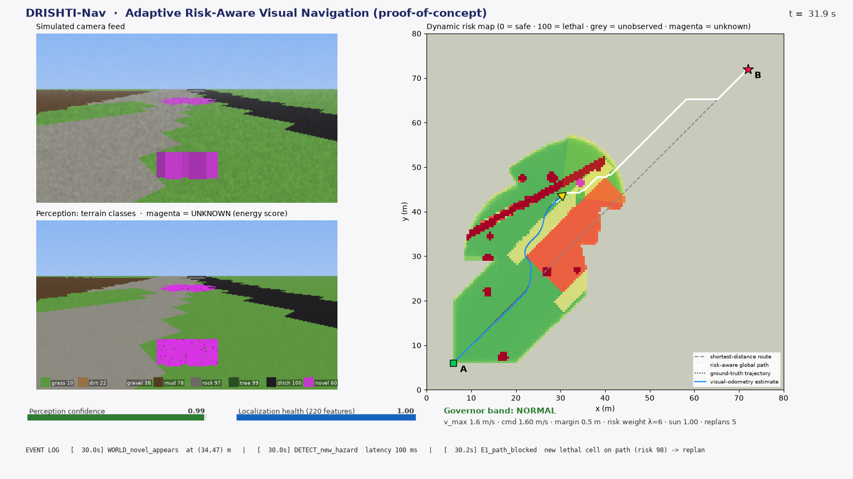

HACKTIDE
RESEARCH AND REFERENCES
PROJECT LINKS & DEMO
PROTOTYPE VIDEO
Full walkthrough of the working simulation (4 min) · [YouTube link – add before submission]
GIT-HUB LINK
Complete repository — simulator, risk map, planner, evaluation harness, deck generator
https://github.com/kiransandilla/SIH_PS_126
RESEARCH & REFERENCES
1. Wigness et al., RUGD: A Dataset for Autonomous Navigation in Unstructured Outdoor Environments, IROS 2019.
2. Jiang et al., RELLIS-3D Dataset: Data, Benchmarks and Analysis, arXiv:2011.12954 (2020).
3. Viswanath et al., OFFSEG: A Semantic Segmentation Framework for Off-Road Driving, 2021.
4. Guan et al., GANav: Efficient Terrain Segmentation for Robot Navigation, IEEE RA-L 2022.
5. Min et al., ORFD: A Dataset and Benchmark for Off-Road Freespace Detection (lighting/weather variation).
6. Liu et al., Energy-based Out-of-distribution Detection, NeurIPS 2020.
7. Hendrycks et al., Deep Anomaly Detection with Outlier Exposure, ICLR 2019.
8. Lakshminarayanan et al., Simple and Scalable Predictive Uncertainty via Deep Ensembles, NeurIPS 2017.
9. Frey et al., Fast Traversability Estimation for Wild Visual Navigation, RSS 2023; RoadRunner, ICRA 2024.
10. Campos et al., ORB-SLAM3, IEEE T-RO 2021; Labbé & Michaud, RTAB-Map, J. Field Robotics 2019.
11. Macenski et al., Nav2 — ROS 2 Navigation Stack; arXiv:2407.18535 (RGB-D → costmap layer).
12. Koenig & Likhachev, D* Lite, AAAI 2002; Fox et al., Dynamic Window Approach, 1997.
13. Xie et al., SegFormer, NeurIPS 2021; Poudel et al., Fast-SCNN, BMVC 2019.
14. BEL Problem Statement 26126, Smart India Hackathon 2026.
Proof-of-concept dashboard (t = 32 s): an unfamiliar object is flagged UNKNOWN (magenta) in the camera and the map; the risk-aware route (white) leaves the mud belt (orange) that the shortest route (grey) crosses; VO estimate vs ground truth, confidence gauge, governor band and event log.
PROTOTYPE RESULTS — 15 seeded runs per planner, same world
Metric | Binary planner | Risk-aware | DRISHTI-Nav
Success (no collision) | 100 % | 100 % | 100 %
Runs with collision | 0/15 | 0/15 | 0/15
Time driving in mud (s, mean) | 39.7 s | 1.6 s | 0.6 s
Hazard detection latency (ms) | 960 | 100 | 213
Global replans / run | 43.1 | 5.3 | 23.2
Path length (m) | 94.1 | 101.8 | 106.2
6
Notes:
References mirror the literature review; video and GitHub links to be inserted by the team.

