Slide 1
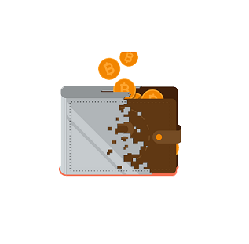

MaceWallet
Team hyjaq

Slide 2
Introduction
MaceWallet is an online digital wallet made formerly for MACians. MaceWallet enables both students and teachers to pay via the use of ID Card barcode.
This MaceWallet is a web based cashless payment which can be applied at any kind of institutions where mobile phones are prohibited.

Slide 3
Features
The main feature of this system is its ease of transaction.
Clients can do their payment with just a scan of their ID Cards, instead of searching for coins.
MaceWallet is not limited just to macians, but any school or institution can register to MaceWallet.
Secure and safe
Convenient
Fast and streamlined payments

Slide 4
How it works
Student
Canteen/Store/Photostat center
Purchases
Barcode scanning
Payment

Slide 5
Applications
In Offices
In Institution
  In Schools and Colleges where mobiles phones are not allowed.

Slide 6
THANK YOU

