Slide 1

FORCASTING A FUTURISTIC CRYPTOCURRENCY(BITCOIN) IN TERMS OF COST
Presented By Kiran babu Basnet Student ID:B00728243

Slide 2

Agenda
Final Idea
01
02
Data Sets i.e. Technical Merits
03
Data Science Process (Methodology)
04
Data Analysis
05
04
Outcome

Slide 3

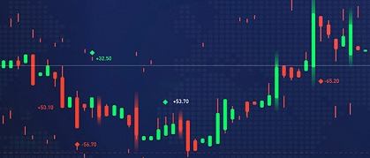
Final Idea
The main purpose of this study is to provide a new or improved ML method, compare several competing ML methods, study the predictive power of the variables in the input set.
To figure out the each ups and down to the crypto world and also help to visualize the upcoming days for the world’s digital economy.
Built a reasonable analytic system based on time series analysis for forecasting the price of crypto currency.
01
02
03
04
05

Slide 4
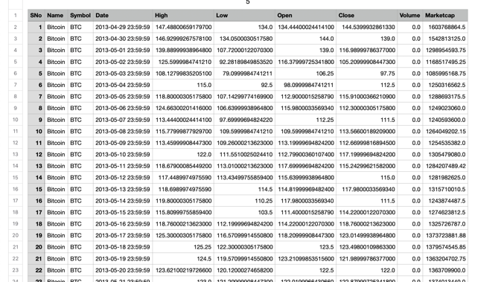
Data sets
All the data sets has taken from following source . https://www.kaggle.com/datasets/sudalairajkumar/cryptocurrencypricehistory/metadata Total size of 2 MB zipped .csv formatted file

Slide 5
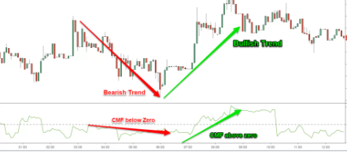
All the formatted data set has mainly six calculative, alphanumeric values
Highest value
Lowest value
Opening value
Closing value
Volume of transaction
Total market capitalization

Slide 6



MODEL
Possible Solution Regression
ARIMA
Monte Carlo Simulation
Random Forest
Gradient Bosting
RNN
ANN
Decision tree
Used Solution LSTM
Pycaret

Slide 7
Data Science Process
Project Planning for Execution
The major activities includes ,
➔ Cryptocurrency data overview
➔ Time Series
➔ Data preprocessing
➔ Build and train LSTM model Pycrate Model
➔ Use the model to predict future Bitcoin price

Slide 8
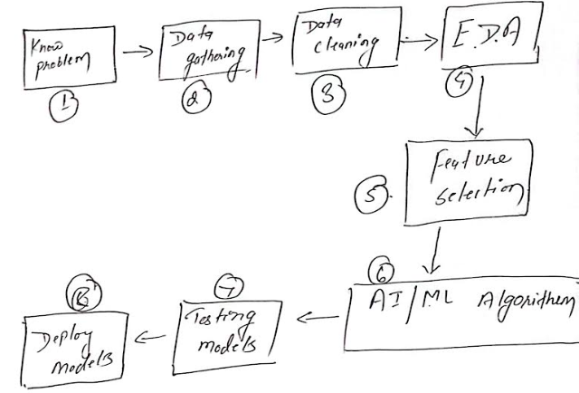
Data Modeling

Slide 9
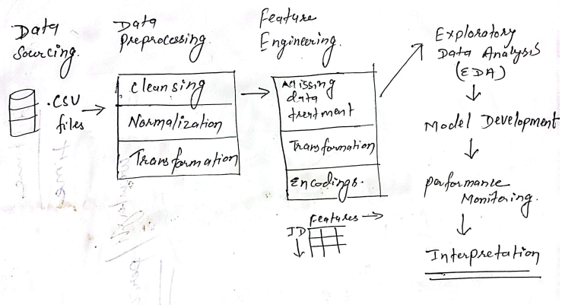
Data Science Pipeline /Project work flow

