Slide 1

This project serves as a comprehensive introduction to SQL for data analysts, covering database setup, data cleaning, exploratory data analysis, and business-driven SQL queries. The findings from this project can help drive business decisions by understanding sales patterns, customer behavior, and product performance.

Slide 2

This project is designed to demonstrate SQL skills and techniques typically used by data analysts to explore, clean, and analyze retail sales data. The project involves setting up a retail sales database, performing exploratory data analysis (EDA), and answering specific business questions through SQL queries. This project is ideal for those who are starting their journey in data analysis and want to build a solid foundation in SQL.
## Objectives
1. Set up a retail sales database- Create and populate a retail sales database with the provided sales data.
2. Data Cleaning- Identify and remove any records with missing or null values.
3. Exploratory Data Analysis (EDA)- Perform basic exploratory data analysis to understand the dataset.
4. Business Analysis- Use SQL to answer specific business questions and derive insights from the sales data.

Slide 3
Creating table Head with its Data-types
create table retail_sales(
transcations_id int primary key,
sale_date date,
sale_time time,
customer_id int,
gender varchar(15),
age int,
category varchar(15),
quantity int,
price_per_unit float,
cogs float,
total_sale float
)
select * from retail_sales

Slide 4
Cleaning the data( removing all the null values)
delete from retail_sales
WHERE
transcations_id IS NULL
OR sale_date IS NULL
OR sale_time IS NULL
OR customer_id IS NULL
OR gender IS NULL
OR age IS NULL
OR category IS NULL
OR quantity IS NULL
OR price_per_unit IS NULL
OR cogs IS NULL
OR total_sale IS NULL

Slide 5
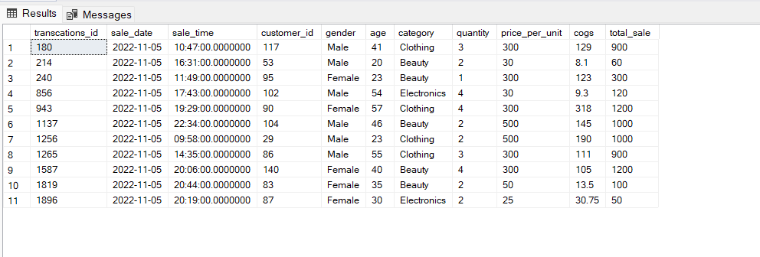
--1. Write a SQL query to retrieve all columns for sales made on '2022-11-05'--
select * from retail_sales
where sale_date='2022-11-05'

Slide 6
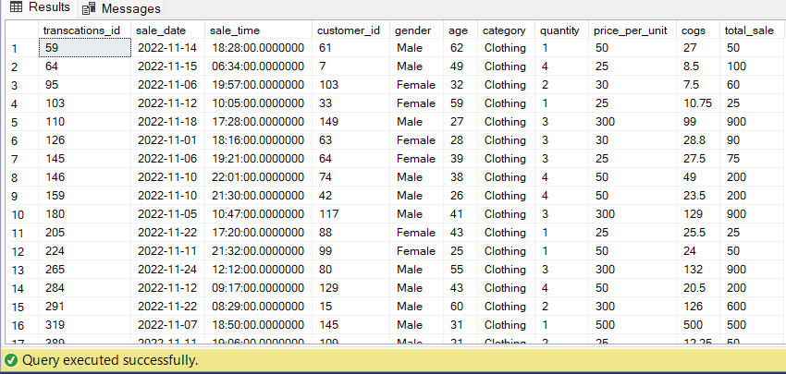
/* 2. **Write a SQL query to retrieve all transactions where the category is 'Clothing'
and the quantity sold is more than 4 in the month of Nov-2022**:*/
SELECT *
FROM retail_sales
WHERE category = 'clothing'
AND FORMAT(sale_date, 'yyyy-MM') = '2022-11'
AND quantity <= 4;

Slide 7
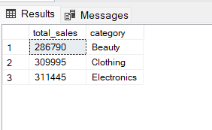
--3. **Write a SQL query to calculate the total sales (total_sale) for each category.**:--
select SUM(total_sale) as total_sales,category from retail_sales
group by category
order by total_sales

Slide 8
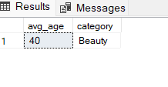
--4. **Write a SQL query to find the average age of customers who purchased items from the 'Beauty' category.**:--
select avg(age) as avg_age, category from retail_sales
where category='Beauty'
group by category

Slide 9
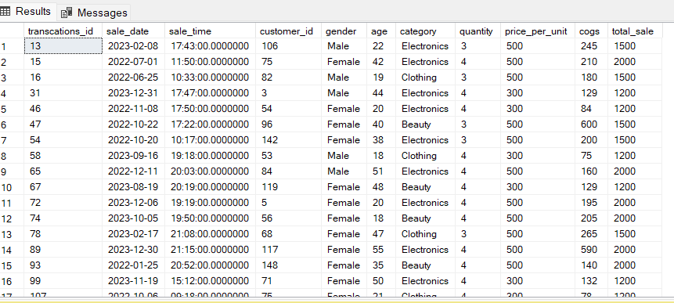
--5. **Write a SQL query to find all transactions where the total_sale is greater than 1000.**:--
select * from retail_sales
where total_sale>1000

Slide 10
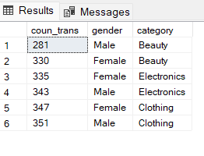
6. **Write a SQL query to find the total number of transactions (transaction_id) made by each gender in each category.**:
select count(transcations_id) as coun_trans, gender ,category from retail_sales
group by gender,category
order by coun_trans

Slide 11
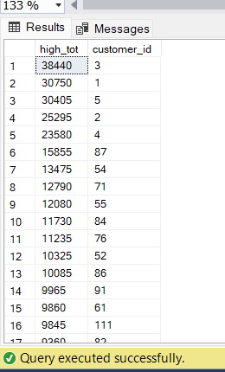
--7. **Write a SQL query to find the top 5 customers based on the highest total sales **:--
select sum(total_sale) as high_tot , customer_id from retail_sales
group by customer_id
order by high_tot desc

Slide 12
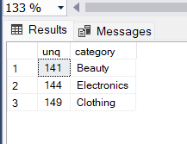
--8. **Write a SQL query to find the number of unique customers who purchased items from each category.**:--
select count(distinct customer_id) as unq_count ,category from retail_sales
group by category
order by unq

Slide 13
--9. **Write a SQL query to create each shift and number of orders
--(Example Morning <12, Afternoon Between 12 & 17, Evening >17)**:--
with hourly_sale
as
(
select *,shiftu=
case
when DATEPART(HOUR, sale_time)<12 then 'morning'
when DATEPART(hour, sale_time) between 12 and 17 then 'afternoon'
else 'evening'
end
from retail_sales
)
select shiftu,
count(*) as total_orders
from
hourly_sale
group by shiftu

Slide 14
## Reports
- **Sales Summary**: A detailed report summarizing total sales, customer demographics, and category performance.
- **Trend Analysis**: Insights into sales trends across different months and shifts.
- **Customer Insights**: Reports on top customers and unique customer counts per category.
## Conclusion
This project serves as a comprehensive introduction to SQL for data analysts, covering database setup, data cleaning, exploratory data analysis, and business-driven SQL queries. The findings from this project can help drive business decisions by understanding sales patterns, customer behavior, and product performance.

