Slide 1
GenAI: Navigating Short-term Skepticism and Long-term Promises
ICT Capstone Project Presentation
Group: 11 Unit: COIT20265/COIT13236
Project Mentor: Dr. Ahemedi Azra Term: 2022 Term 2
Unit Coordinator: Dr. Fariza Sabrina
Bhuwan Thapa (Melbourne)
Kiran Bhusal (Melbourne)
Basanta Adhikari ( Melbourne)
Pratik Singh Dhami (Melbourne)
Notes:
Replace PROJECTITLE should be the title of your project, e.g. Internet-of-Things Network Design for Gladstone Regional Council. Move the title up if space is needed.
Replace NUMBER with your group number.
Give the NAME of your Project Mentor.
List the full names of all students (if less than 5 students, delete the remaining lines).
Give the campus (in brackets) for each student.
If all students are in the same unit (e.g. COIT20265), delete the unit code for the other (e.g. delete COIT13236). If your group has a mix, leave both unit codes.

Slide 2
Table of Contents
01
02
03
Project Introduction
Technical Requirements
Generative AI
Development Process
04
05
06
Testing and Trouble
Shootings
Future scope
Project Challenges
Notes:
Edit the Footer and replace NUMBER with your Group number and replace PROJECTTITLE with your title (use a shorter title if it doesn’t fit on the line), e.g. “IoT Network for Gladstone Regional Council” instead of “Internet-of-Things Network Design for Gladstone Regional Council”.

Slide 3
Project Introduction
The project address about the challenges and opportunities presented by generative AI in cybersecurity.
Problems from Business/Technical perspective due to implementation of GenAI.
Business Perspective | Technical perspective
Intellectual property concerns | Ethical implementation
Economic disruptions | Data quality and bias
Managing expectations | Technical expertise and collaboration
Notes:
Edit the Footer and replace NUMBER with your Group number and replace PROJECTTITLE with your title (use a shorter title if it doesn’t fit on the line), e.g. “IoT Network for Gladstone Regional Council” instead of “Internet-of-Things Network Design for Gladstone Regional Council”.

Slide 4
Project Milestones
Project Milestones
Develop a comprehensive strategy for security leaders to effectively integrate GenAI into cybersecurity along with managing associated risks and ethical issues.
Provide a proper framework for the ethical implementation of GenAI into cybersecurity of Automobile services.
Conduct a thorough risk assessment and provide risk mitigation plan for the implementation of GenAI into cybersecurity for selected industry-automobile services.
Promotes organizations such as automobile services to provide collaborative training for technical and non-technical staff for the safe and secure use of GenAI into cybersecurity in the industry.
Notes:
Edit the Footer and replace NUMBER with your Group number and replace PROJECTTITLE with your title (use a shorter title if it doesn’t fit on the line), e.g. “IoT Network for Gladstone Regional Council” instead of “Internet-of-Things Network Design for Gladstone Regional Council”.

Slide 5
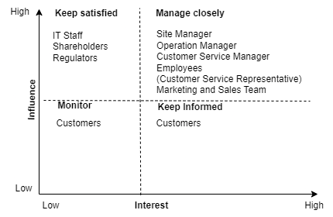
Industry Analysis and Stakeholder Identification
Cybersecurity Issues in Automobile Services
Stakeholders Identification
Data privacy and security concerns:
Ensure data security and privacy such as sensitive personal information including names, contact details, payment information.
Network Security and Vulnerabilities:
Unsecure software, unprotected Wi-Fi networks, and inadequate encryption (Yaqoob et al., 2017).
Secure AI Integration:
Lack of continuous monitoring of AI performance (Habbal et al., 2024).
Fig 3: Stakeholders engagement matrix
Notes:
Edit the Footer and replace NUMBER with your Group number and replace PROJECTTITLE with your title (use a shorter title if it doesn’t fit on the line), e.g. “IoT Network for Gladstone Regional Council” instead of “Internet-of-Things Network Design for Gladstone Regional Council”.

Slide 6
Strategies for Security Leaders
Develop a clear GenAI strategy: Clearly articulate the organization's goals for implementing GenAI in cybersecurity (Huang et al., 2024).
Establish an AI ethics committee: Create a special AI Ethics Committee representative from various stakeholders.
Establish a robust governance structure: Clearly define roles and responsibilities of each stakeholder for AI implementation, Establish clear protocols for AI-assisted decision-making, transparency and biasness.
Conduct comprehensive risk assessment: Create robust mitigation plans to address identified risks, including data privacy concerns and potential biases in AI models (Huang et al., 2024).
Ensure data privacy and security: Implement strong encryption and access control measures to protect sensitive data stored in the system using in GenAI.
Notes:
Edit the Footer and replace NUMBER with your Group number and replace PROJECTTITLE with your title (use a shorter title if it doesn’t fit on the line), e.g. “IoT Network for Gladstone Regional Council” instead of “Internet-of-Things Network Design for Gladstone Regional Council”.

Slide 7
Ethical Framework in Cybersecurity
Unique cybersecurity challenges:
Balancing security with privacy(Sprinto, 2023)
Rapid evolution of threats and technologies
Key ethical considerations:
Data protection and user privacy
Transparency in security measures
Fairness in threat detection and response
Accountability for AI-driven decisions (Christen, Gordijn and Loi, 2023)
Examples of existing frameworks:
NIST Cybersecurity Framework
ACS Ethical framework
EU's Ethical Guid (Flechais and Chalhoub, 2023)
Scalability vs. Security
Human Factor in Cybersecurity(Embroker, 2023)
Notes:
Edit the Footer and replace NUMBER with your Group number and replace PROJECTTITLE with your title (use a shorter title if it doesn’t fit on the line), e.g. “IoT Network for Gladstone Regional Council” instead of “Internet-of-Things Network Design for Gladstone Regional Council”.

Slide 8
Ethical Framewrok for GenAI implementation
Core Principles
A structured set of principles, guidelines, and processes ensuring responsible AI use in digital asset protection.(Floridi and Cowls, 2023)
Transparency
Accountability
Fairness
Privacy
Human Oversight and control
Security(Shneiderman, 2023; Floridi and Cowls, 2023)

Slide 9
Framework for ethical AI Implementation into Automobile Services
Vulnerability Detection:
Use of explainable AI models (code-bert, tenser-flow) for transparent threat identification
Regular bias audits to ensure fair treatment of all system components(UpGuard, 2023)
Data Handling:
Implementation of federated learning to enhance privacy
Strict data minimization and anonymization practices
Decision Support:
AI-assisted decision-making with clear human oversight protocols
Ethical impact assessments for all AI-driven security measures
Notes:
Edit the Footer and replace NUMBER with your Group number and replace PROJECTTITLE with your title (use a shorter title if it doesn’t fit on the line), e.g. “IoT Network for Gladstone Regional Council” instead of “Internet-of-Things Network Design for Gladstone Regional Council”.

Slide 10
Framework for ethical AI Implementation into Automobile Services
Incident Response:
Ethical guidelines integrated into automated response systems
Regular ethical scenario training for security personnel(UpGuard, 2023)
Stakeholder Engagement:
Transparent communication about AI use in security operations(Floridi and Cowls, 2023)
Regular ethical AI workshops for employees and clients
Notes:
Edit the Footer and replace NUMBER with your Group number and replace PROJECTTITLE with your title (use a shorter title if it doesn’t fit on the line), e.g. “IoT Network for Gladstone Regional Council” instead of “Internet-of-Things Network Design for Gladstone Regional Council”.

Slide 11
Risk Assessment and Mitigation Plan
Risk Assessment of GenAI application in cybersecurity for Automobile Service Industry (NIST Special Publication 800-30 Revision 1, titled "Guide for Conducting Risk Assessments") (Katsumata et Al. 2010).
01
02
03
04
Identify Assets "Firewalls, GenAI tool, Model Training Data, Process and AWS Cloud Services"
Identify Threats "Insider Threats, Hardware Failure, Data Poisoning"
Identify Vulnerabilities "Weak authentication, like easily guessable passwords to Access System"
TVA in Cybersecurity "Threat, Vulnerability, Asset relationship“ (Blank and Gallagher 2012).

Slide 12
Risk Assessment and Mitigation plan
01
02
03
Risk Rank : Prioritize vulnerabilities based on their likelihood of exploitation and impact. For example, Vulnerability with High likelihood and High impact is considered a High-risk issue.
Risk Mitigation Plan "NIST Cybersecurity Framework CSF core 2.0"
To mitigate risk specific controls taken to each vulnerability is categorized using NIST core functions "Govern, Identify, Protect, Detect, Respond, and Recover“ (Dimakopoulou and Rantos 2024). Then Category, and finally Subcategory.

Slide 13
Risk Assessment and Mitigation Plan
Example,
Weak Password Policies (Vul No. 17):
CSF Core Function: PROTECT
Category: (PR. AA) Identity Management, Authentication, and Access Control
Subcategory: Align with PR. AA-01 (Identities and credentials for authorized users, services, and hardware are managed by the organization).
Mitigation: Develop strong password policies, including complexity requirements and regular password changes. Implement MFA for critical systems and accounts.

Slide 14
Collaborative Training and Awareness Program
1. Promoting Continuous Learning and Fostering awareness in GenAI ( Meli et al.,2024).
Continuous Learning Initiatives
Regular webinars, workshops and training on GenAI development.
Frequent audits to ensure efficiency of AI system.
Collaboration
Cross-functional teams: IT, Marketing, Compliance, Business working together.
Shared learning through workshops and feedback systems.
Feedback and adaptation
Use of surveys, suggestion forms, and feedback meetings to gather insights.
Continuous improvement of training materials and policies based on feedback.
Notes:
Edit the Footer and replace NUMBER with your Group number and replace PROJECTTITLE with your title (use a shorter title if it doesn’t fit on the line), e.g. “IoT Network for Gladstone Regional Council” instead of “Internet-of-Things Network Design for Gladstone Regional Council”.

Slide 15
Collaborative Training and Awareness Program
2. Building a Culture of Awareness in GenAI (Kelly,Sullivan et al.,2023)
Awareness campaigns
Regular communication via newsletters, emails, and meetings.
Internal initiatives: GenAI Awareness Week, AI Innovation Days.
Promotional Tools
Posters, infographics, and interactive displays to explain GenAI usage.
Strategic placement in high-traffic areas: offices, break rooms.
Stakeholder Involvement
Engaging cybersecurity experts, data scientists, and business leaders for a comprehensive GenAI strategy.
Notes:
Edit the Footer and replace NUMBER with your Group number and replace PROJECTTITLE with your title (use a shorter title if it doesn’t fit on the line), e.g. “IoT Network for Gladstone Regional Council” instead of “Internet-of-Things Network Design for Gladstone Regional Council”.

Slide 16
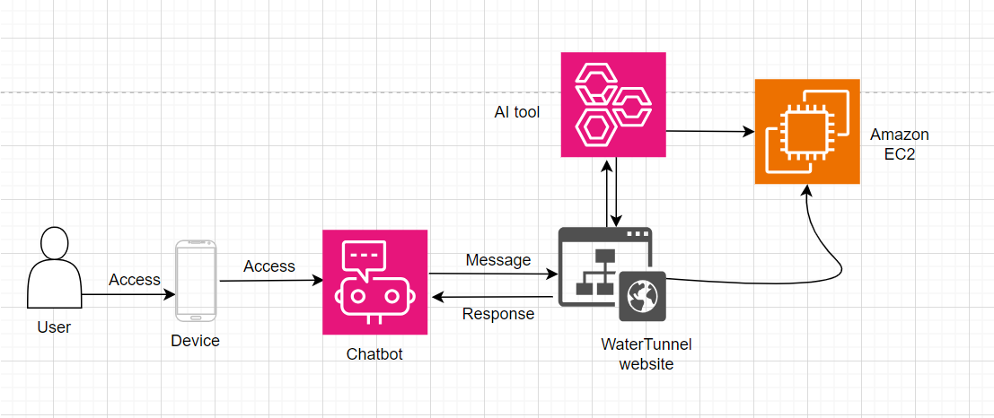
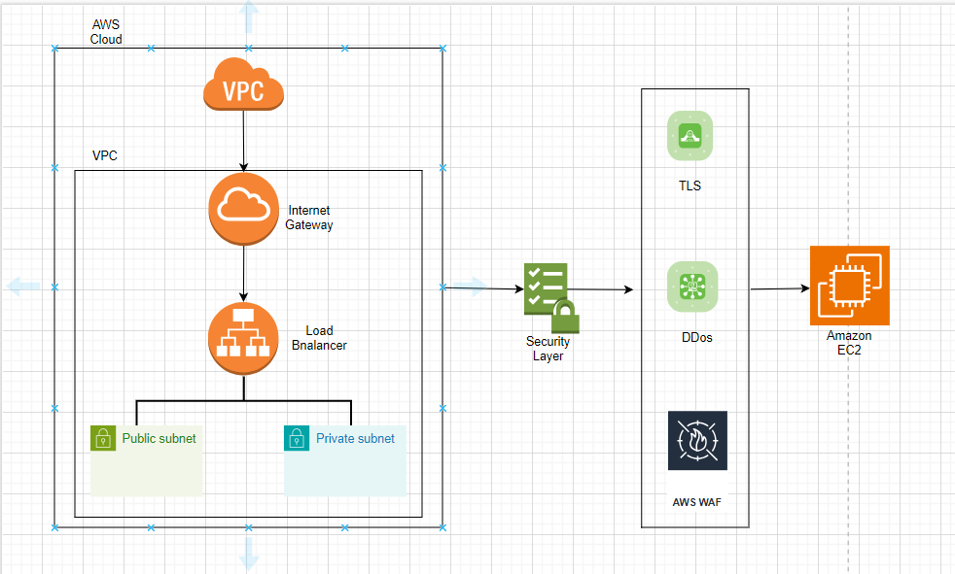
Prototype-System Model Diagram
System Model Diagram
Security Architecture
Fig 1: System model diagram
Fig 2: Security architecture
Notes:
Edit the Footer and replace NUMBER with your Group number and replace PROJECTTITLE with your title (use a shorter title if it doesn’t fit on the line), e.g. “IoT Network for Gladstone Regional Council” instead of “Internet-of-Things Network Design for Gladstone Regional Council”.

Slide 17
Technical Requirements of the Project
01
02
03
Programming Language Python in VS code to development GenAI tool.
Website Design and Development using WordPress.
Prototype deployed on AWS server.
Notes:
Edit the Footer and replace NUMBER with your Group number and replace PROJECTTITLE with your title (use a shorter title if it doesn’t fit on the line), e.g. “IoT Network for Gladstone Regional Council” instead of “Internet-of-Things Network Design for Gladstone Regional Council”.

Slide 18
Development Process of GenAI Prototype
01
02
03
Application development using python in VS code
Machine learning AI models used in the developed prototype are code-bert, tensor flow, isolation forest
Deployment of prototype into AWS server
04
05
Project prototype is used to detect vulnerabilities on the website for XSS, SQI injection, SSRF, RCE, Brute force attack etc.
Generate output-vulnerability report
Notes:
Edit the Footer and replace NUMBER with your Group number and replace PROJECTTITLE with your title (use a shorter title if it doesn’t fit on the line), e.g. “IoT Network for Gladstone Regional Council” instead of “Internet-of-Things Network Design for Gladstone Regional Council”.

Slide 19
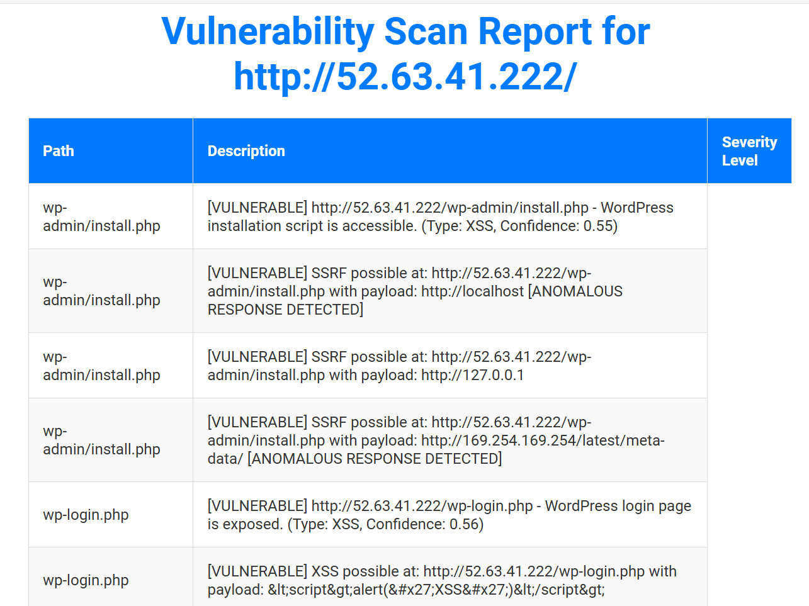
AI tool testing
The developed Generative AI tool detects the cybersecurity vulnerabilities mainly for the WordPress website. Here is the testing result.
Notes:
Edit the Footer and replace NUMBER with your Group number and replace PROJECTTITLE with your title (use a shorter title if it doesn’t fit on the line), e.g. “IoT Network for Gladstone Regional Council” instead of “Internet-of-Things Network Design for Gladstone Regional Council”.

Slide 20
Challenges
01
02
03
Website design and deployment
Selecting machine learning model
Deployment of AI into web server
Notes:
Edit the Footer and replace NUMBER with your Group number and replace PROJECTTITLE with your title (use a shorter title if it doesn’t fit on the line), e.g. “IoT Network for Gladstone Regional Council” instead of “Internet-of-Things Network Design for Gladstone Regional Council”.

Slide 21
Future Scope
Provided guidelines for implementation of Generative AI into cybersecurity focusing on automobile services will be beneficial for the security leaders and other industry stakeholders.
The development of AI tool can be used to detect cybersecurity vulnerability of the any website.
Notes:
Edit the Footer and replace NUMBER with your Group number and replace PROJECTTITLE with your title (use a shorter title if it doesn’t fit on the line), e.g. “IoT Network for Gladstone Regional Council” instead of “Internet-of-Things Network Design for Gladstone Regional Council”.

Slide 22
Thanks!
Does anyone have any questions? Thank you all for your attention and interest.
Acknowledgements: Special thanks to our mentor Dr Ahmedi Azra, unit coordinator Fariza Sabrina for their invaluable guidance and support throughout the project.
Notes:
Edit the Footer and replace NUMBER with your Group number and replace PROJECTTITLE with your title (use a shorter title if it doesn’t fit on the line), e.g. “IoT Network for Gladstone Regional Council” instead of “Internet-of-Things Network Design for Gladstone Regional Council”.

Slide 23
Reference
Yaqoob, I., Ahmed, E., ur Rehman, M.H., Ahmed, A.I.A., Al-garadi, M.A., Imran, M. and Guizani, M., 2017. The rise of ransomware and emerging security challenges in the Internet of Things. Computer Networks, 129, pp.444-458.
Habbal, A., Ali, M.K. and Abuzaraida, M.A., 2024. Artificial Intelligence Trust, risk and security management (AI trism): Frameworks, applications, challenges and future research directions. Expert Systems with Applications, 240, p.122442.
Huang, K., Ponnapalli, J., Tantsura, J. and Shin, K.T., 2024. Navigating the GenAI Security Landscape. In Generative AI Security: Theories and Practices (pp. 31-58). Cham: Springer Nature Switzerland.
Katsumata, P., Hemenway, J. and Gavins, W., 2010, October. Cybersecurity risk management. In 2010-MILCOM 2010 Military Communications Conference (pp. 890-895). IEEE.
Dimakopoulou, A. and Rantos, K., 2024. Comprehensive Analysis of Maritime Cybersecurity Landscape Based on the NIST CSF v2. 0. Journal of Marine Science and Engineering, 12(6), p.919.
Kelly, A., Sullivan, M. and Strampel, K., 2023. Generative artificial intelligence: University student awareness, experience, and confidence in use across disciplines.
Meli, K., Taouki, J. and Pantazatos, D., 2024. Empowering educators with generative ai: The genai education frontier initiative. In EDULEARN24 Proceedings (pp. 4289-4299). IATED.
Sprinto, 2023. Top 5 Challenges of Cyber Security in 2023. [online] Available at: https://sprinto.com/blog/challenges-of-cyber-security/ [Accessed 3 October 2024]
Embroker, 2023. Top 15 Cybersecurity Threats in 2023. [online] Available at: https://www.embroker.com/blog/top-cybersecurity-threats/ [Accessed 1 October 2024].
UpGuard, 2023. Cybersecurity and Social Responsibility: Ethical Considerations. [online] Available at: https://www.upguard.com/blog/cybersecurity-ethics [Accessed 1 October 2024].
Shneiderman, B., 2023. Human-Centered AI. Oxford University Press.
Floridi, L. and Cowls, J., 2023. A Unified Framework of Five Principles for AI in Society. Harvard Data Science Review, 1(1)
Notes:
Edit the Footer and replace NUMBER with your Group number and replace PROJECTTITLE with your title (use a shorter title if it doesn’t fit on the line), e.g. “IoT Network for Gladstone Regional Council” instead of “Internet-of-Things Network Design for Gladstone Regional Council”.

