Slide 1

EECUTIVE BRIEFING
Unified Observability
Platform Strategy
Hybrid Cloud Architecture · Open Source & Dynatrace · L1/L2/L3 Support Model
Platform Engineering · Observability Centre of Excellence · Confidential

Slide 2


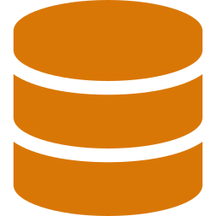


The Business Challenge
01
Fragmented visibility
What we need
Separate tools for AWS, Azure, on-prem and AI systems. No single view of platform health.
A single, unified view across all environments
Data blind spots
Data pipelines and Snowflake environments go unmonitored. Issues surface late, after impact.
Standardised telemetry — metrics, logs, and traces
Tiered support model: L1 (ops) → L2 (engineering) → L3 (AI/data)
Slow incident response
L1/L2/L3 teams lack shared context. Mean time to resolution is high and escalation paths are unclear.
Built-in AI & data pipeline observability
Flexibility to evolve without full vendor lock-in
AI system growth
LLM and agentic workloads are scaling fast with no standardised way to trace prompts, tokens or agents.

Slide 3
Platform Architecture
02
Six integrated layers — from client workloads to AI observability
1
Client environments
Design
principles
AWS · Azure · On-Prem · EKS · AI/LLM Systems
2
Telemetry collection
Open standards (OTel throughout)
OTel SDKs · Prometheus · Promtail · Dynatrace OneAgent
3
Ingestion & routing
Multi-tenant isolation
OTel Gateway · Kafka (optional) · Dynatrace Ingest
4
Core observability
Dual-track: OSS + Dynatrace
Metrics · Logs · Traces · Alerting (real-time)
5
Visualisation & access
Secure outbound only
Grafana · Dynatrace UI · Single pane of glass
6
Data & AI layer
Scales from lean to enterprise
Snowflake · Observe · Langfuse · GenAI tracing

Slide 4
Strategic Options
03
Two proven paths — both built on OpenTelemetry open standards
Open Source Stack
Dynatrace Platform
Metrics
Mimir / Prometheus
Metrics
DT Metrics
Logs
Loki
Logs
DT Logs
Traces
Tempo
Traces
Distributed Tracing
Alerting
Alertmanager
Alerting
Davis AI (automatic)
Dashboards
Grafana
Dashboards
DT UI + AI insights
AI tracing
Langfuse + OTel
AI tracing
DT GenAI Observability
Shared by both paths:
Snowflake · Observe · OpenTelemetry backbone · Grafana dashboards

Slide 5
Architecture — Collection, Ingestion & Core Observability
04a
Layers 1–3 · Data in, route, store & alert
Open Source path
Dynatrace path
Shared / common
CLIENT / WORKLOAD ENVIRONMENTS
AWS
Azure
On-Prem
EKS
Apps
Data Pipelines
AI / LLM Systems
1
TELEMETRY COLLECTION — STANDARDISED LAYER
OPEN SOURCE PATH
DYNATRACE PATH
Prometheus + Promtail / OTel
Dynatrace OneAgent
Prometheus
Promtail
OTel SDKs
OneAgent
Auto-instrument
Common: multi-tenant tagging (Client / Env / App) + OTel SDKs across both paths
Secure outbound only
2
INGESTION & ROUTING — CONTROL PLANE
OPEN SOURCE PATH
DYNATRACE PATH
OTel Gateway
Dynatrace Ingest (SaaS)
OTel Gateway
Kafka (optional)
DT Ingest
Managed pipeline
Tenant isolation enforced at this layer for both paths
3
CORE OBSERVABILITY PLATFORM — REAL-TIME
OPEN SOURCE STACK
DYNATRACE PLATFORM
Mimir / Prometheus · Loki · Tempo
DT Metrics · DT Logs · Distributed Tracing
Mimir / Prometheus
Loki
Tempo
Alertmanager
DT Metrics
DT Logs
Davis AI alerts
L1 / L2 monitoring & incident response
Platform Engineering · Observability Centre of Excellence · Confidential

Slide 6
0
Architecture — Visualisation, Data & AI Observability
04b
Layers 4–6 · See, investigate & trace AI workloads
Open source path
Dynatrace path
Shared / common
4
VISUALIZATION & ACCESS — SINGLE PANE OF GLASS
OPEN SOURCE PATH
DYNATRACE PATH
Grafana
Dynatrace UI
Dashboards, SLOs, alert management, multi-tenant views
Dashboards, Davis AI insights, entity topology
Grafana
SLOs
Alerting
DT UI
Davis AI
Topology
5
DATA & SPECIALIST OBSERVABILITY — L2 / L3
COMMON — BOTH PATHS
COMMON — BOTH PATHS
DYNATRACE ADD-ON
Snowflake
Observe
DT Workflows
Source of truth for data observability signals
Deep data investigation & relationship analysis
Snowflake extension, automated workflows
Snowflake
ZZDB archiving
Observe
Correlation
SF Extension
Workflows
L2 / L3 data engineering & analysis — integrated via Snowflake, not duplicated
6
AI / NEXT-GEN OBSERVABILITY — EMERGING
OPEN SOURCE PATH
DYNATRACE PATH
Langfuse + OTel extensions
DT GenAI Observability
Custom AI tracing, prompt & agent observability
Emerging capabilities for LLM & agentic systems
Langfuse
OTel extensions
Agent tracing
DT GenAI
LLM Tracing
Prompt, token, and agent observability — future-ready for LLM & agentic workloads
Platform Engineering · Observability Centre of Excellence · Confidential

Slide 7
Head-to-Head Comparison
05
Open Source Stack
Dynatrace
Ease of implementation
2/5
4.5/5
High setup effort
Deploy in days
Lean team fit
1.5/5
4/5
Deep expertise needed
1–2 engineers can operate
Total cost of ownership
3/5
2.5/5
Low licence, people cost
Predictable, premium pricing
Day 2 maintenance
1.5/5
4.5/5
Multi-tool upgrade cycles
Vendor-managed SaaS
AI-driven alerting
2/5
4.5/5
Manual rule authoring
Davis AI — noise suppression
Vendor lock-in risk
5/5
2/5
Zero — open standards
Moderate proprietary dependency
Future flexibility
5/5
3/5
Fully composable
Roadmap-dependent
Data observability depth
4/5
2.5/5
Native Snowflake + Observe
Extension required
Leads on 4 of 8 dimensions
Leads on 4 of 8 dimensions

Slide 8
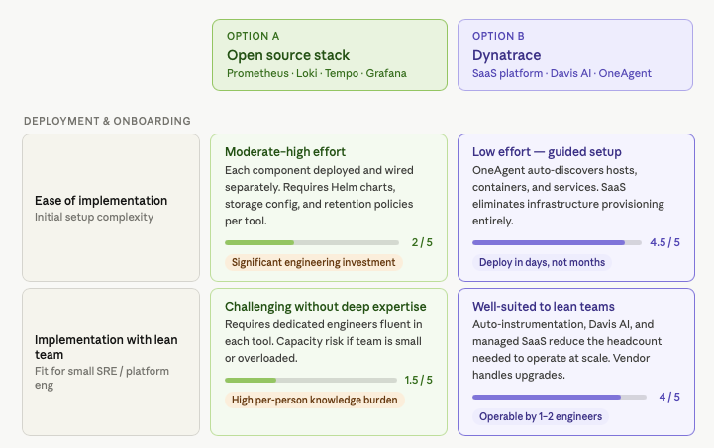
Head-to-Head Comparison in detail
06a
Dynatrace

Slide 9
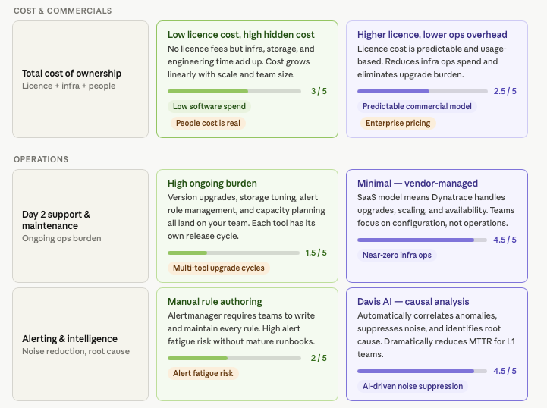
Head-to-Head Comparison
06b
Dynatrace

Slide 10
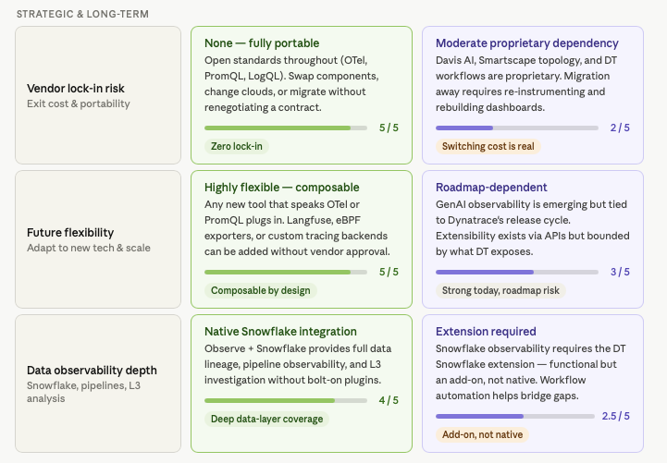
Head-to-Head Comparison
06c
Dynatrace

Slide 11


Key Differentiators — What Really Matters
07
Speed to value
Lean team operations
DT leads
DT leads
Open source
Open source
3–6 months to full deployment. Requires experienced platform engineers for each tool.
High knowledge burden per engineer. Each tool has its own upgrade cadence and tuning needs.
Dynatrace
Dynatrace
2–6 weeks. OneAgent auto-discovers everything. Managed SaaS means no infra to build.
Dynatrace handles upgrades, scaling and availability. Teams focus on config, not infrastructure.
Vendor independence
Data & AI observability
OSS leads
OSS leads
Open source
Open source
100% open standards. Swap any component, change cloud providers, exit anytime at zero cost.
Native Snowflake + Observe integration. Best-in-class for data pipeline and LLM tracing via Langfuse.
Dynatrace
Dynatrace
Davis AI and Smartscape are proprietary. Re-migration requires significant re-instrumentation.
Snowflake extension available but bolt-on. GenAI observability emerging — tied to DT roadmap.

