Slide 1



Web Scraping using Python
Kiran TIRUMALE LAKSHMANA RAO

Slide 2
Contents
01
Introduction
02
The final product
03
How did I build the product
04
Questions and Answers

Slide 3
Introduction

Slide 4
The Goal
Scraping Airbnb listings for Paris, and analysing the listings
Travel Dates: 01-Dec-2020 to 31-Dec-2020
No. of Guests - 2

Slide 5
Why was this project interesting
Understanding webscraping and its benefits
Introduction to html
First time webscraping with no prior knowledge on it – doing something from scratch
The challenges of cleaning the scraped data
Utilizing skills learnt during the course, particularly for data cleaning and visualization
Extensive use of loops

Slide 6
Challenges
Web Scraping
Cleaning
Visualization
1
2
3
Web Scraping
Cleaning
Visualization
Webscraping itself a new concept
Understanding the HTML classes
Looping via all 15 pages of a search
Writing to a CSV File – UTF-8 Format
Taking useful info from a specific column
Handling NULL values
Taking numbers from columns into integer type columns
In short – creating a clean useful dataset from scraped data
The data extracted was insufficient for deriving meaningful insights.
Not sufficient meaningful insights could be derived
Data limited to a specific date range
Very difficult to plot on a Paris map

Slide 7
The Final Product

Slide 8
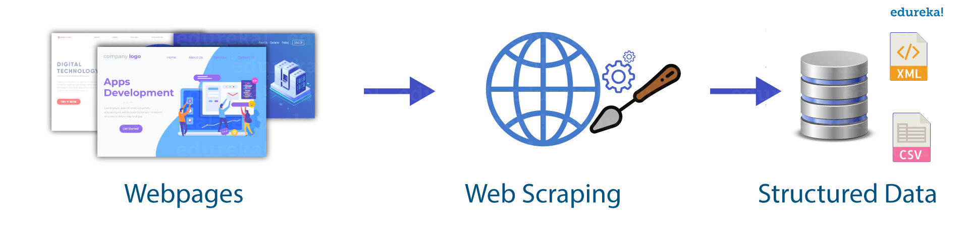

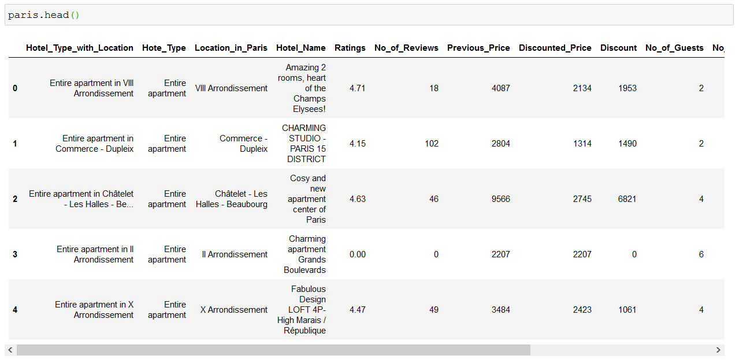
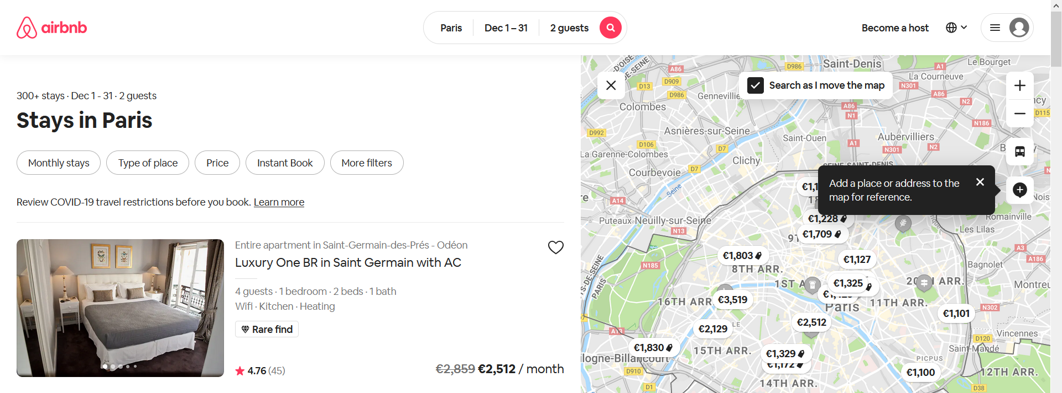
The Final Product

Slide 9
Who can use this application
How can this application help
Anyone who wishes to understand the Airbnb (hotel) listings for a specific city / cities
In particular, the application will be extremely useful for travel and tourism industry
Travel Agencies
This application can assist Travel Agency to better understand the hotel market in a specific city
Based on their understanding of the market:
Create travel packages
Built customized packages for prospective clients

Slide 10
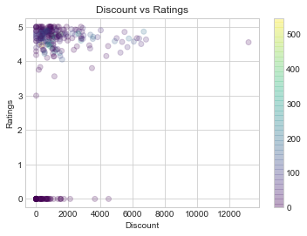
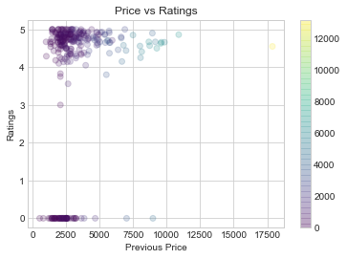
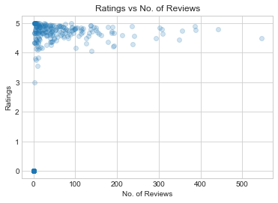
Ratings
Plotted using matplotlib
Discount, Price, No. of Reviews have no effect on Ratings

Slide 11
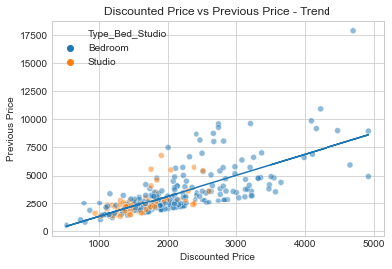
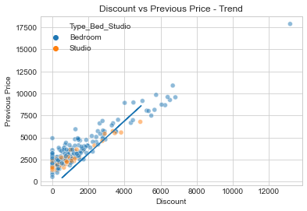
Price and Discount
Plotted using seaborn
The higher the price, the more the discount!

Slide 12
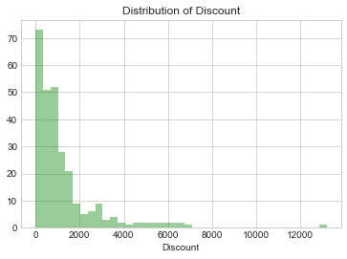
Discount and Price Distributions
Plotted using seaborn
As expected, discounts are grouped on the lower numbers

Slide 13
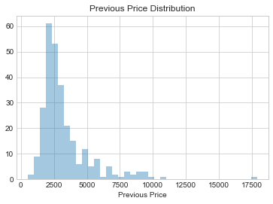
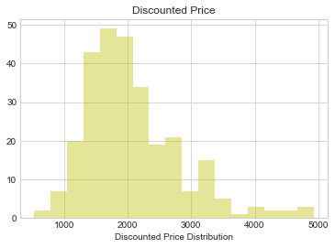
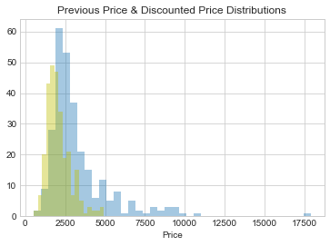
Discount Distributions
Plotted using seaborn
As expected, the Discount distribution is similar to the Price distribution

Slide 14
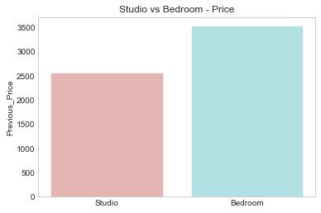
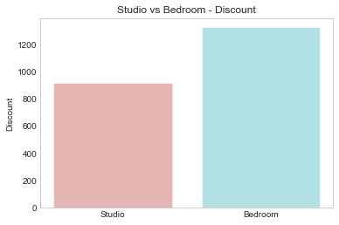
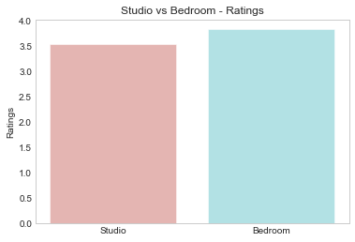
Bedroom or Studio
Plotted using seaborn
Studio is the ideal choice for couples with negligible difference in ratings

Slide 15
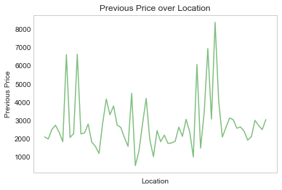
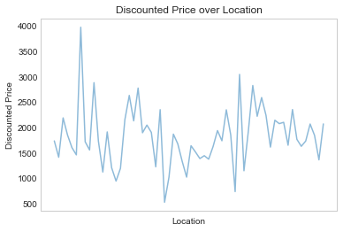
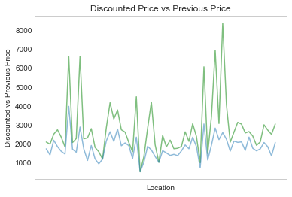
Location wise info
Plotted using seaborn
Discount price is proportional to Previous Price based on Location

Slide 16
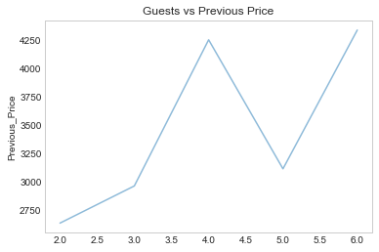
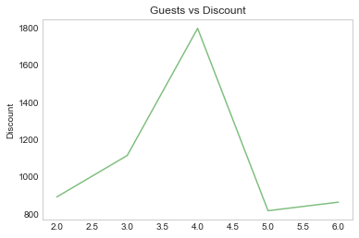
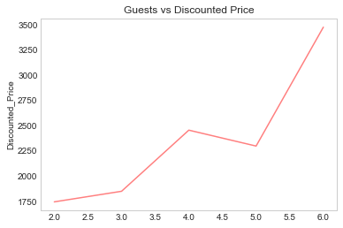
Guest wise info
The final Discounted Price for 5 guests is cheaper than 4 guests

Slide 17
How did I build the Product

Slide 18

Part 1: Web Scraping
Step 1: Creating a LIST of all 15 urls (done using for loop and replacing string in main URL)
Step 2: Finding the main class that holds all the listings of the hotels
Step 3: From each listing, finding the classes for information such as name, location, cost, etc
Step 4: For each listing, writing this listing into the CSV file as one observation

Slide 19
Part 2: Cleaning
Used Pandas extensively for cleaning
Step 1: Imported the scraped data (csv) as df_raw & created an empty df_new.
Step 2: Taking the column, splitting the info if needed, extracting only numbers and copying it to the new_df.
Step 3: Handling missing/null values and changing the column type from object to int
For some columns, I copied the necessary column into a dummy_df, cleaned it on this dummy_df, and then copied the column(s) to the main new_df dataframe.
Exported it as a csv file

Slide 20
Part 3: Analyzing
Used Matplotlib and Seaborn extensively for visualizing the data
Step 1: Grouped data by certain categories and used pivot tables to understand the data better
Step 2: Plotted some basic scatterplots to visualize the data
Step 3: Searching for possible correlation and trends between two variables

Slide 21
Learnings
Undersanding how web-scraping works
Application of python in real-life projects
I took the easy steps and collected data given that I was learning. During which I realized, getting more data would be a more complex task.
At the same time, this means, increasing the workload on cleaning the data.
“Realized why data scientists spend most time cleaning data”

Slide 22
THANK YOU
Any Questions?

