Slide 1

A
utomated Speed Monitoring &
lert System For High-Risk
ccident Zones
IOT Based

Slide 2
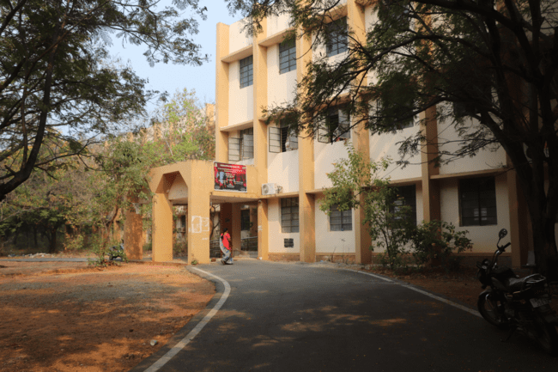


Under
The Guidance
DR.N.USHA RANI
BY
Associate Professor
S ABHISHEIK - 11906053
M RAJ KUMAR - 11906058
M YAMINI PRIYA - 11906063
K LOKESH - 11906068
U SAI KIRAN - 11906073
Department of Computer Science

Slide 3


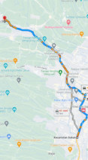
Project Outline
Abstract
Introduction
Literature Survey
Existing System
Proposed System
Results
Future Scope & Conclusion
References

Slide 4

To date, there are many inventions in automobile industries to design and build safety measures for automobiles, but traffic accidents are unavoidable. There are a huge number of accidents prevailing in all urban and rural areas. In this project, we propose to overcome the accident.
The objective of this paper is to understand the various techniques that have contributed to the curb of accidents especially by preventing and detecting accidents.
Patterns involved with different circumstances can be detected by developing an accurate prediction model that will be capable of automatic separation of various accidental scenarios. This cluster will be useful to prevent accidents and develop safety measures. In this project, we have predicted the accident zone and intimate the driver before crossing it with the help of an alarm system.
Abstract

Slide 5

Introduction
As we all know, road accidents are a major cause of injury and death worldwide. In fact, according to the World Health Organization (WHO), around 1.35 million people die each year as a result of road traffic crashes. These accidents are often caused by speeding drivers who fail to obey speed limits, especially in high-risk areas such as school zones, construction sites, and residential areas.
/
/
To address this problem, we have developed an innovative system that can monitor vehicle speeds in real-time and issue alerts to drivers who are exceeding the speed limit. Our system uses advanced technologies such as radar, sensors, and cameras to accurately detect the speed of vehicles and send notifications to the drivers.
In this presentation, we will discuss the main features and benefits of our automated speed monitoring and alert system, as well as the technologies and approaches used in its development. We will also share some examples of successful implementations of similar systems in other countries, and discuss the potential impact of our system on road safety and accident reduction.

Slide 6


Literature
Survey
Mr.Kailasam
states that due to lack of attention, Drowsiness, and drunk driving are the major causes of road accidents, this paper proposes preparing a system to prevent these circumstances.
Leen Thomas
proposed a system that states the vehicle accidents are one of the most leading causes of fatality. The period between the occurrence of an accident and the dispatch of emergency medical services to the accident site is a critical factor in accident survival rates.

Slide 7

Existing System
Currently, speed monitoring and alert systems in high-risk accident zones rely on manual methods such as speed cameras, radar guns, and police monitoring. These methods are often limited in their ability to monitor and detect speeding vehicles in real-time, and may also require a significant amount of resources and manpower to operate effectively.
Some existing automated systems make use of radar and laser technology to detect speeding vehicles, but these systems are typically expensive and require a high level of expertise to install and maintain.

Slide 8
Some existing systems are
Red Light Speed Camera Program in New York City
      Intelligent Speed Assistance (ISA) in Europe
            Safe Speed in South Africa
Disadvantages of existing systems are
Expensive
      Privacy Concerns
            Accuracy Issues

Slide 9

Proposed
System
Accident Data Collection
Accident Location Mapping
Requirement Specifications
Implementation Steps
The proposed system for identifying accident location and speed monitoring in high-risk accident zones can be achieved through the following steps

Slide 10
Collecting accurate accident data is essential for developing an effective Automated Speed Monitoring and Alert System for High-Risk Accident Zones. Here are some of the methods that can be used for collecting accident data:
Accident
Data Collection
Police Reports
Social Media
Sensor-based Technologies
Accident
Location Mapping
It involves the use of Geographic Information System (GIS) technology to map and visualize accident locations on a map. The accident data collected from various sources such as traffic cameras, sensors, and eyewitness reports are geocoded and plotted on a digital map.

Slide 11
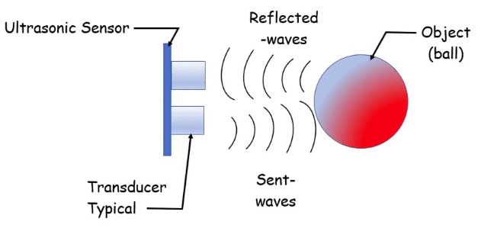
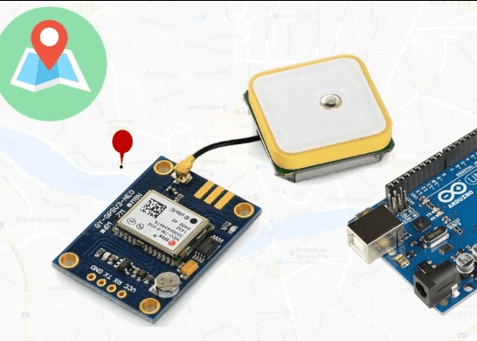
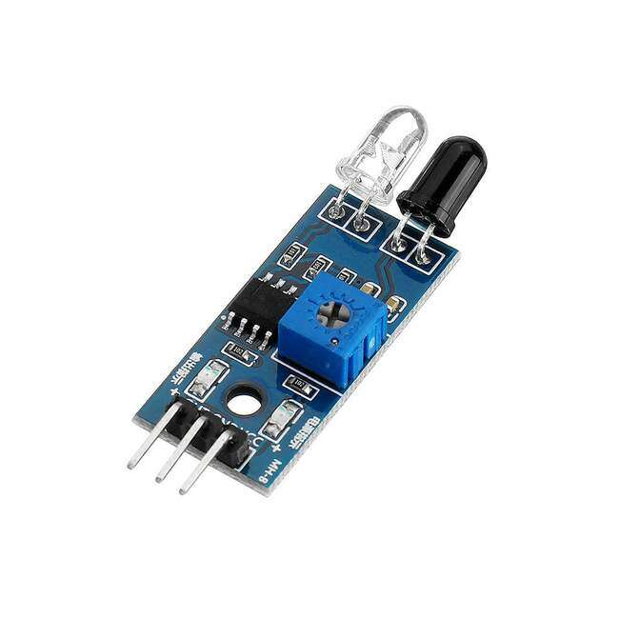
To develop an effective automated speed monitoring and alert system for high-risk accident zones, the following requirements should be considered:
Functional Requirements
Non-Functional Requirements
Software & Hardware Requirements
Requirement
Specifications
Embedded C
Arduino UNO 990
GPS Module
Bread Board
IR Sensor
Buzzer
LED

Slide 12
Step 1:
The code is written in the C++ language and includes libraries such as TinyGPS++, SoftwareSerial, and LiquidCrystal_I2C.
Step 2:
The code is designed to interact with various sensors, such as GPS and IR sensors.
Step 3:
The setup() function initializes the serial communication for GPS and the IR sensor. It also defines the pins for the buzzer output.
Step 4:
The loop() function runs continuously and extracts data from the GPS module using the Tiny-GPS++ library. The extracted data includes location, time, and altitude, which are printed on the serial monitor.
yes
Implementation
Steps
yes

Slide 13
Continued..
Step 5:
The IR sensor code measures the speed of a rotating object such as a motor. It calculates the speed in revolutions per minute (RPM) and prints it on the serial monitor.
Step 6:
The code also generates a beep using the buzzer output if the speed exceeds 40 km/h.
Step 7:
The GPS coordinates are converted from decimal degrees to degrees, minutes, and seconds using the DegMinSec() function. The converted coordinates are printed on the serial monitor.
yes
yes

Slide 14
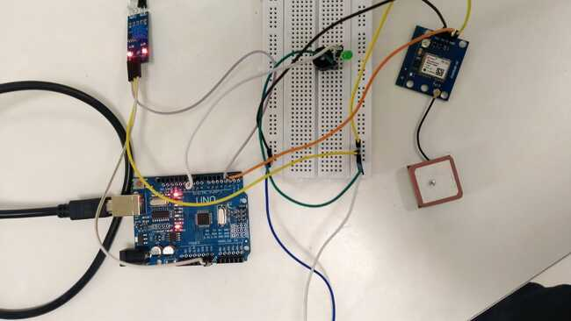
RESULTS
Fig (a) Integration of Arduino, GPS Module, IR Sensor, LED, and Buzzer for Speed Monitoring and Location Tracking.

Slide 15
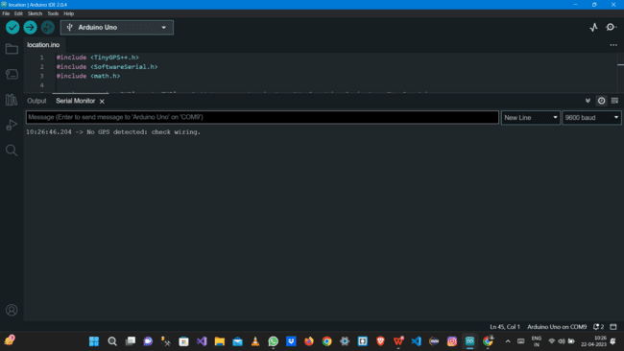
Continued..
Fig (b) Error Message When the GPS Module is not Connected
to the Power Supply.

Slide 16
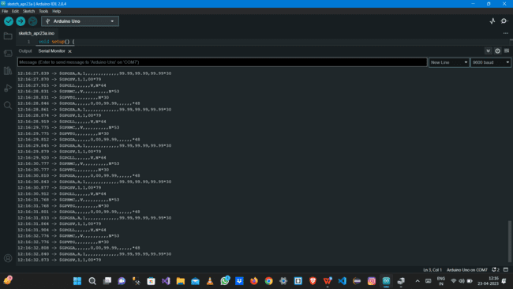
Continued..
Fig (c) Acquiring Status Of GPS Co-ordinates

Slide 17
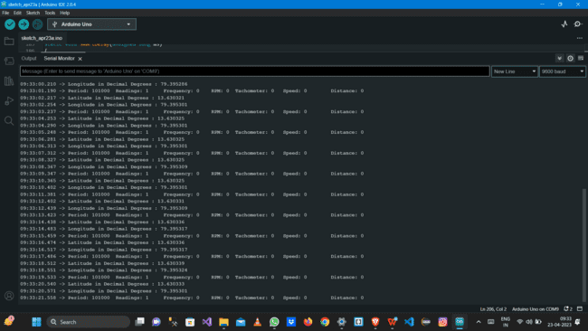
Continued..
Fig (d) Readings of GPS Module Co-ordinates and IR Sensor

Slide 18
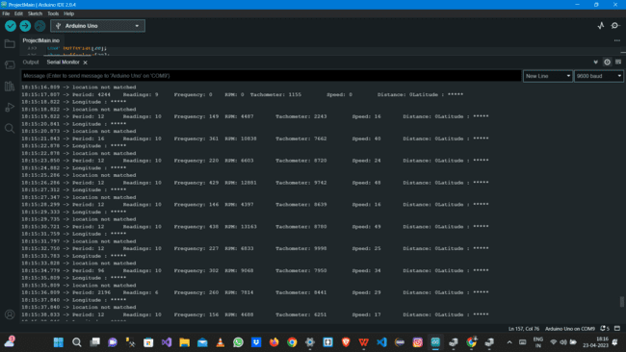
Continued..
Fig (e)Real time Speed Monitoring

Slide 19
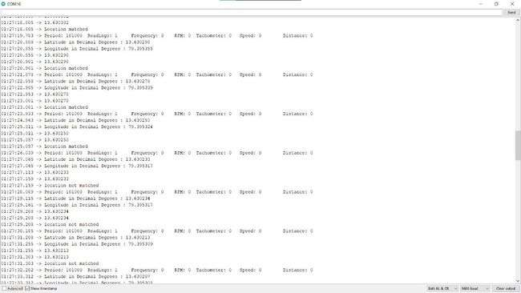
Continued..
Fig (f) Status of Location Matched and Un-Matched Situations

Slide 20
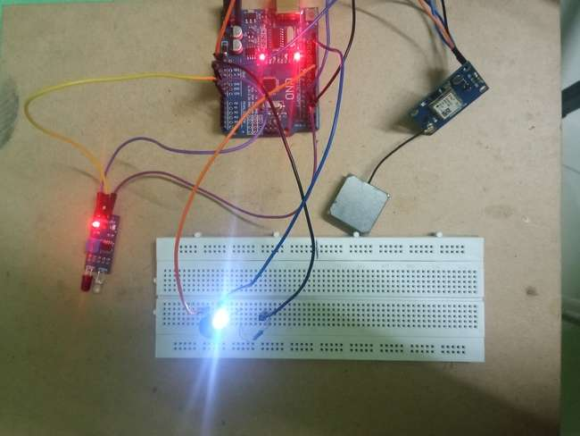
Continued..
Fig (g) Glowing LED when location matches and exceeds
the Speed Limit at the Zone.

Slide 21
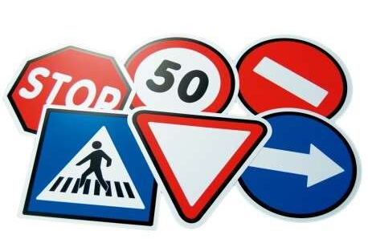
Future Scope
The future scope of the automated speed monitoring and alert system includes the implementation of artificial intelligence (AI) and data visualization techniques to detect objects through cameras and identify them in real-time. This will help to reduce the chances of vehicles hitting objects and improve road safety.
In conclusion, the implementation of AI and data visualization techniques will further enhance the effectiveness of the automated speed monitoring and alert system and improve road safety. The future scope of the system is to integrate with other smart road technologies and provide a comprehensive view of road conditions to stakeholders for making informed decisions.

Slide 22
Conclusion
An automated speed monitoring and alert system for high-risk accident zones can have a significant impact on reducing the number of accidents and fatalities on the road. By using advanced technology such as sensors, cameras, and machine learning algorithms, the system can detect when a driver is traveling above the recommended speed limit and alert them through visual and audio cues.
Overall, implementing an automated speed monitoring and alert system for high-risk accident zones can help to save lives, reduce injuries, and make our roads safer for everyone.

Slide 23

References
[1] Mr S.Kailasam, Mr Karthiga, Dr Kartheeban, R.M.Priyadarshani, K.Anithadevi, “Accident Alert System using face Recognition”,IEEE, 2019 .
[2] Rajvardhan Rishi, Sofiya Yede, Keshav Kunal, Nutan V. Bansode,” Automatic Messaging System for Vehicle Tracking and Accident Detection, Proceedings of the International Conference on Electronics and Sustainable Communication Systems,ICESC, 2020 .
[3] Aarya D.S, Athulya C.K, Anas.P, Basil Kuriakose, Jerin Susan Joy , Leena Thomas, “Accident Alert and Tracking Using Arduino”, International Journal of Advanced Research in Electrical, Electronics and Instrumentation Engineering, Vol. 7, Issue 4, April 2018 .
[4] Nicky Kattukkaran, Arun George, Mithun Haridas T.P, “Intelligent Accident Detection and Alert System for Emergency Medical Assistance “, International Conference on Computer Communication and Informatics, 2017 .
[5] sPrashant Kapri, Shubham Patane, Arul Shalom A, “Accident Detection & Alert System”, IEEE, 2018 Bruno Fernandes, Vitor Gomes, Joaquim Ferreira and Arnaldo Oliveira, “Mobile Application for Automatic Accident Detection and Multimodal Alert”, IEEE, 2015 .
[6] Manuel Fogue, Piedad Garrido, Francisco J. Martinez,”A System for Automatic Notification and Severity Estimation of Automotive Accidents”, IEEE, 2014 .

Slide 24

THANK
YOU
Notes:
Photo by Julien Riedel on Unsplash

