Slide 1
INTRODUCTION TO PYTHON
by
Kiran.V. [ @kiranvm ]
Nakul.E [ @NakulE ]

Slide 2
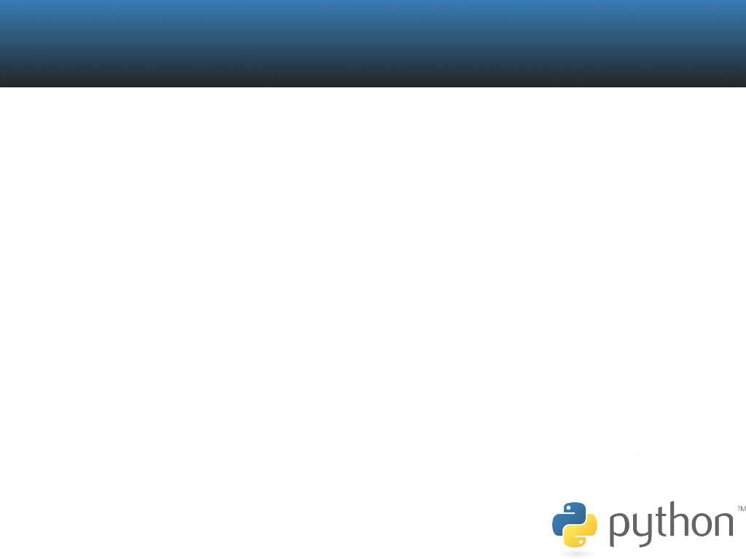
INTRODUCTION TO PYTHON
About Python
Python CLI
    Lists
    Modules
    Exception Handling
Introduction To GUI Programming
    GUI Frameworks
    GTK
    GTK Widgets
    Glade
References

Slide 3
Q: What Makes Python Different?
ANS: Lot Of Things

Slide 4

INSTALLATION
MAC OS and LINUX users, Please Don't Bother.
Windows Guys, Install it from
www.python.org

Slide 5

ABOUT PYTHON
Designed By Guido Van Rossum in 1991
Web Applications, Softwares, Games, Mobiles etc
Interpreted, Interactive, Object Oriented.
Portable over Hardware and Software platforms.
Notes:
>> Google employee
>> Monty Python Flying Circus

Slide 6

LISTS
Easy to work with arrangement of your data.
Eg:
movies=[“if only”,”hachiko”,”the prestige”]

Slide 7
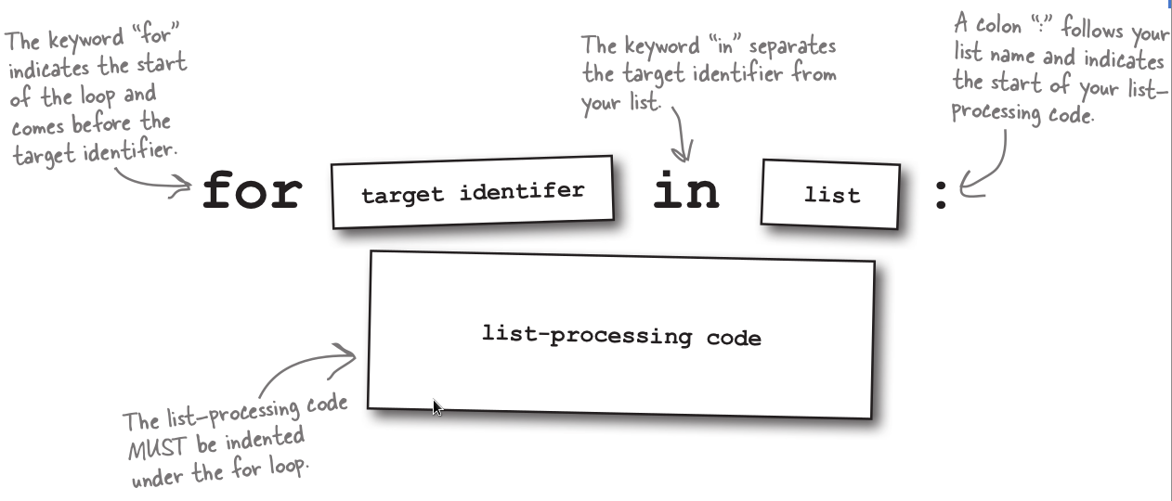

Slide 8
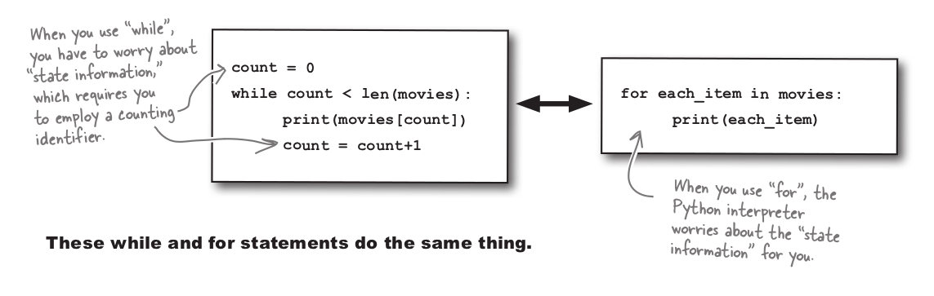

Slide 9
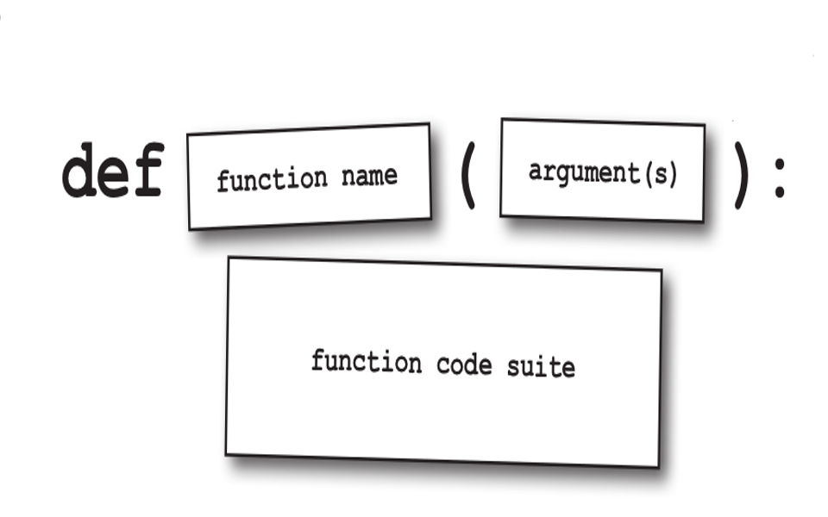
FUNCTIONS

Slide 10

MODULES
Modules let you organize your code for optimal sharing.
Simply a text file containing python code.
>>> Import random

Slide 11
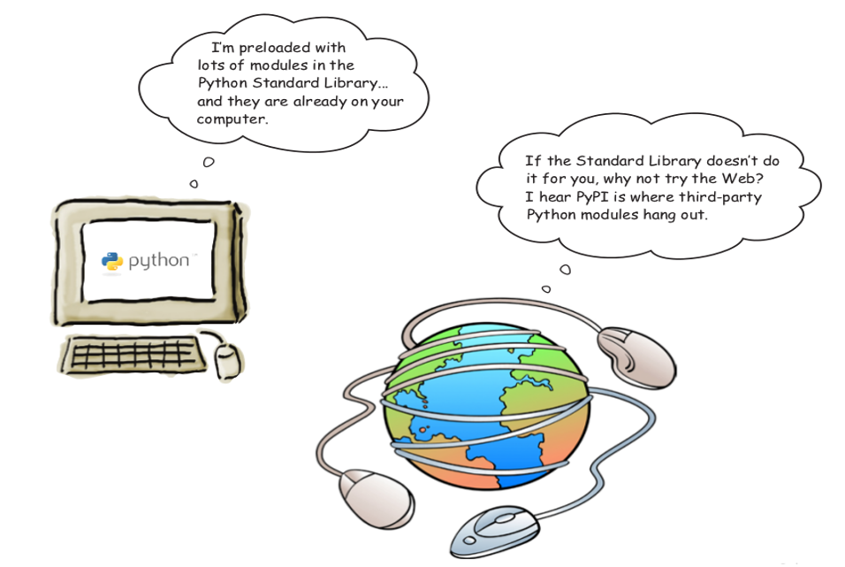

Slide 12
#! /usr/bin/env python
“”” example for using a module “””
Import random
Print random.randint(1,100)

Slide 13
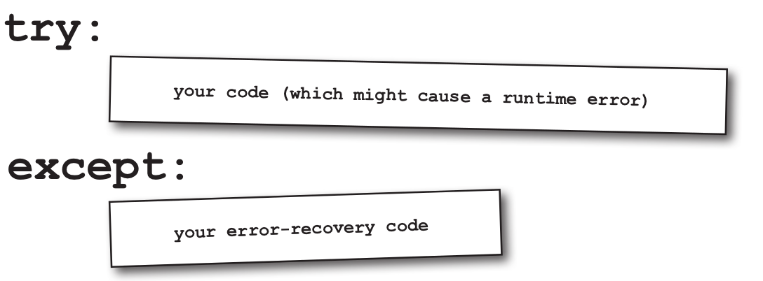

EXCEPTION HANDLING
Exceptions are Run-time Errors.
Traceback is python's way of reporting errors.

Slide 14
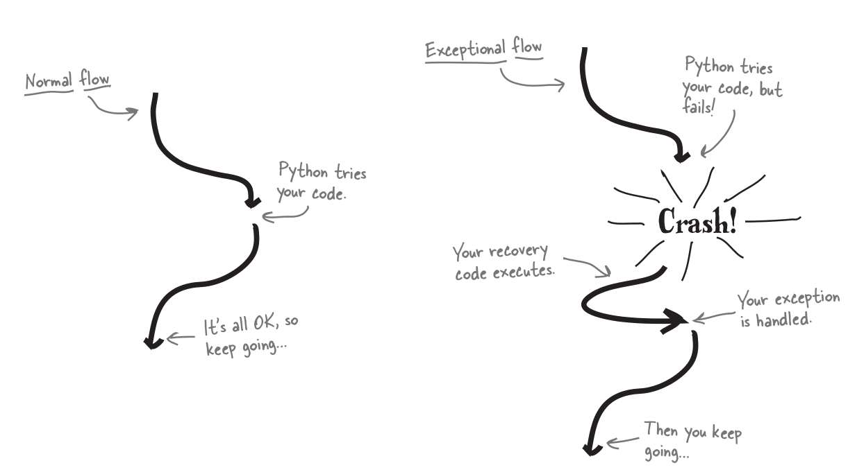

Slide 15
CREATIVE THINGS YOU SHOULD TRY!!
Create a truth and dare game.
Create your classmates birthday list
Download entire results of your classmates
Develop a simple game.
                And much more...

Slide 16
THANK YOU !!

