Slide 1
Estimating Trending Topics on Twitter with Small Subsets of the Total Data
Albert Lee, Evan Miller, and Kiran Vodrahalli

Slide 2
Problem
Finding trending hashtags requires:
Recent hashtags
Historical data about relatively frequent hashtags
A method of

Slide 3
Previous Work

Slide 4
t = 1
M⁰
M¹
A
M²
M³

Slide 5
t = 2
M⁰
M¹
A
B
B
M²
M³

Slide 6
t = 3
M⁰
M¹
B
C
C
A
B
M²
M³

Slide 7
t = 4
M⁰
M¹
C
D
D
A
B
C
D
M²
M³

Slide 8
t = 5
M⁰
M¹
D
C
D
E
M²
M³
A
B
C
D

Slide 9
t =6
M⁰
M¹
C
D
E
F
F
M²
M³
A
B
C
D

Slide 10
t =7
M⁰
M¹
F
G
E
F
M²
M³
A
B
C
D

Slide 11
t =8
M⁰
M¹
G
H
H
E
F
G
H
M²
M³
A
B
C
D
E
F
G
H

Slide 12
Analysis
Space requirements:
Time constraints:
Correctness:

Slide 13
Visualization

Slide 14
Conclusions

Slide 15



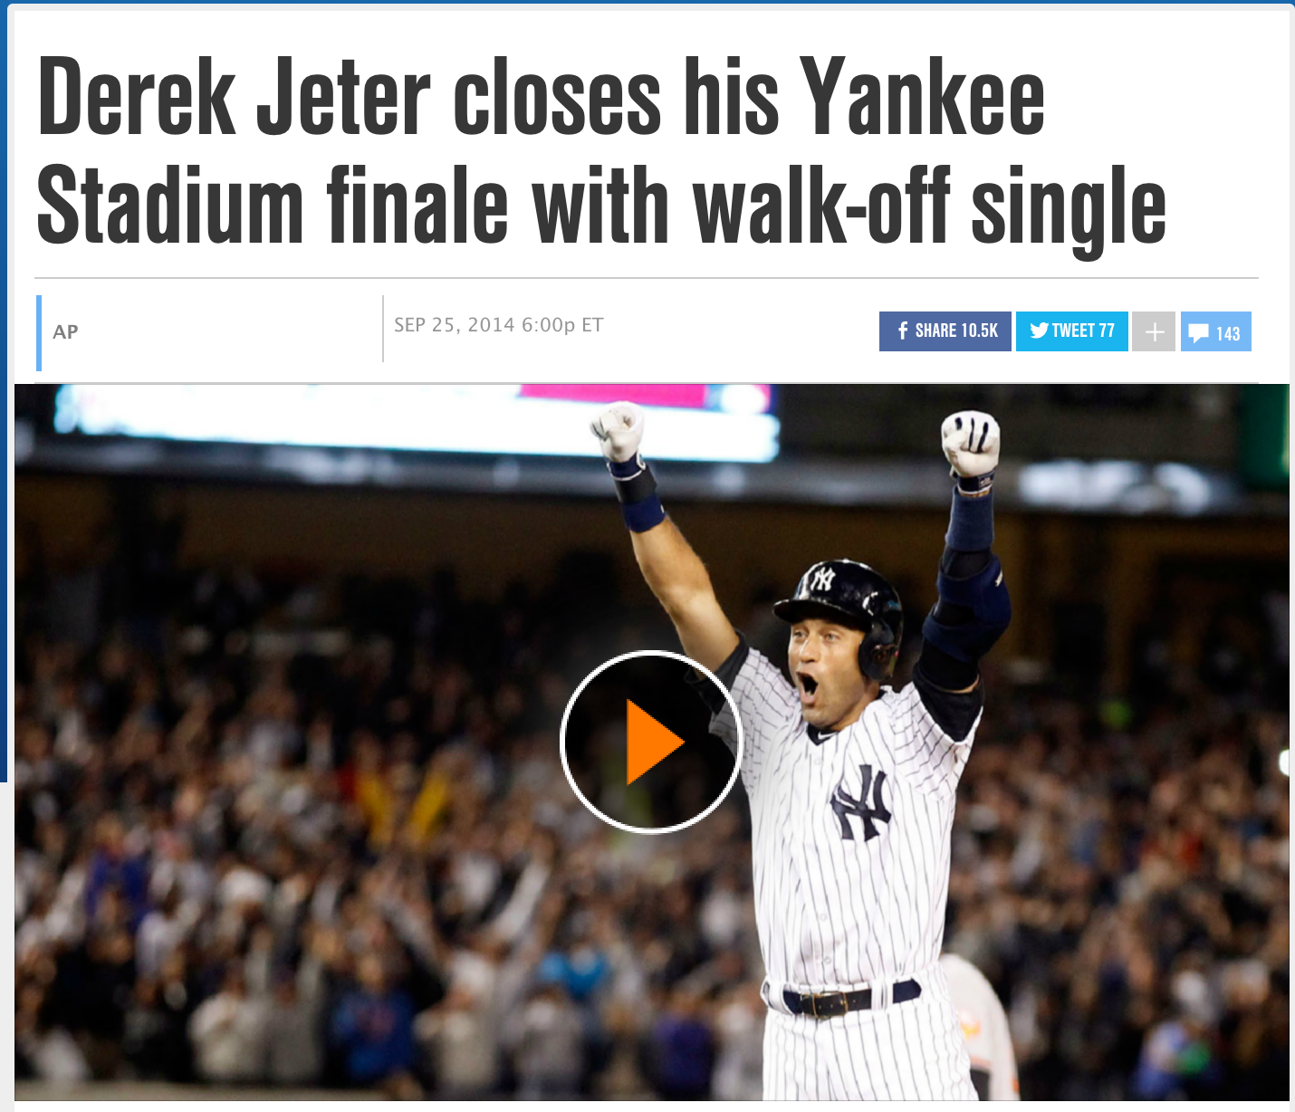
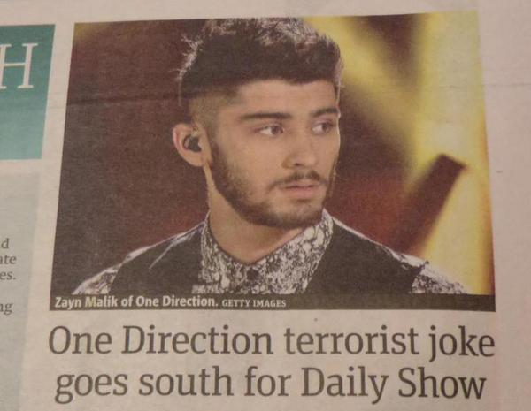
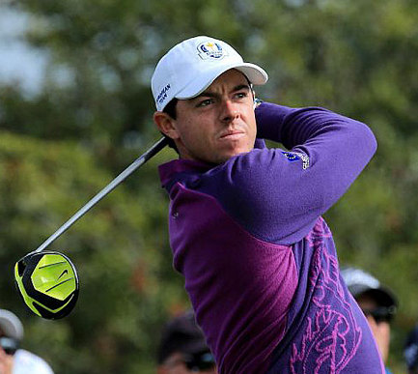
#HowToGetAwayWithMurder
#ToyotaEMR
#BlowTheWhistle
#Walkoff
#RyderCup2014
#TheDailyShowGoneTooFar
18:00
21:00
00:00
03:00
06:00
09:00
12:00
Sept 25
+0000 GMT
Sept 26

