Slide 1
Estimating Trending Topics on Twitter with Small Subsets of the Total Data
Albert Lee, Evan Miller, and Kiran Vodrahalli

Slide 2
Visualization
http://www.princeton.edu/~awlee/trends.html

Slide 3
Problem
Space efficient algorithms for trend detection on Twitter.
Does trend detection benefit from comparing present data against data from the more distant past?

Slide 4
Naive Solution
Find the hashtags with the highest rate of change of frequency between successive time intervals

Slide 5
Hokusai system
Extension of Count-Min sketch
Stores 2^{i} resolution for the past 2^{i} days
Stores older values with less precision under assumption that this data is less relevant

Slide 6
t = 1
M⁰
M¹
A
M²
M³

Slide 7
t = 2
M⁰
M¹
A
B
B
M²
M³

Slide 8
t = 3
M⁰
M¹
B
C
C
A
B
M²
M³

Slide 9
t = 4
M⁰
M¹
C
D
D
A
B
C
D
M²
M³

Slide 10
t = 5
M⁰
M¹
D
C
D
E
M²
M³
A
B
C
D

Slide 11
t =6
M⁰
M¹
C
D
E
F
F
M²
M³
A
B
C
D

Slide 12
t =7
M⁰
M¹
F
G
E
F
M²
M³
A
B
C
D

Slide 13
t =8
M⁰
M¹
G
H
H
E
F
G
H
M²
M³
A
B
C
D
E
F
G
H

Slide 14
History-Sensitive Algorithm
Store historical frequency data in a Hokusai structure
Store exact values of frequencies for recent hashtags
Find hashtags with abnormally high recent frequencies

Slide 15
History
Stores data in a Hokusai structure, h
Kernel function:
Kernel CM sketch

Slide 16
Current Window
Data structure has 3 components:
Max Heap
Queue
Hash table
Heap function is: frequency in last 3 hours/value stored in Kernel CM sketch

Slide 17
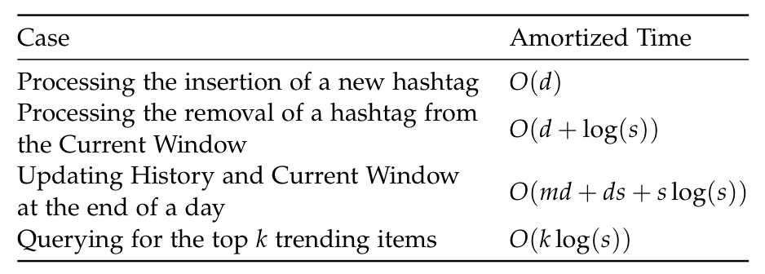
Space/Time Analysis
Space requirements: O(md * log(T) + x)
d = Number of hash tables for each CM sketch
m = Size of each hash table in each CM sketch
s = Number of distinct hashtags in the Current Window
T = Upper bound on the number of days of data stored in History
x = Total number of hashtags in the Current Window

Slide 18
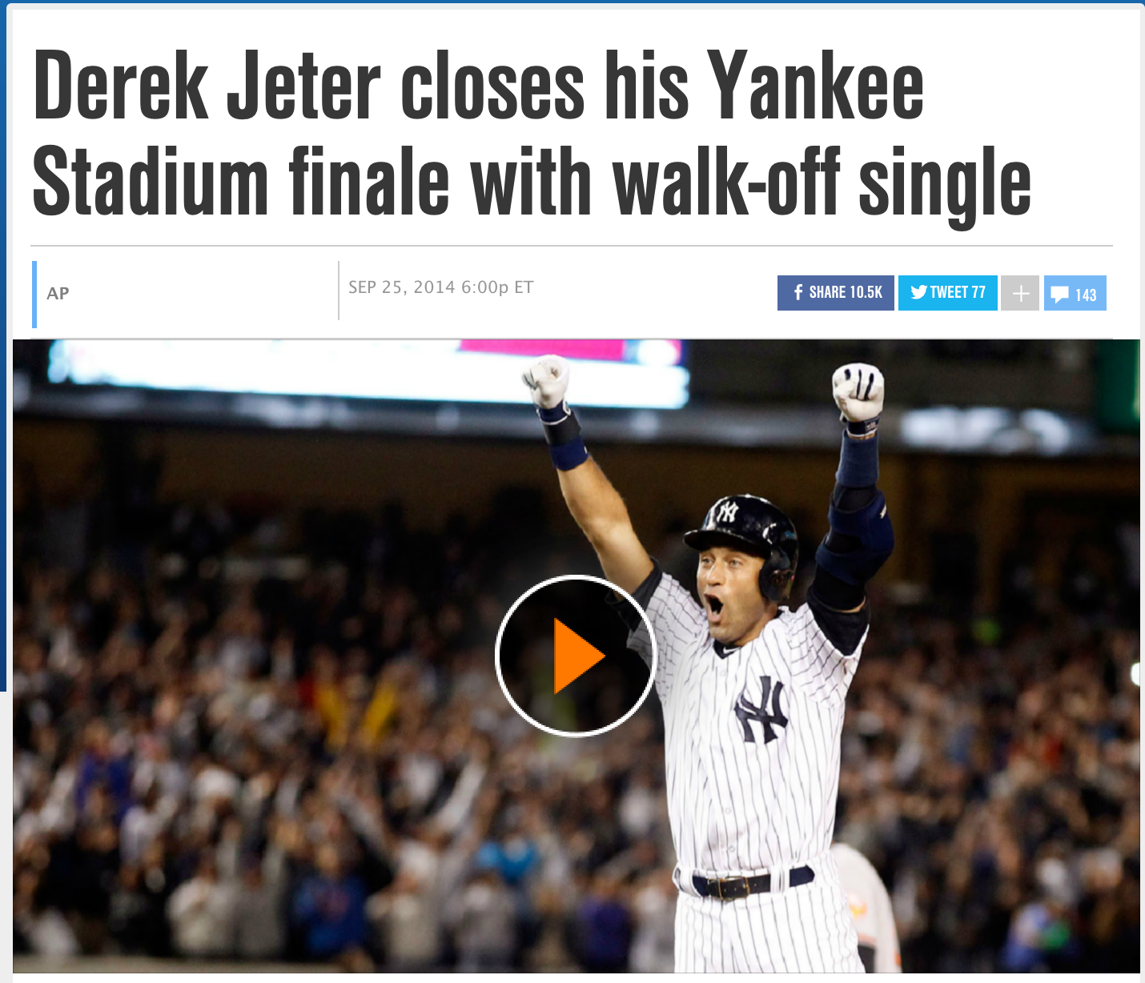
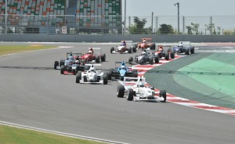



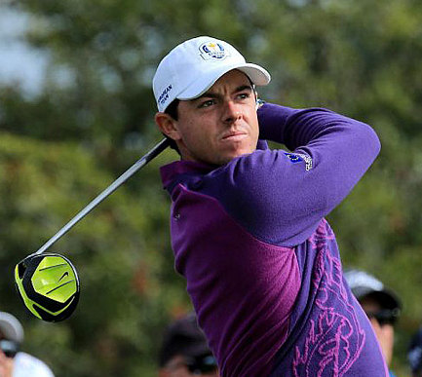
#Walkoff
#ToyotaEMR
#BlowTheWhistle
#HowToGetAwayWithMurder
#RyderCup2014
#TheDailyShowGoneTooFar
18:00
21:00
00:00
03:00
06:00
09:00
12:00
Sept 25
+0000 GMT
Sept 26

Slide 19
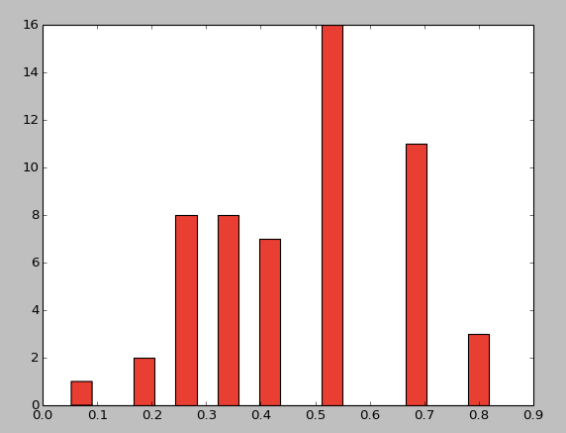
Conclusions
Using historical data seems to give relatively small benefit in determining what is trending
Jaccard similarity of list of trending topics for both algorithms

Slide 20
References

