Slide 1
Attribute-Efficient Learning of Monomials over Highly-Correlated Variables
Alexandr Andoni, Rishabh Dudeja, Daniel Hsu, Kiran Vodrahalli
Columbia University
Yahoo Research, Aug. 2019

Slide 2
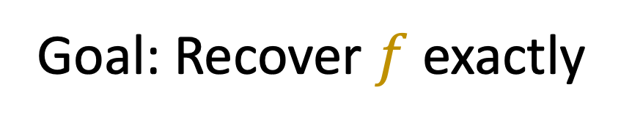
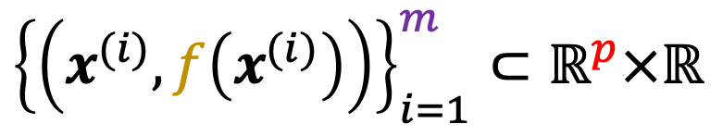
General Learning Problem
$${\left\{\left(x^{(i)}, f\left(x^{(i)}\right)\right)\right\}}_{i=1}^{m}⊂{\text{ℝ}}^{p}×ℝ$$
Given: , drawn i.i.d.
Assumption 1: $f$ is from a low-complexity class
Assumption 2:${ x}^{(i)}\sim D$, some reasonable distribution
Goal: Recover $f$ exactly

Slide 3
A Natural Class?
$${\left\{\left(x^{(i)}, f\left(x^{(i)}\right)\right)\right\}}_{i=1}^{m}⊂{\text{ℝ}}^{p}×ℝ$$
Given: , drawn i.i.d.
Assumption 1: $f$ depends on only $k$ features

Slide 4

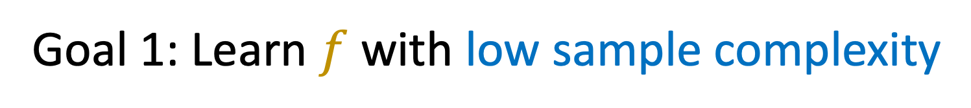
A Natural Class?
$${\left\{\left(x^{(i)}, f\left(x^{(i)}\right)\right)\right\}}_{i=1}^{m}⊂{\text{ℝ}}^{p}×ℝ$$
Given: , drawn i.i.d.
Assumption 1: $f$ depends on only $k$ features
Goal 1: Learn $f$ with low sample complexity
Goal 2: Learn $f$ computationally efficiently

Slide 5
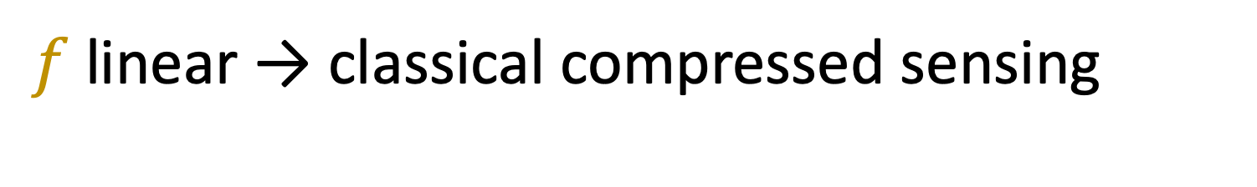
A Natural Class?
$${\left\{\left(x^{(i)}, f\left(x^{(i)}\right)\right)\right\}}_{i=1}^{m}⊂{\text{ℝ}}^{p}×ℝ$$
Given: , drawn i.i.d.
Assumption 1: $f$ depends on only $k$ features
$f$ linear → classical compressed sensing
Goal 1: Learn $f$ with low sample complexity
Goal 2: Learn $f$ computationally efficiently

Slide 6
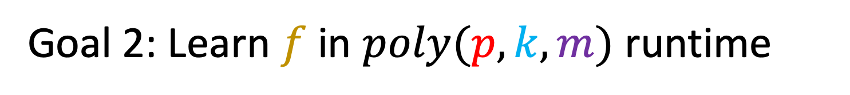
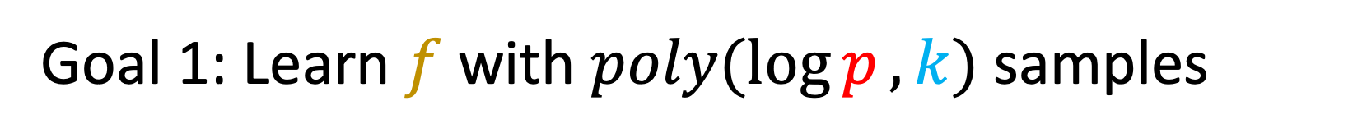
Linear functions: Compressed Sensing
$${\left\{\left(x^{(i)}, f\left(x^{(i)}\right)\right)\right\}}_{i=1}^{m}⊂{\text{ℝ}}^{p}×ℝ$$
Given: , drawn i.i.d.
Assumption 1: $f$ depends on only $k$ features
Goal 1: Learn $f$ with $poly(\log{p},k)$samples
Goal 2: Learn $f$ in $poly(p,k, m)$ runtime

Slide 7
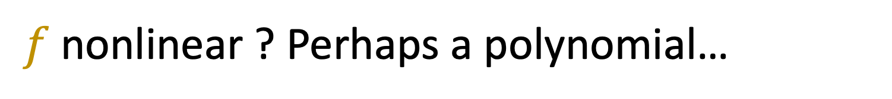
A Natural Class?
$${\left\{\left(x^{(i)}, f\left(x^{(i)}\right)\right)\right\}}_{i=1}^{m}⊂{\text{ℝ}}^{p}×ℝ$$
Given: , drawn i.i.d.
Assumption 1: $f$ depends on only $k$ features
$f$ nonlinear ? Perhaps a polynomial…
Goal 1: Learn $f$ with low sample complexity
Goal 2: Learn $f$ computationally efficiently

Slide 8
Sparse polynomial functions
$${\left\{\left(x^{(i)}, f\left(x^{(i)}\right)\right)\right\}}_{i=1}^{m}⊂{\text{ℝ}}^{p}×ℝ$$
Given: , drawn i.i.d.
Assumption 1: $f$ depends on only $k$ features
Goal 1: Learn $f$ with $poly(\log{p},k)$samples
Goal 2: Learn $f$ in $poly(p,k, m)$ runtime

Slide 9
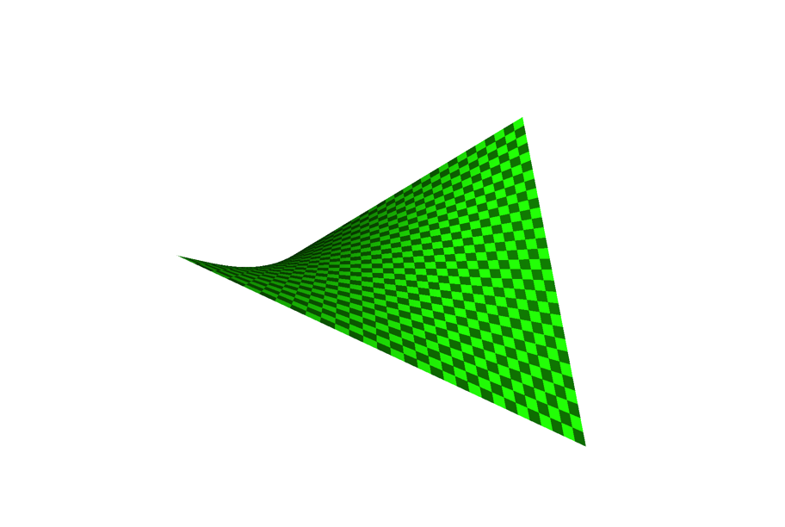
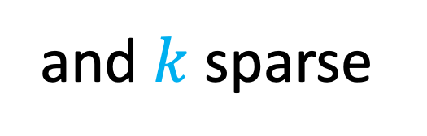
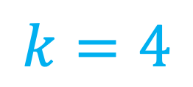

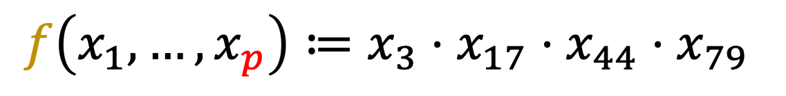
Simplest Case: Sparse Monomials
A Simple Nonlinear Function Class
3 dimensions
In $p$ dimensions
Ex:
$$f\left(x_{1}, …, x_{p}\right)≔x_{3}⋅x_{17}⋅x_{44}⋅x_{79}$$
and $k$sparse
$$k=4$$

Slide 10
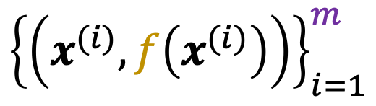
The Learning Problem
$${\left\{\left(x^{(i)}, f\left(x^{(i)}\right)\right)\right\}}_{i=1}^{m}$$
Given: , drawn i.i.d.
Assumption 1: $f$ is a $k$-sparse monomial function
Assumption 2:${ x}^{(i)}\sim 𝒩\left(0, Σ\right)$
Goal: Recover $f$ exactly

Slide 11
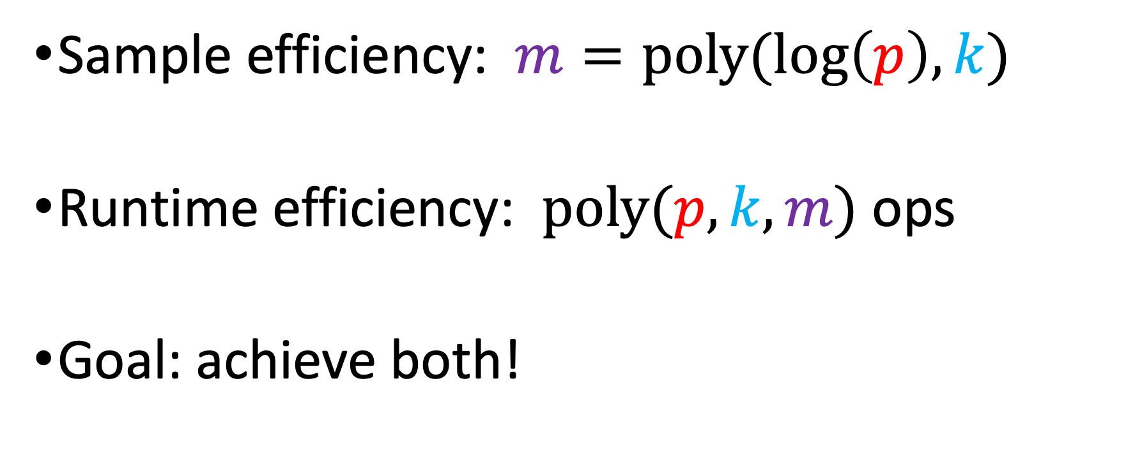
Attribute-Efficient Learning
Sample efficiency: $m=poly(log\left(p\right), k)$
Runtime efficiency: $poly(p, k, m)$ ops
Goal: achieve both!

Slide 12


Motivation
$$x_{i}∈\left\{±1\right\}$$
Monomials $≡$ Parity functions
No attribute-efficient algs! [Blum’98, Klivans&Servedio’06, Kalai+’09, Kocaoglu+’14…]
$$x_{i}∈ℝ$$
Sparse linear regression [Candes+’04, Donoho+’04, Bickel+’09…]
Sparse sums of monomials [Andoni+’14]

Slide 13

Motivation
$$x_{i}∈\left\{±1\right\}$$
Monomials $≡$ Parity functions
No attribute-efficient algs! [Blum’98, Klivans&Servedio’06, Kalai+’09, Kocaoglu+’14…]
Even in the noiseless setting
$$x_{i}∈ℝ$$
Sparse linear regression [Candes+’04, Donoho+’04, Bickel+’09…]
Sparse sums of monomials [Andoni+’14]

Slide 14

Motivation
$$x_{i}∈\left\{±1\right\}$$
Monomials $≡$ Parity functions
No attribute-efficient algs! [Blum’98, Klivans&Servedio’06, Kalai+’09, Kocaoglu+’14…]
Even in the noiseless setting
Brute force: $poly(\log{p},k)$samples, $O(p^{k})$runtime
$$x_{i}∈ℝ$$
Sparse linear regression [Candes+’04, Donoho+’04, Bickel+’09…]
Sparse sums of monomials [Andoni+’14]

Slide 15

Motivation
$$x_{i}∈\left\{±1\right\}$$
Monomials $≡$ Parity functions
No attribute-efficient algs! [Blum’98, Klivans&Servedio’06, Kalai+’09, Kocaoglu+’14…]
Even in the noiseless setting
Brute force: $poly(\log{p},k)$samples, $O(p^{k})$runtime
Can improve to $O(p^{k/2})$runtime
$$x_{i}∈ℝ$$
Sparse linear regression [Candes+’04, Donoho+’04, Bickel+’09…]
Sparse sums of monomials [Andoni+’14]

Slide 16

Motivation
$$x_{i}∈\left\{±1\right\}$$
Monomials $≡$ Parity functions
No attribute-efficient algs! [Blum’98, Klivans&Servedio’06, Kalai+’09, Kocaoglu+’14…]
Even in the noiseless setting
Brute force: $poly(\log{p},k)$samples, $O(p^{k})$runtime
Can improve to $O(p^{k/2})$runtime
Improper learner: $O(p^{1−1/k})$samples, $O(p^{4})$runtime
$$x_{i}∈ℝ$$
Sparse linear regression [Candes+’04, Donoho+’04, Bickel+’09…]
Sparse sums of monomials [Andoni+’14]

Slide 17

Motivation
$$x_{i}∈\left\{±1\right\}$$
Monomials $≡$ Parity functions
No attribute-efficient algs! [Blum’98, Klivans&Servedio’06, Kalai+’09, Kocaoglu+’14…]
Even in the noiseless setting
Brute force: $poly(\log{p},k)$samples, $O(p^{k})$runtime
Can improve to $O(p^{k/2})$runtime
Improper learner: $O(p^{1−1/k})$samples, $O(p^{4})$runtime
Even under avg. case assumptions…
$poly(p,2^{k})$samples and runtime
$$x_{i}∈ℝ$$
Sparse linear regression [Candes+’04, Donoho+’04, Bickel+’09…]
Sparse sums of monomials [Andoni+’14]

Slide 18

Motivation
$$x_{i}∈\left\{±1\right\}$$
Monomials $≡$ Parity functions
No attribute-efficient algs! [Blum’98, Klivans&Servedio’06, Kalai+’09, Kocaoglu+’14…]
Even in the noiseless setting
Brute force: $poly(\log{p},k)$samples, $O(p^{k})$runtime
Can improve to $O(p^{k/2})$runtime
Improper learner: $O(p^{1−1/k})$samples, $O(p^{4})$runtime
Even under avg. case assumptions…
$poly(p,2^{k})$samples and runtime
$$x_{i}∈ℝ$$
Sparse linear regression [Candes+’04, Donoho+’04, Bickel+’09…]
Sparse sums of monomials [Andoni+’14]
$poly(p,2^{d}, s)$samples and runtime
$d$ is maximum degree
$s$ is number of monomials

Slide 19

Motivation
$$x_{i}∈\left\{±1\right\}$$
Monomials $≡$ Parity functions
No attribute-efficient algs! [Blum’98, Klivans&Servedio’06, Kalai+’09, Kocaoglu+’14…]
Even in the noiseless setting
Brute force: $poly(\log{p},k)$samples, $O(p^{k})$runtime
Can improve to $O(p^{k/2})$runtime
Improper learner: $O(p^{1−1/k})$samples, $O(p^{4})$runtime
Even under avg. case assumptions…
$poly(p,2^{k})$samples and runtime
$$x_{i}∈ℝ$$
Sparse linear regression [Candes+’04, Donoho+’04, Bickel+’09…]
Sparse sums of monomials [Andoni+’14]
$poly(p,2^{d}, s)$samples and runtime
$d$ is maximum degree
$s$ is number of monomials
Works for Gaussian and Uniform distributions…

Slide 20

Motivation
$$x_{i}∈\left\{±1\right\}$$
Monomials $≡$ Parity functions
No attribute-efficient algs! [Blum’98, Klivans&Servedio’06, Kalai+’09, Kocaoglu+’14…]
Even in the noiseless setting
Brute force: $poly(\log{p},k)$samples, $O(p^{k})$runtime
Can improve to $O(p^{k/2})$runtime
Improper learner: $O(p^{1−1/k})$samples, $O(p^{4})$runtime
Even under avg. case assumptions…
$poly(p,2^{k})$samples and runtime
$$x_{i}∈ℝ$$
Sparse linear regression [Candes+’04, Donoho+’04, Bickel+’09…]
Sparse sums of monomials [Andoni+’14]
$poly(p,2^{d}, s)$samples and runtime
$d$ is maximum degree
$s$ is number of monomials
Works for Gaussian and Uniform distributions…
BUT they must be product distributions!

Slide 21

Motivation
$$x_{i}∈\left\{±1\right\}$$
Monomials $≡$ Parity functions
No attribute-efficient algs! [Blum’98, Klivans&Servedio’06, Kalai+’09, Kocaoglu+’14…]
Even in the noiseless setting
Brute force: $poly(\log{p},k)$samples, $O(p^{k})$runtime
Can improve to $O(p^{k/2})$runtime
Improper learner: $O(p^{1−1/k})$samples, $O(p^{4})$runtime
Even under avg. case assumptions…
$poly(p,2^{k})$samples and runtime
$$x_{i}∈ℝ$$
Sparse linear regression [Candes+’04, Donoho+’04, Bickel+’09…]
Sparse sums of monomials [Andoni+’14]
$poly(p,2^{d}, s)$samples and runtime
$d$ is maximum degree
$s$ is number of monomials
Works for Gaussian and Uniform distributions…
BUT they must be product distributions!
Whitening blows up complexity

Slide 22






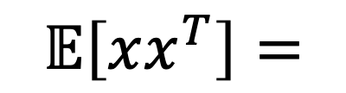



Motivation
$$x_{i}∈\left\{±1\right\}$$
Monomials $≡$ Parity functions
No attribute-efficient algs! [Blum’98, Klivans&Servedio’06, Kalai+’09, Kocaoglu+’14…]
Even in the noiseless setting
Brute force: $poly(\log{p},k)$samples, $O(p^{k})$runtime
Can improve to $O(p^{k/2})$runtime
Improper learner: $O(p^{1−1/k})$samples, $O(p^{4})$runtime
Even under avg. case assumptions…
$poly(p,2^{k})$samples and runtime
$$x_{i}∈ℝ$$
Sparse linear regression [Candes+’04, Donoho+’04, Bickel+’09…]
Sparse sums of monomials [Andoni+’14] Uncorrelated features:
$$σ_{1}^{2}$$
$$σ_{2}^{2}$$
$$0$$
$$𝔼\left[xx^{T}\right]=$$
$$σ_{3}^{2}$$
$$σ_{4}^{2}$$
$$0$$
$$σ_{5}^{2}$$
$$σ_{6}^{2}$$

Slide 23




















Motivation
$$x_{i}∈\left\{±1\right\}$$
Monomials $≡$ Parity functions
No attribute-efficient algs! [Helmbold+ ‘92, Blum’98, Klivans&Servedio’06, Kalai+’09, Kocaoglu+’14…]
$$x_{i}∈ℝ$$
Sparse linear regression [Candes+’04, Donoho+’04, Bickel+’09…]
Sparse polynomials [Andoni+’14] For uncorrelated features:
Question: What if
$$1$$
$$≤ρ$$
$$1$$
?
$$𝔼\left[xx^{T}\right]=$$
$$1$$
$$1$$
$$σ_{1}^{2}$$
$$≤ρ$$
$$1$$
$$σ_{2}^{2}$$
$$0$$
$$1$$
$$𝔼\left[xx^{T}\right]=$$
$$σ_{3}^{2}$$
$$σ_{4}^{2}$$
$$0$$
$$σ_{5}^{2}$$
$$σ_{6}^{2}$$

Slide 24


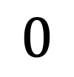
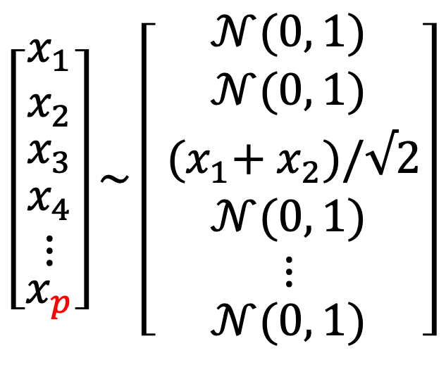
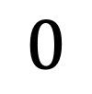
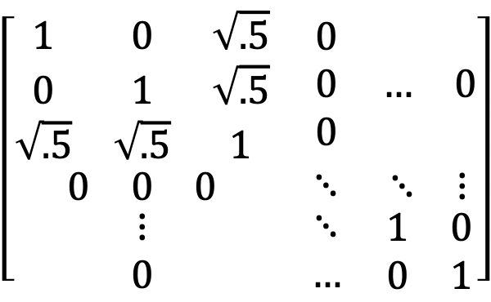

Potential Degeneracy of
$$=𝔼\left[xx^{T}\right]$$
$$\left[\begin{matrix}x_{1} \\ x_{2} \\ \begin{matrix}x_{3} \\ \begin{matrix}x_{4} \\ ⋮\end{matrix} \\ x_{p}\end{matrix}\end{matrix}\right]\sim \left[\begin{matrix}𝒩(0, 1) \\ 𝒩(0, 1) \\ \begin{matrix}{ (x}_{1}+{ x}_{2})/√2 \\ \begin{matrix}𝒩(0, 1) \\ ⋮\end{matrix} \\ 𝒩(0, 1)\end{matrix}\end{matrix}\right]$$
$$\left[\begin{matrix}\begin{matrix}1 & 0 & \sqrt{.5} \\ 0 & 1 & \sqrt{.5} \\ \sqrt{.5} & \sqrt{.5} & 1\end{matrix} & \begin{matrix}0 \\ 0 \\ 0\end{matrix} & \begin{matrix}… & 0\end{matrix} \\ \begin{matrix}0 & 0 & 0\end{matrix} & ⋱ & \begin{matrix}⋱ & ⋮\end{matrix} \\ \begin{matrix}⋮ \\ 0\end{matrix} & \begin{matrix}⋱ \\ …\end{matrix} & \begin{matrix}1 & 0 \\ 0 & 1\end{matrix}\end{matrix}\right]$$
$$0$$
$$0$$
Ex:
$$=$$
$$0$$
Singular matrix
can be low-rank!

Slide 25
Rest of the Talk
Algorithm
Intuition
Analysis
Conclusion

Slide 26
1. Algorithm

Slide 27


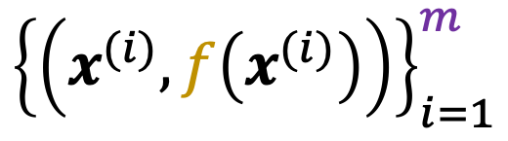
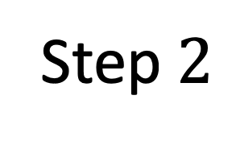

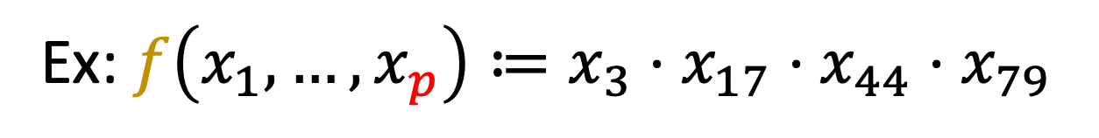
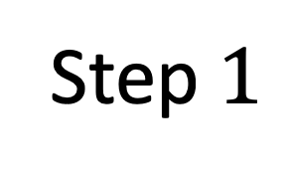

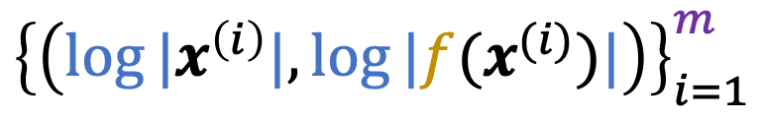



The Algorithm
Ex: $f\left(x_{1}, …, x_{p}\right)≔x_{3}⋅x_{17}⋅x_{44}⋅x_{79}$
Step $1$
$$log⁡|⋅|$$
$${\left\{\left(x^{(i)}, f\left(x^{(i)}\right)\right)\right\}}_{i=1}^{m}$$
$${\left\{\left(log⁡|x^{\left(i\right)}|,log⁡|f(x^{(i)})|\right)\right\}}_{i=1}^{m}$$
Gaussian Data
Log-transformed Data
Step $2$
$$1$$
Sparse Regression:
(Ex: Basis Pursuit)
feature
$$0$$
$$3$$
$$17$$
$$44$$
$$79$$

Slide 28
2. Intuition

Slide 29
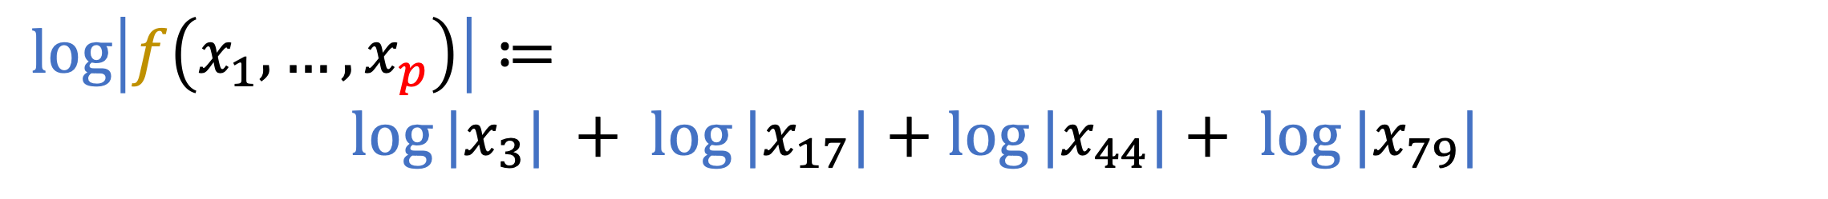
Why is our Algorithm Attribute-Efficient?
Runtime: basis pursuit is efficient
Sample complexity?
Sparse linear regression? E.g.,
But: sparse recovery properties may not hold…
$$\log\left|f\left(x_{1}, …, x_{p}\right)\right|≔$$
${log⁡|x}_{3}| + {log⁡|x}_{17}|$ $+$ ${log⁡|x}_{44}|+ {log⁡|x}_{79}|$

Slide 30

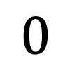

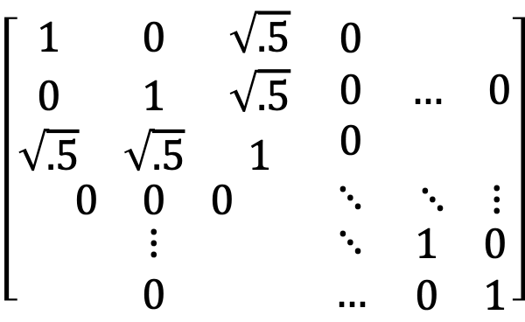
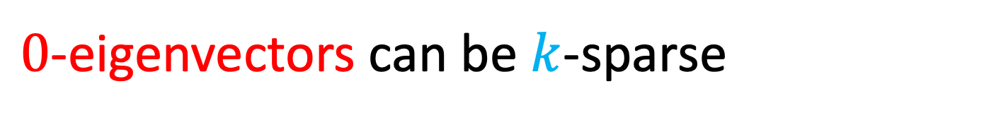
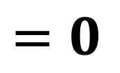

Degenerate High Correlation
$$=𝔼\left[xx^{T}\right]$$
$$\left[\begin{matrix}\begin{matrix}1 & 0 & \sqrt{.5} \\ 0 & 1 & \sqrt{.5} \\ \sqrt{.5} & \sqrt{.5} & 1\end{matrix} & \begin{matrix}0 \\ 0 \\ 0\end{matrix} & \begin{matrix}… & 0\end{matrix} \\ \begin{matrix}0 & 0 & 0\end{matrix} & ⋱ & \begin{matrix}⋱ & ⋮\end{matrix} \\ \begin{matrix}⋮ \\ 0\end{matrix} & \begin{matrix}⋱ \\ …\end{matrix} & \begin{matrix}1 & 0 \\ 0 & 1\end{matrix}\end{matrix}\right]$$
$$0$$
Recall the example:
$$=$$
$$0$$
$$0$$
$$\left[\begin{matrix}−1/2 \\ −1/2 \\ \begin{matrix}1/\sqrt{2} \\ \begin{matrix}0 \\ ⋮\end{matrix} \\ 0\end{matrix}\end{matrix}\right]$$
$$=0$$
$0$-eigenvectors can be $k$-sparse
Sparse recovery conditions false!
3-sparse

Slide 31
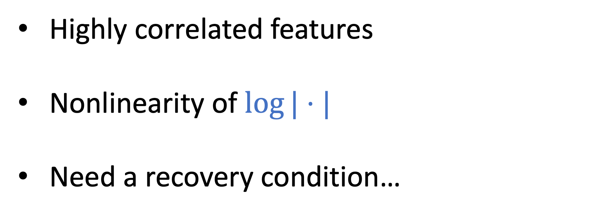
Summary of Challenges
Highly correlated features
Nonlinearity of $log⁡|⋅|$
Need a recovery condition…

Slide 32




Log-Transform affects Data Covariance
$$log⁡|⋅|$$
$𝔼\left[xx^{T}\right]≽0$
$$𝔼\left[\log\left|x\right|{\log\left|x\right|}^{T}\right]≻0$$
“inflating the balloon”
Spectral View:
Destroys correlation structure

Slide 33
3. Analysis

Slide 34






Restricted Eigenvalue Condition [Bickel, Ritov, & Tsybakov ‘09]
Restricted Eigenvalue $RE(k)$
Ex:
$$S=\left\{3, 17, 44, 79\right\}$$
$$k=4$$
$$\min_{v∈C} \frac{v^{T}XX^{T}v}{||v||_{2}^{2}}>ε$$
Cone restriction
“restricted strong convexity”
Note: ${RE\left(k\right)≥λ}_{min}\left(XX^{T}\right)$
$$C=\{v: ||v_{S}||_{1}≥||v_{S^{c}}||_{1}\}$$
$$\left|S\right|=k$$

Slide 35
Restricted Eigenvalue Condition [Bickel, Ritov, & Tsybakov ‘09]
Restricted Eigenvalue $RE(k)$
Ex:
$$S=\left\{3, 17, 44, 79\right\}$$
$$k=4$$
$$\min_{v∈C} \frac{v^{T}XX^{T}v}{||v||_{2}^{2}}>ε$$
Cone restriction
“restricted strong convexity”
Note: ${RE\left(k\right)≥λ}_{min}\left(XX^{T}\right)$
Sufficient to prove exact recovery
for basis pursuit!
$$C=\{v: ||v_{S}||_{1}≥||v_{S^{c}}||_{1}\}$$
$$\left|S\right|=k$$

Slide 36




Sample Complexity Analysis
$$=𝔼\left[\log\left|x\right|{\log\left|x\right|}^{T}\right]$$
Population Transformed Eigenvalue
Concentration of Restricted Eigenvalue
$$λ_{min}\left( \right)>ε>0$$
${|λ}_{RE(k)}\left( \right)$ - $λ_{RE(k)}\left( \right)|<ε$
with probability $≥1 −δ$
$$λ_{RE(k)}\left( \right)>0$$
with high probability
Exact Recovery for Basis Pursuit
with high probability

Slide 37




Sample Complexity Analysis
$$=𝔼\left[\log\left|x\right|{\log\left|x\right|}^{T}\right]$$
Population Transformed Eigenvalue
Concentration of Restricted Eigenvalue
$$λ_{min}\left( \right)>ε>0$$
${|λ}_{RE(k)}\left( \right)$ - $λ_{RE(k)}\left( \right)|<ε$
with probability $≥1 −δ$
Sample Complexity Bound:
$$m= \tilde{O}\left(\frac{k^{2}\log{2k}}{1−ρ}⋅\log^{2}{\frac{2p}{δ}}\right)$$
$$λ_{RE(k)}\left( \right)>0$$
with high probability
Exact Recovery for Basis Pursuit
with high probability

Slide 38







Population Minimum Eigenvalue
$$=𝔼\left[\log\left|x\right|{\log\left|x\right|}^{T}\right]$$
$$=𝔼\left[xx^{T}\right]$$
Hermite expansion of $log⁡|⋅|:$
${l≥1: c}_{2l}^{2} \sim \frac{√π}{4}⋅\frac{1}{l^{3/2}}$
$⋅^{ (2l)}$ off-diagonals decay fast!
Apply $λ_{min}$ to Hermite formula:
Apply Gershgorin Circle Theorem:
$$=c_{0}^{2}1_{pxp}+\sum_{l=1}^{∞}{c_{2l}^{2}⋅^{ (2l)}}$$
$$λ_{min} ≥\sum_{l=1}^{∞}{c_{2l}^{2}λ_{min}^{ (2l)}}$$
$$λ_{min}⋅^{ (2l)} ≥1 −\left(p−1\right)ρ^{2l}$$
(for large enough $l$)
Notes:
E_{x, y}[H_i(x)H_j(y)] = correlation^j if i = j, 0 otherwise for standard Gaussians x, y that are correlated.
We must show log | | is L^2 integrable to apply Hermite polynomials. This follows by explicit calculation of the second log-moment and using the replica trick + properties of moments of the Gaussian.
3. c_{2l} is calculated via integration by parts and recursive properties of the derivatives of Hermite polynomials. Non-even terms are 0.
4. The approximation of c_{2l}^2 follows from Stirling.
5. A^{(2l)} means elementwise product of A with itself 2l times.
6. Minimum eigenvalues of elementwise products behave nicely when the diagonals are 1. (This assumption is fine, we are just rescaling the features which we often do in practice).
In particular, lambda_min(A^(i)) \geq lambda_min(A) * 1 if A is symmetric PSD (which all covariance matrices are) and has diagonal only 1.
7. Threshold chosen so that the bound on lambda_min is positive, since the bound gets better and better for larger l.

Slide 39





Population Minimum Eigenvalue
$$=𝔼\left[\log\left|x\right|{\log\left|x\right|}^{T}\right]$$
$$=𝔼\left[xx^{T}\right]$$
Hermite expansion of $log⁡|⋅|:$
${l≥1: c}_{2l}^{2} \sim \frac{√π}{4}⋅\frac{1}{l^{3/2}}$
$⋅^{ (2l)}$ off-diagonals decay fast!
Apply $λ_{min}$ to Hermite formula:
Apply Gershgorin Circle Theorem:
$$𝔼_{a}\left[{\left(\log\left|a\right|\right)}^{2}\right]<∞$$
$$=c_{0}^{2}1_{pxp}+\sum_{l=1}^{∞}{c_{2l}^{2}⋅^{ (2l)}}$$
$$+$$
$$λ_{min} ≥\sum_{l=1}^{∞}{c_{2l}^{2}λ_{min}^{ (2l)}}$$
$$\log\left|a\right|=\sum_{l=0}^{∞}{c_{l}H_{l}\left(a\right)}$$
$$+$$
$$𝔼_{a, a^{′}}\left[H_{l}\left(a\right)H_{l′}\left(a^{′}\right)\right]=ρ_{a, a^{′}}^{l}$$
$$\text{if} l=l^{′}, 0 \text{otherwise}$$
$$λ_{min}⋅^{ (2l)} ≥1 −\left(p−1\right)ρ^{2l}$$
(for large enough $l$)
Notes:
E_{x, y}[H_i(x)H_j(y)] = correlation^j if i = j, 0 otherwise for standard Gaussians x, y that are correlated.
We must show log | | is L^2 integrable to apply Hermite polynomials. This follows by explicit calculation of the second log-moment and using the replica trick + properties of moments of the Gaussian.
3. c_{2l} is calculated via integration by parts and recursive properties of the derivatives of Hermite polynomials. Non-even terms are 0.
4. The approximation of c_{2l}^2 follows from Stirling.
5. A^{(2l)} means elementwise product of A with itself 2l times.
6. Minimum eigenvalues of elementwise products behave nicely when the diagonals are 1. (This assumption is fine, we are just rescaling the features which we often do in practice).
In particular, lambda_min(A^(i)) \geq lambda_min(A) * 1 if A is symmetric PSD (which all covariance matrices are) and has diagonal only 1.
7. Threshold chosen so that the bound on lambda_min is positive, since the bound gets better and better for larger l.

Slide 40



Population Minimum Eigenvalue
$$=𝔼\left[\log\left|x\right|{\log\left|x\right|}^{T}\right]$$
$$=𝔼\left[xx^{T}\right]$$
Hermite expansion of $log⁡|⋅|:$
${l≥1: c}_{2l}^{2} \sim \frac{√π}{4}⋅\frac{1}{l^{3/2}}$
$⋅^{ (2l)}$ off-diagonals decay fast!
Apply $λ_{min}$ to Hermite formula:
Apply Gershgorin Circle Theorem:
Integration by Parts
$$=c_{0}^{2}1_{pxp}+\sum_{l=1}^{∞}{c_{2l}^{2}⋅^{ (2l)}}$$
$$λ_{min} ≥\sum_{l=1}^{∞}{c_{2l}^{2}λ_{min}^{ (2l)}}$$
$$+$$
Recursive Properties of Hermite Polynomials
$$+$$
Stirling Approximation
$$λ_{min}⋅^{ (2l)} ≥1 −\left(p−1\right)ρ^{2l}$$
Note: $c_{l}=0$ if $l$ odd.
(for large enough $l$)
Notes:
E_{x, y}[H_i(x)H_j(y)] = correlation^j if i = j, 0 otherwise for standard Gaussians x, y that are correlated.
We must show log | | is L^2 integrable to apply Hermite polynomials. This follows by explicit calculation of the second log-moment and using the replica trick + properties of moments of the Gaussian.
3. c_{2l} is calculated via integration by parts and recursive properties of the derivatives of Hermite polynomials. Non-even terms are 0.
4. The approximation of c_{2l}^2 follows from Stirling.
5. A^{(2l)} means elementwise product of A with itself 2l times.
6. Minimum eigenvalues of elementwise products behave nicely when the diagonals are 1. (This assumption is fine, we are just rescaling the features which we often do in practice).
In particular, lambda_min(A^(i)) \geq lambda_min(A) * 1 if A is symmetric PSD (which all covariance matrices are) and has diagonal only 1.
7. Threshold chosen so that the bound on lambda_min is positive, since the bound gets better and better for larger l.

Slide 41
Population Minimum Eigenvalue
$$=𝔼\left[\log\left|x\right|{\log\left|x\right|}^{T}\right]$$
$$=𝔼\left[xx^{T}\right]$$
Hermite expansion of $log⁡|⋅|:$
${l≥1: c}_{2l}^{2} \sim \frac{√π}{4}⋅\frac{1}{l^{3/2}}$
$⋅^{ (2l)}$ off-diagonals decay fast!
Apply $λ_{min}$ to Hermite formula:
Apply Gershgorin Circle Theorem:
$$=c_{0}^{2}1_{pxp}+\sum_{l=1}^{∞}{c_{2l}^{2}⋅^{ (2l)}}$$
$$λ_{min} ≥\sum_{l=1}^{∞}{c_{2l}^{2}λ_{min}^{ (2l)}}$$
$$λ_{min}⋅^{ (2l)} ≥1 −\left(p−1\right)ρ^{2l}$$
Elementwise Matrix Product
(for large enough $l$)
Notes:
E_{x, y}[H_i(x)H_j(y)] = correlation^j if i = j, 0 otherwise for standard Gaussians x, y that are correlated.
We must show log | | is L^2 integrable to apply Hermite polynomials. This follows by explicit calculation of the second log-moment and using the replica trick + properties of moments of the Gaussian.
3. c_{2l} is calculated via integration by parts and recursive properties of the derivatives of Hermite polynomials. Non-even terms are 0.
4. The approximation of c_{2l}^2 follows from Stirling.
5. A^{(2l)} means elementwise product of A with itself 2l times.
6. Minimum eigenvalues of elementwise products behave nicely when the diagonals are 1. (This assumption is fine, we are just rescaling the features which we often do in practice).
In particular, lambda_min(A^(i)) \geq lambda_min(A) * 1 if A is symmetric PSD (which all covariance matrices are) and has diagonal only 1.
7. Threshold chosen so that the bound on lambda_min is positive, since the bound gets better and better for larger l.

Slide 42






Population Minimum Eigenvalue
$$=𝔼\left[\log\left|x\right|{\log\left|x\right|}^{T}\right]$$
$$=𝔼\left[xx^{T}\right]$$
Hermite expansion of $log⁡|⋅|:$
${l≥1: c}_{2l}^{2} \sim \frac{√π}{4}⋅\frac{1}{l^{3/2}}$
$⋅^{ (2l)}$ off-diagonals decay fast!
Apply $λ_{min}$ to Hermite formula:
Apply Gershgorin Circle Theorem:
$λ_{min}$ is superadditive
$$=c_{0}^{2}1_{pxp}+\sum_{l=1}^{∞}{c_{2l}^{2}⋅^{ (2l)}}$$
$$λ_{min} ≥\sum_{l=1}^{∞}{c_{2l}^{2}λ_{min}^{ (2l)}}$$
$$+$$
$$λ_{min}\left(1_{pxp}\right)=0$$
$$+$$
$$λ_{min}\left(A^{(l)}\right)≥λ_{min}(A)$$
when $A$ is symmetric PSD with $1$ on the diagonal [Bapat & Sunder, ’85]
$$λ_{min}⋅^{ (2l)} ≥1 −\left(p−1\right)ρ^{2l}$$
(for large enough $l$)
Notes:
E_{x, y}[H_i(x)H_j(y)] = correlation^j if i = j, 0 otherwise for standard Gaussians x, y that are correlated.
We must show log | | is L^2 integrable to apply Hermite polynomials. This follows by explicit calculation of the second log-moment and using the replica trick + properties of moments of the Gaussian.
3. c_{2l} is calculated via integration by parts and recursive properties of the derivatives of Hermite polynomials. Non-even terms are 0.
4. The approximation of c_{2l}^2 follows from Stirling.
5. A^{(2l)} means elementwise product of A with itself 2l times.
6. Minimum eigenvalues of elementwise products behave nicely when the diagonals are 1. (This assumption is fine, we are just rescaling the features which we often do in practice).
In particular, lambda_min(A^(i)) \geq lambda_min(A) * 1 if A is symmetric PSD (which all covariance matrices are) and has diagonal only 1.
7. Threshold chosen so that the bound on lambda_min is positive, since the bound gets better and better for larger l.

Slide 43


Population Minimum Eigenvalue
$$=𝔼\left[\log\left|x\right|{\log\left|x\right|}^{T}\right]$$
$$=𝔼\left[xx^{T}\right]$$
Hermite expansion of $log⁡|⋅|:$
${l≥1: c}_{2l}^{2} \sim \frac{√π}{4}⋅\frac{1}{l^{3/2}}$
$⋅^{ (2l)}$ off-diagonals decay fast!
Apply $λ_{min}$ to Hermite formula:
Apply Gershgorin Circle Theorem:
$$=c_{0}^{2}1_{pxp}+\sum_{l=1}^{∞}{c_{2l}^{2}⋅^{ (2l)}}$$
$$λ_{min} ≥\sum_{l=1}^{∞}{c_{2l}^{2}λ_{min}^{ (2l)}}$$
Choose $l$ so that
$$λ_{min}⋅^{ (2l)} ≥1 −\left(p−1\right)ρ^{2l}$$
$$\left(p−1\right)ρ^{2l}<1$$
(for large enough $l$)
Notes:
E_{x, y}[H_i(x)H_j(y)] = correlation^j if i = j, 0 otherwise for standard Gaussians x, y that are correlated.
We must show log | | is L^2 integrable to apply Hermite polynomials. This follows by explicit calculation of the second log-moment and using the replica trick + properties of moments of the Gaussian.
3. c_{2l} is calculated via integration by parts and recursive properties of the derivatives of Hermite polynomials. Non-even terms are 0.
4. The approximation of c_{2l}^2 follows from Stirling.
5. A^{(2l)} means elementwise product of A with itself 2l times.
6. Minimum eigenvalues of elementwise products behave nicely when the diagonals are 1. (This assumption is fine, we are just rescaling the features which we often do in practice).
In particular, lambda_min(A^(i)) \geq lambda_min(A) * 1 if A is symmetric PSD (which all covariance matrices are) and has diagonal only 1.
7. Threshold chosen so that the bound on lambda_min is positive, since the bound gets better and better for larger l.

Slide 44






Population Minimum Eigenvalue
$$=𝔼\left[\log\left|x\right|{\log\left|x\right|}^{T}\right]$$
$$=𝔼\left[xx^{T}\right]$$
Apply $λ_{min}$ to Hermite formula:
Apply Gershgorin Circle Theorem:
The Full, Ugly Bound
$$λ_{min} ≥\sum_{l=1}^{∞}{c_{2l}^{2}λ_{min}^{ (2l)}}$$
$$λ_{min} ≥$$
$$\sum_{l=1}^{\frac{log⁡(p −1)}{2log⁡(ρ^{−1})}}{\frac{λ_{min} .^{ (2l)}}{5l^{3/2}}+ \frac{2}{5}\sqrt{\frac{2\log{ρ^{−1}}}{\log{\frac{p −1}{ρ}}+\max\left\{2, log⁡(ρ^{−1})\right\}}}}$$
$$λ_{min}⋅^{ (2l)} ≥1 −\left(p−1\right)ρ^{2l}$$
(for large enough $l$)
Notes:
After applying the previous bounds, to get the final (ugly) bound, need to upper and lower bound the sum by integrals and calculate/bound the integrals (not too hard) with the explicit functional forms.

Slide 45

Population Minimum Eigenvalue
$$=𝔼\left[\log\left|x\right|{\log\left|x\right|}^{T}\right]$$
$$=𝔼\left[xx^{T}\right]$$
Apply $λ_{min}$ to Hermite formula:
Apply Gershgorin Circle Theorem:
The Full, Ugly Bound
$$λ_{min} ≥\sum_{l=1}^{∞}{c_{2l}^{2}λ_{min}^{ (2l)}}$$
$$λ_{min} ≥$$
$$\sum_{l=1}^{\frac{log⁡(p −1)}{2log⁡(ρ^{−1})}}{\frac{λ_{min} .^{ (2l)}}{5l^{3/2}}+ \frac{2}{5}\sqrt{\frac{2\log{ρ^{−1}}}{\log{\frac{p −1}{ρ}}+\max\left\{2, log⁡(ρ^{−1})\right\}}}}$$
$$λ_{min}⋅^{ (2l)} ≥1 −\left(p−1\right)ρ^{2l}$$
(for large enough $l$)
$$≥0$$
Notes:
1. Since the original untransformed matrix is only guaranteed to be PSD. (could be low-rank).

Slide 46

Population Minimum Eigenvalue
$$=𝔼\left[\log\left|x\right|{\log\left|x\right|}^{T}\right]$$
$$=𝔼\left[xx^{T}\right]$$
Apply $λ_{min}$ to Hermite formula:
Apply Gershgorin Circle Theorem:
The Full, Ugly Bound
$$λ_{min} ≥\sum_{l=1}^{∞}{c_{2l}^{2}λ_{min}^{ (2l)}}$$
$$λ_{min} ≥$$
$$\sum_{l=1}^{\frac{log⁡(p −1)}{2log⁡(ρ^{−1})}}{\frac{λ_{min} .^{ (2l)}}{5l^{3/2}}+ \frac{2}{5}\sqrt{\frac{2\log{ρ^{−1}}}{\log{\frac{p −1}{ρ}}+\max\left\{2, log⁡(ρ^{−1})\right\}}}}$$
$$λ_{min}⋅^{ (2l)} ≥1 −\left(p−1\right)ρ^{2l}$$
(for large enough $l$)
$$>0$$
Notes:
We could also bound the restricted eigenvalue directly with almost the same approach. This will change the ugly bound given in a few ways: a) dependence will be on restricted eigenvalues in the left term, b) all instances of dimension p can be replaced with k. This improves the bound.
While interesting on its own, this improvement has basically no effect on the final sample complexity, since dependence on log p shows up from concentration.

Slide 47

Concentration of Restricted Eigenvalue
$$=𝔼\left[\log\left|x\right|{\log\left|x\right|}^{T}\right]$$
${|λ}_{RE(k)}\left( \right)$ - $λ_{RE(k)}\left( \right)|<k⋅|| − ||_{∞}$
Follows from Holder’s inequality and the Restricted Cone condition
Log-transformed variables are sub-exponential
$\max_{j, k ∈\left[p\right]}\frac{1}{m}{\sum_{i=1}^{m}{Var\left(\log\left|x_{j}^{(i)}\right|\log\left|x_{k}^{(i)}\right|\right)}}≤C$
Elementwise $ℓ_{∞}$ error concentrates
[Kuchibhotla & Chakrabortty ‘18]
Notes:
The first bound follows by the definition of restricted eigenvalue – can look at the restricted eigenvalue of Sigma – hat(Sigma). Then can apply Holder’s inequality with 1 and infinity norms : \|v\|_1 * \|(Sigma – hat(Sigma)v\|_{infty} \leq \|v\|_1^2 * \|Sigma - \hat(Sigma)\\_{infty}
Then, \|v\|_1 can be reasoned about in the usual way – write it as a decomposition into the restricted cone set and the complement, and apply the cone restriction (see below).
3. Technically, there’s a constant 16 in front of the k in the first line (comes from restricted cone condition constants like ((1 + 3)^2 = 16) in the case of Lasso (it’ll be (1 + 1)^2 = 4 for basis pursuit)).
4. The Kuchibhotla bound on the infinity norm requires a) the transformed variables z = log |x| to be entry-wise sub-exponential and b) an upper bound on the maximum (over pairs of features) [ average (over samples) variance of the product of the pair of features]
5. sub-exponential is easy to show – intuitively, log | | concentrates an already concentrated variable even more as long as it’s not too close to zero. And it’s not too close to zero thanks to Gaussian anti-concentration.
6. Upper bound on maximum variance is a constant. This follows from the sub-exponential bound.

Slide 48



Concentration of Elementwise $ℓ_{∞}$ error
$$=𝔼\left[\log\left|x\right|{\log\left|x\right|}^{T}\right]$$
With probability at least $1 −3e^{−t}$,
$$|| − ||_{∞}$$
$$≤O\left(\sqrt{\frac{t+\log{p} }{m}}+\frac{{\left(\log{m}\right)}^{2}{\left(t+\log{p}\right)}^{2}}{m} \right)$$
[Kuchibhotla & Chakrabortty ‘18]
Notes:
The first bound follows by the definition of restricted eigenvalue – can look at the restricted eigenvalue of Sigma – hat(Sigma). Then can apply Holder’s inequality with 1 and infinity norms : \|v\|_1 * \|(Sigma – hat(Sigma)v\|_{infty} \leq \|v\|_1^2 * \|Sigma - \hat(Sigma)\\_{infty}
Then, \|v\|_1 can be reasoned about in the usual way – write it as a decomposition into the restricted cone set and the complement, and apply the cone restriction (see below).
3. Technically, there’s a constant 16 in front of the k in the first line (comes from restricted cone condition constants like ((1 + 3)^2 = 16) in the case of Lasso (it’ll be (1 + 1)^2 = 4 for basis pursuit)).
4. The Kuchibhotla bound on the infinity norm requires a) the transformed variables z = log |x| to be entry-wise sub-exponential and b) an upper bound on the maximum (over pairs of features) [ average (over samples) variance between the pair features]
5. sub-exponential is easy to show – intuitively, log | | concentrates an already concentrated variable even more as long as it’s not too close to zero. And it’s not too close to zero thanks to Gaussian anti-concentration.
6. Upper bound on maximum variance is a constant. This follows from the sub-exponential bound.

Slide 49
4. Conclusion

Slide 50

Recap
Attribute-efficient algorithm for monomials
Prior (nonlinear) work: uncorrelated features
This work: allow highly correlated features
Works beyond multilinear monomials
Blessing of nonlinearity
$$log⁡|⋅|$$

Slide 51
Future Work
Rotations of product distributions
Additive noise
Sparse polynomials with correlated features
Thanks! Questions?

