Slide 1
Learning the Optimal Step Size for Gradient Descent on Convex Quadratics
Alexandr Andoni, Daniel Hsu, Tim Roughgarden, Kiran Vodrahalli
Columbia University
NYAS ML Symposium, March 2020

Slide 2











A Distribution on Optimization Problems
Given: Distribution $D$ over $\left(f, x_{0}\right)$:
$$f_{1}$$
$$f_{2}$$
$$…$$
$$f_{i}$$
$$…$$
loss
$$x_{0}^{1}$$
$$x_{0}^{i}$$
$$∼D$$
$$x_{0}^{2}$$
$$𝒳$$
$f: {\text{ℝ}}^{d}→\text{ℝ}$ is convex quadratic

Slide 3

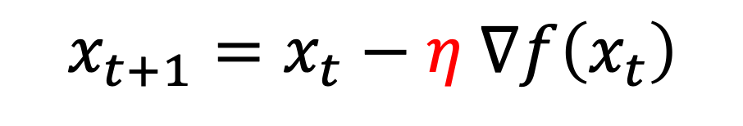

Learning Gradient Descent Step Size
$$x_{t+1}=x_{t}−η ∇f\left(x_{t}\right)$$
After $L$ steps: $x_{L}\left(η, x_{0}\right)$
Goal: Learn optimal single step size $η$ for distribution $D$.
$$η_{L}^{∗}= \underset{η}{argmin}{𝔼_{{f, x}_{0}∼D}\left[ f(x_{L}\left(η, x_{0}\right))\right]}$$

Slide 4
Motivation
Gupta + Roughgarden ’17: Sample complexity of learning step size of GD
How much does learning the step size help performance?
Push the limits of performance of a single step size

Slide 5
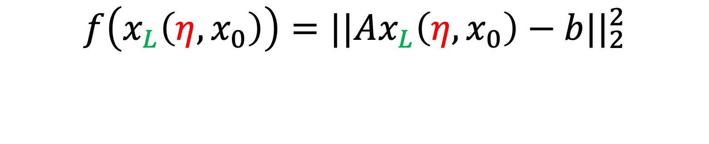
Convex Quadratic Loss
$$f\left(x_{L}\left(η, x_{0}\right)\right)=||Ax_{L}\left(η, x_{0}\right)−b||_{2}^{2}$$

Slide 6
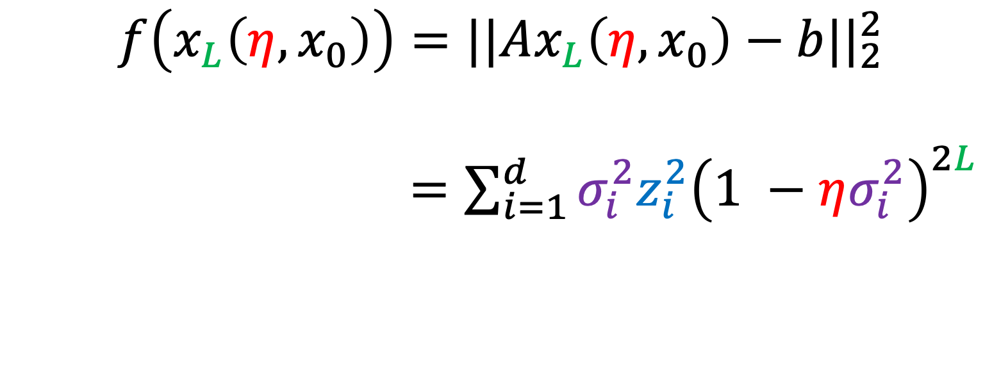
Convex Quadratic Loss
$$f\left(x_{L}\left(η, x_{0}\right)\right)=||Ax_{L}\left(η, x_{0}\right)−b||_{2}^{2}$$
$=\sum_{i=1}^{d}{σ_{i}^{2}z_{i}^{2}{\left(1 −ησ_{i}^{2}\right)}^{2L}}$

Slide 7
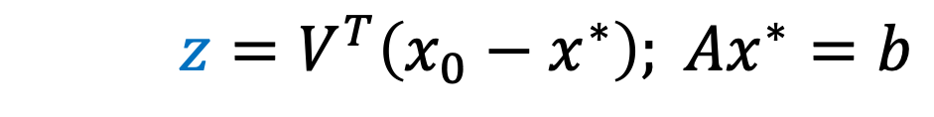
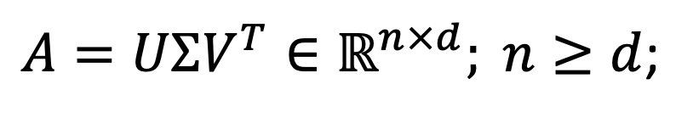
Convex Quadratic Loss
$$f\left(x_{L}\left(η, x_{0}\right)\right)=||Ax_{L}\left(η, x_{0}\right)−b||_{2}^{2}$$
$=\sum_{i=1}^{d}{σ_{i}^{2}z_{i}^{2}{\left(1 −ησ_{i}^{2}\right)}^{2L}}$
$A=UΣV^{T}∈ℝ^{n×d}; n≥d$;
$$z=V^{T}\left(x_{0}−x^{∗}\right); Ax^{∗}=b$$
$spectrum\left(AA^{T}\right)=σ_{1}^{2}≥σ_{2}^{2}≥⋯≥σ_{d}^{2}>0$

Slide 8


Worst Case
spectral ratio: $c=\frac{σ_{1}^{2}}{σ_{2}^{2}}>1$
As $c→∞$: No benefit over regular GD!

Slide 9

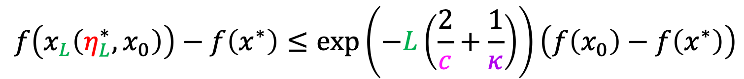
Worst Case
spectral ratio: $c=\frac{σ_{1}^{2}}{σ_{2}^{2}}>1$
condition number: $κ=\frac{σ_{1}^{2}}{σ_{d}^{2}}>1$
As $c→∞$: No benefit over regular GD!
But: If $c→∞$, with $L=α⋅c, α∈ℝ$:
$$f\left(x_{L}\left(η_{L}^{∗}, x_{0}\right)\right)−f\left(x^{∗}\right)≤\exp\left(−L\left(\frac{2}{c}+\frac{1}{κ}\right)\right)\left(f\left(x_{0}\right)−f\left(x^{∗}\right)\right)$$

Slide 10
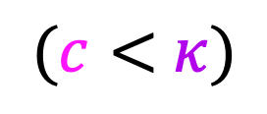

Worst Case
spectral ratio: $c=\frac{σ_{1}^{2}}{σ_{2}^{2}}>1$
condition number: $κ=\frac{σ_{1}^{2}}{σ_{d}^{2}}>1$
As $c→∞$: No benefit over regular GD!
But: If $c→∞$, with $L=α⋅c, α∈ℝ$:
$$f\left(x_{L}\left(η_{L}^{∗}, x_{0}\right)\right)−f\left(x^{∗}\right)≤\exp\left(−L\left(\frac{2}{c}+\frac{1}{κ}\right)\right)\left(f\left(x_{0}\right)−f\left(x^{∗}\right)\right)$$
Improvement in the limit for large $L$!
$(c<$ $κ)$

Slide 11
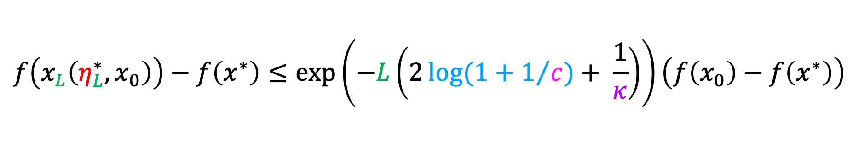


Main Theorem
spectral ratio: $c=\frac{σ_{1}^{2}}{σ_{2}^{2}}>1$
condition number: $κ=\frac{σ_{1}^{2}}{σ_{d}^{2}}>1$
Theorem (informal): For $L$ large enough, for fixed $f,x_{0}$ :
$$f\left(x_{L}\left(η_{L}^{∗}, x_{0}\right)\right)−f\left(x^{∗}\right)≤\exp\left(−L\left(2\log{(1+1/{c)}+ \frac{1}{κ}}\right)\right)\left(f\left(x_{0}\right)−f\left(x^{∗}\right)\right)$$

Slide 12
Main Theorem
spectral ratio: $c=\frac{σ_{1}^{2}}{σ_{2}^{2}}>1$
condition number: $κ=\frac{σ_{1}^{2}}{σ_{d}^{2}}>1$
Theorem (informal): For $L$ large enough, for fixed $f,x_{0}$ :
$$f\left(x_{L}\left(η_{L}^{∗}, x_{0}\right)\right)−f\left(x^{∗}\right)≤\exp\left(−L\left(2\log{(1+1/{c)}+ \frac{1}{κ}}\right)\right)\left(f\left(x_{0}\right)−f\left(x^{∗}\right)\right)$$
Generalizes to expectations over $\left(f, x_{0}\right)∼D$

Slide 13


Main Theorem
spectral ratio: $c=\frac{σ_{1}^{2}}{σ_{2}^{2}}>1$
condition number: $κ=\frac{σ_{1}^{2}}{σ_{d}^{2}}>1$
Theorem (informal): For $L$ large enough, for fixed $f,x_{0}$ :
$$f\left(x_{L}\left(η_{L}^{∗}, x_{0}\right)\right)−f\left(x^{∗}\right)≤\exp\left(−L\left(2\log{(1+1/{c)}+ \frac{1}{κ}}\right)\right)\left(f\left(x_{0}\right)−f\left(x^{∗}\right)\right)$$
Generalizes to expectations over $\left(f, x_{0}\right)∼D$
constant pseudo-dim
Efficient to learn $η^{∗}$:
binary search ERM to find $η^{∗}$

Slide 14

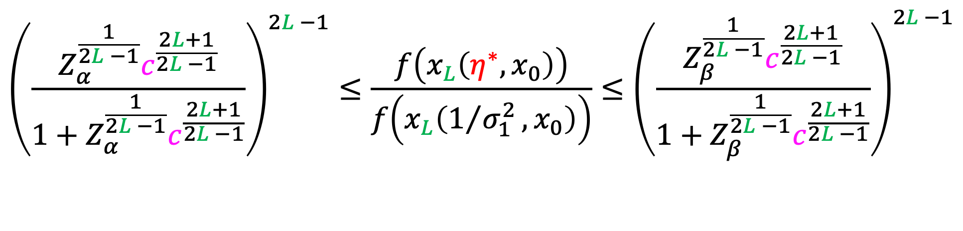
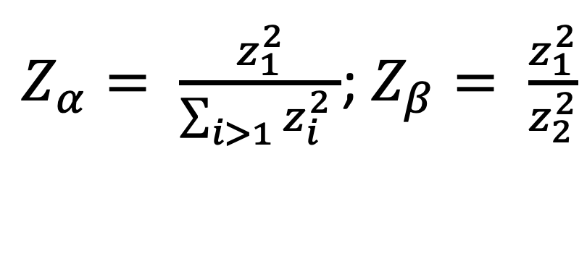
Key Bound – Single Problem Instance
$${\left(\frac{Z_{α}^{\frac{1}{2L −1}}c^{\frac{2L+1}{2L −1}}}{1+Z_{α}^{\frac{1}{2L −1}}c^{\frac{2L+1}{2L −1}}}\right)}^{2L −1}≤\frac{f\left(x_{L}\left(η^{∗}, x_{0}\right)\right)}{f\left(x_{L}\left(1/{σ_{1}^{2}}, x_{0}\right)\right)}≤{\left(\frac{Z_{β}^{\frac{1}{2L −1}}c^{\frac{2L+1}{2L −1}}}{1+Z_{β}^{\frac{1}{2L −1}}c^{\frac{2L+1}{2L −1}}}\right)}^{2L −1}$$
$Z_{α}= \frac{z_{1}^{2}}{\sum_{i>1}{z_{i}^{2} }}$; $Z_{β}= \frac{z_{1}^{2}}{z_{2}^{2}}$
Spectral ratio $c=\frac{σ_{1}^{2}}{σ_{2}^{2}}>1$

