Slide 1
The Platform Design Problem
Christos Papadimitriou, Kiran Vodrahalli, Mihalis Yannakakis
Columbia University
Google Learning Theory Reading Group
October 11, 2021

Slide 2
The Data-Collection Problem
Modern machine learning requires large amounts of high-quality data
Collecting supervised labels is expensive
Unsupervised learning is challenging to use
Is it possible to create environments which generate useful data?
Ex: Reddit users provide sarcasm labels using the “/s” tag
Notes:
Weakly supervised learning methods are a compromise
Active learning is also hard
Of course, unsupervised learning is powerful, but you don’t know what is in the dataset half the time! Many issues with this

Slide 3
The Data-Collection Problem
Modern machine learning requires large amounts of high-quality data
Collecting supervised labels is expensive
Unsupervised learning is challenging to use
Is it possible to create environments which generate useful data?
Ex: Reddit users provide sarcasm labels using the “/s” tag
Modern tech companies try to solve this problem.
Notes:
Weakly supervised learning methods are a compromise
Active learning is also hard
Of course, unsupervised learning is powerful, but you don’t know what is in the dataset half the time! Many issues with this

Slide 4



Economics of the Online Firm
User data
Services
Online firm
Users
User data feeds revenue
Better demand segmentation
Ad/recommendation revenue
Better models => better services
Online services bring value
Convenience
Knowledge

Slide 5
Outline
Problem Definition
General Case
Tractable “Flower” Case
Agent Behavior
Designer’s Algorithm
Extensions
Summary
Future Work

Slide 6
Problem Definition

Slide 7
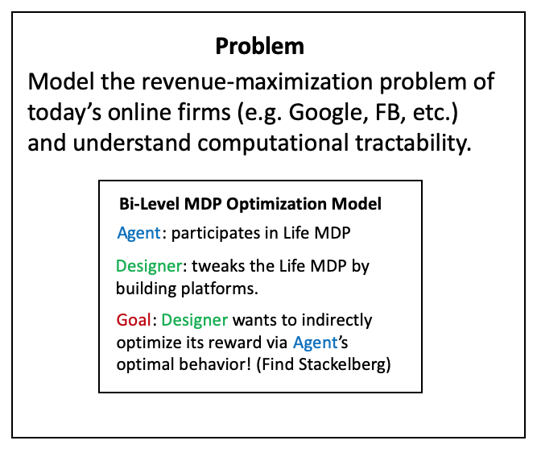
Platform Design
Key Idea: Google builds various apps (Maps, Search, Social Network, etc.) and profits based on usage of these apps.
The usage of apps modifies the transitions of the Markov Chain of the user’s life
Assume the Designer has linear rewards over the steady state distribution of the resulting Markov chain (agent policy + Life MDP)
Bi-Level MDP Optimization Model
Bi-Level MDP Optimization Model
Bi-Level MDP Optimization Model
Agent: participates in Life MDP
Agent: participates in Life MDP
Agent: participates in Life MDP
Designer: tweaks the Life MDP by building platforms.
Designer: tweaks the Life MDP by building platforms.
Designer: tweaks the Life MDP by building platforms.
Goal: Designer wants to indirectly optimize its reward via Agent’s optimal behavior! (Find Stackelberg)
Goal: Designer wants to indirectly optimize its reward via Agent’s optimal behavior! (Find Stackelberg)
Goal: Designer wants to indirectly optimize its reward via Agent’s optimal behavior! (Find Stackelberg)

Slide 8
The Stackelberg Game
Designer moves first:
Adds platforms which, if adopted, modify transitions to an existing Markov Chain
Agent moves second:
Receives MDP from Designer, plays optimal behavior
Example of bi-level MDP optimization
What is the computational complexity of solving for equilibrium?

Slide 9
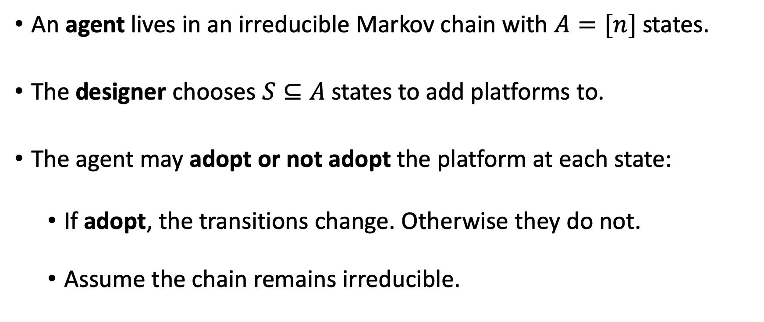
Formal Problem Statement
An agent lives in an irreducible Markov chain with $A=[n]$ states.
The designer chooses $S⊆A$ states to add platforms to.
The agent may adopt or not adopt the platform at each state:
If adopt, the transitions change. Otherwise they do not.
Assume the chain remains irreducible.

Slide 10
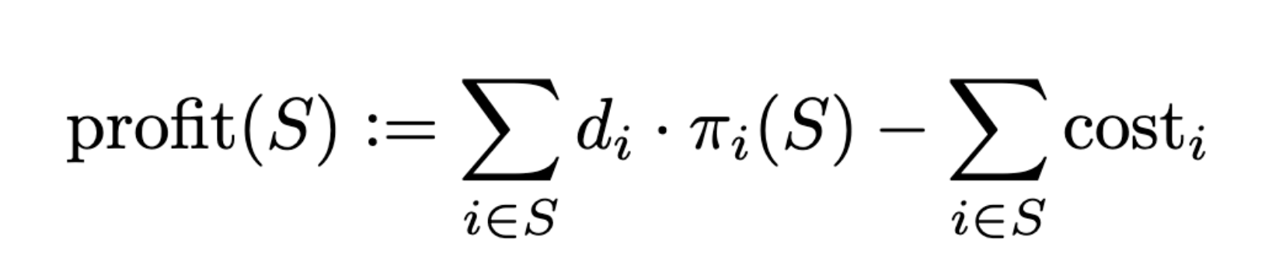
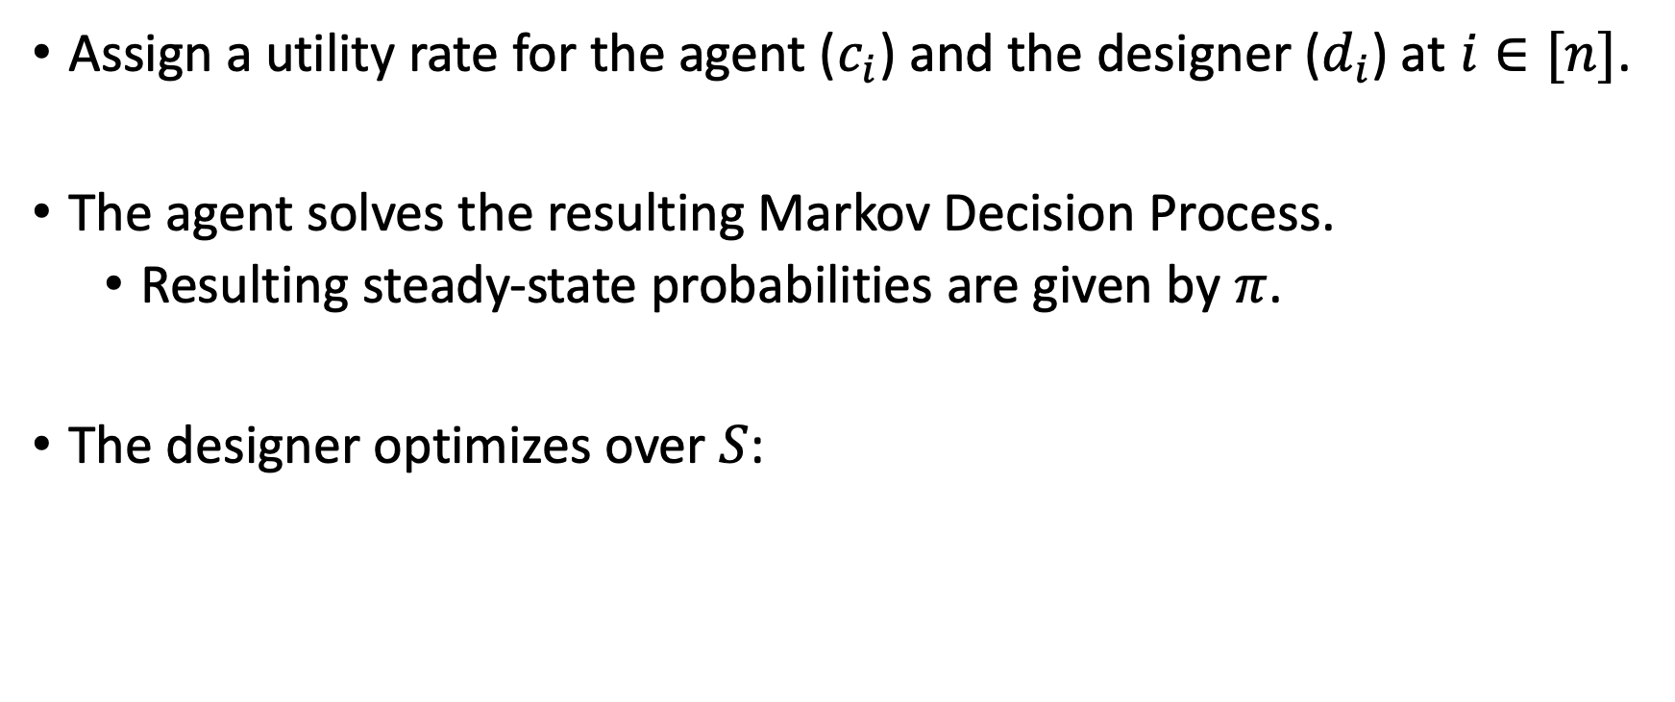
Formal Problem Statement
Assign a utility rate for the agent ($c_{i}$) and the designer ($d_{i}$) at $i∈[n]$.
The agent solves the resulting Markov Decision Process.
Resulting steady-state probabilities are given by $π$.
The designer optimizes over $S$:

Slide 11
General Case

Slide 12

Picture of the General Case
What platforms should I build?
Shopping online
Driving
Exercising
Eating lunch
Studying
Online firm
Watching movie
Reading news
Agent’s Life

Slide 13
Picture of the General Case
What platforms should I build?
Shopping online
Driving
Exercising
Eating lunch
Studying
Online firm
Watching movie
Reading news
At a cost, the firm can add an opt-in action to platforms they create (ex: Google Maps).
Agent’s Life

Slide 14
Picture of the General Case
Maybe we should create Maps technology….
Shopping online
Driving
Exercising
Eating lunch
Studying
Online firm
Watching movie
Builds platform Maps at a cost.
Reading news
Agent’s Life changes
Opt in to Maps
Notes:
Now, if Agent opts in to maps, the Agent can more easily find the retail store she wanted to purchase goods from, and can easily transition to driving to the store to purchase in person.
This is an example of complementary goods: Online advertisements reveal goods an Agent may want to buy, and building a Google Maps platform makes it easier for the Agent to go to the store and buy the good (perhaps an archaic example since now people buy things online).
We can also see how adopting Maps might change other parts of the Agent’s Markov chain (now an MDP):
Easier to find a restaurant you want to go to
Easier to find a movie theatre
Easier to find a hiking trail
Increases likelihoods of transitions from driving to a whole host of other possibilities, while also boosting likelihood from online shopping to driving to a store.

Slide 15
Computational Tractability I: General Case
It is strongly NP-hard to decide whether the Designer can obtain positive profit – and therefore hard to approximate.
Reduction from SET COVER
Designer builds platforms which each solve subset of Agent’s problems.
Most cost-effective covering set is NP hard.
In economic terms, the reduction exploits the complexity of “complementary goods.”
Ex: Brick-and-mortar retail ads help the Agent discover the store, Maps helps the Agent get to the store.
Notes:
SET COVER reduction proof: set of “urgent problems” U and a set of “platform solutions” P. platform transitions: Self loops for each problem inside P and also back to U. Transitions from U to P are also platform opt-ins.
Also, a bad unproductive state that’s extremely hard to escape from: you escape with tiny probability (scaled according to problem size n^2) back to U.
If you don’t opt in to platform, you get sent to this terrible state w/100% probability.
Each platform costs something to build.
Thus, the designer’s problem is to build as few platforms as possible which cover the set of all the agent’s problems (as few pieces of technology which can resolve largest set of urgent problems).
Thus you want a complementary set of products: need to solve as many problems as possible so if one platform/product handles one set and not another, and other platform/product solves another, it’s great! Like peanut butter and jelly.

Slide 16
Tractable “Flower” Case

Slide 17
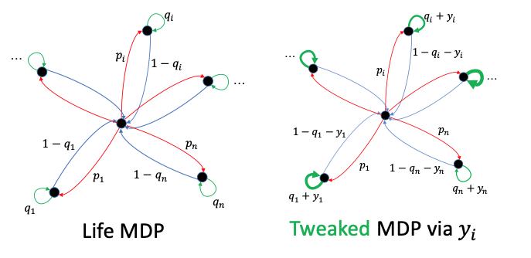
A More Tractable Case: The Flower
Notes:
* Only restricted changes are possible to the transitions.

Slide 18
A More Tractable Case: The Flower
Problem can be solved by an FPTAS
Why tractable?
Substitutes rather than complements
Allocate time spent in each platform
Simpler low-level behavior (greedy agent)
Admits a DP upon discretization (knapsack DP)

Slide 19
Agent Behavior

Slide 20
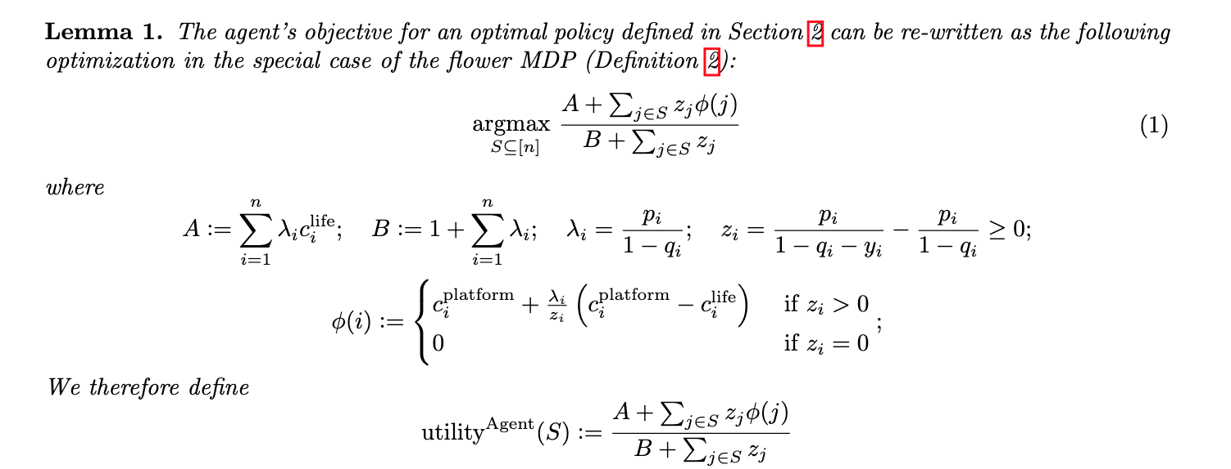
The Agent’s Greedy Algorithm
Solving for the steady state distribution yields a quasi-concave combinatorial optimization problem:

Slide 21
The Agent’s Greedy Algorithm
Solving for the steady state distribution yields quasi-concave combinatorial optimization problem:
Potential function
Notes:
* For simplicity, z_i is non-negative. Similar results go through when it is allowed to be negative, with a slight change of the algorithm.

Slide 22
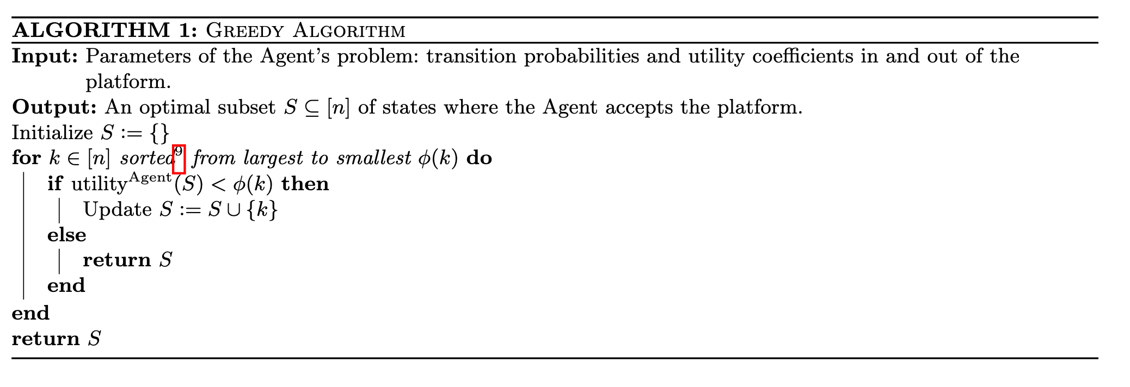
The Agent’s Greedy Algorithm
Sort states by potential function and add until utility = potential
Notes:
Note the algorithm is slightly different when z_i’s are allowed to be negative.
Essentially: first add the positive values in decreasing order, then add the negative values in increasing order (in terms of phi).

Slide 23
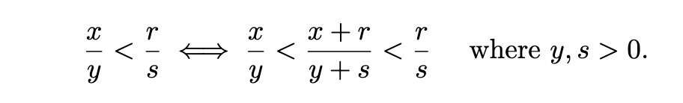
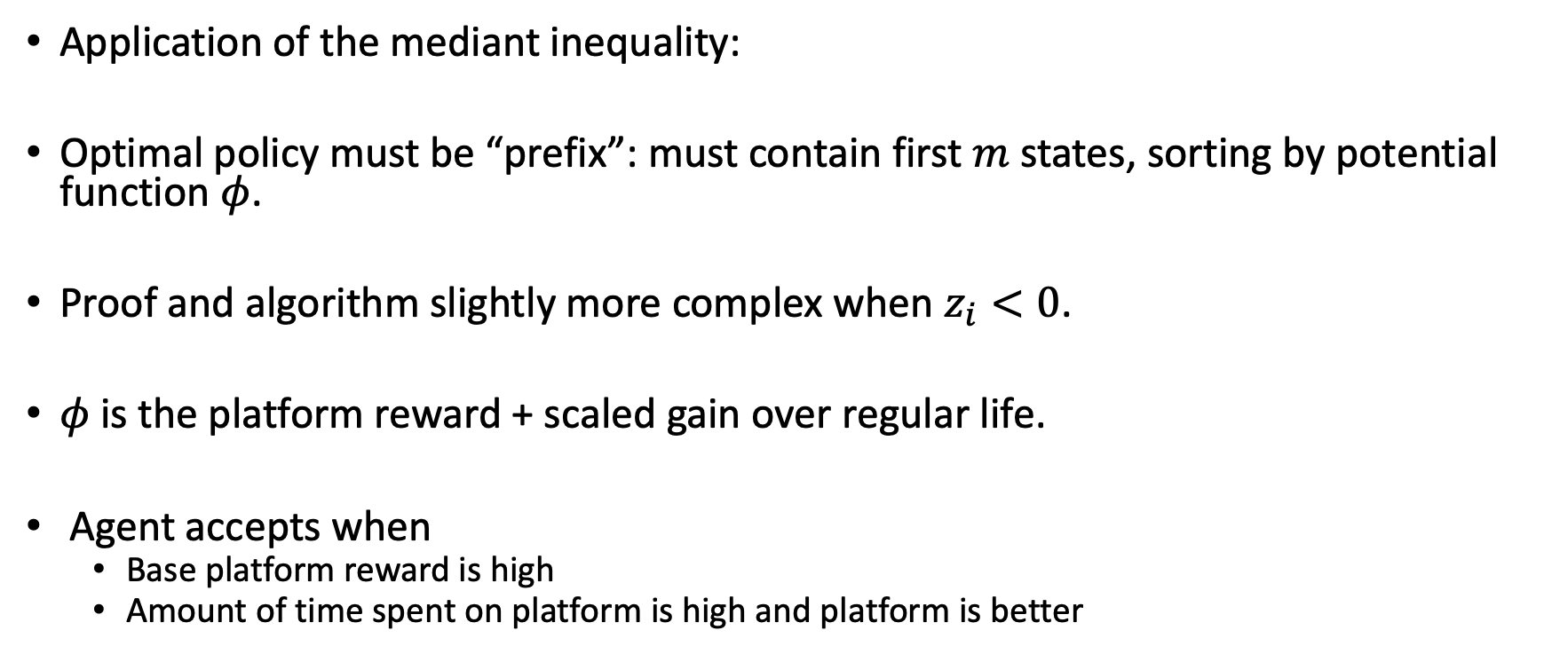
Proof Outline
Application of the mediant inequality:
Optimal policy must be “prefix”: must contain first $m$ states, sorting by potential function $φ$.
Proof and algorithm slightly more complex when $z_{i}<0$.
$φ$ is the platform reward + scaled gain over regular life.
Agent accepts when
Base platform reward is high
Amount of time spent on platform is high and platform is better
Notes:
If z_i < 0: add the positive z_i first, then the negative z_i.
Prove prefix property by standard greedy swap arguments and application of mediant. Then show greedy picks optimal prefix.

Slide 24
Designer’s Algorithm

Slide 25
Recall: Designer’s Objective
Designer’s steady-state reward rates
Designer’s one-time costs for building each platform
Set of states to build platforms
Agent’s steady state probabilities

Slide 26
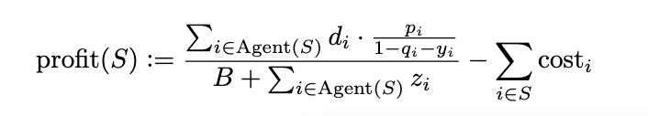


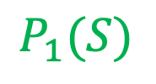
Restrictions
Expanding the profit function given agent behavior:
Define $\max_{i}{d_{i}=:K}$
Maximum profit is $nK$
Assume $z_{i}$ are $poly(n)$ and discretized with gap $δ$ and costs are $K ∗poly(n)$
$$P_{1}(S)$$
$$D(S)$$

Slide 27
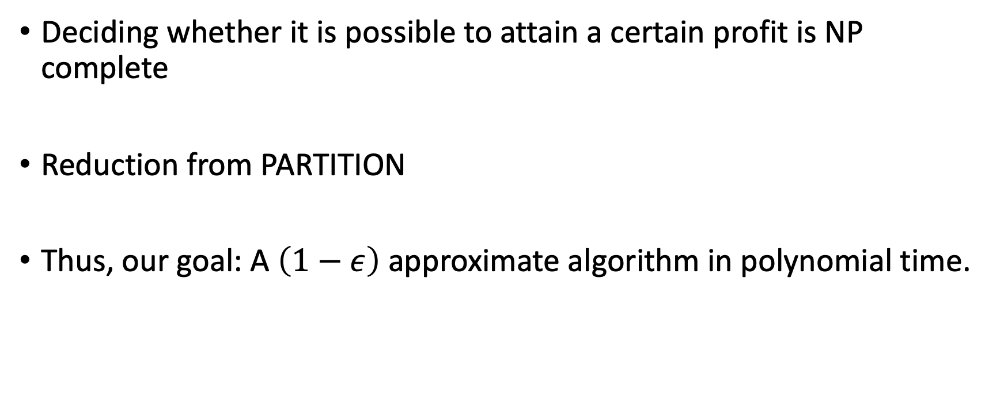
Target Algorithm
Deciding whether it is possible to attain a certain profit is NP complete
Reduction from PARTITION
Thus, our goal: A $\left(1−ε\right)$ approximate algorithm in polynomial time.

Slide 28
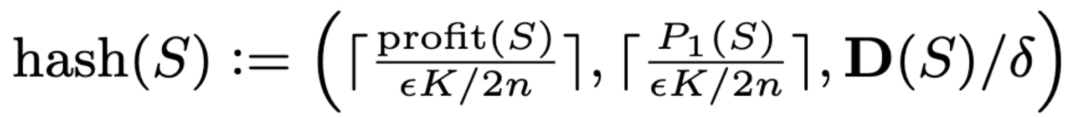
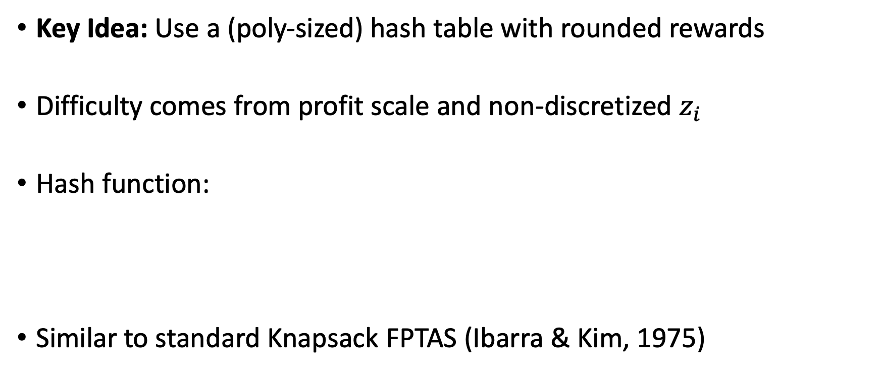
The Designer’s Dynamic Program
Key Idea: Use a (poly-sized) hash table with rounded rewards
Difficulty comes from profit scale and non-discretized $z_{i}$
Hash function:
Similar to standard Knapsack FPTAS (Ibarra & Kim, 1975)
Notes:
Note that it may be possible to have an efficient alg with non-discretized z_i, but it precludes an efficient dynamic program with this approach
We suspect it is necessary to discretize z_i though.

Slide 29
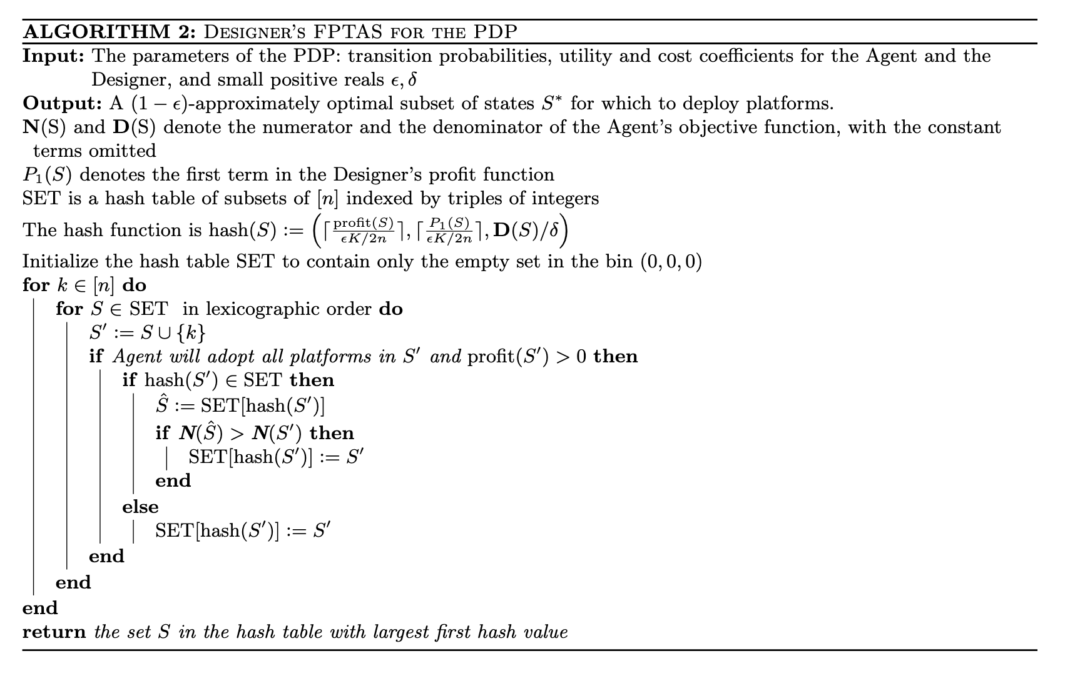
The Designer’s Dynamic Program
efficient feasibility check
update if numerator of agent reward is smaller than current hash
new hash

Slide 30
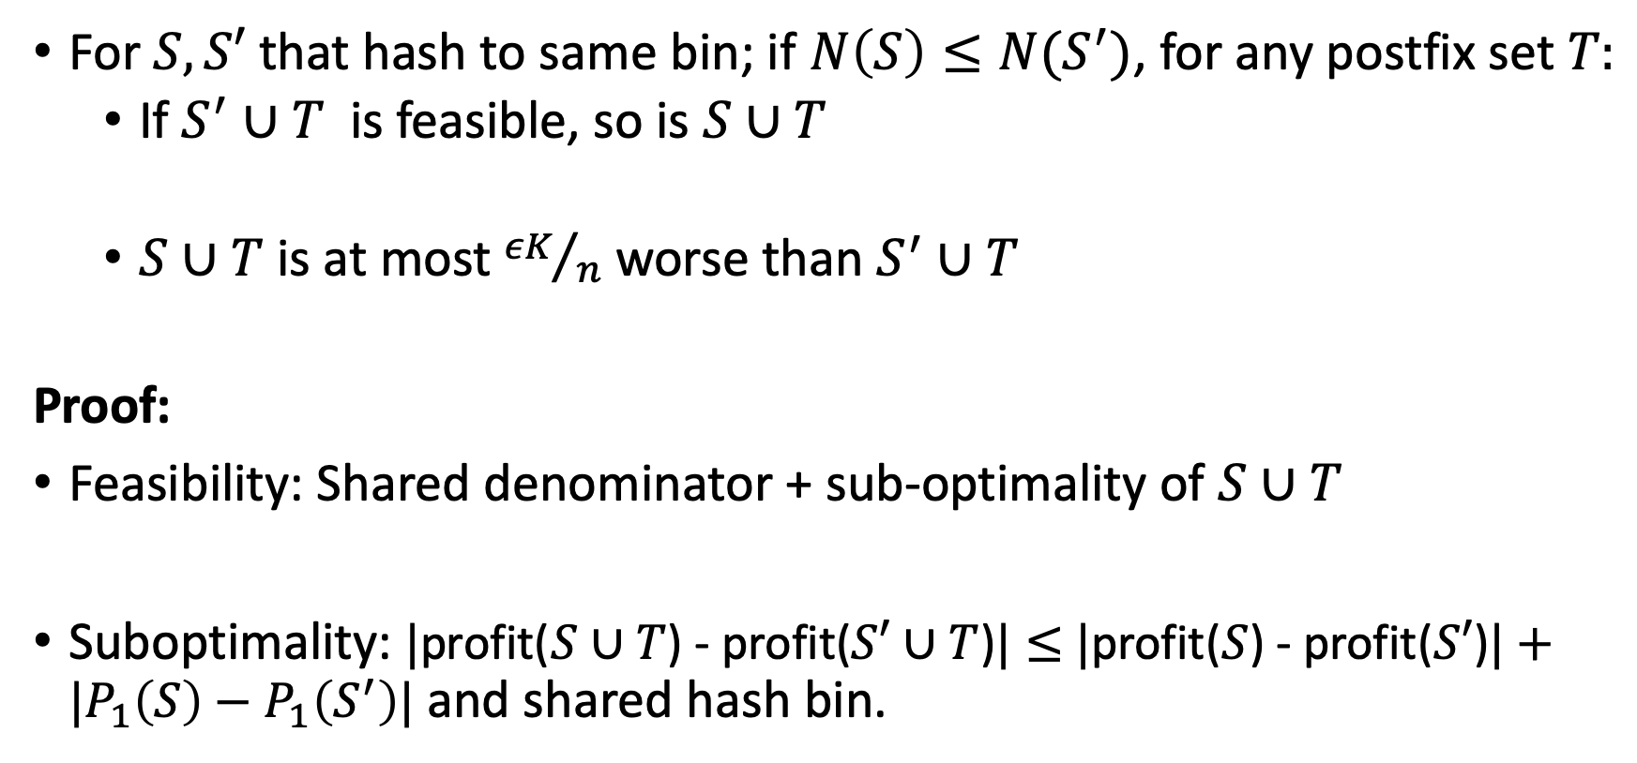
Proof Outline: Key Lemma
For $S, S′$ that hash to same bin; if $N\left(S\right)≤N(S^{′})$, for any postfix set $T:$
If $S^{′}∪T$ is feasible, so is $S∪T$
$S∪T$ is at most ${εK}/n$ worse than $S^{′}∪T$
Proof:
Feasibility: Shared denominator + sub-optimality of $S∪T$
Suboptimality: $|$profit($S∪T$) - profit($S′∪T$)$|≤$ $|$profit($S$) - profit($S′$)$|+|P_{1}\left(S\right)−P_{1}\left(S^{′}\right)|$ and shared hash bin.

Slide 31
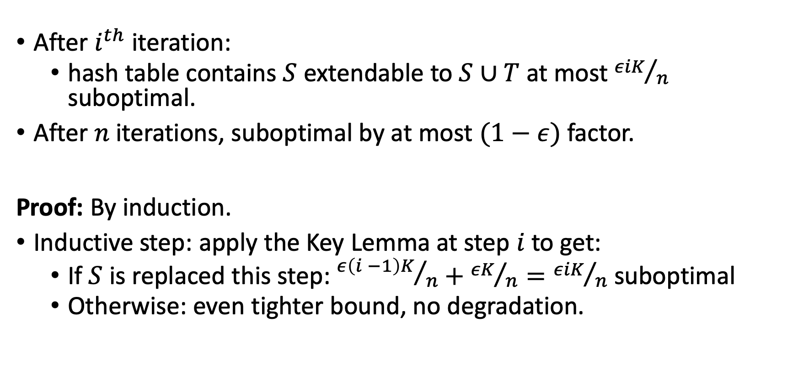
Proof Outline: Applying Key Lemma
After $i^{th}$iteration:
hash table contains $S$ extendable to $S∪T$ at most ${εiK}/n$ suboptimal.
After $n$ iterations, suboptimal by at most $(1−ε)$ factor.
Proof: By induction.
Inductive step: apply the Key Lemma at step $i$ to get:
If $S$ is replaced this step: ${ε\left(i −1\right)K}/n+{εK}/n={εiK}/n$ suboptimal
Otherwise: even tighter bound, no degradation.
Notes:
Extendable: meaning we add a subset T of {i+1, …, n} to get the desired suboptimality.
S cup T is what is eps*i*K/n suboptimal.

Slide 32
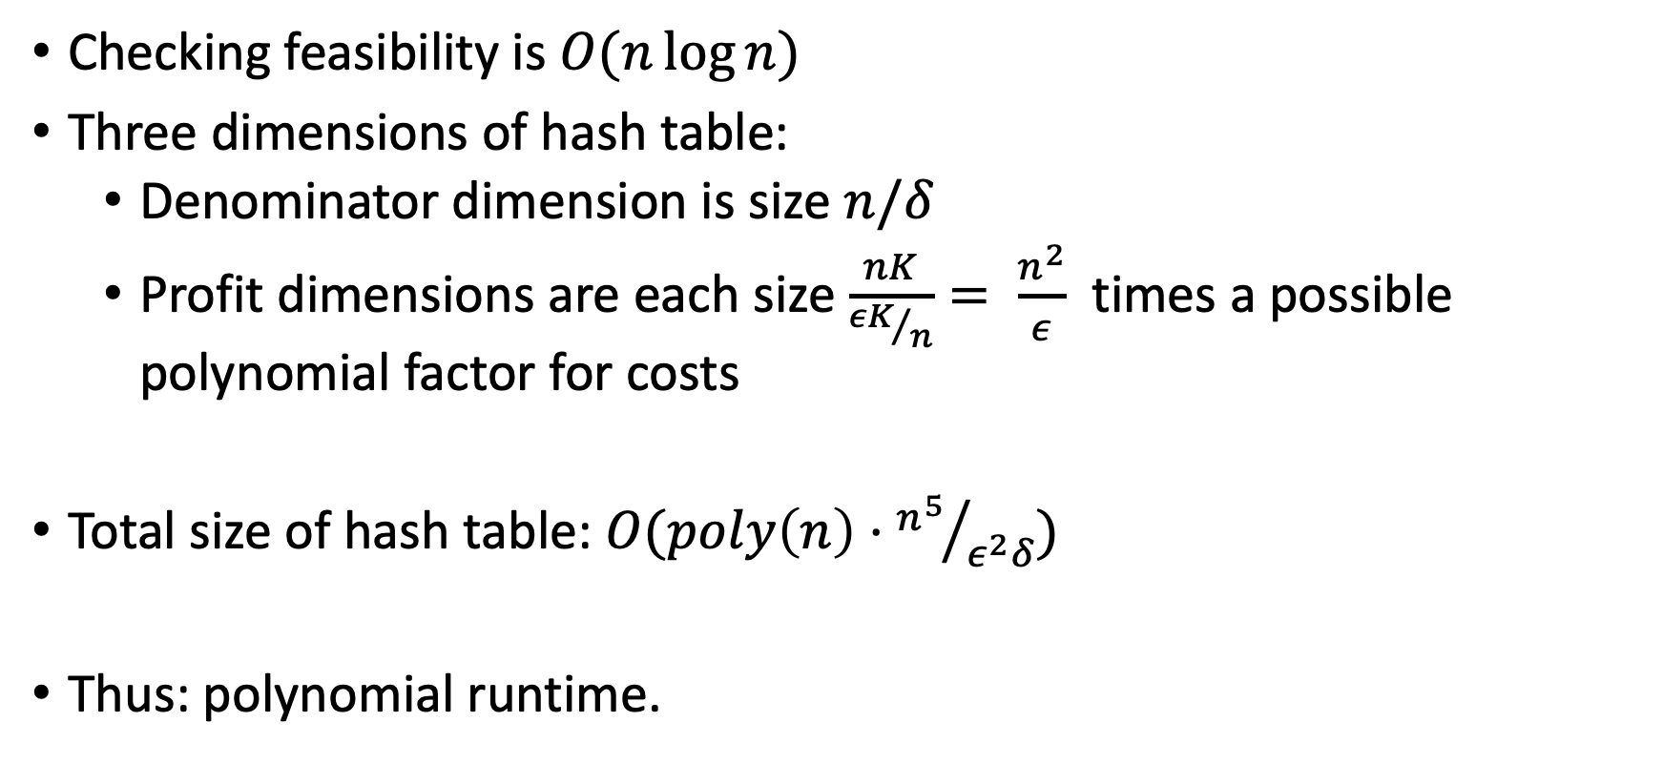
Proof Outline: Complexity
Checking feasibility is $O(n\log{n)}$
Three dimensions of hash table:
Denominator dimension is size $n/δ$
Profit dimensions are each size $\frac{nK}{{εK}/n}= \frac{n^{2}}{ε}$ times a possible polynomial factor for costs
Total size of hash table: $O(poly\left(n\right)⋅{n^{5}}/{ε^{2}δ})$
Thus: polynomial runtime.

Slide 33
Extensions

Slide 34
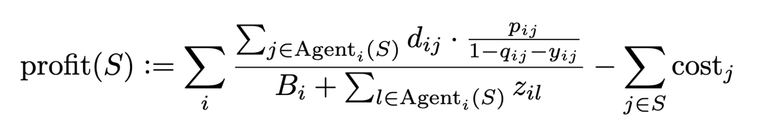
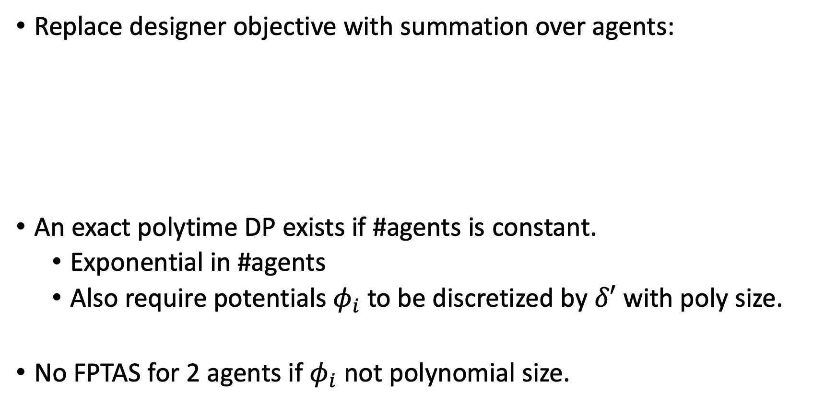
Multiple Agents
Replace designer objective with summation over agents:
An exact polytime DP exists if #agents is constant.
Exponential in #agents
Also require potentials $φ_{i}$ to be discretized by $δ′$ with poly size.
No FPTAS for 2 agents if $φ_{i}$ not polynomial size.
Notes:
* No FPTAS proof: reduction from PARTITION

Slide 35
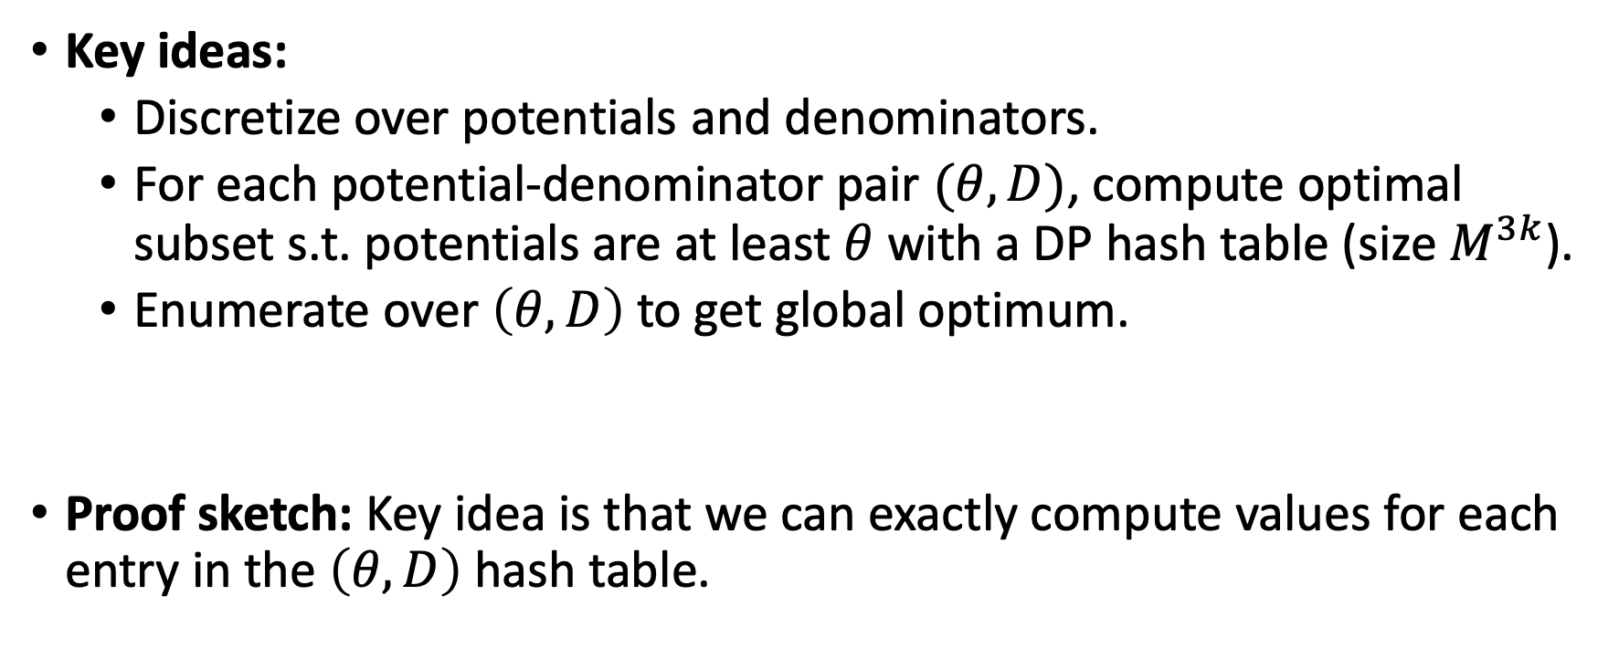
Multiple Agents
Key ideas:
Discretize over potentials and denominators.
For each potential-denominator pair $(θ, D)$, compute optimal subset s.t. potentials are at least $θ$ with a DP hash table (size $M^{3k}$).
Enumerate over $\left(θ, D\right)$ to get global optimum.
Proof sketch: Key idea is that we can exactly compute values for each entry in the $\left(θ, D\right)$ hash table.
Notes:
Note this is an exact algorithm, which we can get via extra assumption that potentials are discretized.
Each hash table is size $M^{3k}$ with $k$ agents and $M$ number of discretized numerators and denominators.
$M^{2}$ for terms corresponding to $z φ$ (numerator)
$M$ for terms corresponding to $z$ (denominator)

Slide 36
Designer Competition
What platforms should I build to compete?
Shopping online
Driving
Exercising
Online firm
Eating lunch
Studying
Watching movie
Reading news
Competing firm
Agent’s Life

Slide 37
Multiple Platforms (Flower Setting)
What if other competing designers have already built platforms?
Each platform affects only one state
At most one for each designer per state
How does an agent behave?
How should a designer optimally place platforms?

Slide 38
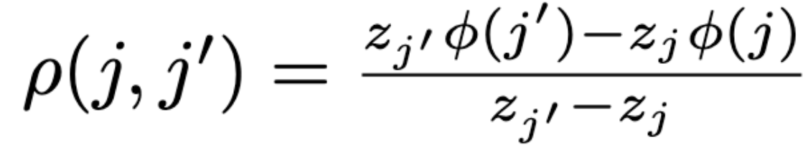

Multiple Platforms (Flower Setting)
Agent’s algorithm is still greedy – but different potential function
For platforms $j, j^{′}$ at the same state, define:

Slide 39

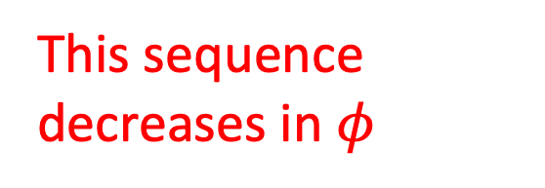
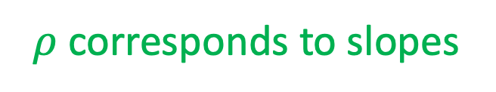
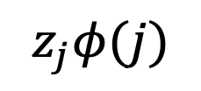
Multiple Platforms (Flower Setting)
Each state’s non-redundant platforms obey the following structure:
Piecewise concave curve
$ρ$ corresponds to slopes
$$z_{j}φ(j)$$
Redundant points
This sequence decreases in $φ$
1 2 3 4 5
$$z_{j}$$
Notes:
* The arguments to prove this structure rely on swapping arguments, the mediant inequality, and comparing the slope values.

Slide 40
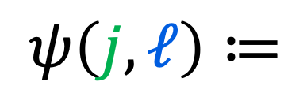
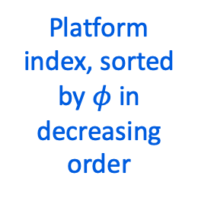
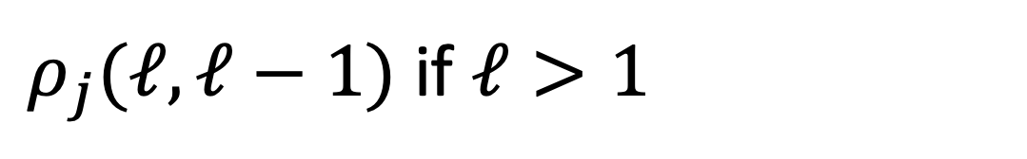
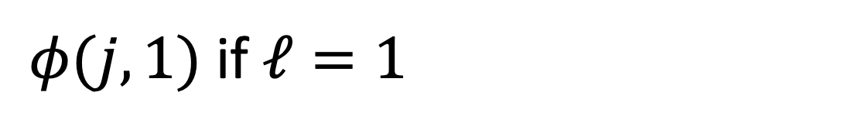
Multiple Platforms (Flower Setting)
Proof idea: Greedy swap argument with new potential, many details.
The new potential function:
$φ(j, 1)$ if $ℓ=1$
$$ψ\left(j, ℓ\right)≔$$
$ρ_{j}(ℓ, ℓ−1)$ if $ℓ>1$
state
Platform index, sorted by $φ$ in decreasing order
Notes:
* Relatively straightforward though I guess. Not any new ideas other than swaps, mediant, and analyzing slope/ function value.

Slide 41
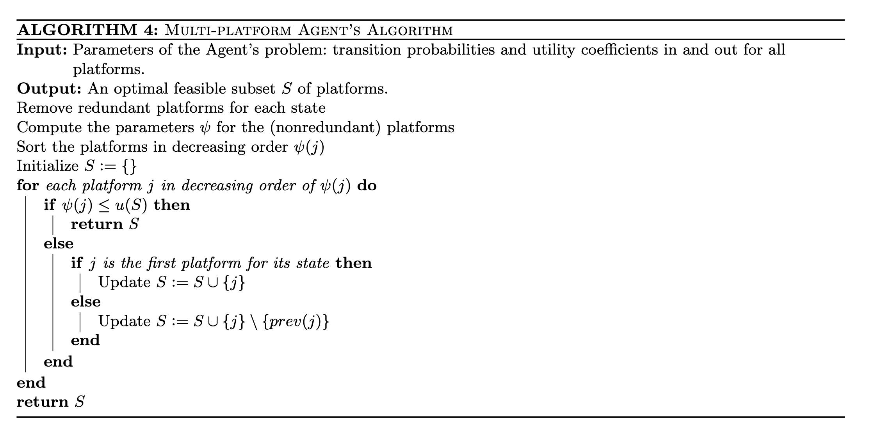

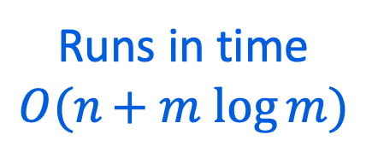
Multiple Platforms (Flower Setting)
Runs in time $O(n+ m log{m})$
Agent utility
n = # states
m = # total platforms
Replace the platform at state $j$
Notes:
Runtime: sorting over platforms and linear scan to remove redundant platforms
u(S) = agent utility for set S

Slide 42
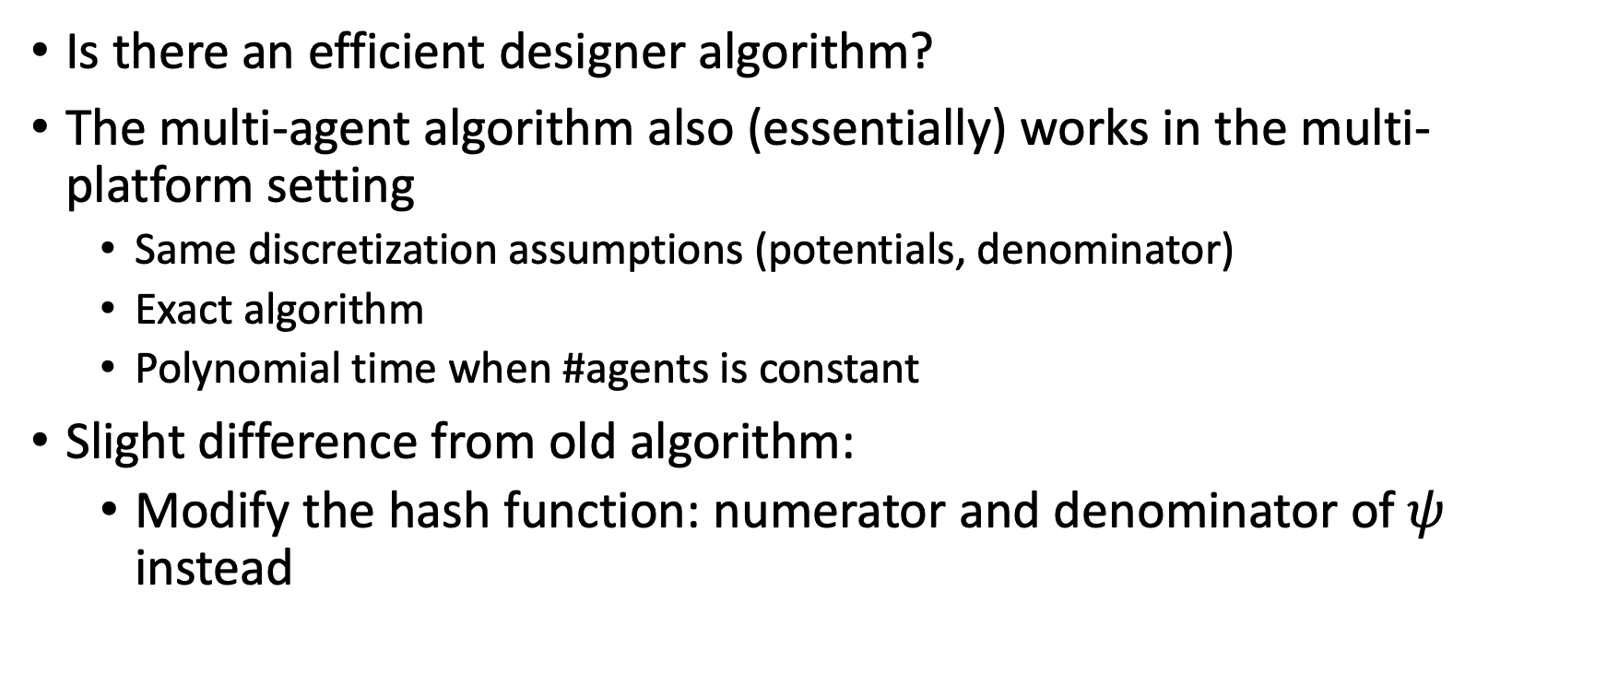
Multiple Platforms (Flower Setting)
Is there an efficient designer algorithm?
The multi-agent algorithm also (essentially) works in the multi-platform setting
Same discretization assumptions (potentials, denominator)
Exact algorithm
Polynomial time when #agents is constant
Slight difference from old algorithm:
Modify the hash function: numerator and denominator of $ψ$ instead

Slide 43
Summary

Slide 44
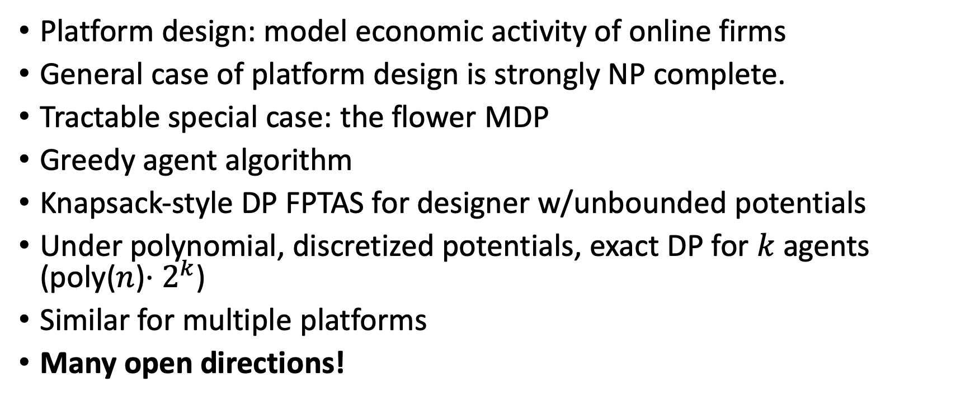
Recap
Platform design: model economic activity of online firms
General case of platform design is strongly NP complete.
Tractable special case: the flower MDP
Greedy agent algorithm
Knapsack-style DP FPTAS for designer w/unbounded potentials
Under polynomial, discretized potentials, exact DP for $k$ agents (poly($n$)$⋅2^{k}$)
Similar for multiple platforms
Many open directions!

Slide 45
Future Work

Slide 46
Future Work
Designer vs. designer
Complexity of pure Nash
Repeated game settings
Privacy/fairness questions for agent
Other classes of tractable MDPs?
Results for generic classes of agent behavior?
Many questions are problems of formulation
Notes:
* Generic classes of agent behavior: ex:, various notions of “greedy” agents – use greedy algorithm which is sub-optimal perhaps.

Slide 47
Learning Theoretic Questions
What if agent/designer have to learn?

Slide 48
Learning Theoretic Questions
What if agent/designer have to learn?
Optimizing over distribution of agent types w/finite support
Expected reward: smoothed version of the objective
ERM with quasi-linear function class
We can solve ERM efficiently if finite support is constant (with discretized, poly-bounded potentials)
Notes:
Optimization from samples hardness doesn’t apply here if our objective is to perform well in expectation over the distribution of functions, rather than perform well on a specific instance which we can only access via samples.
Lipschitz concentration suffices for finite support to get decent sample complexity
Can we learn with polynomial samples of agent payoffs?
Actually, for sure: with constant finite support, the objective is just a linear function of the probabilities and the agent costs for each possibility are known exactly.
So the problem is super easy sample complexity wise in that setting.
For finite support, sample complexity wise, this is easy: ultimately only need to learn the distribution over the agent types.
Most likely in a lot of settings it’s probably still hard. But I could believe that smoothing out the problem could make it easier
We actually haven’t proved anything about the exponent in k, the # of agents/ agent-types, being required.
We’ve only shown that with 2 agents it is NP complete if you don’t have poly-bounded potentials. But the rest is still open.
So we can view this as motivation for getting sub-exponential in k – computationally efficient learning.

Slide 49
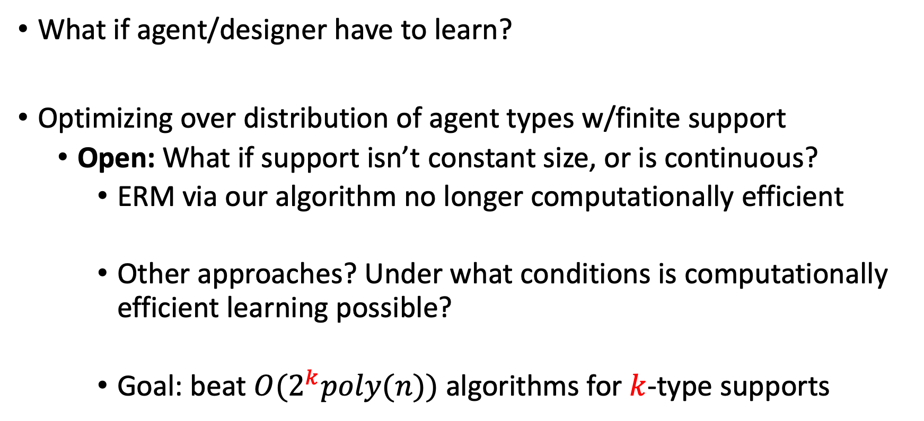
Learning Theoretic Questions
What if agent/designer have to learn?
Optimizing over distribution of agent types w/finite support
Open: What if support isn’t constant size, or is continuous?
ERM via our algorithm no longer computationally efficient
Other approaches? Under what conditions is computationally efficient learning possible?
Goal: beat ${O(2}^{k}poly(n))$ algorithms for $k$-type supports
Notes:
Optimization from samples hardness doesn’t apply here if our objective is to perform well in expectation over the distribution of functions, rather than perform well on a specific instance which we can only access via samples.
Lipschitz concentration suffices for finite support to get decent sample complexity
Can we learn with polynomial samples of agent payoffs?
Actually, for sure: with constant finite support, the objective is just a linear function of the probabilities and the agent costs for each possibility are known exactly.
So the problem is super easy sample complexity wise in that setting.
For finite support, sample complexity wise, this is easy: ultimately only need to learn the distribution over the agent types.
Most likely in a lot of settings it’s probably still hard. But I could believe that smoothing out the problem could make it easier
We actually haven’t proved anything about the exponent in k, the # of agents/ agent-types, being required.
We’ve only shown that with 2 agents it is NP complete if you don’t have poly-bounded potentials. But the rest is still open.
So we can view this as motivation for getting sub-exponential in k – computationally efficient learning.

Slide 50
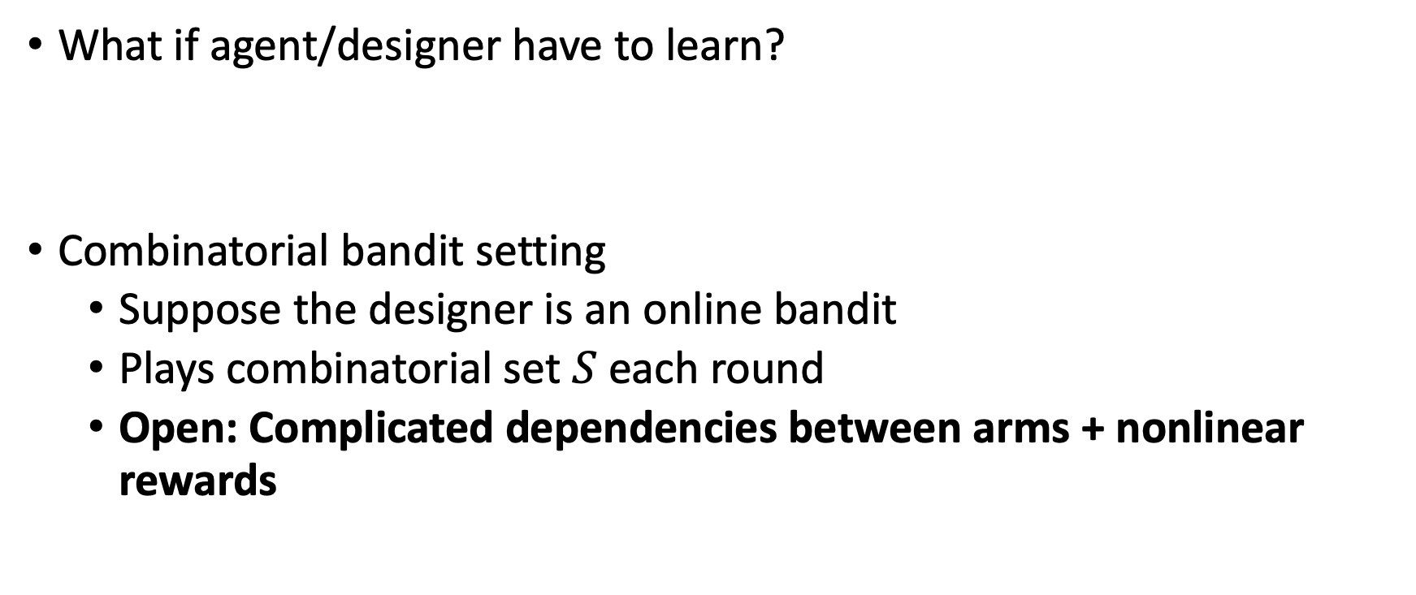
Learning Theoretic Questions
What if agent/designer have to learn?
Combinatorial bandit setting
Suppose the designer is an online bandit
Plays combinatorial set $S$ each round
Open: Complicated dependencies between arms + nonlinear rewards

Slide 51
Learning Theoretic Questions
What if agent/designer have to learn?
Repeated game variants of the problem where both agent and designer are learners
Other equilibria: what is computationally tractable?
Strategic agents and designer-designer competition

Slide 52
Learning Theoretic Questions
What if agent/designer have to learn?
Remove the abstraction of designer rewards:
Agents emit data distributions
Restricted sampling conditions
Goal: Solve some learning problem about agents
Connected with data valuation
How to design sampling environment?
Notes:
* “Active learning with extra steps”

Slide 53
Grand Vision
Design environments which generate useful, sampleable data
Model economics of companies dependent on information economy
Model strategic behavior of online firms and their users
Reinforcement learning aided by environment design
Manipulation and resistance of learning agents
Notes:
* Manipulation etc. via other parameters: ex: feedback? Restricted rewards? Transitions?

