Slide 1
Attribute-Efficient Learning of Monomials over Highly-Correlated Variables
Alexandr Andoni, Rishabh Dudeja, Daniel Hsu, Kiran Vodrahalli
Columbia University
Algorithmic Learning Theory 2019

Slide 2
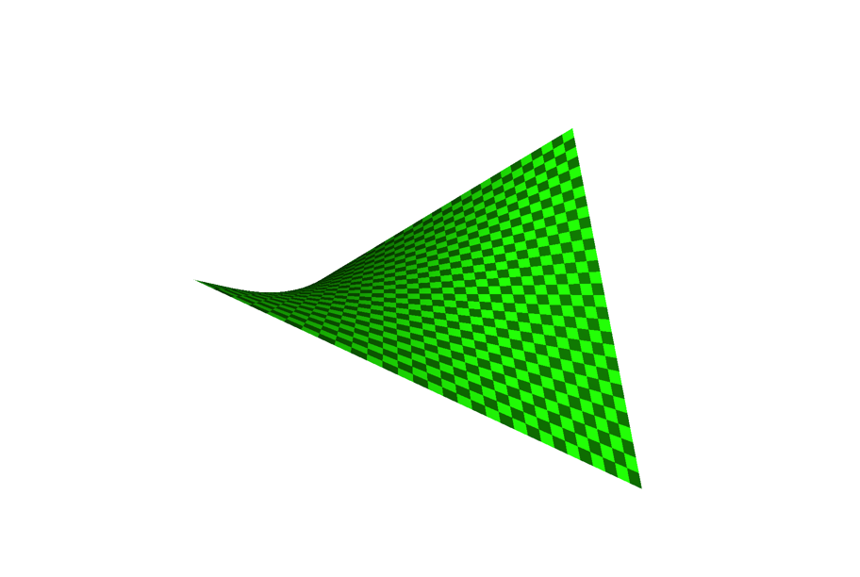
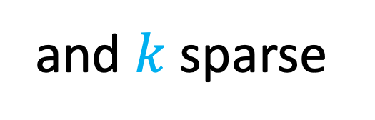
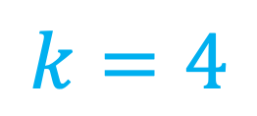
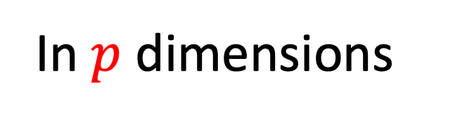
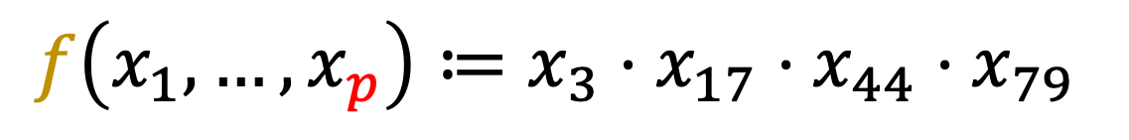
Learning Sparse Monomials
A Simple Nonlinear Function Class
3 dimensions
In $p$ dimensions
Ex:
$$f\left(x_{1}, …, x_{p}\right)≔x_{3}⋅x_{17}⋅x_{44}⋅x_{79}$$
and $k$sparse
$$k=4$$

Slide 3
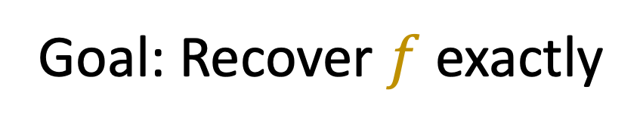
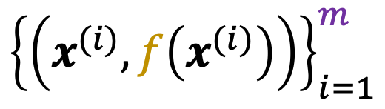
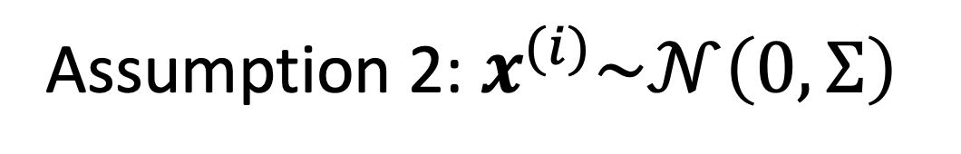
The Learning Problem
$${\left\{\left(x^{(i)}, f\left(x^{(i)}\right)\right)\right\}}_{i=1}^{m}$$
Given: , drawn i.i.d.
Assumption 1: $f$ is a $k$-sparse monomial function
Assumption 2:${ x}^{(i)}\sim 𝒩\left(0, Σ\right)$
Goal: Recover $f$ exactly

Slide 4
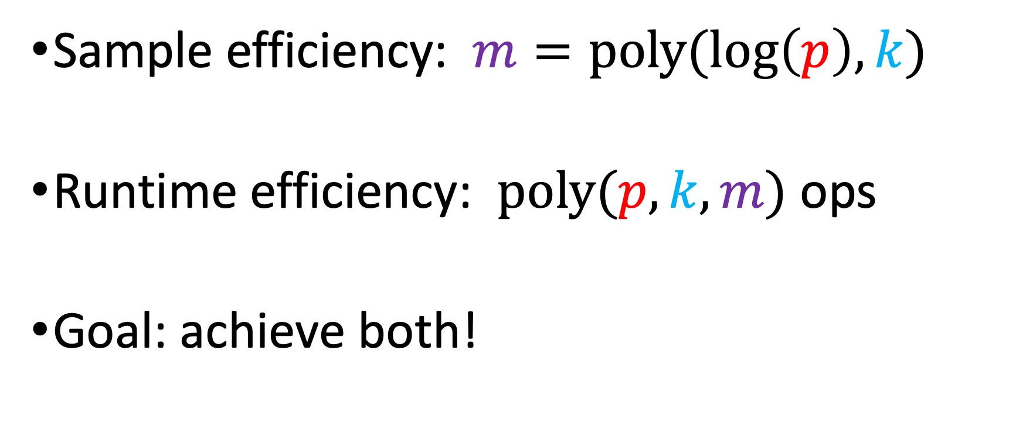
Attribute-Efficient Learning
Sample efficiency: $m=poly(log\left(p\right), k)$
Runtime efficiency: $poly(p, k, m)$ ops
Goal: achieve both!

Slide 5







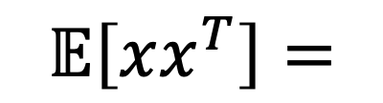



Motivation
$$x_{i}∈\left\{±1\right\}$$
Monomials $≡$ Parity functions
No attribute-efficient algs! [Helmbold+ ‘92, Blum’98, Klivans&Servedio’06, Kalai+’09, Kocaoglu+’14…]
$$x_{i}∈ℝ$$
Sparse linear regression [Candes+’04, Donoho+’04, Bickel+’09…]
Sparse sums of monomials [Andoni+’14] For uncorrelated features:
$$σ_{1}^{2}$$
$$σ_{2}^{2}$$
$$0$$
$$𝔼\left[xx^{T}\right]=$$
$$σ_{3}^{2}$$
$$σ_{4}^{2}$$
$$0$$
$$σ_{5}^{2}$$
$$σ_{6}^{2}$$

Slide 6




















Motivation
$$x_{i}∈\left\{±1\right\}$$
Monomials $≡$ Parity functions
No attribute-efficient algs! [Helmbold+ ‘92, Blum’98, Klivans&Servedio’06, Kalai+’09, Kocaoglu+’14…]
$$x_{i}∈ℝ$$
Sparse linear regression [Candes+’04, Donoho+’04, Bickel+’09…]
Sparse polynomials [Andoni+’14] For uncorrelated features:
Question: What if
$$1$$
$$≤ρ$$
$$1$$
?
$$𝔼\left[xx^{T}\right]=$$
$$1$$
$$1$$
$$σ_{1}^{2}$$
$$≤ρ$$
$$1$$
$$σ_{2}^{2}$$
$$0$$
$$1$$
$$𝔼\left[xx^{T}\right]=$$
$$σ_{3}^{2}$$
$$σ_{4}^{2}$$
$$0$$
$$σ_{5}^{2}$$
$$σ_{6}^{2}$$

Slide 7


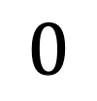
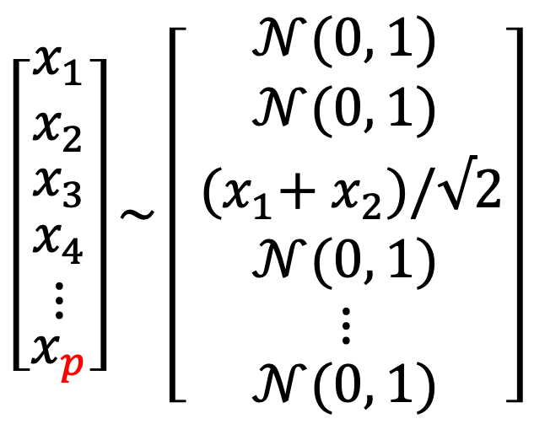
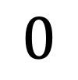
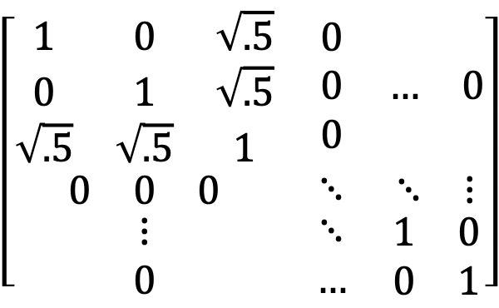

Potential Degeneracy of
$$=𝔼\left[xx^{T}\right]$$
$$\left[\begin{matrix}x_{1} \\ x_{2} \\ \begin{matrix}x_{3} \\ \begin{matrix}x_{4} \\ ⋮\end{matrix} \\ x_{p}\end{matrix}\end{matrix}\right]\sim \left[\begin{matrix}𝒩(0, 1) \\ 𝒩(0, 1) \\ \begin{matrix}{ (x}_{1}+{ x}_{2})/√2 \\ \begin{matrix}𝒩(0, 1) \\ ⋮\end{matrix} \\ 𝒩(0, 1)\end{matrix}\end{matrix}\right]$$
$$\left[\begin{matrix}\begin{matrix}1 & 0 & \sqrt{.5} \\ 0 & 1 & \sqrt{.5} \\ \sqrt{.5} & \sqrt{.5} & 1\end{matrix} & \begin{matrix}0 \\ 0 \\ 0\end{matrix} & \begin{matrix}… & 0\end{matrix} \\ \begin{matrix}0 & 0 & 0\end{matrix} & ⋱ & \begin{matrix}⋱ & ⋮\end{matrix} \\ \begin{matrix}⋮ \\ 0\end{matrix} & \begin{matrix}⋱ \\ …\end{matrix} & \begin{matrix}1 & 0 \\ 0 & 1\end{matrix}\end{matrix}\right]$$
$$0$$
$$0$$
Ex:
$$=$$
$$0$$
Singular matrix
can be low-rank!

Slide 8
Rest of the Talk
Algorithm
Intuition
Analysis
Conclusion

Slide 9
1. Algorithm

Slide 10


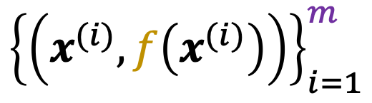
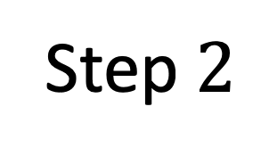

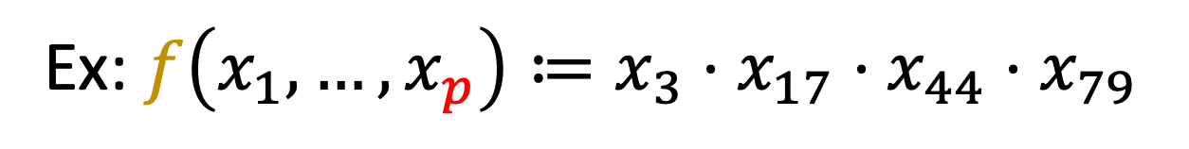
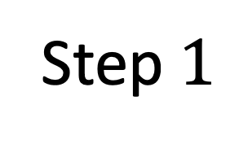

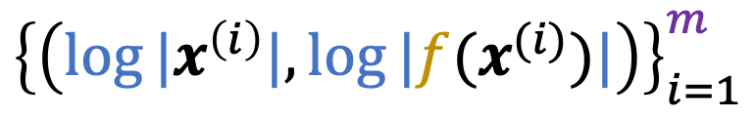



The Algorithm
Ex: $f\left(x_{1}, …, x_{p}\right)≔x_{3}⋅x_{17}⋅x_{44}⋅x_{79}$
Step $1$
$$log⁡|⋅|$$
$${\left\{\left(x^{(i)}, f\left(x^{(i)}\right)\right)\right\}}_{i=1}^{m}$$
$${\left\{\left(log⁡|x^{\left(i\right)}|,log⁡|f(x^{(i)})|\right)\right\}}_{i=1}^{m}$$
Gaussian Data
Log-transformed Data
Step $2$
$$1$$
Sparse Regression:
(Ex: Basis Pursuit)
feature
$$0$$
$$3$$
$$17$$
$$44$$
$$79$$

Slide 11
2. Intuition

Slide 12
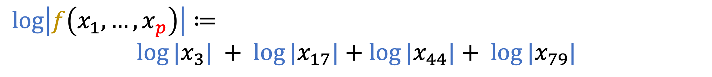
Why is our Algorithm Attribute-Efficient?
Runtime: basis pursuit is efficient
Sample complexity?
Sparse linear regression? E.g.,
But: sparse recovery properties may not hold…
$$\log\left|f\left(x_{1}, …, x_{p}\right)\right|≔$$
${log⁡|x}_{3}| + {log⁡|x}_{17}|$ $+$ ${log⁡|x}_{44}|+ {log⁡|x}_{79}|$

Slide 13

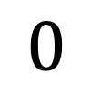

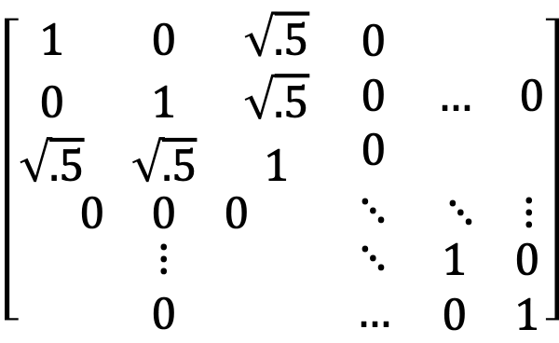
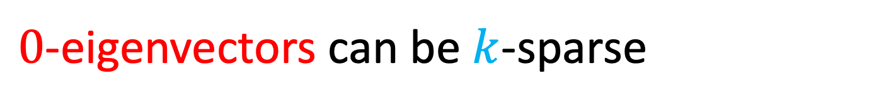
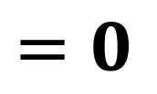

Degenerate High Correlation
$$=𝔼\left[xx^{T}\right]$$
$$\left[\begin{matrix}\begin{matrix}1 & 0 & \sqrt{.5} \\ 0 & 1 & \sqrt{.5} \\ \sqrt{.5} & \sqrt{.5} & 1\end{matrix} & \begin{matrix}0 \\ 0 \\ 0\end{matrix} & \begin{matrix}… & 0\end{matrix} \\ \begin{matrix}0 & 0 & 0\end{matrix} & ⋱ & \begin{matrix}⋱ & ⋮\end{matrix} \\ \begin{matrix}⋮ \\ 0\end{matrix} & \begin{matrix}⋱ \\ …\end{matrix} & \begin{matrix}1 & 0 \\ 0 & 1\end{matrix}\end{matrix}\right]$$
$$0$$
Recall the example:
$$=$$
$$0$$
$$0$$
$$\left[\begin{matrix}−1/2 \\ −1/2 \\ \begin{matrix}1/\sqrt{2} \\ \begin{matrix}0 \\ ⋮\end{matrix} \\ 0\end{matrix}\end{matrix}\right]$$
$$=0$$
$0$-eigenvectors can be $k$-sparse
Sparse recovery conditions false!
3-sparse

Slide 14
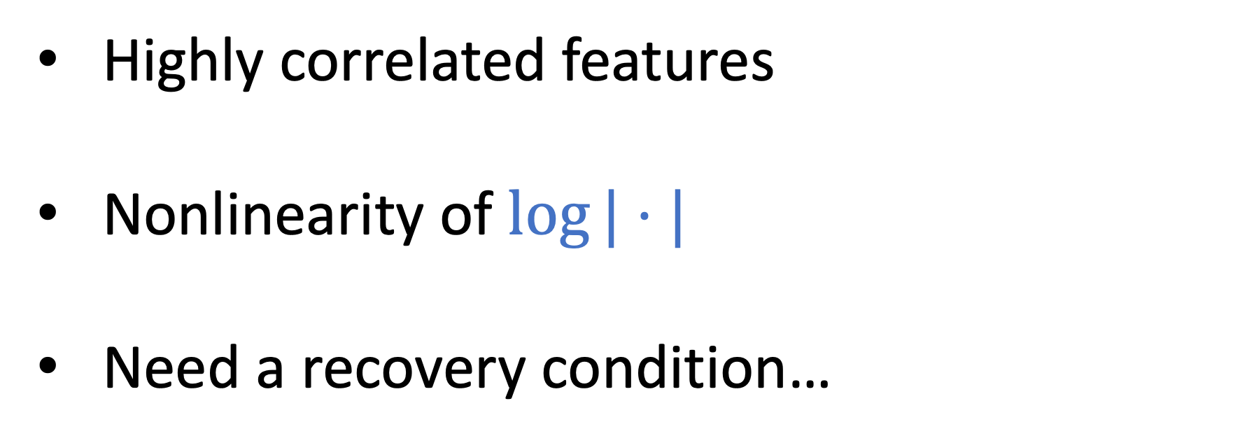
Summary of Challenges
Highly correlated features
Nonlinearity of $log⁡|⋅|$
Need a recovery condition…

Slide 15
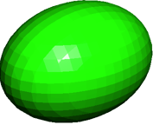
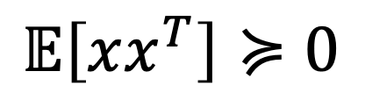
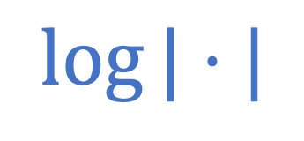
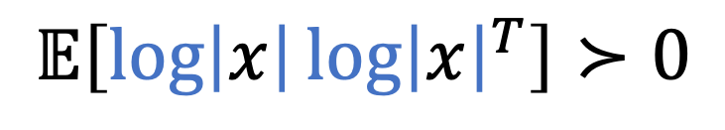
Log-Transform affects Data Covariance
$$log⁡|⋅|$$
$𝔼\left[xx^{T}\right]≽0$
$$𝔼\left[\log\left|x\right|{\log\left|x\right|}^{T}\right]≻0$$
“inflating the balloon”
Spectral View:
Destroys correlation structure

Slide 16
3. Analysis

Slide 17
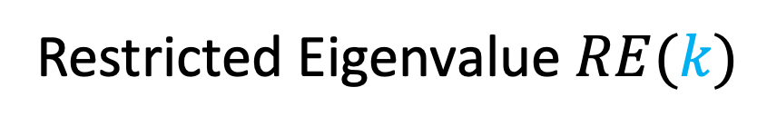
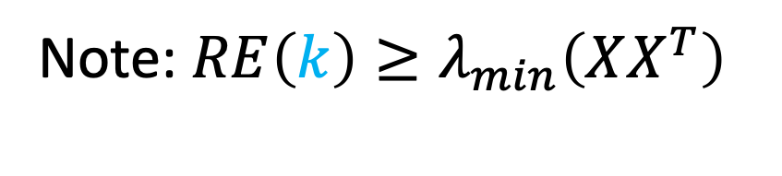
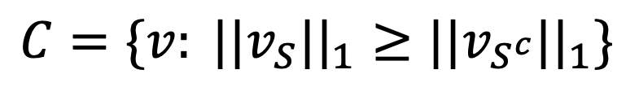
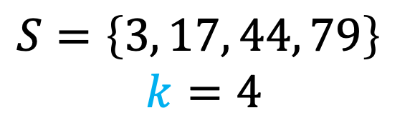


Restricted Eigenvalue Condition [Bickel, Ritov, & Tsybakov ‘09]
Restricted Eigenvalue $RE(k)$
Ex:
$$S=\left\{3, 17, 44, 79\right\}$$
$$k=4$$
$$\min_{v∈C} \frac{v^{T}XX^{T}v}{||v||_{2}^{2}}>ε$$
Cone restriction
“restricted strong convexity”
Note: ${RE\left(k\right)≥λ}_{min}\left(XX^{T}\right)$
Sufficient to prove exact recovery
for basis pursuit!
$$C=\{v: ||v_{S}||_{1}≥||v_{S^{c}}||_{1}\}$$
$$\left|S\right|=k$$

Slide 18
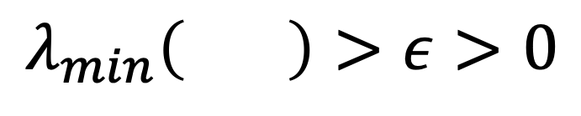
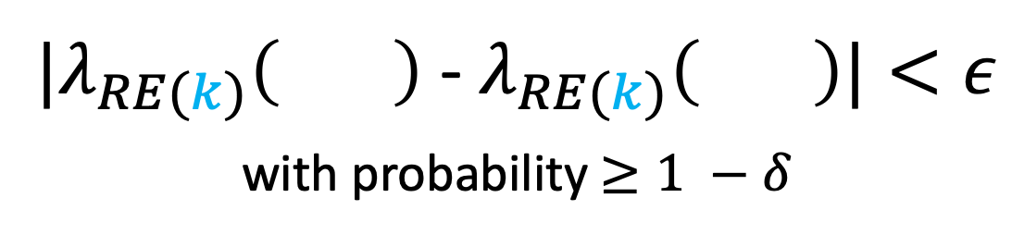

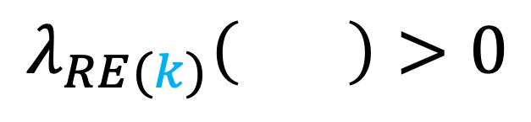
Sample Complexity Analysis
$$=𝔼\left[\log\left|x\right|{\log\left|x\right|}^{T}\right]$$
Population Transformed Eigenvalue
Concentration of Restricted Eigenvalue
$$λ_{min}\left( \right)>ε>0$$
${|λ}_{RE(k)}\left( \right)$ - $λ_{RE(k)}\left( \right)|<ε$
with probability $≥1 −δ$
$$λ_{RE(k)}\left( \right)>0$$
with high probability
Exact Recovery for Basis Pursuit
with high probability

Slide 19
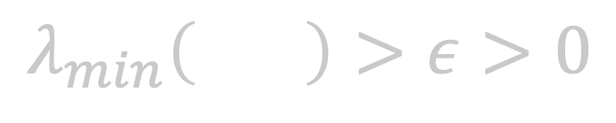
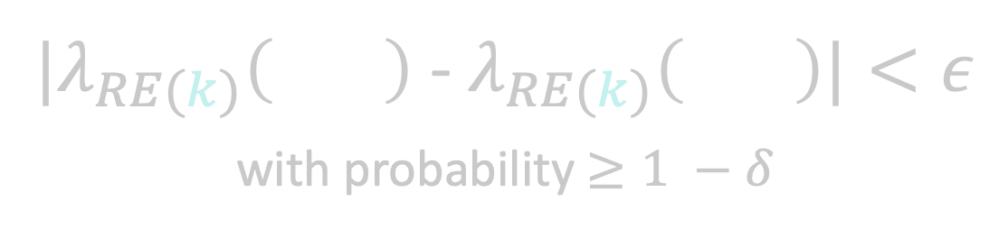


Sample Complexity Analysis
$$=𝔼\left[\log\left|x\right|{\log\left|x\right|}^{T}\right]$$
Population Transformed Eigenvalue
Concentration of Restricted Eigenvalue
$$λ_{min}\left( \right)>ε>0$$
${|λ}_{RE(k)}\left( \right)$ - $λ_{RE(k)}\left( \right)|<ε$
with probability $≥1 −δ$
Sample Complexity Bound:
$$m= O\left(\frac{k^{2}\log{2k}}{1−ρ}⋅\log^{2}{\frac{2p}{δ}}\right)$$
$$λ_{RE(k)}\left( \right)>0$$
with high probability
Exact Recovery for Basis Pursuit
with high probability

Slide 20







Population Minimum Eigenvalue
$$=𝔼\left[\log\left|x\right|{\log\left|x\right|}^{T}\right]$$
$$=𝔼\left[xx^{T}\right]$$
Hermite expansion of $log⁡|⋅|:$
${l≥1: c}_{2l}^{2} \sim \frac{√π}{4}⋅\frac{1}{l^{3/2}}$
$⋅^{ (2l)}$ off-diagonals decay fast!
Apply $λ_{min}$ to Hermite formula:
Apply Gershgorin Circle Theorem:
$$=c_{0}^{2}1_{pxp}+\sum_{l=1}^{∞}{c_{2l}^{2}⋅^{ (2l)}}$$
$$λ_{min} ≥\sum_{l=1}^{∞}{c_{2l}^{2}λ_{min}^{ (2l)}}$$
$$λ_{min}⋅^{ (2l)} ≥1 −\left(p−1\right)ρ^{2l}$$
(for large enough $l$)

Slide 21

Concentration of Restricted Eigenvalue
$$=𝔼\left[\log\left|x\right|{\log\left|x\right|}^{T}\right]$$
${|λ}_{RE(k)}\left( \right)$ - $λ_{RE(k)}\left( \right)|<k⋅|| − ||_{∞}$
Log-transformed variables are sub-exponential
Elementwise $ℓ_{∞}$ error concentrates [Kuchibhotla & Chakrabortty ‘18]

Slide 22
4. Conclusion

Slide 23

Recap
Attribute-efficient algorithm for monomials
Prior (nonlinear) work: uncorrelated features
This work: allow highly correlated features
Works beyond multilinear monomials
Blessing of nonlinearity
$$log⁡|⋅|$$

Slide 24
Future Work
Rotations of product distributions
Additive noise
Sparse polynomials with correlated features
Thanks! Questions?

