Slide 1
The Platform Design Problem
Christos Papadimitriou, Kiran Vodrahalli, Mihalis Yannakakis
Columbia University
NetEcon 2021

Slide 2
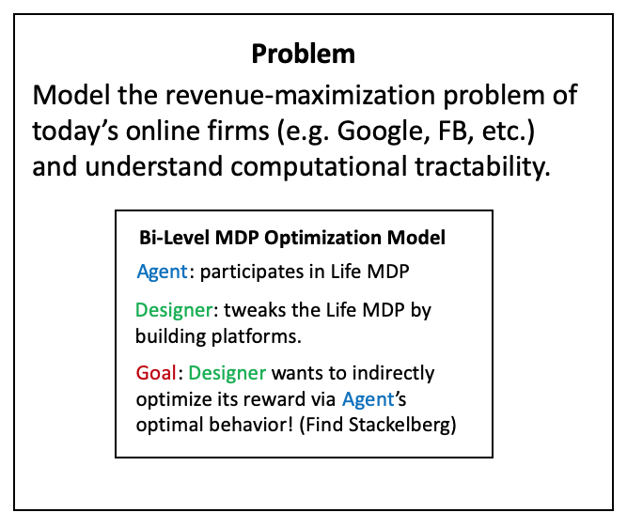
Platform Design
Key Idea: Google builds various apps (Maps, Search, Social Network, etc.) and profits based on usage of these apps.
The usage of apps modifies the transitions of the Markov Chain of the user’s life
Assume the Designer has linear rewards over the steady state distribution of the resulting Markov chain (agent policy + Life MDP)
Bi-Level MDP Optimization Model
Bi-Level MDP Optimization Model
Bi-Level MDP Optimization Model
Agent: participates in Life MDP
Agent: participates in Life MDP
Agent: participates in Life MDP
Designer: tweaks the Life MDP by building platforms.
Designer: tweaks the Life MDP by building platforms.
Designer: tweaks the Life MDP by building platforms.
Goal: Designer wants to indirectly optimize its reward via Agent’s optimal behavior! (Find Stackelberg)
Goal: Designer wants to indirectly optimize its reward via Agent’s optimal behavior! (Find Stackelberg)
Goal: Designer wants to indirectly optimize its reward via Agent’s optimal behavior! (Find Stackelberg)

Slide 3
The Stackelberg Game
Designer moves first:
Adds platforms which, if adopted, modify transitions to an existing Markov Chain
Agent moves second:
Receives MDP from Designer, plays optimal behavior
Example of bi-level MDP optimization
What is the computational complexity of solving for equilibrium?

Slide 4
Computational Tractability I: General Case
It is strongly NP-hard to decide whether the Designer can obtain positive profit – and therefore hard to approximate.
Reduction from Set Cover
Designer builds platforms which each solve subset of Agent’s problems.
Most cost-effective covering set is NP hard.
In economic terms, the reduction exploits the complexity of “complementary goods.”
Ex: Brick-and-mortar retail ads help the Agent discover the store, Maps helps the Agent get to the store.

Slide 5
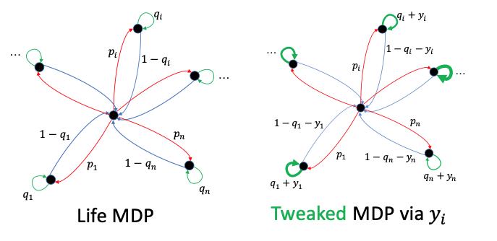
A More Tractable Case: The Flower

Slide 6
A More Tractable Case: The Flower
Problem can be solved by an FPTAS
Why tractable?
Substitutes rather than complements
Allocate time spent in each platform
Simpler low-level behavior (greedy agent)
Admits a DP upon discretization (knapsack DP)

Slide 7
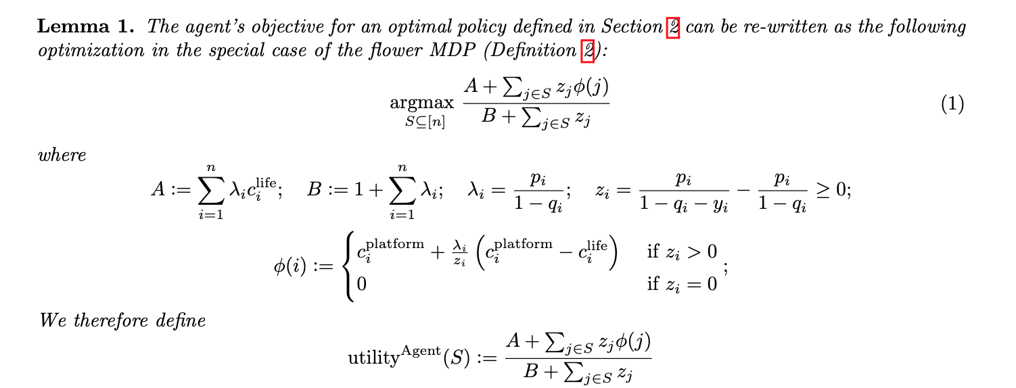
The Agent’s Greedy Algorithm
Sort states by potential function and add until utility = potential:

Slide 8
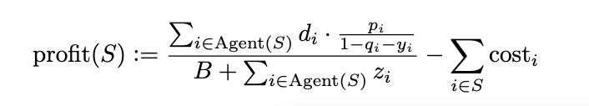
The Designer’s Dynamic Program
Designer’s profit function for set of platforms S:
Assume z is discretized and costs are polynomially bounded
Goal: (1 - 𝜖) approximate algorithm in polynomial time.

Slide 9
The Designer’s Dynamic Program
Hash (total profit, revenue, revenue denominator) into a table
Scale the first two terms by 𝜖 * max profit/ num. states and round
Similar to standard Knapsack DP
Store only platform sets that Agent accepts
Easy to simulate
Update the platform set if revenue numerator is smaller
Smaller numerator + any successor set of states is feasible (Agent’s behavior)
Profit is at least current profit minus 𝜖 * max profit/ num. states
Overall suboptimality is at most 𝜖 * max profit

Slide 10
Extensions
Optimize rewards over many Agents
Similar DP exists, but exponential in # of Agent types
Pre-Existing Designers
What if other Designers have already built platforms?
Similar DP exists

Slide 11
Future Work
Designer vs. Designer
We assumed everything is known to both sides
What about learning settings?
Privacy/Fairness questions for Agent
Many others…

