Slide 1
The Platform Design Problem
Christos Papadimitriou, Kiran Vodrahalli, Mihalis Yannakakis
Columbia University
WINE 2021
December 15, 2021

Slide 2



Economics of the Online Firm
User data
Services
Online firm
Users
User data feeds revenue
Better demand segmentation
Ad/recommendation revenue
Better models => better services
Online services bring value
Convenience
Knowledge

Slide 3
Outline
Problem Definition
General Case
Tractable “Flower” Case
Agent Behavior
Designer’s Algorithm
Extensions
Summary
Future Work

Slide 4
Problem Definition

Slide 5
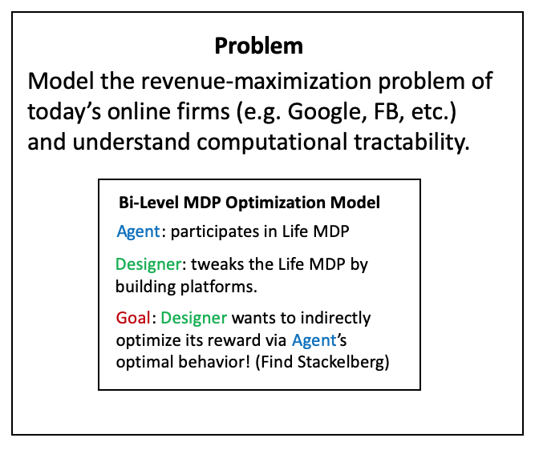
Platform Design
Key Idea: Google builds various apps (Maps, Search, Social Network, etc.) and profits based on usage of these apps.
The usage of apps modifies the transitions of the Markov Chain of the user’s life
Assume the Designer has linear rewards over the steady state distribution of the resulting Markov chain (agent policy + Life MDP)
Bi-Level MDP Optimization Model
Bi-Level MDP Optimization Model
Bi-Level MDP Optimization Model
Agent: participates in Life MDP
Agent: participates in Life MDP
Agent: participates in Life MDP
Designer: tweaks the Life MDP by building platforms.
Designer: tweaks the Life MDP by building platforms.
Designer: tweaks the Life MDP by building platforms.
Goal: Designer wants to indirectly optimize its reward via Agent’s optimal behavior! (Find Stackelberg)
Goal: Designer wants to indirectly optimize its reward via Agent’s optimal behavior! (Find Stackelberg)
Goal: Designer wants to indirectly optimize its reward via Agent’s optimal behavior! (Find Stackelberg)

Slide 6
The Stackelberg Game
Designer moves first:
Adds platforms which, if adopted, modify transitions to an existing Markov Chain
Agent moves second:
Receives MDP from Designer, plays optimal behavior
Example of bi-level MDP optimization
What is the computational complexity of solving for equilibrium?

Slide 7
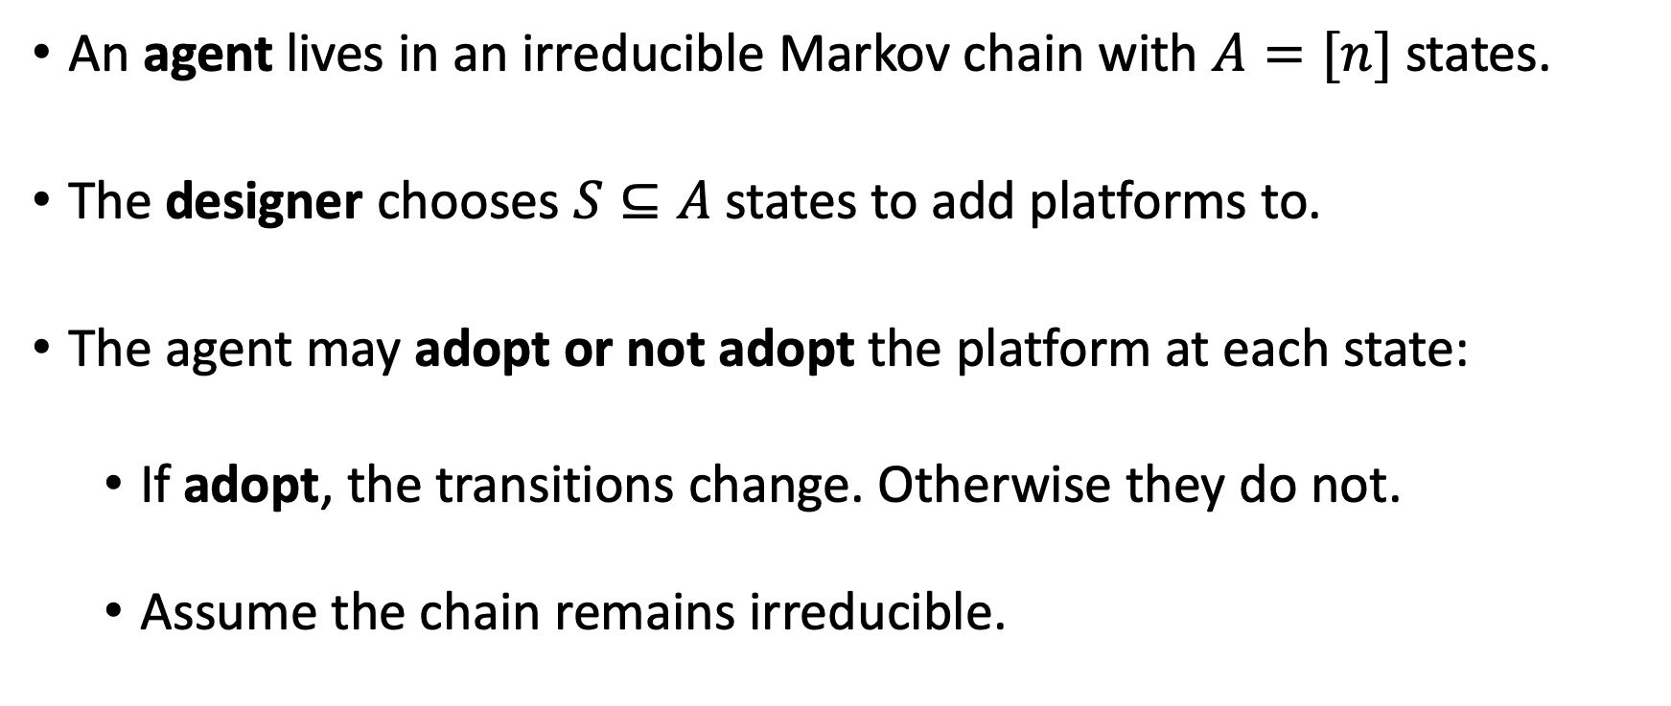
Formal Problem Statement
An agent lives in an irreducible Markov chain with $A=[n]$ states.
The designer chooses $S⊆A$ states to add platforms to.
The agent may adopt or not adopt the platform at each state:
If adopt, the transitions change. Otherwise they do not.
Assume the chain remains irreducible.

Slide 8
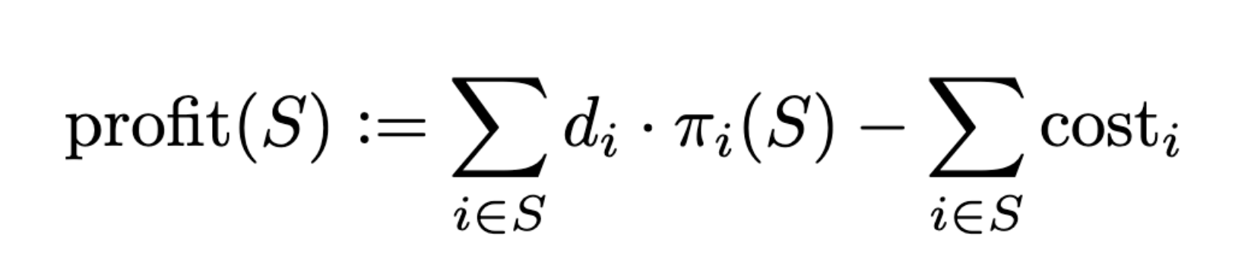
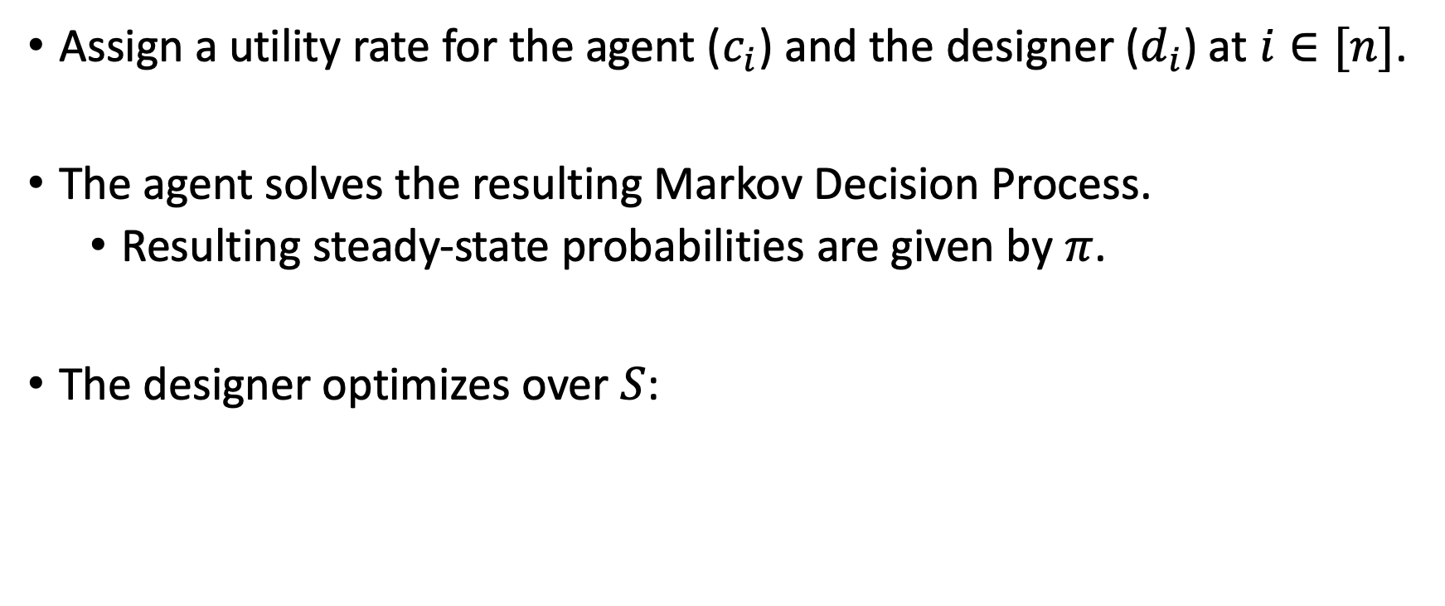
Formal Problem Statement
Assign a utility rate for the agent ($c_{i}$) and the designer ($d_{i}$) at $i∈[n]$.
The agent solves the resulting Markov Decision Process.
Resulting steady-state probabilities are given by $π$.
The designer optimizes over $S$:

Slide 9
General Case

Slide 10

Picture of the General Case
What platforms should I build?
Shopping online
Driving
Exercising
Eating lunch
Studying
Online firm
Watching movie
Reading news
Agent’s Life

Slide 11
Picture of the General Case
What platforms should I build?
Shopping online
Driving
Exercising
Eating lunch
Studying
Online firm
Watching movie
Reading news
At a cost, the firm can add an opt-in action to platforms they create (ex: Google Maps).
Agent’s Life

Slide 12
Picture of the General Case
Maybe we should create Maps technology….
Shopping online
Driving
Exercising
Eating lunch
Studying
Online firm
Watching movie
Builds platform Maps at a cost.
Reading news
Agent’s Life changes
Opt in to Maps
Notes:
Now, if Agent opts in to maps, the Agent can more easily find the retail store she wanted to purchase goods from, and can easily transition to driving to the store to purchase in person.
This is an example of complementary goods: Online advertisements reveal goods an Agent may want to buy, and building a Google Maps platform makes it easier for the Agent to go to the store and buy the good (perhaps an archaic example since now people buy things online).
We can also see how adopting Maps might change other parts of the Agent’s Markov chain (now an MDP):
Easier to find a restaurant you want to go to
Easier to find a movie theatre
Easier to find a hiking trail
Increases likelihoods of transitions from driving to a whole host of other possibilities, while also boosting likelihood from online shopping to driving to a store.

Slide 13
Computational Tractability I: General Case
It is strongly NP-hard to decide whether the Designer can obtain positive profit – and therefore hard to approximate.
Reduction from SET COVER
Designer builds platforms which each solve subset of Agent’s problems.
Most cost-effective covering set is NP hard.
In economic terms, the reduction exploits the complexity of “complementary goods.”
Ex: Brick-and-mortar retail ads help the Agent discover the store, Maps helps the Agent get to the store.
Notes:
SET COVER reduction proof: set of “urgent problems” U and a set of “platform solutions” P. platform transitions: Self loops for each problem inside P and also back to U. Transitions from U to P are also platform opt-ins.
Also, a bad unproductive state that’s extremely hard to escape from: you escape with tiny probability (scaled according to problem size n^2) back to U.
If you don’t opt in to platform, you get sent to this terrible state w/100% probability.
Each platform costs something to build.
Thus, the designer’s problem is to build as few platforms as possible which cover the set of all the agent’s problems (as few pieces of technology which can resolve largest set of urgent problems).
Thus you want a complementary set of products: need to solve as many problems as possible so if one platform/product handles one set and not another, and other platform/product solves another, it’s great! Like peanut butter and jelly.

Slide 14
Tractable “Flower” Case

Slide 15
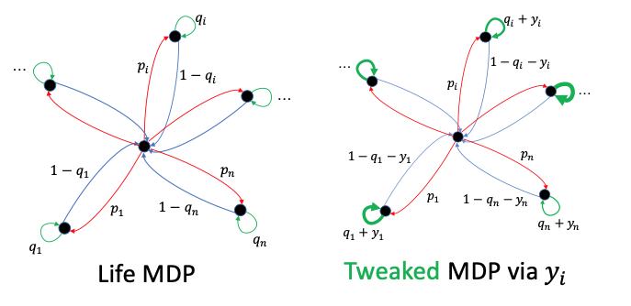
A More Tractable Case: The Flower
Notes:
* Only restricted changes are possible to the transitions.

Slide 16
A More Tractable Case: The Flower
Problem can be solved by an FPTAS
Why tractable?
Substitutes rather than complements
Allocate time spent in each platform
Simpler low-level behavior (greedy agent)
Admits a DP upon discretization (knapsack DP)

Slide 17
Agent Behavior

Slide 18
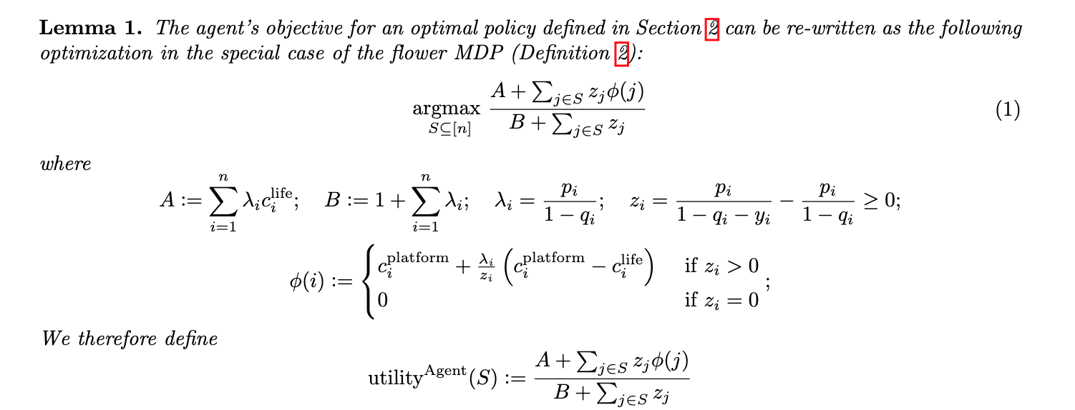
The Agent’s Greedy Algorithm
Solving for the steady state distribution yields a quasi-concave combinatorial optimization problem:

Slide 19
The Agent’s Greedy Algorithm
Solving for the steady state distribution yields a quasi-concave combinatorial optimization problem:
Potential function
Notes:
* For simplicity, z_i is non-negative. Similar results go through when it is allowed to be negative, with a slight change of the algorithm.

Slide 20
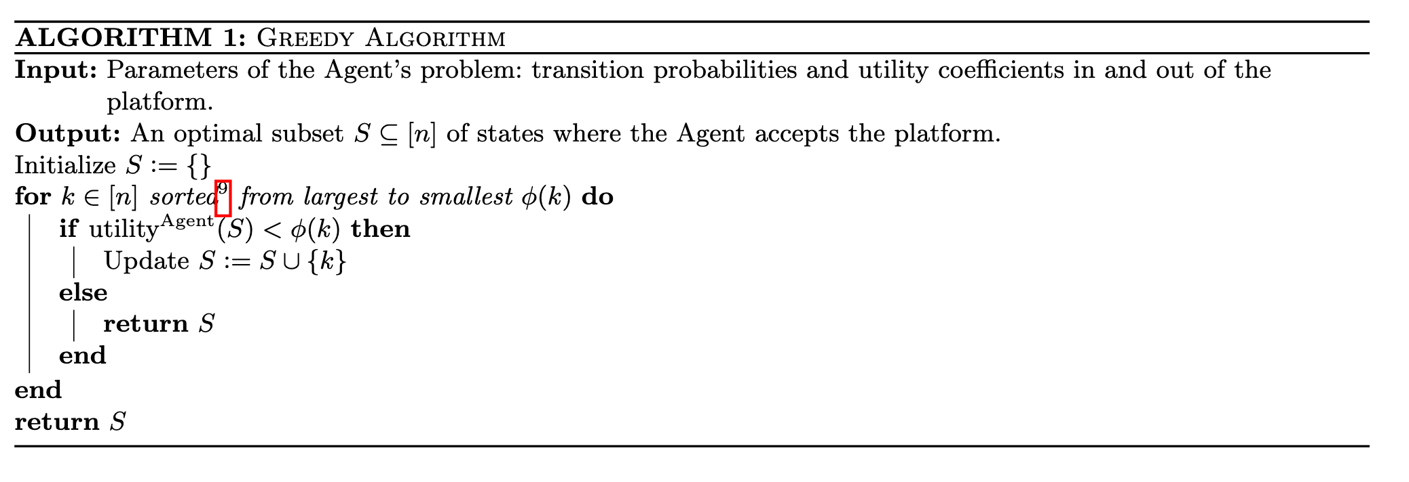
The Agent’s Greedy Algorithm
Sort states by potential function and add until utility = potential
Notes:
Note the algorithm is slightly different when z_i’s are allowed to be negative.
Essentially: first add the positive values in decreasing order, then add the negative values in increasing order (in terms of phi).

Slide 21
Designer’s Algorithm

Slide 22
Recall: Designer’s Objective
Designer’s steady-state reward rates
Designer’s one-time costs for building each platform
Set of states to build platforms
Agent’s steady state probabilities

Slide 23
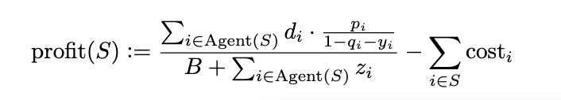


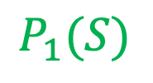
Restrictions
Expanding the profit function given agent behavior:
Define $\max_{i}{d_{i}=:K}$
Maximum profit is $nK$
Assume $z_{i}$ are $poly(n)$ and discretized with gap $δ$ and costs are $K ∗poly(n)$
$$P_{1}(S)$$
$$D(S)$$

Slide 24
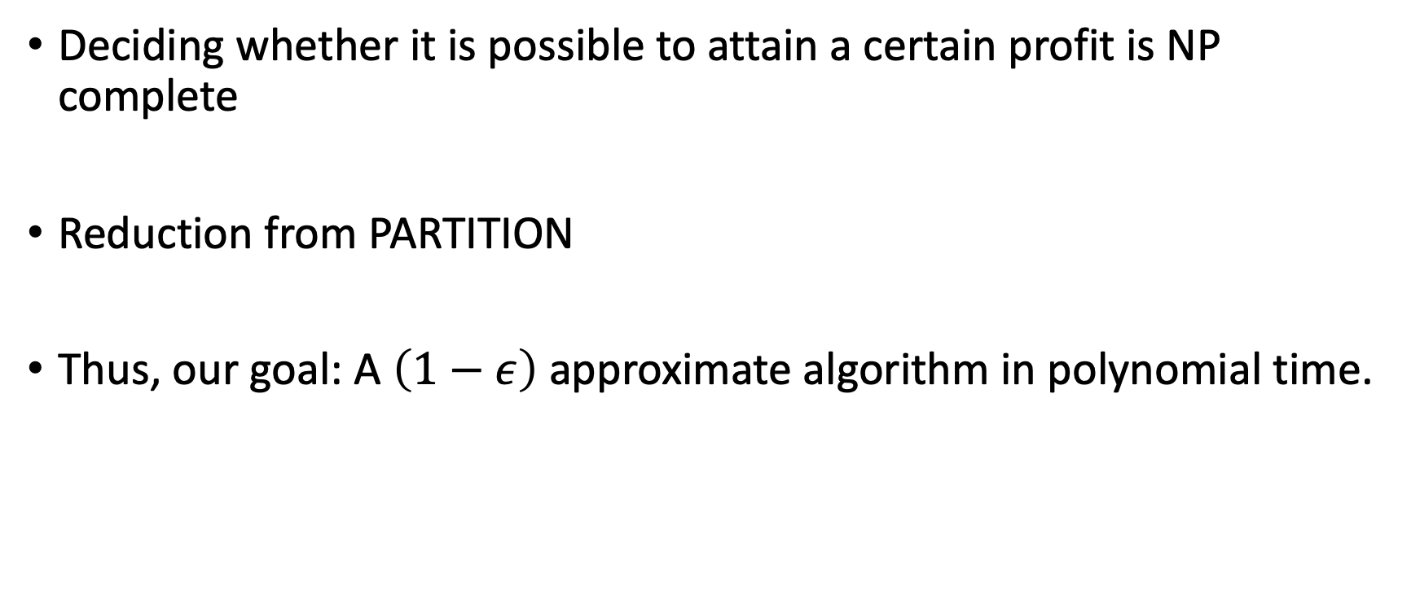
Target Algorithm
Deciding whether it is possible to attain a certain profit is NP complete
Reduction from PARTITION
Thus, our goal: A $\left(1−ε\right)$ approximate algorithm in polynomial time.

Slide 25
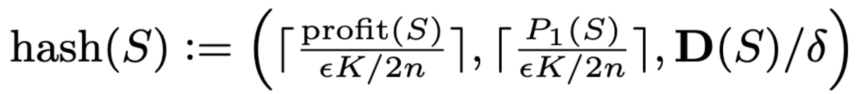
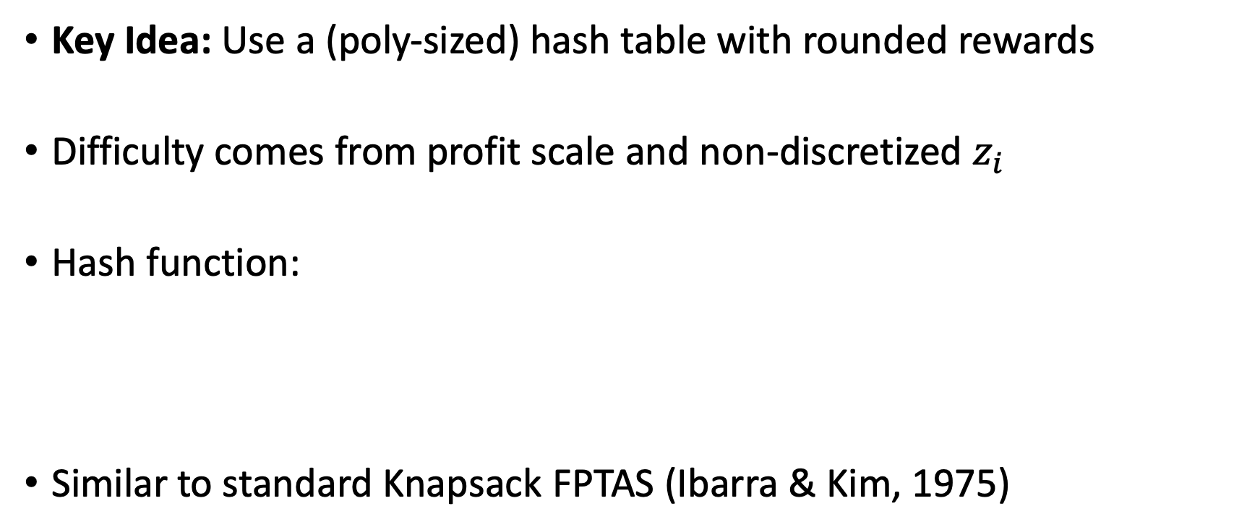
The Designer’s Dynamic Program
Key Idea: Use a (poly-sized) hash table with rounded rewards
Difficulty comes from profit scale and non-discretized $z_{i}$
Hash function:
Similar to standard Knapsack FPTAS (Ibarra & Kim, 1975)
Notes:
Note that it may be possible to have an efficient alg with non-discretized z_i, but it precludes an efficient dynamic program with this approach
We suspect it is necessary to discretize z_i though.

Slide 26
Extensions

Slide 27
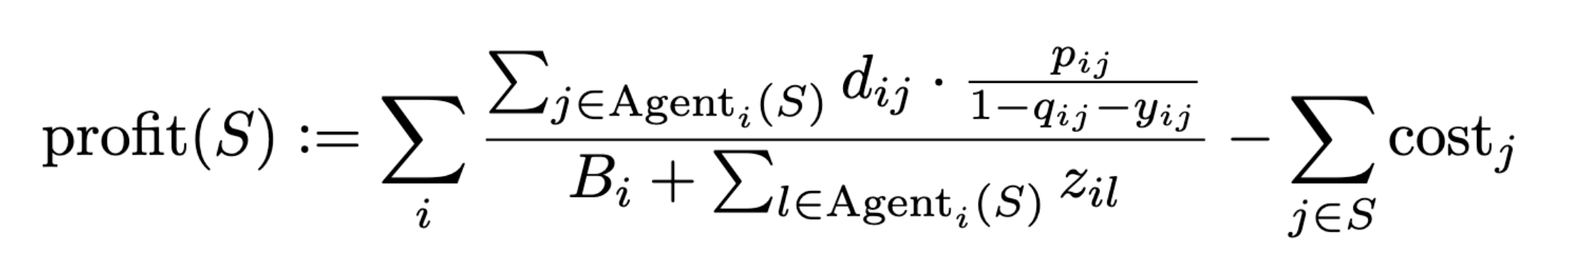
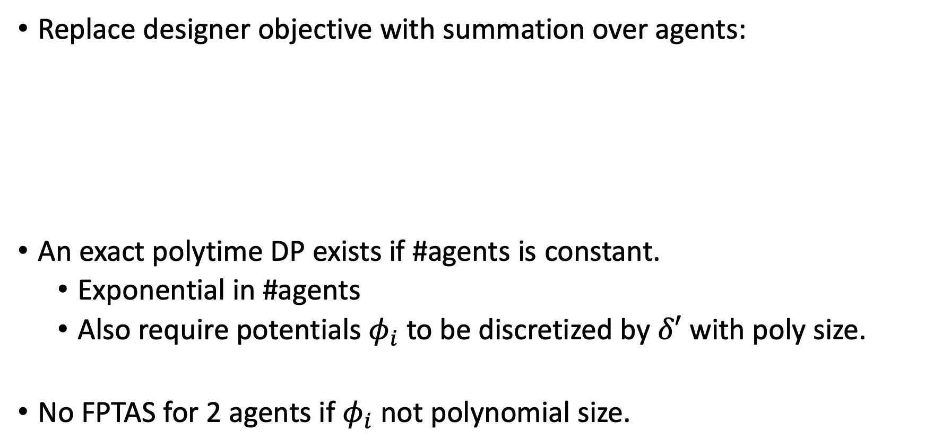
Multiple Agents
Replace designer objective with summation over agents:
An exact polytime DP exists if #agents is constant.
Exponential in #agents
Also require potentials $φ_{i}$ to be discretized by $δ′$ with poly size.
No FPTAS for 2 agents if $φ_{i}$ not polynomial size.
Notes:
* No FPTAS proof: reduction from PARTITION

Slide 28
Designer Competition
What platforms should I build to compete?
Shopping online
Driving
Exercising
Online firm
Eating lunch
Studying
Watching movie
Reading news
Competing firm
Agent’s Life

Slide 29
Multiple Platforms (Flower Setting)
What if other competing designers have already built platforms?
Each platform affects only one state
At most one for each designer per state
How does an agent behave?
How should a designer optimally place platforms?

Slide 30
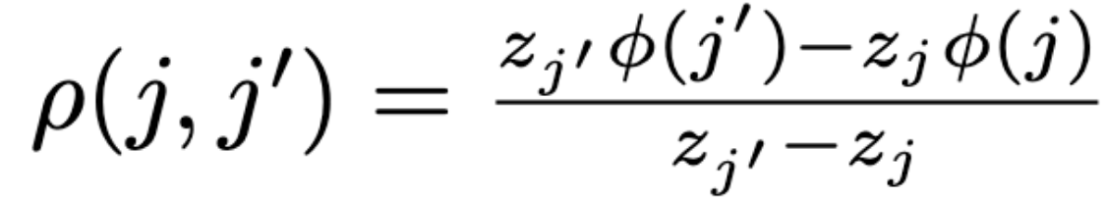
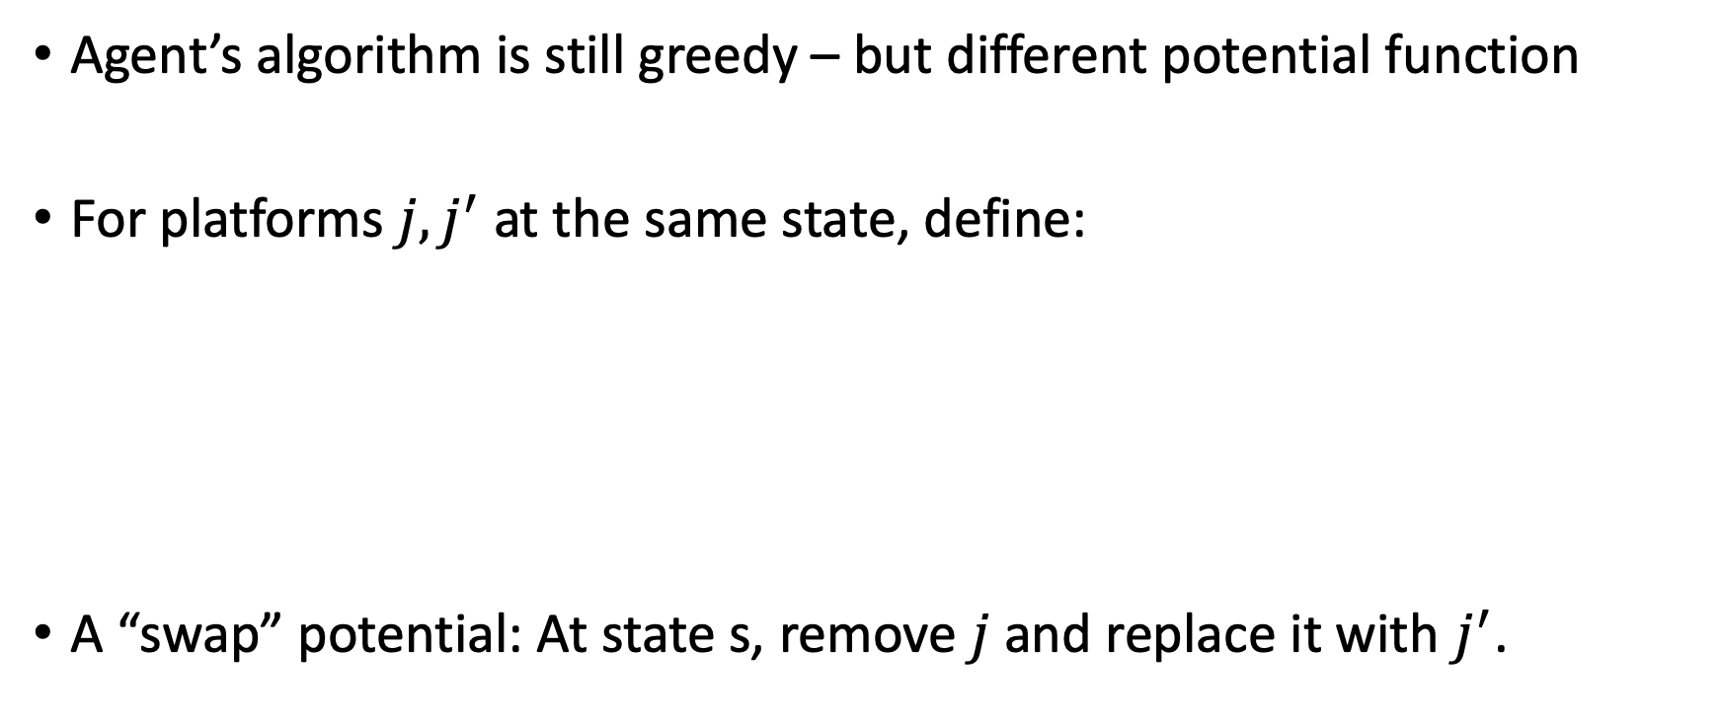
Multiple Platforms (Flower Setting)
Agent’s algorithm is still greedy – but different potential function
For platforms $j, j^{′}$ at the same state, define:
A “swap” potential: At state s, remove $j$ and replace it with $j^{′}$.
Notes:
Can think of this in terms of a swap: remove platform j at state s and replace it with platform j’ at state s. (denominator term is what happens in the overall denominator, numerator term is what happens in overall numerator).

Slide 31
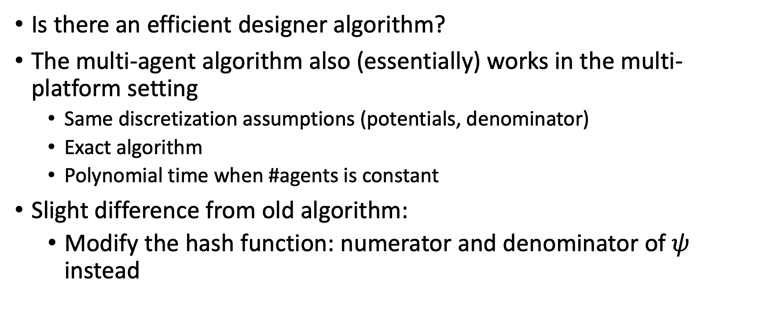
Multiple Platforms (Flower Setting)
Is there an efficient designer algorithm?
The multi-agent algorithm also (essentially) works in the multi-platform setting
Same discretization assumptions (potentials, denominator)
Exact algorithm
Polynomial time when #agents is constant
Slight difference from old algorithm:
Modify the hash function: numerator and denominator of $ψ$ instead

Slide 32
Summary

Slide 33
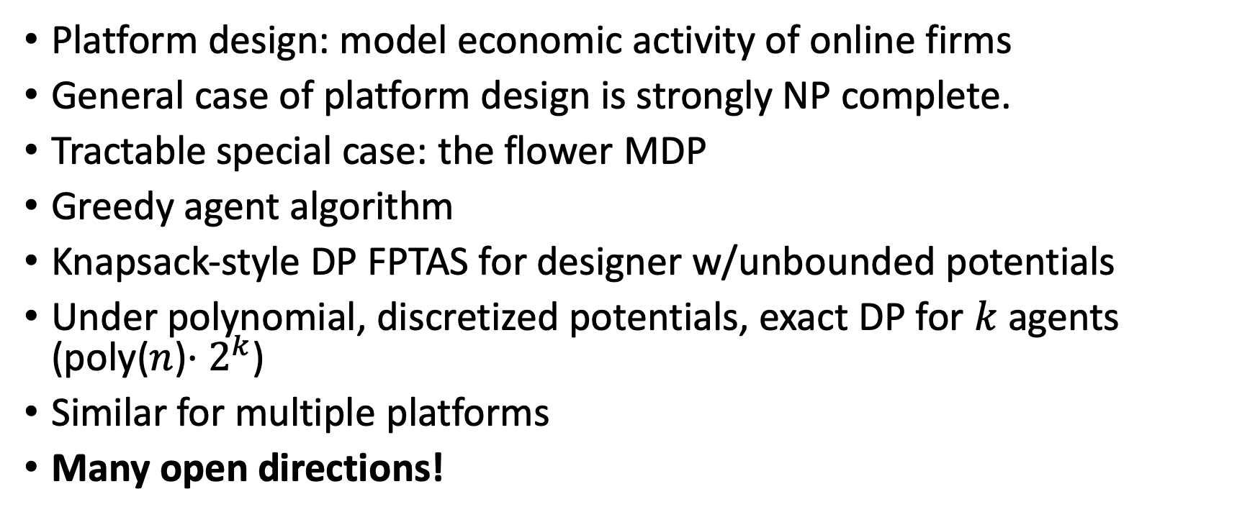
Recap
Platform design: model economic activity of online firms
General case of platform design is strongly NP complete.
Tractable special case: the flower MDP
Greedy agent algorithm
Knapsack-style DP FPTAS for designer w/unbounded potentials
Under polynomial, discretized potentials, exact DP for $k$ agents (poly($n$)$⋅2^{k}$)
Similar for multiple platforms
Many open directions!

Slide 34
Future Work

Slide 35
Future Work
Designer vs. designer
Complexity of pure Nash
Repeated game settings
Privacy/fairness questions for agent
Other classes of tractable MDPs?
Results for generic classes of agent behavior?
Many questions are problems of formulation
Notes:
* Generic classes of agent behavior: ex:, various notions of “greedy” agents – use greedy algorithm which is sub-optimal perhaps.

