Slide 1
Sparse and Low-Rank: Resource-Efficient Methods in Machine Learning
Kiran Vodrahalli
Columbia University
January 11, 2022

Slide 2
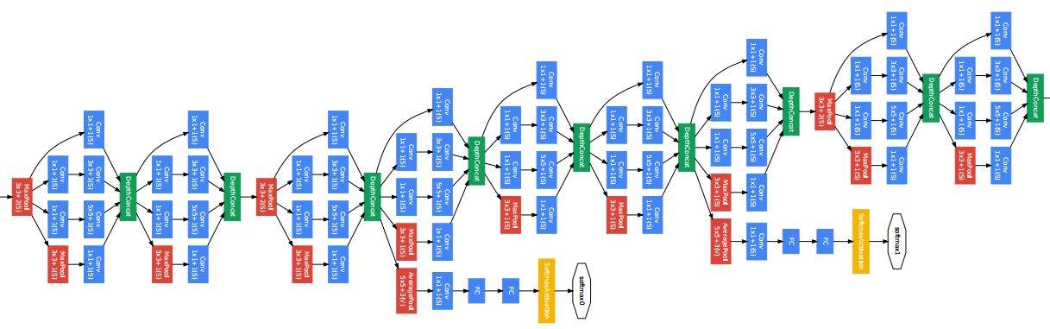
Resource-Efficient Machine Learning
A challenge in modern machine learning:
Notes:
Large models: computational + statistical issues
Large amounts of data: computational issues

Slide 3
Resource-Efficient Machine Learning
A challenge in modern machine learning:
Very large models!
Notes:
Large models: computational + statistical issues
Large amounts of data: computational issues

Slide 4
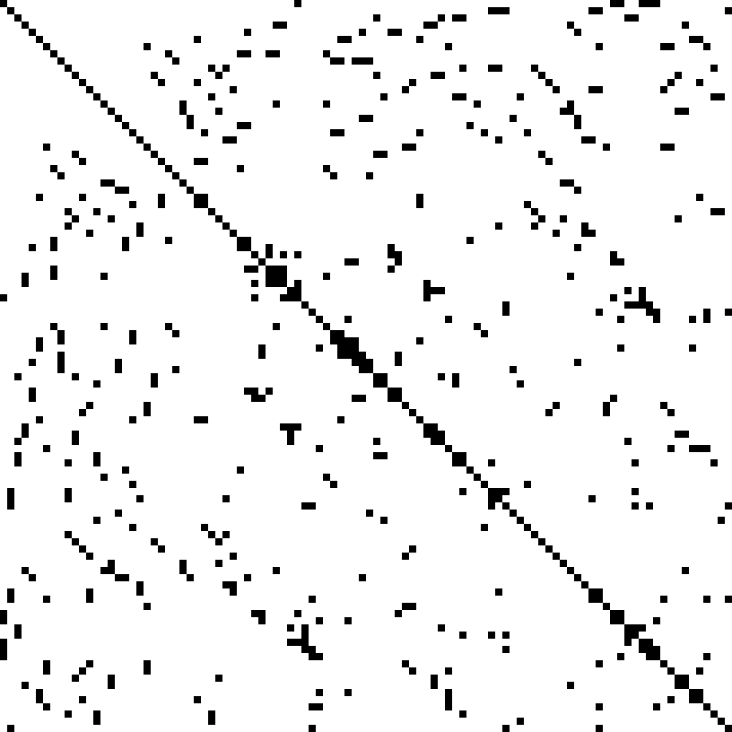
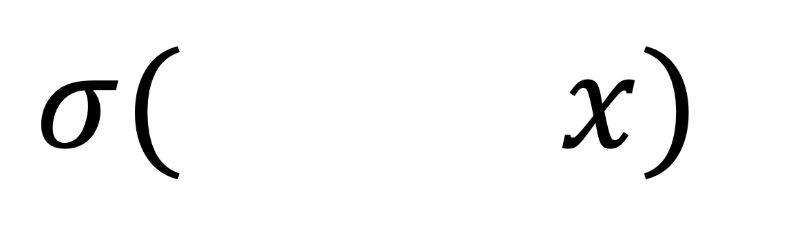
Resource-Efficient Machine Learning
Can we mitigate computational/statistical strains of large nonlinear models via
Sparse models?:
$$σ( x)$$

Slide 5
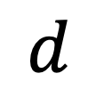
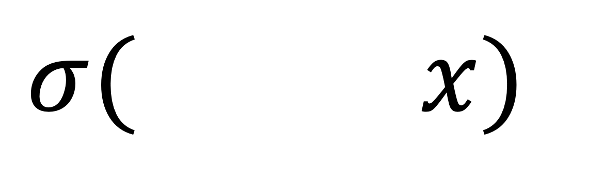
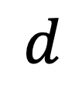



Resource-Efficient Machine Learning
Can we mitigate computational/statistical strains of large nonlinear models via
Low-rank models?:
$$r$$
$$σ( x)$$
$$×$$
$$r$$
$$d$$
$$d$$

Slide 6
Outline of the Talk
1. Sparse machine learning for monomials
2. Low rank deep learning
3. Future research plans
Notes:
I’ll tackle the first question in the first two sections on sparse machine learning and low rank deep learning
And I’ll tackle the second question in the section on memory bounds for streaming SVM.

Slide 7
Sparse Machine Learning
(Attribute-Efficient Learning of Monomials over Highly-Correlated Variables)
Alexandr Andoni, Rishabh Dudeja, Daniel Hsu, Kiran Vodrahalli
ALT 2019

Slide 8
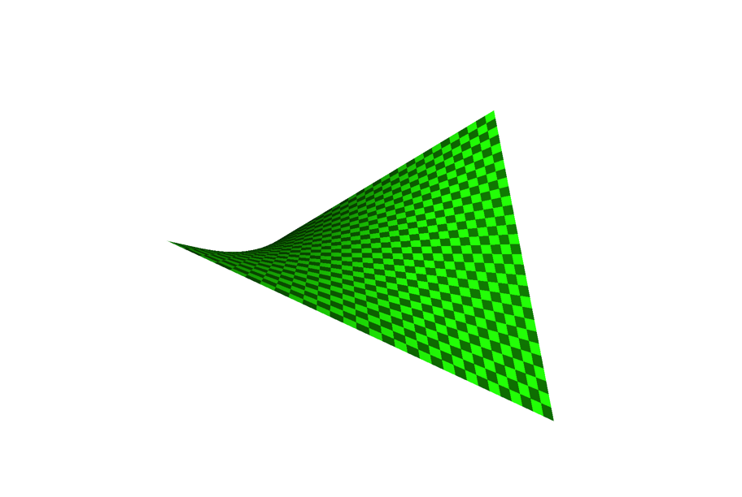
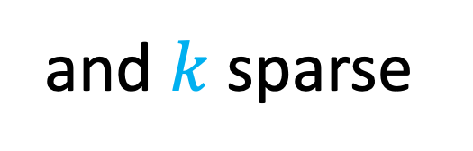
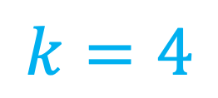
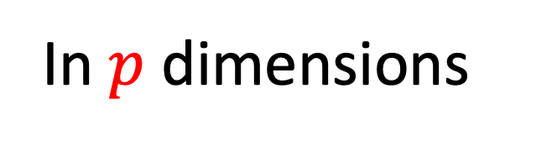
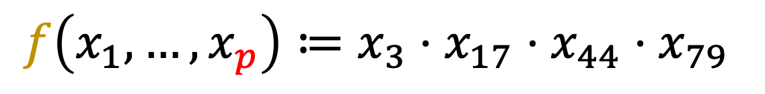
Learning Sparse Monomials
Sparse high-dim log-log regression
3 dimensions
In $p$ dimensions
Ex:
$$f\left(x_{1}, …, x_{p}\right)≔x_{3}⋅x_{17}⋅x_{44}⋅x_{79}$$
and $k$sparse
$$k=4$$
Notes:
Here we consider multilinear monomial, but all our results apply to setting where sum of degrees is bounded.
For the rest of the talk, assume a multi-linear monomial for simplicity.
Can think of this as modeling sparse high-dimensional log-log regression with correlated gaussian features!
Interesting because: simple nonlinear model class to study the phenomenon of sparse regression with highly correlated features.
Applications?: when power laws show up. Some examples:
1. economics
2. biological models, ecology (“tree allometry”: https://academic.oup.com/biolinnean/article/113/4/1167/2416036), biochemistry
3. For more: https://onlinelibrary.wiley.com/doi/epdf/10.1002/sim.4780140810

Slide 9
Learning Sparse Monomials
A Simple Nonlinear Function Class
3 dimensions
In $p$ dimensions
Ex:
$$f\left(x_{1}, …, x_{p}\right)≔x_{3}⋅x_{17}⋅x_{44}⋅x_{79}$$
and $k$sparse
$$k=4$$
Notes:
Here we consider multilinear monomial, but all our results apply to setting where sum of degrees is bounded.
For the rest of the talk, assume a multi-linear monomial for simplicity.
Can think of this as modeling sparse high-dimensional log-log regression with correlated gaussian features!
Interesting because: simple nonlinear model class to study the phenomenon of sparse regression with highly correlated features.
Applications?: when power laws show up. Some examples:
1. economics
2. biological models, ecology (“tree allometry”: https://academic.oup.com/biolinnean/article/113/4/1167/2416036), biochemistry
3. For more: https://onlinelibrary.wiley.com/doi/epdf/10.1002/sim.4780140810

Slide 10
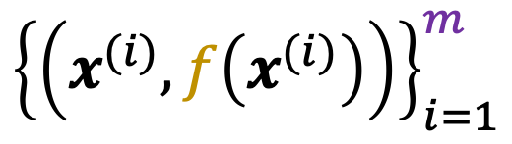
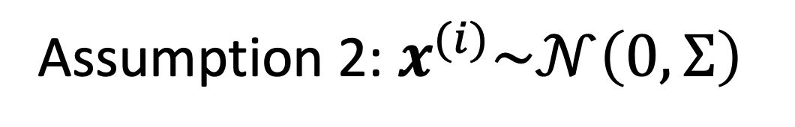
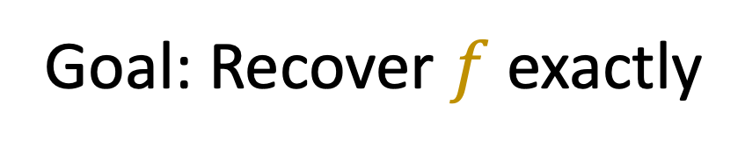
The Learning Problem
$${\left\{\left(x^{(i)}, f\left(x^{(i)}\right)\right)\right\}}_{i=1}^{m}$$
Given: , drawn i.i.d.
Assumption 1: $f$ is a $k$-sparse monomial function
Assumption 2:${ x}^{(i)}\sim 𝒩\left(0, Σ\right)$
Goal: Recover $f$ exactly
Notes:
Can think of this as modeling sparse high-dimensional log-log regression with correlated gaussian features!

Slide 11
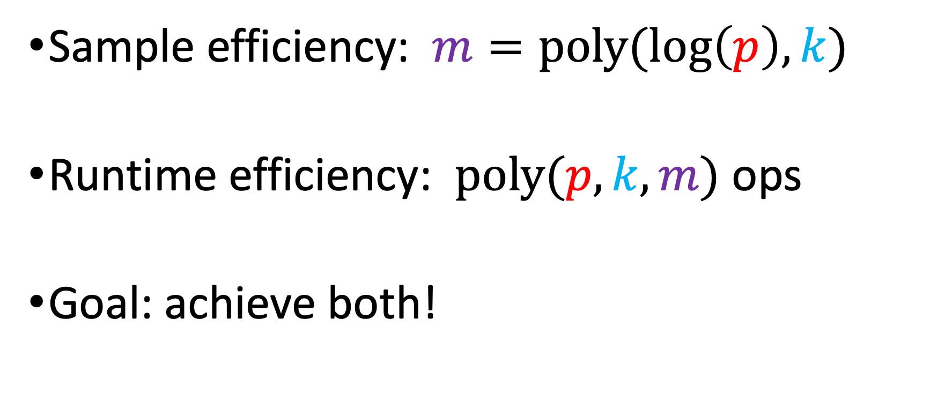
Attribute-Efficient Learning
Sample efficiency: $m=poly(log\left(p\right), k)$
Runtime efficiency: $poly(p, k, m)$ ops
Goal: achieve both!

Slide 12







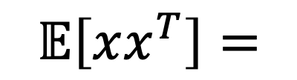



Motivation
$$x_{i}∈\left\{±1\right\}$$
Monomials $≡$ Parity functions
No attribute-efficient algs! [Helmbold+ ‘92, Blum’98, Klivans&Servedio’06, Kalai+’09, Kocaoglu+’14…]
$$x_{i}∈ℝ$$
Sparse sums of monomials [Andoni+’14] For uncorrelated features:
$$σ_{1}^{2}$$
$$σ_{2}^{2}$$
$$0$$
$$𝔼\left[xx^{T}\right]=$$
$$σ_{3}^{2}$$
$$σ_{4}^{2}$$
$$0$$
$$σ_{5}^{2}$$
$$σ_{6}^{2}$$
Notes:
Naïve sparse parity: sample complexity poly(log(p), k), computation p^k.
Some improvements: p^{k/2}, attribute-efficient improper learner with sample complexity p^{1 – 1/k} and run time p^4 for noiseless case, p^{0.8k} time (attribute inefficient) algorithm for noisy parity under uniform dist.
Andoni for single monomial: poly(p, 2^k) (where k is our notion of sparsity, aka sum of degrees of the monomial). Avoids O(p^k) (which so far parities can’t really handle). (k = degree = monomial sparsity)
For sparse sum of monomials: poly(p, 2^k, s) where s = # of monomials in the sum.
Growing monomial basis: identify highest degree terms first via squared correlations, peel off the monomial terms one at a time. Only works if it’s a product distribution over the features.

Slide 13




















Motivation
$$x_{i}∈\left\{±1\right\}$$
Monomials $≡$ Parity functions
No attribute-efficient algs! [Helmbold+ ‘92, Blum’98, Klivans&Servedio’06, Kalai+’09, Kocaoglu+’14…]
$$x_{i}∈ℝ$$
Sparse linear regression [Candes+’04, Donoho+’04, Bickel+’09…]
Sparse polynomials [Andoni+’14] For uncorrelated features:
Question: What if
$$1$$
$$≤ρ$$
$$1$$
?
$$𝔼\left[xx^{T}\right]=$$
$$1$$
$$1$$
$$σ_{1}^{2}$$
$$≤ρ$$
$$1$$
$$σ_{2}^{2}$$
$$0$$
$$1$$
$$𝔼\left[xx^{T}\right]=$$
$$σ_{3}^{2}$$
$$σ_{4}^{2}$$
$$0$$
$$σ_{5}^{2}$$
$$σ_{6}^{2}$$

Slide 14
Outline for This Project
Algorithm
Analysis
Conclusion

Slide 15
1. Algorithm

Slide 16


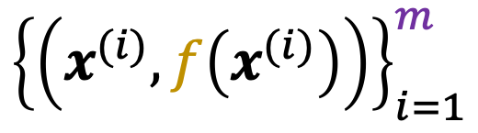
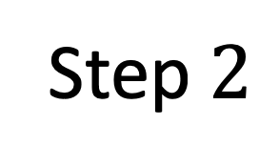

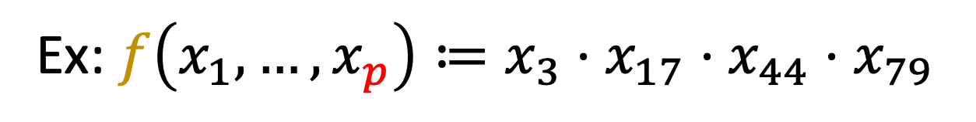
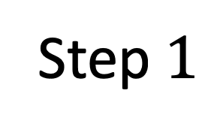

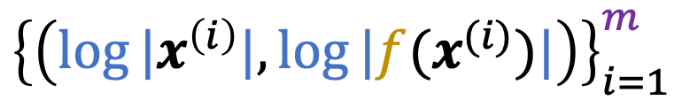



The Algorithm
Ex: $f\left(x_{1}, …, x_{p}\right)≔x_{3}⋅x_{17}⋅x_{44}⋅x_{79}$
Step $1$
$$log⁡|⋅|$$
$${\left\{\left(x^{(i)}, f\left(x^{(i)}\right)\right)\right\}}_{i=1}^{m}$$
$${\left\{\left(log⁡|x^{\left(i\right)}|,log⁡|f(x^{(i)})|\right)\right\}}_{i=1}^{m}$$
Gaussian Data
Log-transformed Data
Step $2$
$$1$$
Sparse Regression:
(Ex: Basis Pursuit)
feature
$$0$$
$$3$$
$$17$$
$$44$$
$$79$$

Slide 17
Why is our Algorithm Attribute-Efficient?
Runtime: basis pursuit is efficient
Key Question: Sample complexity
Sparse linear regression analysis on transformed vars? E.g.:
To prove: sparse linear regression recovery holds
$\log\left|f\left(x_{1}, …, x_{p}\right)\right|≔{log⁡|x}_{3}| + {log⁡|x}_{17}|$ $+$ ${log⁡|x}_{44}|+ {log⁡|x}_{79}|$

Slide 18
2. Analysis

Slide 19
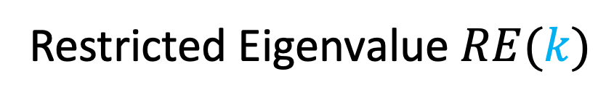
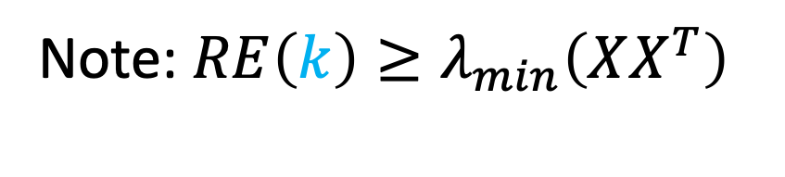
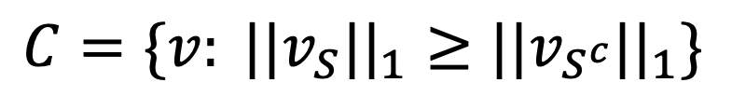
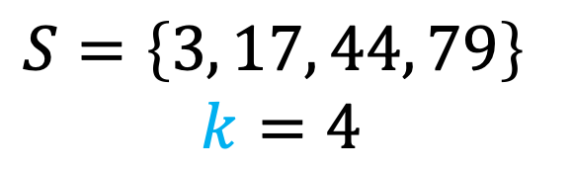


Restricted Eigenvalue Condition [Bickel, Ritov, & Tsybakov ‘09]
Restricted Eigenvalue $RE(k)$
Ex:
$$S=\left\{3, 17, 44, 79\right\}$$
$$k=4$$
$$\min_{v∈C} \frac{v^{T}XX^{T}v}{||v||_{2}^{2}}>ε$$
Cone restriction
“restricted strong convexity”
Note: ${RE\left(k\right)≥λ}_{min}\left(XX^{T}\right)$
Sufficient to prove exact recovery
for basis pursuit in
sparse linear regression!
$$C=\{v: ||v_{S}||_{1}≥||v_{S^{c}}||_{1}\}$$
$$\left|S\right|=k$$

Slide 20
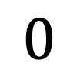

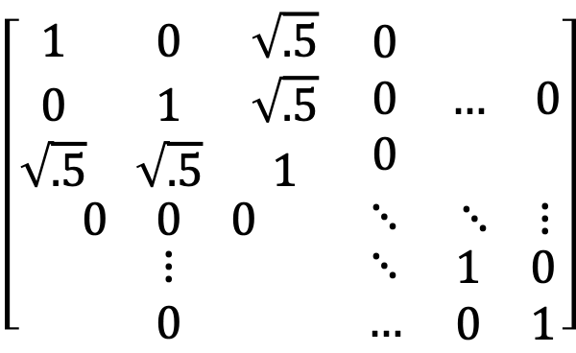

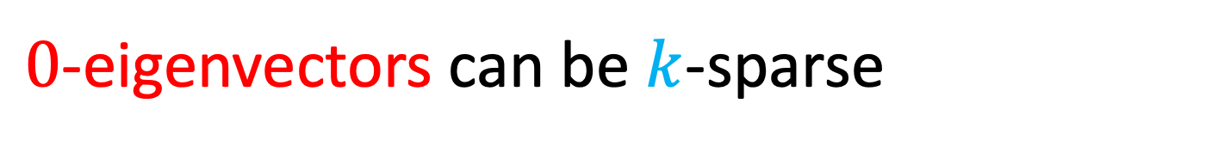
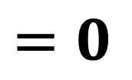


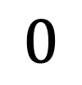
Degenerate High Correlation
$$=𝔼\left[xx^{T}\right]$$
$$\left[\begin{matrix}\begin{matrix}1 & 0 & \sqrt{.5} \\ 0 & 1 & \sqrt{.5} \\ \sqrt{.5} & \sqrt{.5} & 1\end{matrix} & \begin{matrix}0 \\ 0 \\ 0\end{matrix} & \begin{matrix}… & 0\end{matrix} \\ \begin{matrix}0 & 0 & 0\end{matrix} & ⋱ & \begin{matrix}⋱ & ⋮\end{matrix} \\ \begin{matrix}⋮ \\ 0\end{matrix} & \begin{matrix}⋱ \\ …\end{matrix} & \begin{matrix}1 & 0 \\ 0 & 1\end{matrix}\end{matrix}\right]$$
Consider the example:
$$0$$
$$=$$
$$0$$
$$0$$
$$\left[\begin{matrix}−1/2 \\ −1/2 \\ \begin{matrix}1/\sqrt{2} \\ \begin{matrix}0 \\ ⋮\end{matrix} \\ 0\end{matrix}\end{matrix}\right]$$
$$=0$$
$0$-eigenvectors can be $k$-sparse
Sparse recovery conditions false!
3-sparse

Slide 21
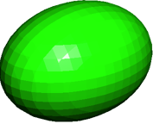
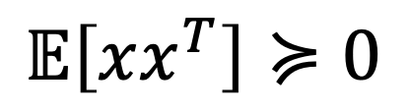
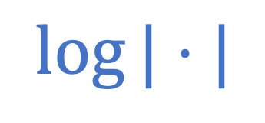
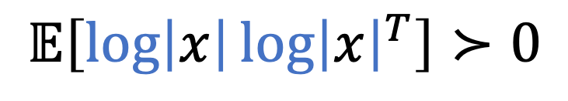
Log-Transform affects Data Covariance
$$log⁡|⋅|$$
$𝔼\left[xx^{T}\right]≽0$
$$𝔼\left[\log\left|x\right|{\log\left|x\right|}^{T}\right]≻0$$
“inflating the balloon”
Spectral View:
Destroys correlation structure

Slide 22
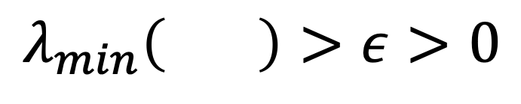
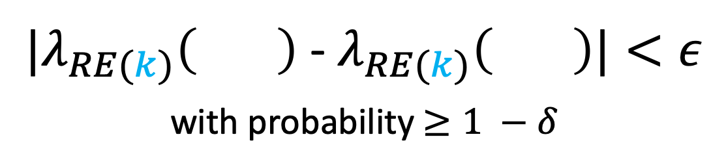

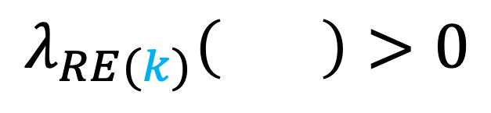
Sample Complexity Analysis
$$=𝔼\left[\log\left|x\right|{\log\left|x\right|}^{T}\right]$$
Population Transformed Eigenvalue
Concentration of Restricted Eigenvalue
$$λ_{min}\left( \right)>ε>0$$
${|λ}_{RE(k)}\left( \right)$ - $λ_{RE(k)}\left( \right)|<ε$
with probability $≥1 −δ$
$$λ_{RE(k)}\left( \right)>0$$
with high probability
Exact Recovery for Basis Pursuit
with high probability

Slide 23
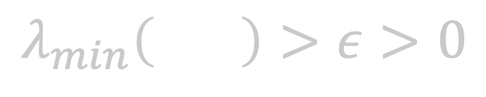
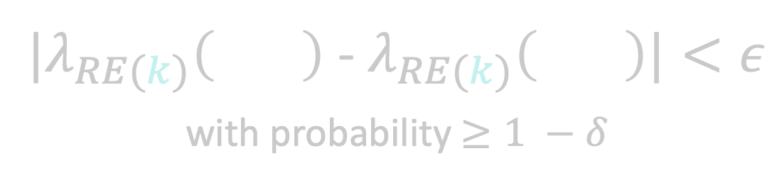


Sample Complexity Analysis
$$=𝔼\left[\log\left|x\right|{\log\left|x\right|}^{T}\right]$$
Population Transformed Eigenvalue
Concentration of Restricted Eigenvalue
$$λ_{min}\left( \right)>ε>0$$
${|λ}_{RE(k)}\left( \right)$ - $λ_{RE(k)}\left( \right)|<ε$
with probability $≥1 −δ$
Sample Complexity Bound:
$$m= O\left(\frac{k^{2}\log{2k}}{1−ρ}⋅\log^{2}{\frac{2p}{δ}}\right)$$
$$λ_{RE(k)}\left( \right)>0$$
with high probability
Exact Recovery for Basis Pursuit
with high probability

Slide 24
3. Conclusion

Slide 25

Recap
Attribute-efficient algorithm for monomials
Prior (nonlinear) work: uncorrelated features
This work: allow highly correlated features
Works beyond multilinear monomials
Blessing of nonlinearity
$$log⁡|⋅|$$

Slide 26
Low Rank Deep Learning
Kiran Vodrahalli, Rakesh Shivanna, Mahesh Sathiamoorthy, Sagar Jain, Ed Chi
Google Brain Research Internship (Summer + Fall 2021)

Slide 27
Speeding Up Deep Nets
Deep neural networks are extremely large today.
Goal: speed up forward and backward passes
Example approach: sparse deep networks

Slide 28

Low Rank Deep Models
Replace full-rank layers with low-rank equivalents:
Given weights of layer $i$:
$$W_{i}=U_{i}V_{i}^{T}$$
Then replace the standard parameterization w/RHS.

Slide 29
Prior Work [Khodak et. al. 2021]
Low-rank methods outperform sparse methods if tuned correctly
Key issues:
Initialization of the low-rank parameters
Regularization of weights

Slide 30
Impact of Initialization
Can achieve ~ 1% additive gain in accuracy by choosing better initialization
Khodak et al 2021 studies small image classification datasets
Key approach: spectral initialization

Slide 31
Outline for This Project
1. Low-Rank Initialization Scheme
2. Theory

Slide 32
1. Low-Rank Initialization Scheme

Slide 33

Spectral Initialization
For each layer $W∈R^{m ×n} \sim D$ :
Minimize the Frobenius distance between the full-rank initialization parameters and the low rank parameters:
$$\min_{U∈R^{m ×r}, V∈R^{n ×r}}{||W −UV^{T}||_{F}^{2}}$$

Slide 34

Generalized Spectral Initialization
For each layer $W∈R^{m ×n} \sim D$ with nonlinearity $σ$:
Perform distillation: Minimize $ℓ_{2}^{2}$ error between the function outputs of full-rank initialization and low rank initialization:
$$\min_{U∈R^{m ×r}, V∈R^{n ×r}}{E_{x∼N(0, I)}\left[||σ(Wx) −σ(UV^{T}x)||_{2}^{2}\right]}$$

Slide 35
Generalized Spectral Initialization
For each layer $W∈R^{m ×n} \sim D$ with nonlinearity $σ$:
Perform distillation: Minimize $ℓ_{2}^{2}$ error between the function outputs of full-rank initialization and low rank initialization:
$$\min_{U∈R^{m ×r}, V∈R^{n ×r}}{E_{x∼N(0, I)}\left[||σ(Wx) −σ(UV^{T}x)||_{2}^{2}\right]}$$
Results in empirical gains over spectral initialization!

Slide 36
2. Theory

Slide 37


Is GSpectral Initialization Tractable?
Suppose $W_{ij} \sim N\left(0,\frac{1}{\sqrt{n}}\right)$ for layer weight $W∈R^{m × n}$
Define $f_{W}\left(x\right)≔σ(Wx)$
Given $D_{W}=\left\{\left(x, f_{W}\left(x\right)\right):x∼N\left(0, I_{n × n}\right)\right\}$, find $\hat{U}, \hat{V}$ s.t.
Notes:
Sigma is ReLU
opt + eps.

Slide 38

Is GSpectral Initialization Tractable?
For GSpectral algorithm to be efficient:
Return $\hat{U}, \hat{V}$ w/ $opt+ ε$ error w/ prob $≥\frac{3}{4}$
$ε= \frac{1}{10}$
Runtime poly$(n)$

Slide 39

Related Work
ReLU Regression (additive square loss, learn $σ(w^{T}x)$)
Realizable case w/Gaussian $x$: Gradient Descent succeeds [Soltanolkotabi 2017]
Agnostic case w/Gaussian $x$: GD (+ any SQ algorithm) achieving squared loss generalization error $opt+ε$ requires $\exp\left({Θ(n}^{c})\right)$ statistical queries or ${ n}^{{Θ(\left(\frac{1}{ε}\right)}^{2b})}$samples per query for some $b, c∈\left(0,½\right)$. Also the basic problem is SPWN-hard. [Goel et. al. 2019, 2020]
Agnostic case w/log-concave $x: O\left(opt\right)+ε$ has polytime algo [Diakonikolas et. al. 2020]
Notes:
Statistical Query: SQ algorithm is a learning alg that succeeds given only estimates of E_{(x, y) ~ D} [q(x, y)] for query functions q of the learner’s choosing to an oracle up to a fixed tolerance parameter tau.
Technically this result is for the p-concept setting of learning (function that maps each point to random binary label s.t. E[y|x] = f*(x) for fixed function f*, conditional mean function.
Correlational Statistical Queries: A restricted class of statistical queries where q(x, y) is of the form y * g(x).
Independent Statistical Queries: A restricted class of statistical queries where q(x, y) is of the form h(x).
Restricting the class of queries is weaker – you prove a lower bound against a smaller class of algorithms.
How does Surbhi’s paper use statistical queries while dealing with real-valued functions?: Since the queries take in a Boolean rather than real-valued label.
They work in probabilistic concept (p-concept) setting, so they can consider the induced label distribution w.r.t. the p-concept (which is real valued and is a stand-in for the agnostic output of the ReLU), and access statistical queries w.r.t. that.
Then since their result works by showing you can simulate functional gradient descent on a surrogate loss to boost a ReLU solver to a 2-layer solver (for which there exist bounds), they need to cook up a real-valued distribution which they can simulate access to with statistical queries to the induced p-concept label distribution.
It turns out that all they need to simulate this is correlation query with respect to a construction distribution D (namely, dist over (x, y – psi(f(x)) where psi is some nonlinearity and f is a p-concept. It turns out one can simulate these correlation queries with SQ access to the induced distribution D_{psi(f*)} (since we can just take expectations w.r.t. induced distribution.
Some notes on p-concepts:
They work in the probabilistic concepts setting (p-concepts): one wishes to find a hypothesis that is a good real-valued approx of conditional expectation of label given instance x.
So you model the conditional distribution via considering a hypothesis class to approximate E[y | x], which is real-valued. Quadratic loss dimension is a lower bound on required sample size, and characterizes sample complexity of p-concept learning (similar to the way VC dimension does in PAC learning). But apparently not a criterion of learnability (some infinite quadratic dimension can be learned in p-concept model).
n is dimension here.
K-SPWN: k-sparse parity w/noise: if you can do agnostic relu w/gaussian marginals to get opt + eps in time and samples poly(n, 1/eps), then you can get k-SPWN in time poly(n, 2^k) whereas the best known is n^{theta(k)).
The reduction implies that if hardness of sparse parity w/noise assumption is correct (that you can’t beat n^{omega(k)}), then any algorithm for agnostically learning ReLUs on Gaussian marginals must run in time n^Omega(log(1/eps)).
Log-concave: PDF satisfies log-concavity: if you take the log, the function is concave. They actually require ISOTROPIC log concavity. They use uniform one-sided concentration/ anti-concentration bounds for empirical processes of log-concave distributions.
They need log-concavity for some spectral norm bound on data matrix, as well as anti-concentration of log-concave distributions.

Slide 40
Our Setting
Combines average-case weights and Gaussian data
Not realizable, but not arbitrary output distribution
Common assumptions from theory are practical!

Slide 41

Main Results Teaser
There is an efficient algorithm for constant rank!
Algorithm:
1. Exact algorithm in runtime poly$(n)$ when $W$ is given
2. Recover $W$ from samples via $m$ realizable ReLU regressions.

Slide 42
Main Results Teaser
Suppose width is super-linear in dimension.
High-dimension + Low Rank
Then, gap between GSpectral and Spectral grows with dimension.

Slide 43
Future Research Plans

Slide 44
Resource-Efficient Sequence Modeling
Sequence modeling / time series abound in the sciences and ML
Language modeling
Brain recordings
….
Broadly useful simulation/modeling tool
Limitation of modern deep sequence models: small context!
Notes:
Applications of Sequence Modeling in the Sciences and ML:
weather, climate, protein sequences, any sequence / time series data -- many many more applications (look up transformers for X – many times you’ll find an application to sciences
Ex: Machine Learning in Physical Sciences Workshop at Neurips 2021 (https://nips.cc/Conferences/2021/Schedule?showEvent=21862) – Ctrl-F transformer
Ex: Retrosynthetic Reaction Prediction Using Neural Sequence-to-Sequence Models | ACS Central Science (chemistry example)
Of course, this doesn’t discount the many AI / ML applications as well (NLP, Vision, Speech, Music, robotics, control/RL, and so on… it’s often a fundamental component of many models).
Another really fun one: Algorithms can be described as sequences as well, and are sometimes modeled as sequence models.

Slide 45
Resource-Efficient Sequence Modeling
Key Question 1:
Can we employ techniques from low-rank and sparse modeling to achieve long-range context neural sequence models in sublinear space and time?
Notes:
Sublinear in context length

Slide 46
Resource-Efficient Sequence Modeling
Key Question 2:
Can we employ techniques from sketching/streaming theory to analyze long-range context neural sequence models in sublinear space and time?
Notes:
Sublinear in context length
I have other work I didn’t discuss on sketching/streaming

Slide 50
For reference

Slide 51
Monomials

Slide 52







Population Minimum Eigenvalue
$$=𝔼\left[\log\left|x\right|{\log\left|x\right|}^{T}\right]$$
$$=𝔼\left[xx^{T}\right]$$
Hermite expansion of $log⁡|⋅|:$
${l≥1: c}_{2l}^{2} \sim \frac{√π}{4}⋅\frac{1}{l^{3/2}}$
$⋅^{ (2l)}$ off-diagonals decay fast!
Apply $λ_{min}$ to Hermite formula:
Apply Gershgorin Circle Theorem:
$$=c_{0}^{2}1_{pxp}+\sum_{l=1}^{∞}{c_{2l}^{2}⋅^{ (2l)}}$$
$$λ_{min} ≥\sum_{l=1}^{∞}{c_{2l}^{2}λ_{min}^{ (2l)}}$$
$$λ_{min}⋅^{ (2l)} ≥1 −\left(p−1\right)ρ^{2l}$$
(for large enough $l$)

Slide 53

Concentration of Restricted Eigenvalue
$$=𝔼\left[\log\left|x\right|{\log\left|x\right|}^{T}\right]$$
${|λ}_{RE(k)}\left( \right)$ - $λ_{RE(k)}\left( \right)|<k⋅|| − ||_{∞}$
Log-transformed variables are sub-exponential
Elementwise $ℓ_{∞}$ error concentrates
[Kuchibhotla & Chakrabortty ‘18]

