Slide 1
The Platform Design Problem
Christos Papadimitriou, Kiran Vodrahalli, Mihalis Yannakakis
Columbia University
Strategic ML Workshop @ NeurIPS 2021

Slide 2
The Data-Collection Problem
Modern machine learning requires large amounts of high-quality data
Collecting supervised labels is expensive
Unsupervised learning is challenging to use
Is it possible to create environments which generate useful data?
Ex: Reddit users provide sarcasm labels using the “/s” tag
Notes:
Weakly supervised learning methods are a compromise
Active learning is also hard
Of course, unsupervised learning is powerful, but you don’t know what is in the dataset half the time! Many issues with this

Slide 3
The Data-Collection Problem
Modern machine learning requires large amounts of high-quality data
Collecting supervised labels is expensive
Unsupervised learning is challenging to use
Is it possible to create environments which generate useful data?
Ex: Reddit users provide sarcasm labels using the “/s” tag
Modern tech companies try to solve this problem.
Notes:
Weakly supervised learning methods are a compromise
Active learning is also hard
Of course, unsupervised learning is powerful, but you don’t know what is in the dataset half the time! Many issues with this

Slide 4



Economics of the Online Firm
User data
Services
Online firm
Users
User data feeds revenue
Better demand segmentation
Ad/recommendation revenue
Better models => better services
Online services bring value
Convenience
Knowledge

Slide 5
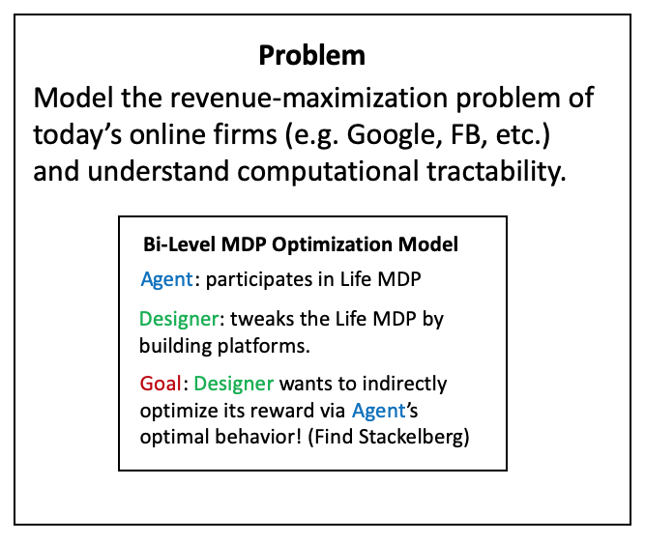
Platform Design
Key Idea: Google builds various apps (Maps, Search, Social Network, etc.) and profits based on usage of these apps.
The usage of apps modifies the transitions of the Markov Chain of the user’s life
Assume the Designer has linear rewards over the steady state distribution of the resulting Markov chain (agent policy + Life MDP)
Bi-Level MDP Optimization Model
Bi-Level MDP Optimization Model
Bi-Level MDP Optimization Model
Agent: participates in Life MDP
Agent: participates in Life MDP
Agent: participates in Life MDP
Designer: tweaks the Life MDP by building platforms.
Designer: tweaks the Life MDP by building platforms.
Designer: tweaks the Life MDP by building platforms.
Goal: Designer wants to indirectly optimize its reward via Agent’s optimal behavior! (Find Stackelberg)
Goal: Designer wants to indirectly optimize its reward via Agent’s optimal behavior! (Find Stackelberg)
Goal: Designer wants to indirectly optimize its reward via Agent’s optimal behavior! (Find Stackelberg)

Slide 6
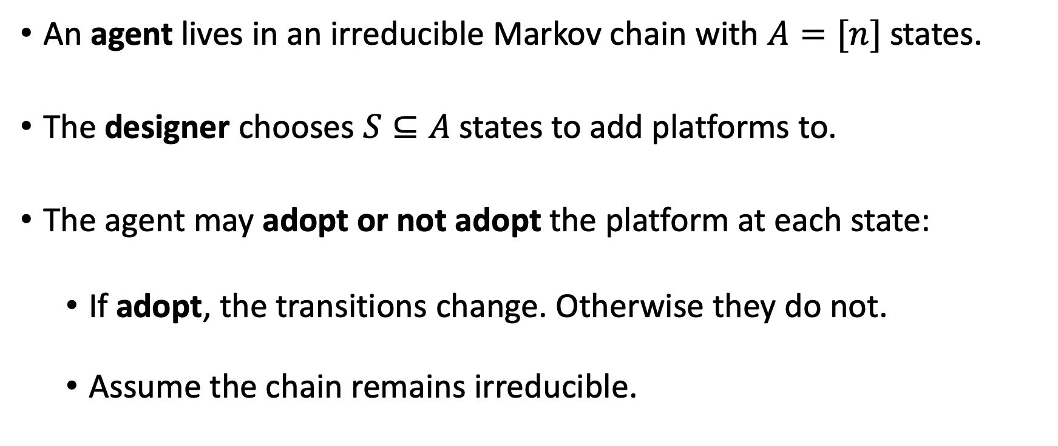
Formal Problem Statement
An agent lives in an irreducible Markov chain with $A=[n]$ states.
The designer chooses $S⊆A$ states to add platforms to.
The agent may adopt or not adopt the platform at each state:
If adopt, the transitions change. Otherwise they do not.
Assume the chain remains irreducible.

Slide 7
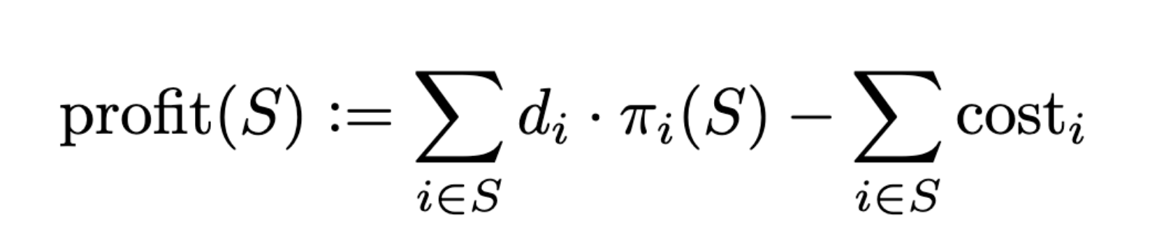
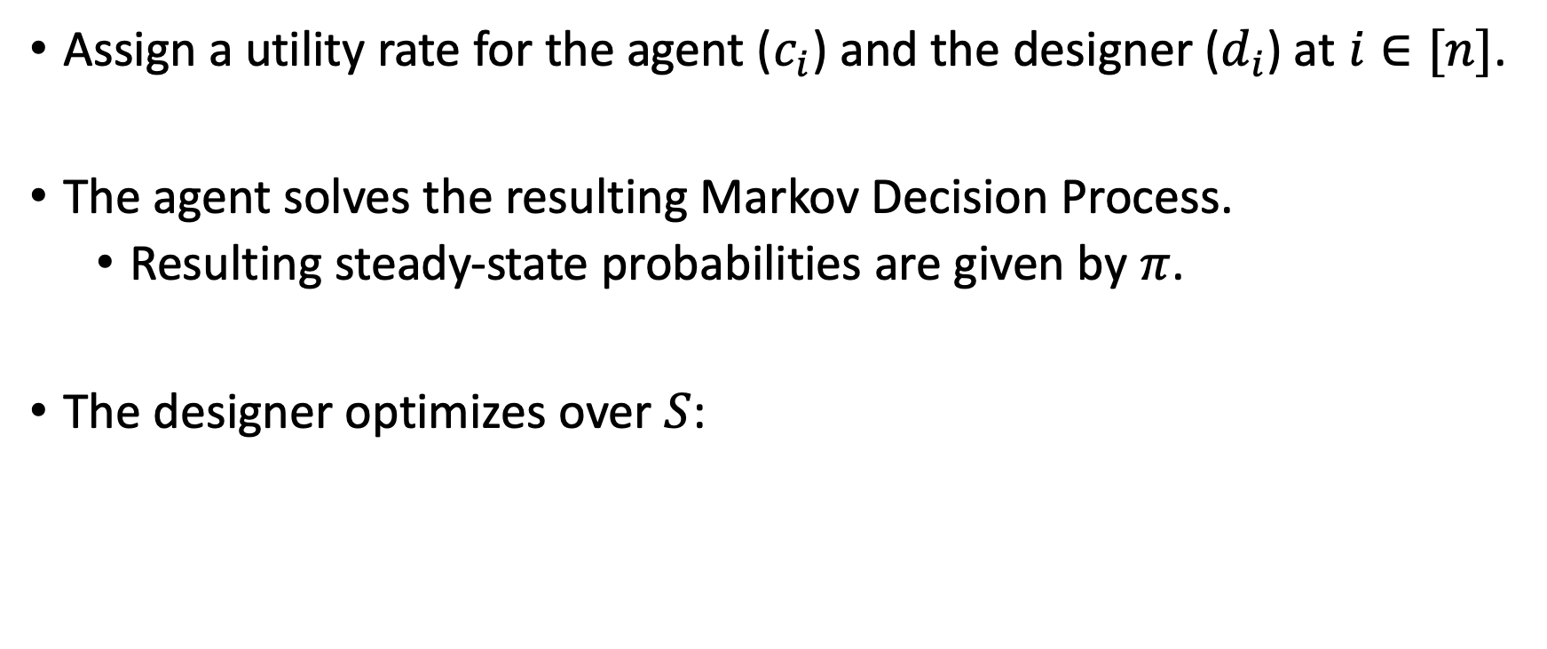
Formal Problem Statement
Assign a utility rate for the agent ($c_{i}$) and the designer ($d_{i}$) at $i∈[n]$.
The agent solves the resulting Markov Decision Process.
Resulting steady-state probabilities are given by $π$.
The designer optimizes over $S$:

Slide 8
General Case

Slide 9

Picture of the General Case
What platforms should I build?
Shopping online
Driving
Exercising
Eating lunch
Studying
Online firm
Watching movie
Reading news
Agent’s Life

Slide 10
Picture of the General Case
What platforms should I build?
Shopping online
Driving
Exercising
Eating lunch
Studying
Online firm
Watching movie
Reading news
At a cost, the firm can add an opt-in action to platforms they create (ex: Google Maps).
Agent’s Life

Slide 11
Picture of the General Case
Maybe we should create Maps technology….
Shopping online
Driving
Exercising
Eating lunch
Studying
Online firm
Watching movie
Builds platform Maps at a cost.
Reading news
Agent’s Life changes
Opt in to Maps
Notes:
Now, if Agent opts in to maps, the Agent can more easily find the retail store she wanted to purchase goods from, and can easily transition to driving to the store to purchase in person.
This is an example of complementary goods: Online advertisements reveal goods an Agent may want to buy, and building a Google Maps platform makes it easier for the Agent to go to the store and buy the good (perhaps an archaic example since now people buy things online).
We can also see how adopting Maps might change other parts of the Agent’s Markov chain (now an MDP):
Easier to find a restaurant you want to go to
Easier to find a movie theatre
Easier to find a hiking trail
Increases likelihoods of transitions from driving to a whole host of other possibilities, while also boosting likelihood from online shopping to driving to a store.

Slide 12
Computational Tractability I: General Case
It is strongly NP-hard to decide whether the Designer can obtain positive profit – and therefore hard to approximate.
Reduction from Set Cover
Designer builds platforms which each solve subset of Agent’s problems.
Most cost-effective covering set is NP hard.
In economic terms, the reduction exploits the complexity of “complementary goods.”
Ex: Brick-and-mortar retail ads help the Agent discover the store, Maps helps the Agent get to the store.

Slide 13
Tractable “Flower” Case

Slide 14
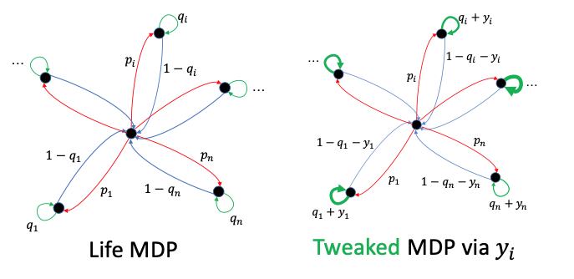
A More Tractable Case: The Flower

Slide 15
A More Tractable Case: The Flower
Problem can be solved by an FPTAS
Why tractable?
Substitutes rather than complements
Allocate time spent in each platform
Simpler low-level behavior (greedy agent is optimal)
Admits a DP upon discretization (knapsack DP)

Slide 16
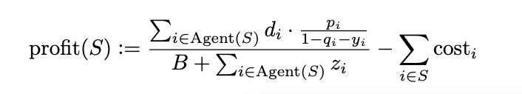
The Designer’s Dynamic Program
Designer’s profit function for set of platforms S:
Assume z is discretized and costs are polynomially bounded
Goal: (1 - 𝜖) approximate algorithm in polynomial time.

Slide 17
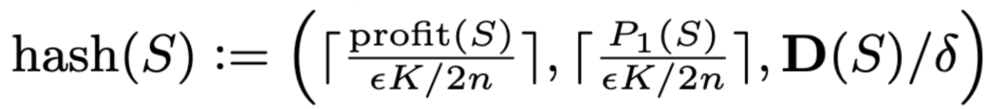
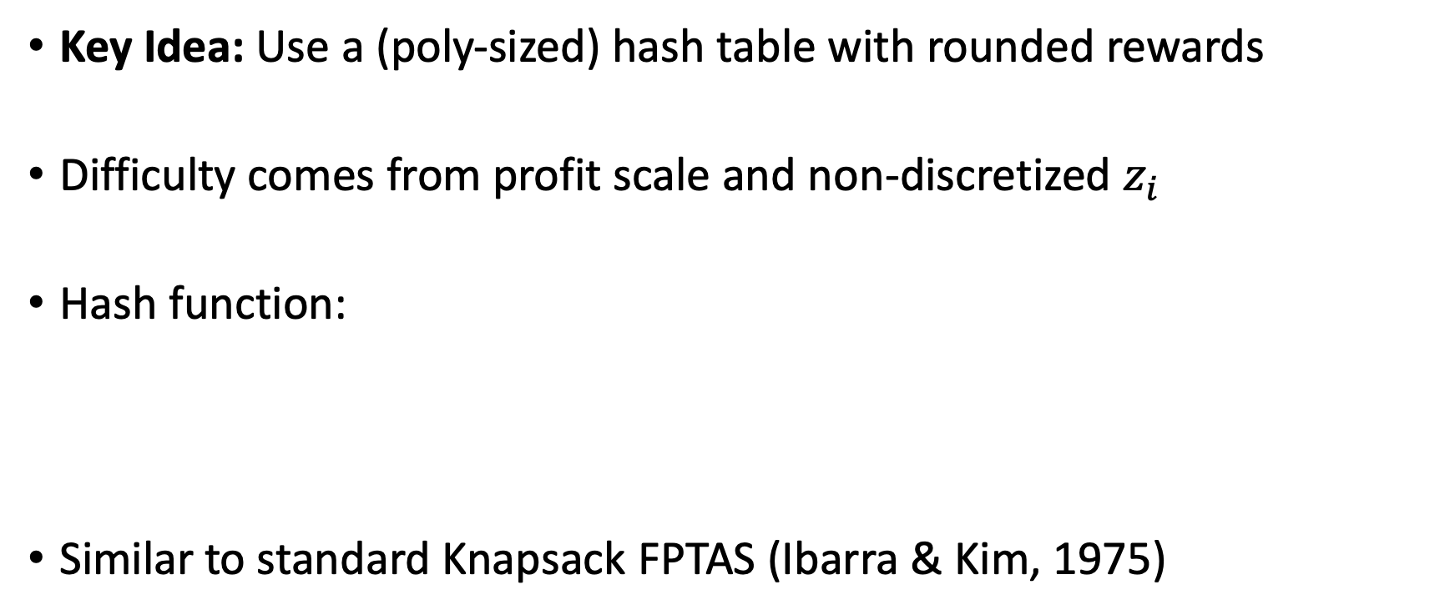
The Designer’s Dynamic Program
Key Idea: Use a (poly-sized) hash table with rounded rewards
Difficulty comes from profit scale and non-discretized $z_{i}$
Hash function:
Similar to standard Knapsack FPTAS (Ibarra & Kim, 1975)
Notes:
Note that it may be possible to have an efficient alg with non-discretized z_i, but it precludes an efficient dynamic program with this approach
We suspect it is necessary to discretize z_i though.

Slide 18
Extensions

Slide 19
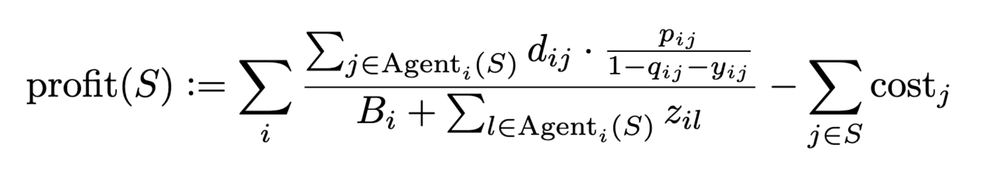
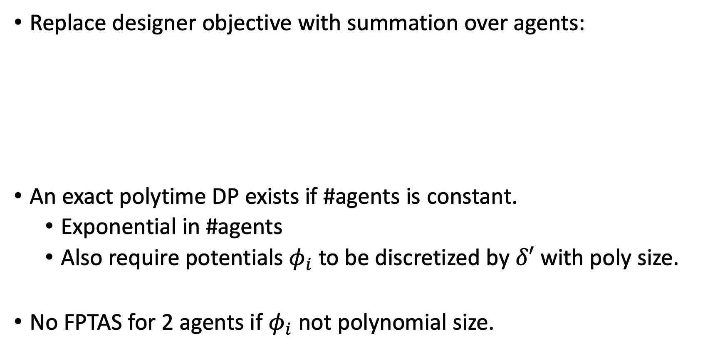
Multiple Agents
Replace designer objective with summation over agents:
An exact polytime DP exists if #agents is constant.
Exponential in #agents
Also require potentials $φ_{i}$ to be discretized by $δ′$ with poly size.
No FPTAS for 2 agents if $φ_{i}$ not polynomial size.
Notes:
* No FPTAS proof: reduction from PARTITION

Slide 20
Designer Competition
What platforms should I build to compete?
Shopping online
Driving
Exercising
Online firm
Eating lunch
Studying
Watching movie
Reading news
Competing firm
Agent’s Life

Slide 21
Future Work
Designer vs. Designer
Complexity of pure Nash
Repeated game settings
Privacy/fairness questions for Agent
Unknown rewards for Designer and Agent
Learning in games
Strategic Agents
And many more… please reach out at kiran.vodrahalli@columbia.edu if you would like to chat!
Notes:
* Generic classes of agent behavior: ex:, various notions of “greedy” agents – use greedy algorithm which is sub-optimal perhaps.

