Slide 1
PROMETHEUS

Slide 2
INTRODUCTION
Opensource system monitoring & alerting toolkit.
Collects and stores its metrics as time series data.
FEATURES
A multi-dimensional data model with time series data identified by metric name and key/value pairs
Promql, a flexible query language to leverage this dimensionality
No reliance on distributed storage; single server nodes are autonomous
Time series collection happens via a pull model over HTTP
Pushing time series is supported via an intermediary gateway
Targets are discovered via service discovery or static configuration
Multiple modes of graphing and dashboarding support

Slide 3
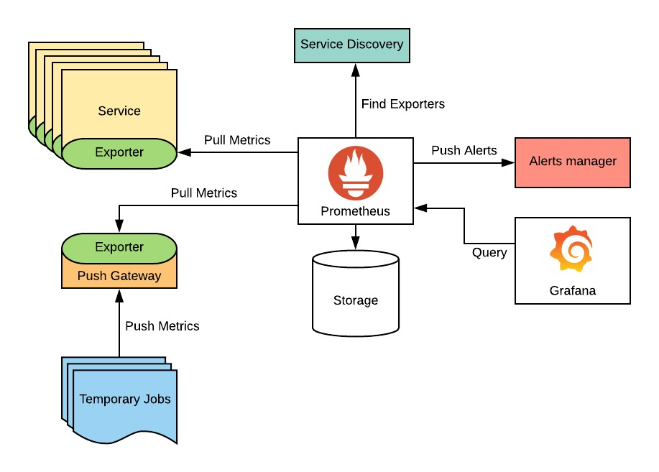
ARCHITECTURE

Slide 4
PROMETHEUS DATA SOURCE IN GRAFANA
To create a Prometheus data source in Grafana:
Click on the "cogwheel" in the sidebar to open the Configuration menu.
Click on "Data Sources".
Click on "Add data source".
Select "Prometheus" as the type.
Set the appropriate Prometheus server URL (for example, http://localhost:9090/)
Adjust other data source settings as desired (for example, choosing the right Access method).
Click "Save & Test" to save the new data source.'

Slide 5
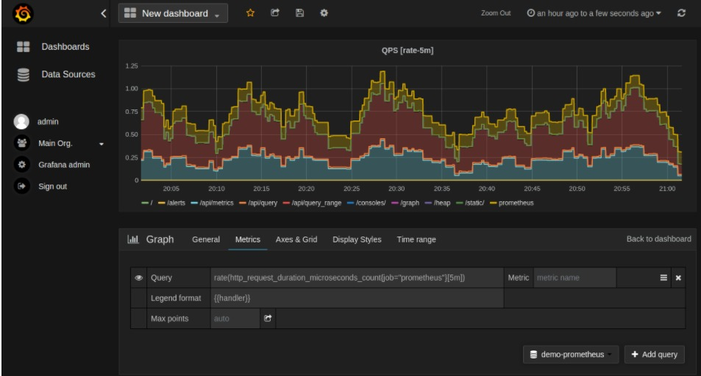
CREATING PROMETHEUS GRAPH
Click the graph title, then click "Edit".
Under the "Metrics" tab, select your Prometheus data source (bottom right).
Enter any Prometheus expression into the "Query" field, while using the "Metric" field to lookup metrics via autocompletion.
To format the legend names of time series, use the "Legend format" input.
Tune other graph settings until you have a working graph

