Slide 1

Electromagnetism
Ejalo academy

Slide 2
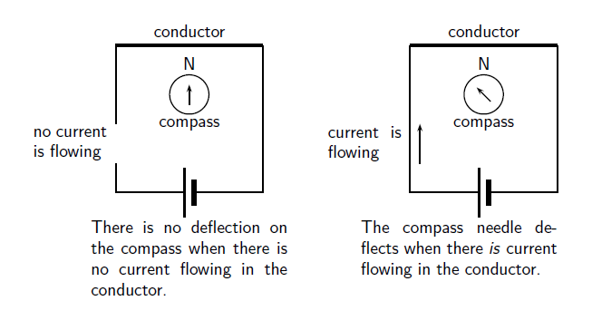
Magnetic field associated with a current

Slide 3
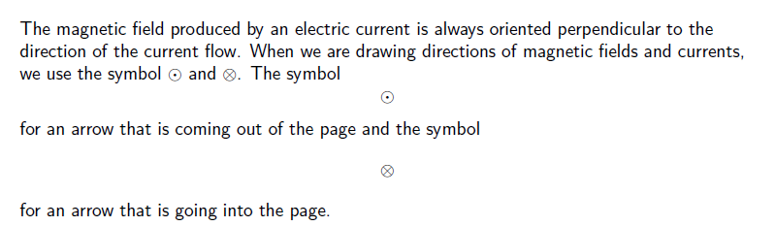
Notations:

Slide 4
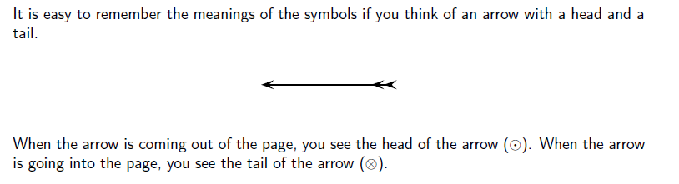
Notations:

Slide 5
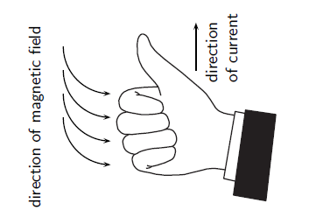
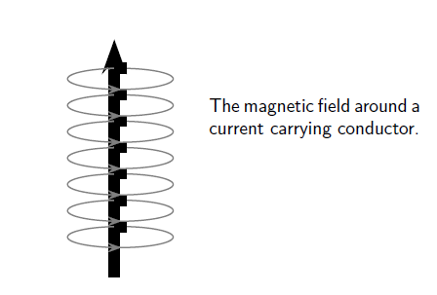
Right Hand Rule

Slide 6
Current Induced by a changing Magnetic field
While Oersted’s surprising discovery of electromagnetism paved the way for more practical applications of electricity, it was Michael Faraday who gave us the key to the practical generation of electricity: electromagnetic induction.

Slide 7
Current Induced by a changing Magnetic field
While Oersted’s surprising discovery of electromagnetism paved the way for more practical applications of electricity, it was Michael Faraday who gave us the key to the practical generation of electricity: electromagnetic induction.
Faraday discovered that a voltage was generated across a length of wire while moving a magnet nearby, such that the distance between the two changed. This meant that the wire was exposed to a magnetic field flux of changing intensity. Furthermore, the voltage also depended on the orientation of the magnet; this is easily understood again in terms of the magnetic flux.
The flux will be at its maximum as the magnet is aligned perpendicular to the wire. The
magnitude of the changing flux and the voltage are linked. In fact, if the lines of flux are
parallel to the wire, there will be no induced voltage.

Slide 8
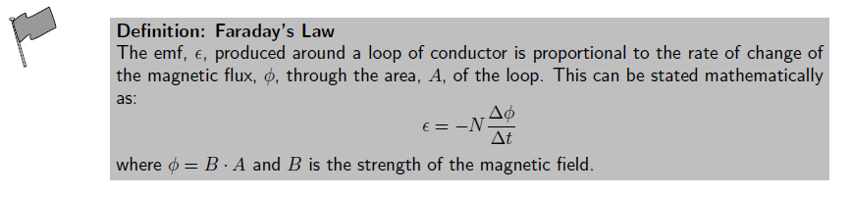
Faraday’s law

Slide 9
Example: Faraday’s law
Question:
Consider a flat square coil with 5 turns. The coil is 0,50 m on each side, and has a magnetic field of 0,5 T passing through it. The plane of the coil is perpendicular to the magnetic field: the field points out of the page. Use Faraday’s Law to calculate the induced emf if the magnetic field is increases uniformly from 0,5 T to 1 T in 10 s. Determine the direction of the induced current.

Slide 10
Real-life applications of Faraday’s law
Induction stoves
Tape Players
Metal detectors
Transformers

Slide 11

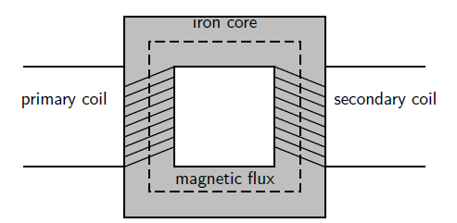
Transformers

Slide 12
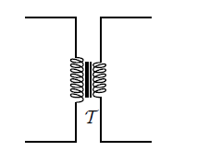
Transformers
When an alternating voltage is applied to the primary coil it creates an alternating current in
that coil, which induces an alternating magnetic field in the iron core. This changing magnetic
field induces an emf, which creates a current in the secondary coil.

Slide 13
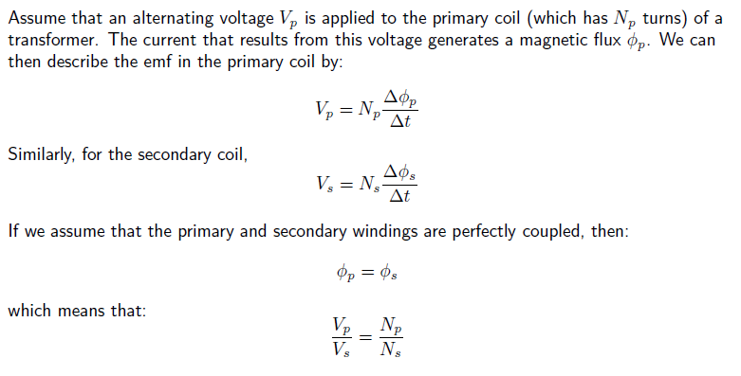
Transformers

Slide 14
Transformers

Slide 15
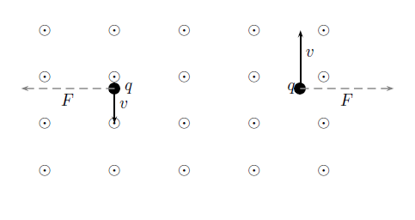
Motion of a charged particle in a magnetic field

Slide 16
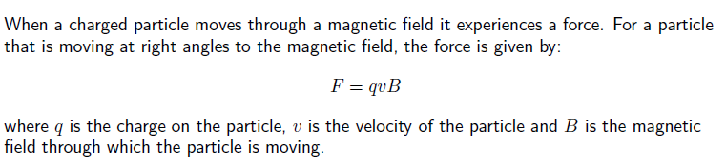
Motion of a charged particle in a magnetic field

Slide 17
Motion of a charged particle in a magnetic field
Question: An electron travels at 150m.s−1 at right angles to a magnetic field of 80 000 T. What force is exerted on the electron?

Slide 18
Applications
Televisions
Oscilloscope

