Slide 1

Electrostatics
Ejalo academy

Slide 2
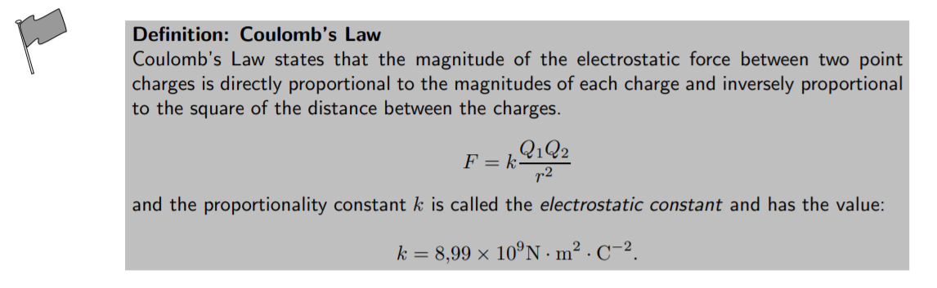
Force between charges – Columb’s law

Slide 3
Exercise: Columb’s law
Question: Two point-like charges carrying charges of +3 × 10−9C and −5 × 10−9C are 2 m apart. Determine the magnitude of the force between them and state whether it is attractive or repulsive.

Slide 4
Exercise: Columb’s law
Question: Three point charges are in a straight line. Their charges are Q1 = +2 × 10−9C, Q2 = +1 × 10−9C and Q3 = −3 × 10−9C. The distance between Q1 and Q2 is 2 × 10−2m and the distance between Q2 and Q3 is 4 × 10−2m. What is the net electrostatic force on Q2 from the other two charges?

Slide 5
Electric field around charges
We have learnt that objects that carry charge feel forces from all other charged objects. It is useful to determine what the effect of a charge would be at every point surrounding it. To do this we need some sort of reference. We know that the force that one charge feels due to another depends on both charges (Q1 and Q2). How then can we talk about forces if we only have one charge? The solution to this dilemma is to introduce a test charge. We then determine the force that would be exerted on it if we placed it at a certain location. If we do this for every point surrounding a charge we know what would happen if we put a test charge at any location.

Slide 6
Electric field around charges
This map of what would happen at any point we call an electric field map. It is a map of the electric field due to a charge. It tells us how large the force on a test charge would be and in what direction the force would be. Our map consists of the lines that tell us how the test charge would move if it were placed there.

Slide 7
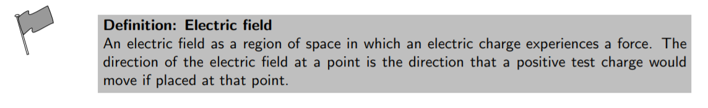
Electric field around charges

Slide 8
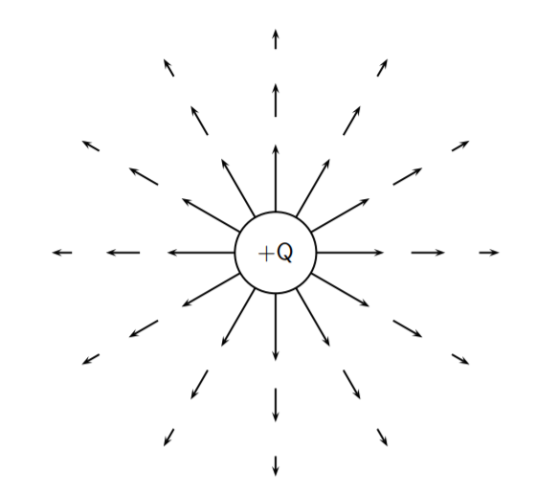
Electric field lines

Slide 9
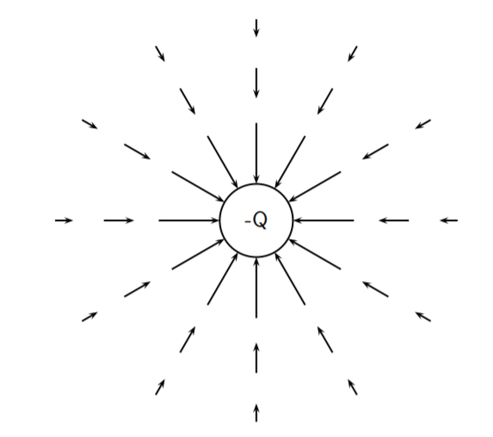
Electric field lines

Slide 10
Electric field lines

Slide 11
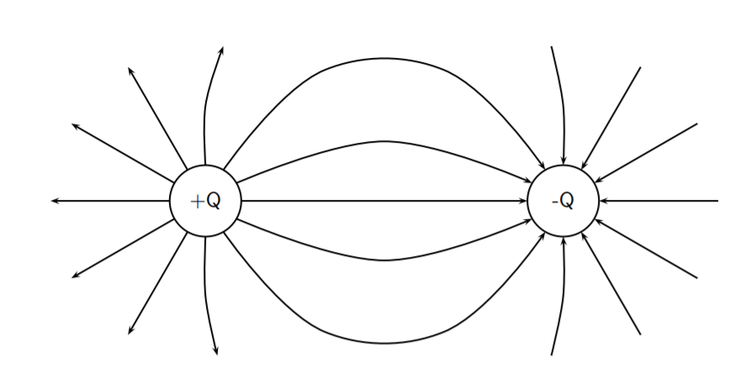
Electric field lines

Slide 12
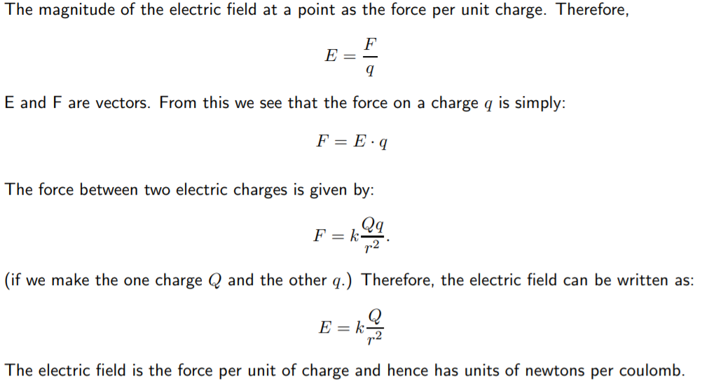
Strength of Electric field

Slide 13
Strength of Electric field

Slide 14
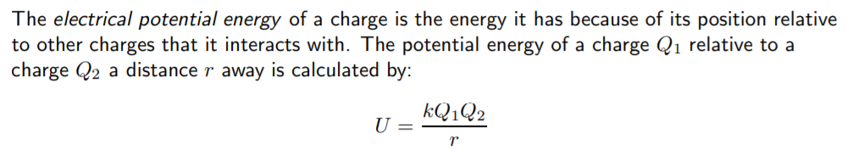
Electric potential energy and Potential

Slide 15
Example: Electric potential
Question: What is the electric potential energy of a 7nC charge that is 2 cm from a 20nC?

Slide 16
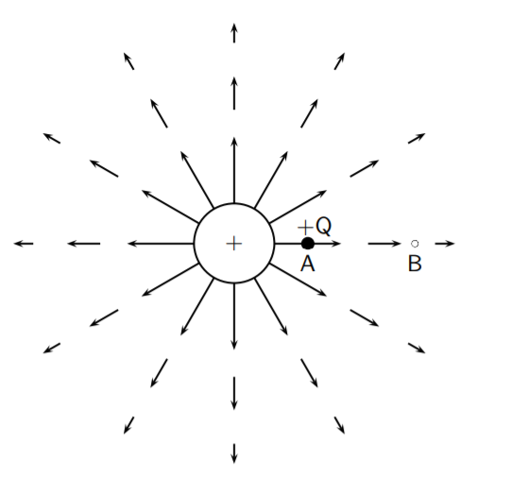
Electric potential
The electric potential at a point is the electrical potential energy per unit charge, i.e. the potential energy a positive test charge would have if it were placed at that point.

