Slide 1

Vectors
Ejalo academy

Slide 2

Scalars and Vectors

Slide 3

Scalars and Vectors

Slide 4
Mathematical Representation

Slide 5
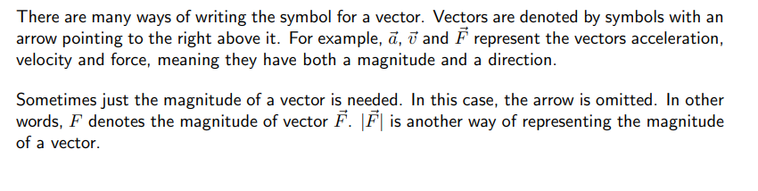
Mathematical Representation

Slide 6
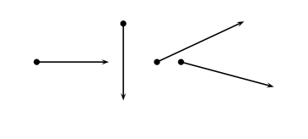
Graphical Representation

Slide 7
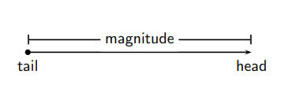
Graphical Representation

Slide 8
Mathematical Properties of Vectors
Adding Vectors
Subtracting Vectors
Scalar Multiplication

Slide 9
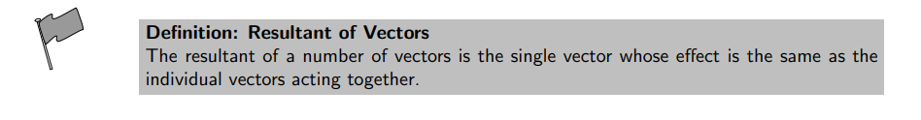
Adding Vectors

Slide 10
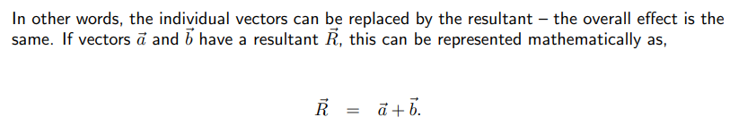
Adding Vectors

Slide 11

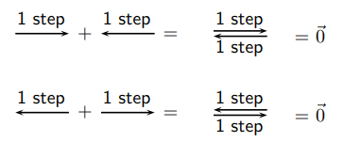
Adding Vectors

Slide 12
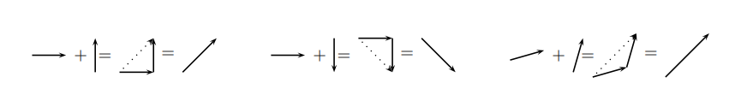
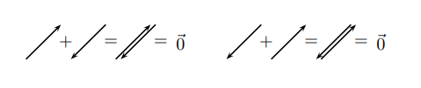
Adding Vectors

Slide 13
Adding Vectors

Slide 14


Subtracting Vectors

Slide 15
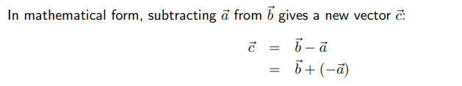
Subtracting Vectors

Slide 16
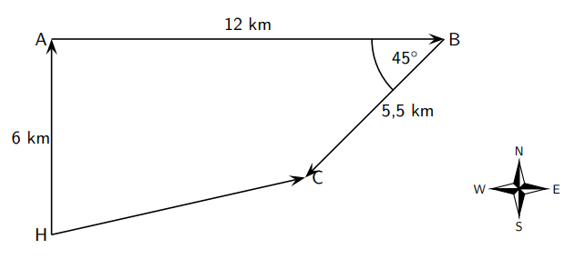
Techniques of Vector Addition
Graphical Techniques

Slide 17
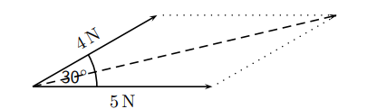
The Parallelogram Method

Slide 18
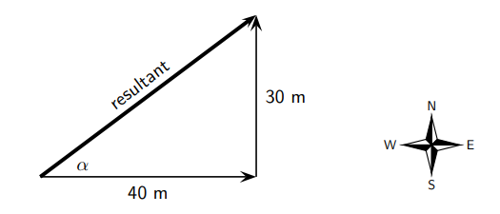
Algebraic Addition and Subtraction of Vectors

Slide 19

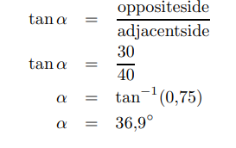
Algebraic Addition and Subtraction of Vectors

Slide 20
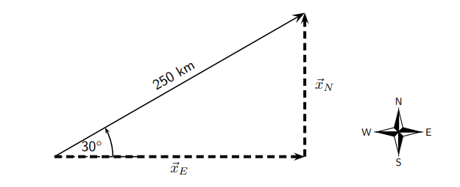
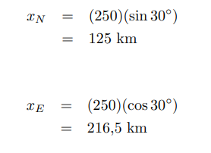
Components of Vectors

Slide 21
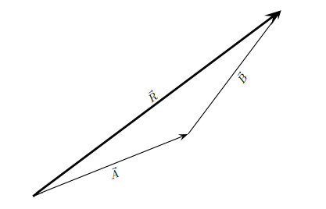
Components of Vectors

Slide 22
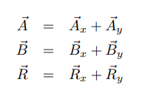

Components of Vectors

Slide 23
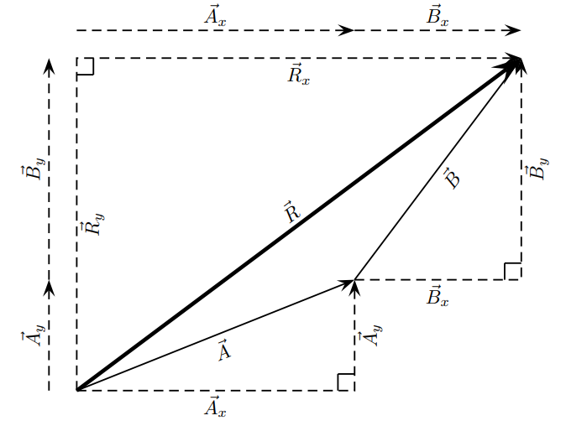
Example: Adding Vectors Using Components

Slide 24
Summary:
A scalar is a physical quantity with magnitude only.

Slide 25
Summary:
A scalar is a physical quantity with magnitude only.
A vector is a physical quantity with magnitude and direction.

Slide 26
Summary:
A scalar is a physical quantity with magnitude only.
A vector is a physical quantity with magnitude and direction.
Vectors are drawn as arrows where the length of the arrow indicates the magnitude and the arrowhead indicates the direction of the vector.

Slide 27
Summary:
A scalar is a physical quantity with magnitude only.
A vector is a physical quantity with magnitude and direction.
Vectors are drawn as arrows where the length of the arrow indicates the magnitude and the arrowhead indicates the direction of the vector.
Vectors can be added using the head-to-tail method, the parallelogram method or the component method.

Slide 28
Summary:
A scalar is a physical quantity with magnitude only.
A vector is a physical quantity with magnitude and direction.
Vectors are drawn as arrows where the length of the arrow indicates the magnitude and the arrowhead indicates the direction of the vector.
Vectors can be added using the head-to-tail method, the parallelogram method or the component method.
The resultant of a vector is the single vector whose effect is the same as the individual vectors acting together.

